Slide 1
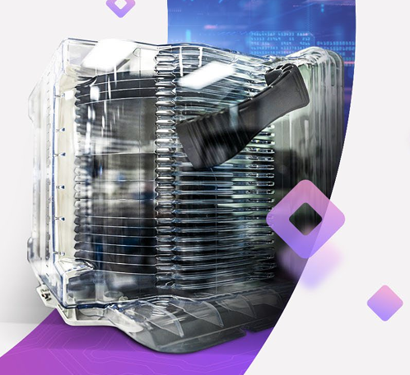
Sheryl Patterson
DC Regional, Model Investment Club of Northern Virginia
NOVA Ltd.(NYSE: NOVA)
Notes:
I found NOVA Ltd, formerly known as Nova Measuring Instruments, in the BetterInvesting Quality Predefined Screen and the Small Cap Informer. Nova is a leading innovator and a key provider of solutions for advanced used in semiconductor manufacturing

Slide 3
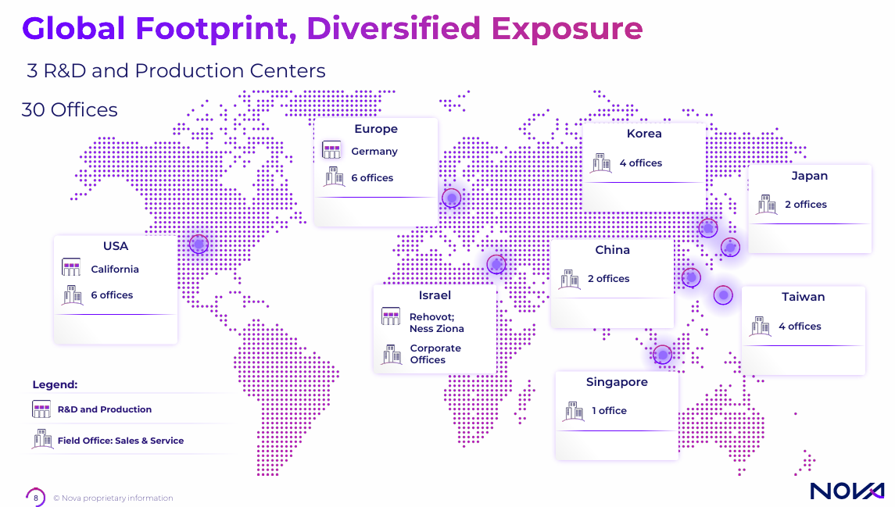

Slide 4
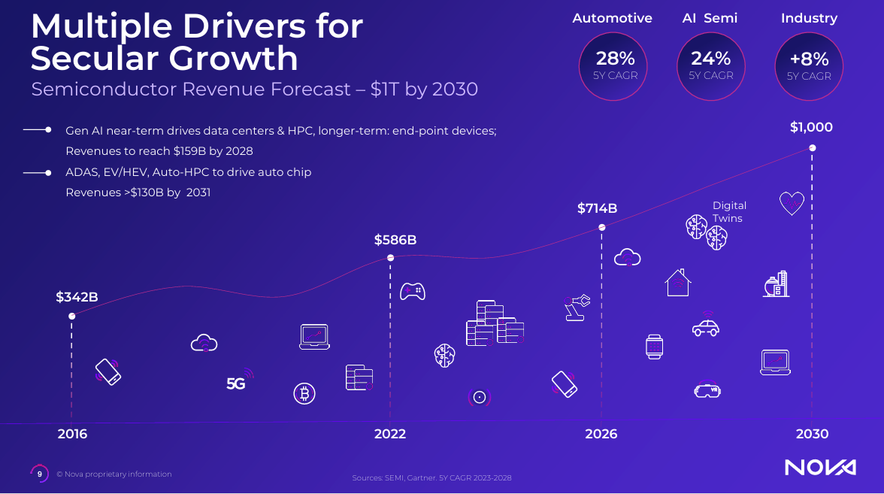

Slide 6
Notes:
AMPH has growth strategies from 2018 to 2023. Primary organic growth in Pipeline Development includes Primatene mist, Glucogen injection, Rextovy TM and insulin analog. Secondary inorganic growth resulted from the strategic acquisitions of Armstrong, AFP and BAGSIMI from 2003 to 2023.

Slide 7
Notes:
Management insists on high quality, efficiency and technology. This focus results in high net profit margins. Revenues have tripled from $295M in 2018 to $644M in 2023. Net income margins have increased from 3.5% in 2018 to 27.3% in 2023 almost 9 times during those years.

Slide 11
Notes:
The increase of existing products provides a very strong base when you compare the Percent growth and increased product diversification from 2014 to 2023.

Slide 12
Notes:
BAQSIMI which is one of the prime revenue drivers has annual sales that have more than doubled in the last 3 to 4 years. Annual Sales are projected to reach $250 to $275M in 2023, while EPS are projected to grow from 0.18cents to $2.50 in 2023, as Amphastar takes over the distribution of Baqsimi from Lily on a country by country basis through 2024 thus giving Amphastar a global reach.

Slide 13
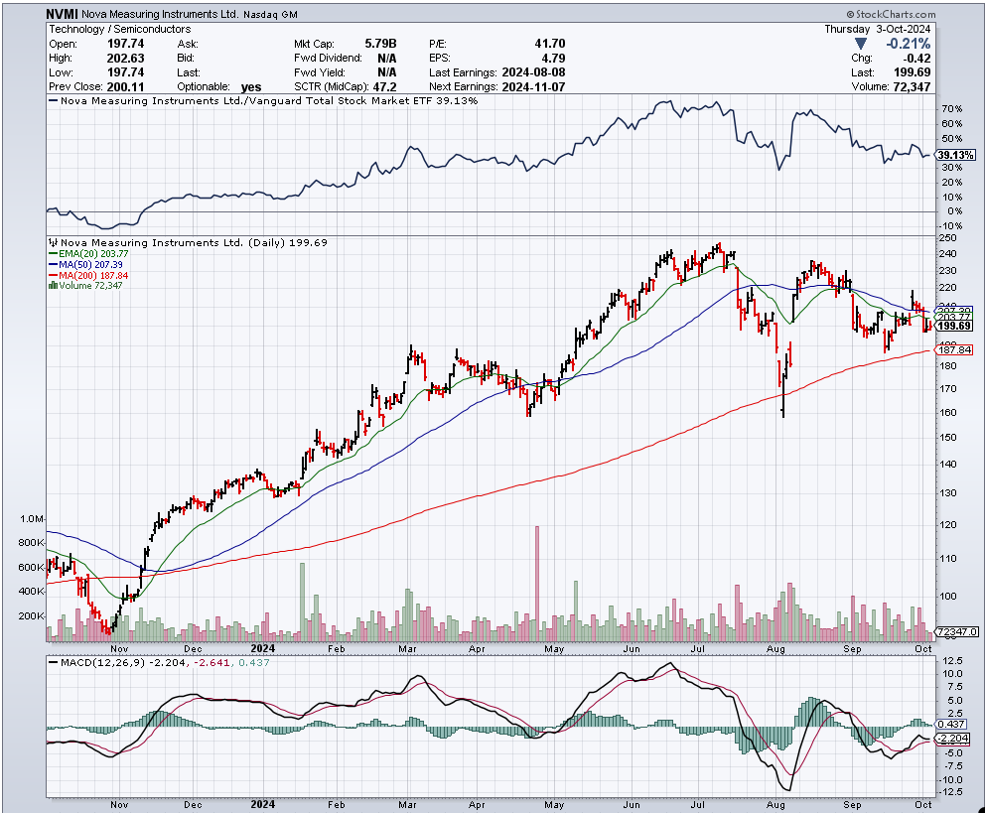

Slide 15
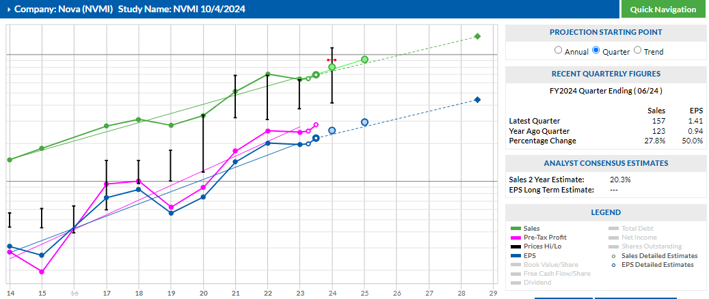

Slide 16
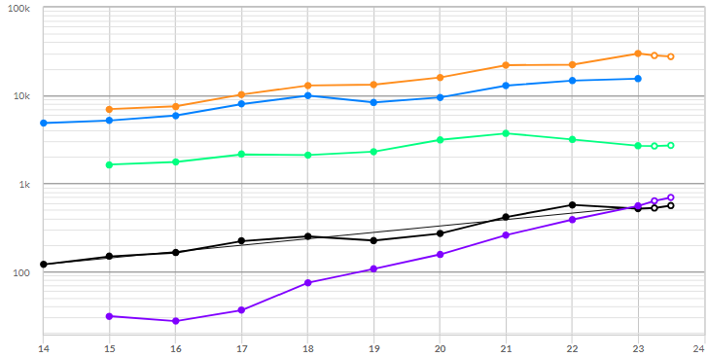
NVMI Peer Comparison
Notes:
AMPH EPS graph for the last five years is also up straight as compared to its peers. The recent quarterly results for AMPH is up 49.6% while the peers are all on the negative side.

Slide 17
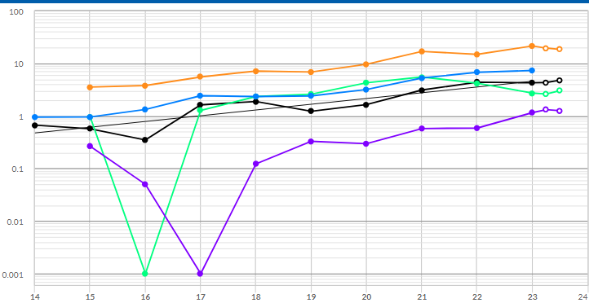
NVMI Peer Comparison

Slide 18
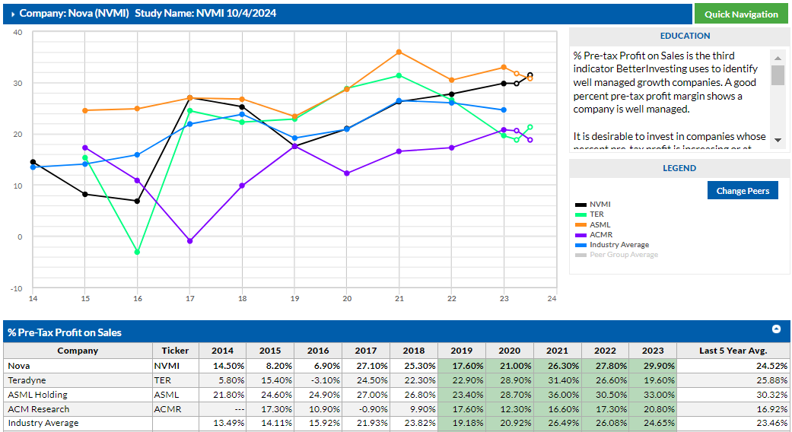
Peer Comparison: Pre-tax Profit on Sales
Notes:
For EPS I have used 12% which results in a 5 year projected EPS of 5.52. The growth rate predicted by VL is 18%

Slide 19
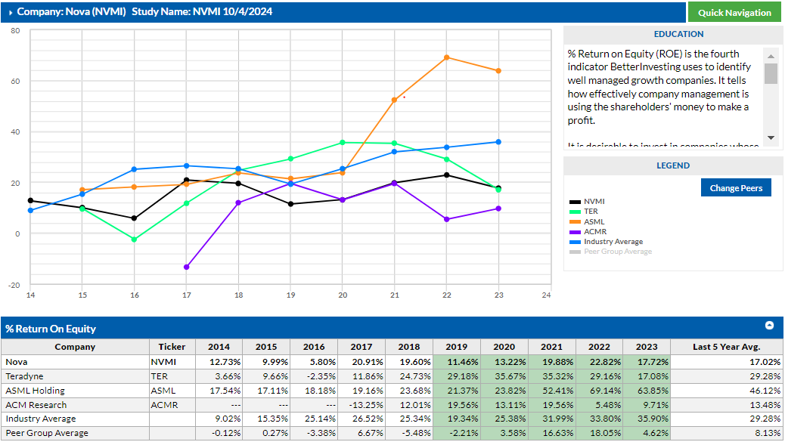
Peer Comparison: Return on Equity

Slide 20
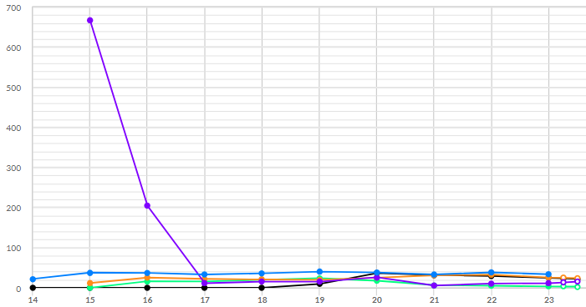
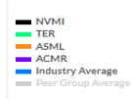
Peer Comparison: % Debt to Capital
Notes:
In looking at the % change from a year ago this quarter, all but ACM research is a negative. I believe this is caused by the availability of materials declined due to COVID, then gets ramped up when materials return to availability and then it gets normalized in the following year.

Slide 21
Notes:
The SSG Forecasted 5 year average high P/E is 24.2. I used the 5 year average P/E of 18.8 to forecast a high price of $103.8.

Slide 22
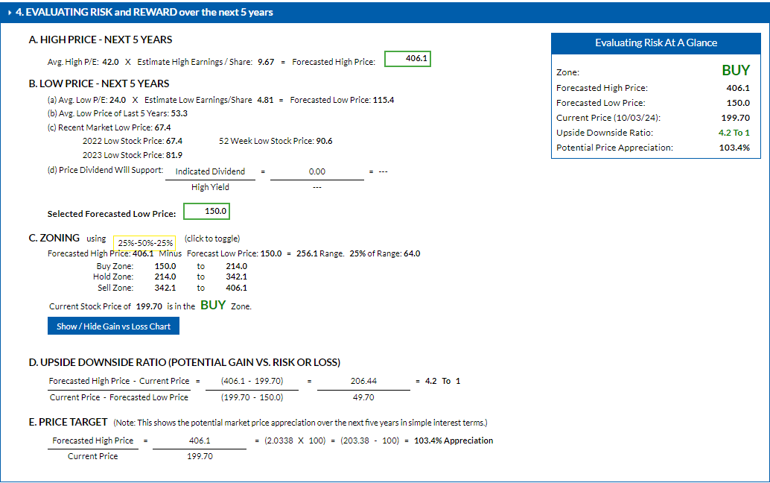

Slide 23
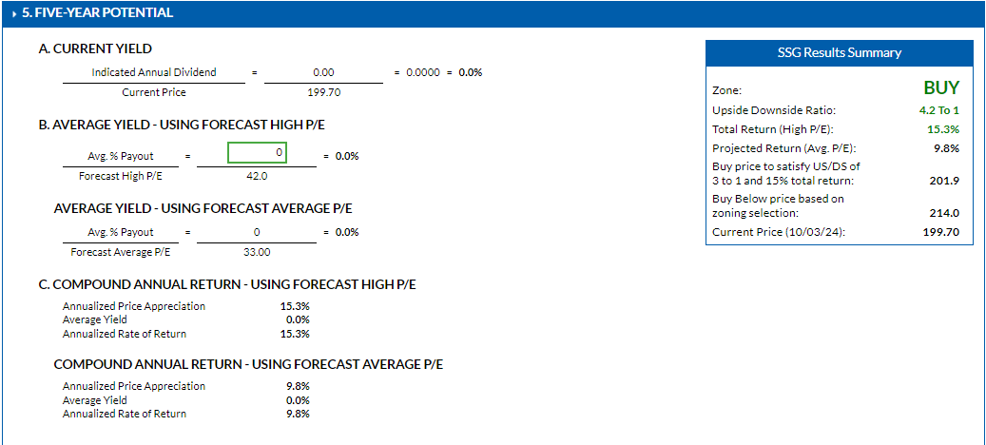
Notes:
Used 80% of low avg low per forecast of 12.0% of current price for low stock price forecast: $244.0

Slide 24
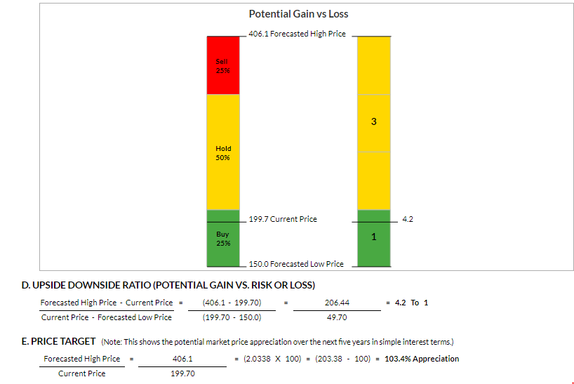
If purchased at the SSG 10/3/2024 price of $199.70, return is likely to double.
The compounded total return of 15.3% will more than double your money over the next five years.
NVMI does not currently pay a dividend
Notes:
NVMI is in the BUY range with an upside-downside ratio of 4.2 to 1.

Slide 25
Conclusion
NVMI is a Small sized sales growth company.
AMPH is a well managed company.
AMPH is trading within the buy range.
AMPH is a worthy candidate to add to your watchlist for further study.
AMPH (current price of $199.70) is within the buy range up to $214 (buy below price of $214.0 to satisfy US/DS Ratio of 3:1 for a 15% total return).
Notes:
Read the slide

