Slide 1
New Stock Presentation: NVIDIA MicNova July 9, 2024

Slide 2
DISCLAIMER
The information in this presentation is for educational purposes only and is not intended to be a recommendation to purchase or sell any of the stocks, mutual funds, or other securities that may be referenced. The securities of companies referenced or featured in the seminar materials are for illustrative purposes only and are not to be considered endorsed or recommended for purchase or sale by BetterInvestingTMNational Association of Investors Corporation (“BI”). The views expressed are those of the instructors, commentators, guests and participants, as the case may be, anddo not necessarily represent those of BetterInvesting. Investors should conduct their own review and analysis of any companyof interest before making an investment decision.
Securities discussed may be held by the presenters in their own personal portfolios. BI presenters and volunteers are held to a strict code of conduct that precludes benefiting financially from educational presentations or public activities via any BetterInvesting programs, events and/or educational sessions in which they participate. Any violation is strictly prohibited and should be reported to the CEO of BetterInvesting or the Director of Chapter Relations.
This presentation may contain images of websites and products, or services not endorsed by BetterInvesting. The presenters are not endorsing or promoting the use of these websites, products or services.

Slide 3
Gladys Henrikson
DC Chapter, The Model Investment Club of Northern Virginia
NVIDA Corporation (Nasdaq: NVDA) BI Member Website: Top 10 Companies our members are investing in (NVDA =‘1”)
First IPO 1999; HQ in Santa Clara CA
Industry: Semiconductors, Sector: Technology
Large Company, >10B in Sales as of March 2024
Analysts June 2024; Value Line: Financial Strength: A+,;Timeliness = “1”
Notes:
Good evening, I'm Sheryl Patterson, the president of the DC Regional chapter.
My company tonight is Raytheon – ticker symbol RTX on the NYSE.
It's the February 2024 BI Magazine “Undervalued Stock.”
The stock to study goal is to double an investment within five years with the market price appreciation + dividends.

Slide 4
NVDIA Business Overview
Leading developer of computing platforms using graphics processing and software for various applications.
Revenue by market platform, as of 2023::
Data center (78%),
Gaming (17%),
Professional visualization (3%),
Automotive (2%), and other (less than 1%).
Production of semiconductor wafers outsourced to Taiwan Semiconductor, Samsung Electronics,and others.
Int’l. sales accounted for 56% of revenues.
About 29,500 employees.
Officers and directors .own 4.2% of common stock;
President & CEO: Jen-Hsun Huang. Inc.:
Had a 10:1 stock split in June 2024.

Slide 5
NVDA’s Market Platforms at a Glance; (Tonight’s focus on Data Center)

Slide 6
NVDA’s Three Decades of Research & Development in Accelerated Computing- Initially for Gaming Industry.

Slide 7
What’s Special about NVDA Computing ?
Nvda’s Graphics Processing Units (GPUs)=“Blackwell”, & Software Platform = “Cuda”
Apple, Microsoft, AMD, Intel, etc. use slower CPU architecture; 2 yrs behind NVDA in GPUs

Slide 8
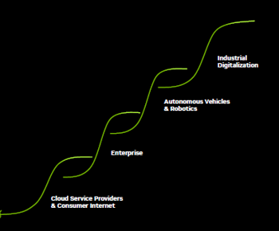
Waves of Adoption of Accelerated Computing
Accelerated Computing enabled rise of AI- driving shift from general purpose to accelerated computing
Huge Installed base of data center infrastructure with => Accerated computing
Hyperscale cloud service providers and consumer internet companies = early Ai adapters with broader adoption under way.

Slide 9
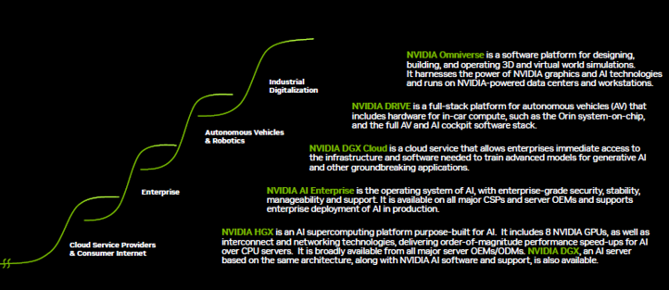
NVDA Products for Developers, Partners, Enterprises, OEMs, Other Customers

Slide 10
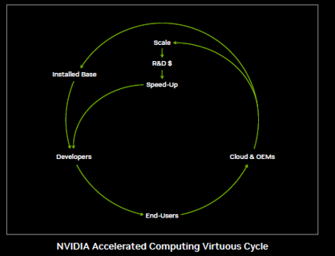
NVDA’s Data Customers
Developers, using NVDA’s one architecture and installed base
End Users= NVIDIA offered by every computing provider & accelerates applications from cloud to edge
Cloud Providers & OEMS- NVIDIA”s suite of Acceleration Platforms lets partners build one offering to address large markets

Slide 11
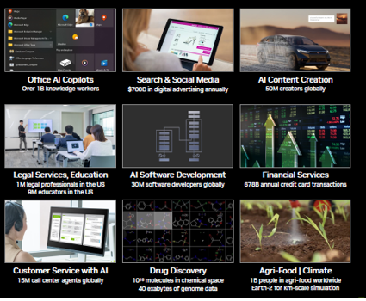
Ai is Driving a Powerful New Investment Cycle

Slide 12
NVIDIA’s Market Opportunities

Slide 13
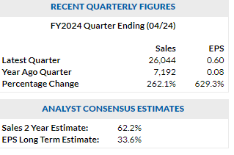
NVIDIA SSG
WWW.BETTERINVESTING.ORG

Slide 14
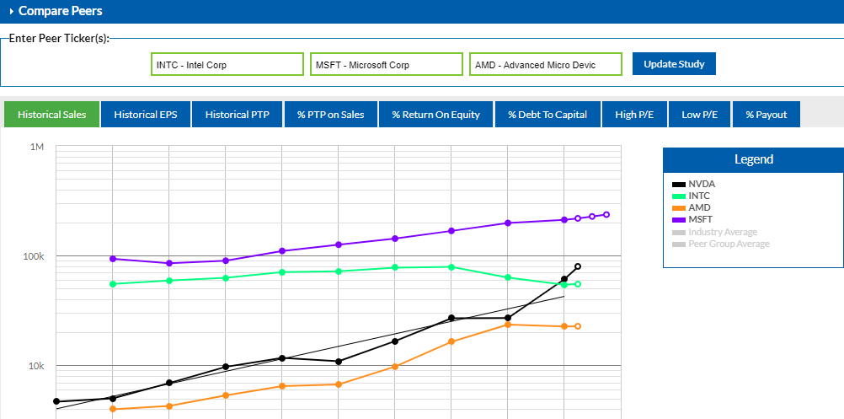
NVIDIA SSG Section 3

Slide 15
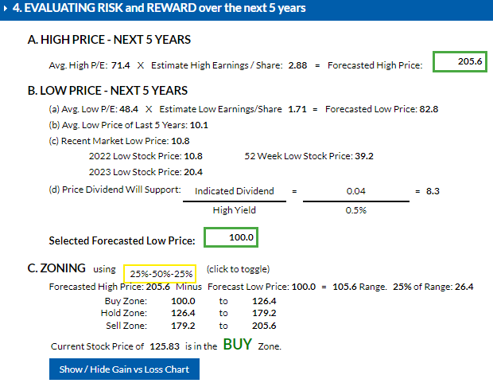
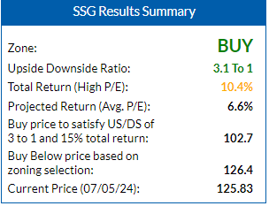
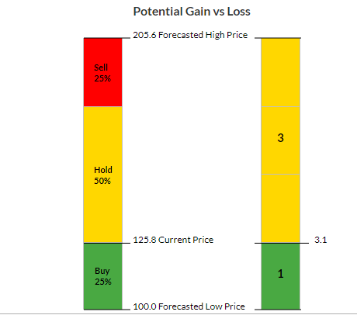
NVDA SSG Section 4-5

Slide 16
Conclusions
NVIDIA is a large growth technology company, a leading developer of graphics processing units (GPUs) initially designed for gaming applications on PCs
GPU Use Cases have become important components in the data management arena for artificial intelligence (AI) applications.
While the semiconductor sector is cyclical, and computer gaming is volatile, analysts predict strong investments, by large firms, in AI data development and applications over the next two years. These applications use NVIDIA silicon chips
Value Line, Morningstar, and CFRA, in their June 2024 reports, rate Nvidia an A or A+ for financial management
Morningstar rates Nvidia’s capital allocation (management) as Exemplary
NVIDIA is a good candidate for further study, or to buy, or place on one’s Watch List.

