Slide 1
Air Products and Chemicals
June MicNOVA Stock Presentation
Jo Murphy

Slide 2
Founded 1940
Global Reach (50 countries and about 2300 employees)
Basic Materials sector, diversified chemical industry
Largest supplier of hydrogen and helium in the world
Notes:
This is a large well-run company with about 13 Billion in Revenues that’s been around for a long time. It operates in 50 countries and is in the Basic Materials sector and is the third largest industrial diversified chemical company in the world. It stands out as the largest hydrogen producer in the world.

Slide 3
Best description of what they do:
Leading provider of equipment that can separate atmospheric gases (nitrogen & oxygen) from natural gas
Largest provider of process gases from natural gas (hydrogen, helium, and carbon dioxide) from crude oil
Largest producer of hydrogen through electrolysis
Notes:
They provide the machinery that can pull nitrogen and oxygen out of natural gas and they then sell their process gases to energy companies to help them de-carbonize their operations.

Slide 4
Notes:
Large global company with 13 ? Billion in sales that has been around for over 80 years. And serves over 30 industries from energy to chemical to food and medicine.

Slide 5
Notes:
Half of their market is the energy and chemicals companies. But smaller markets for them are the electronic industry, the Metals industry and a touch with Medical and food markets. Next

Slide 6
Notes:
North America has 45% of revenue, with Europe and Asia 2t% each. Next

Slide 7
Notes:
Half of their business comes from long-term 15 to 20 year contracts on site through their pipelines, a third from 3 to 5 year contracts though liquid bulk in trucks, 11% through packaged gas, and 7% through the sale of equipment.

Slide 8
Notes:
They basically have two business parts: their core industrial gases business and the Hydrogen production part which removes carbon dioxide. Blue Hydogen removes all carbon dioxide while green lowers it. A large capital allocation (15 Billion over several years) to this area is under way and is stoking their growth. Investors are wary of their five year allocation to get more companies and industries to purchase their product and so the price has gone down in the past two years, even while revenue continues to increase.Next

Slide 9
Notes:
What they do: they have projects that capture Carbon, make hydrogen fuel cells used in transportation, have low carbon operations, and promote renewable energy like wind turbines to to best use our resources to create a sustainable world

Slide 10
Notes:
Goal by 2030 is a reduction by 30% of carbon emissions, and a net zero carbon by 2050, by which time they hope that the synthetic gas they produce and that carbon-free fuel cells will replace gasoline and diesel fuel in local transportation. This long-range plan is their goal going forward. Right now,they are the world’s largest producer of hydrogen. They have acurrent partnership with cummins to use hydrogen fuel cells in their trucks

Slide 11
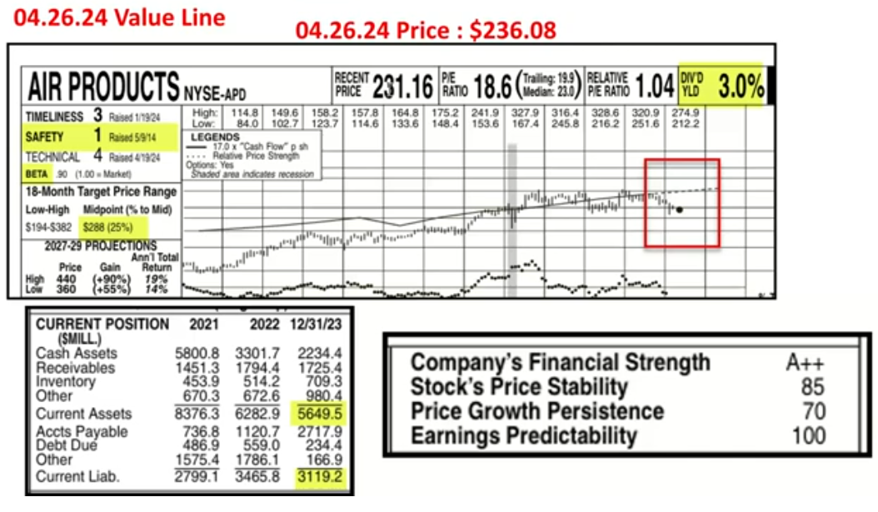
Notes:
The VL from 6 weeks ago gives APD its highest D safety rating and an A++ financial Strength rating with an Earnings Peddictability of 100. Their dividend yield is 3%. Their current ratio is excellent, also. Note the red box around he black dot which shows the price languishing below the value line (solid black line). Companies fluctuate around that lline but usually revert to the mean, or, come back up to that line. APD is expected to go back up.. VL thinks this company will be in a price range of $360 to $440 in 3 to 5 years. ($279 on June 7) Next

Slide 13
Notes:
Analyst estimates are the open green and blue circles. Note that eps and pe-tax profit has been rising for the past two quarters while sales have faltered. This company’s product is a commodity that depends on macroeconomic conditions and so rises and falls with the world markets. LIN, its closest competitor follows the same trend. Sales Growth for the past 10 ears has only been 2.5% but I am forcasting 6.6 % which is lower than ACE, and a growth rate of 9%. The red trend line doesn’t bother me because I see that their pre-tax profit on sales hovers in the mid 20’s . Return on equity is also steady and in the mid-teens. They manage debt well. Next

Slide 14
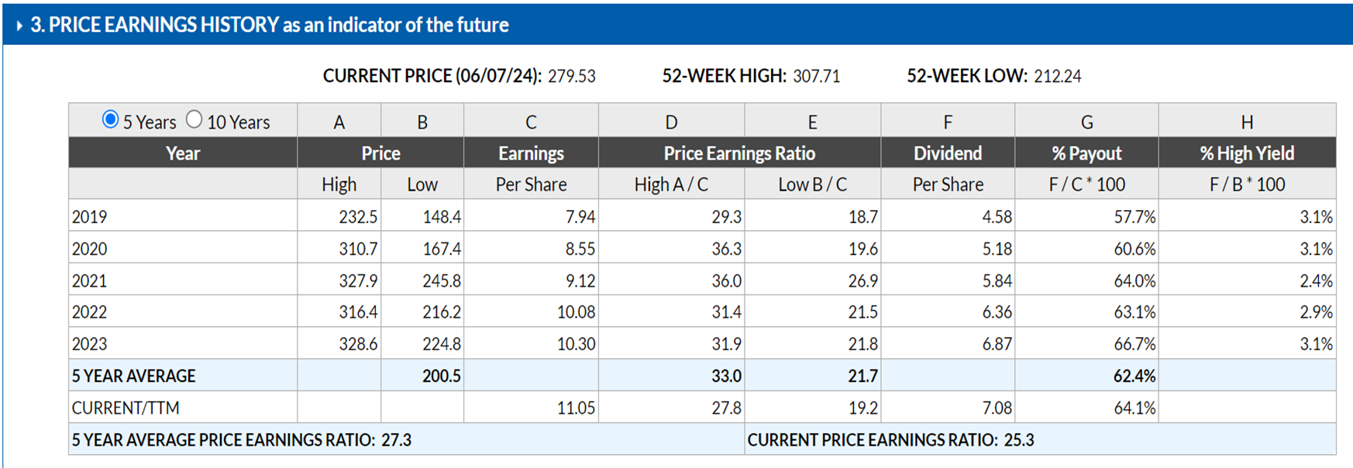

Slide 15
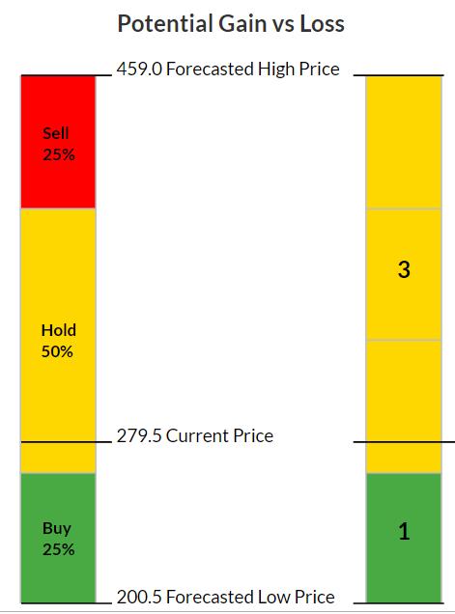
Notes:
High price for the next five years is $459 using an average high PE of 27. My low price is the average low price of the last five years/ or, $200.5 I included the dividend yield of 3% and found itin the HOLD range. With an upside/downside ratio of 2.3 to 1 with a projected total return of 10.7, not bad for a large company.. It is suggested that a price under $265 would be in the buy range..

Slide 16
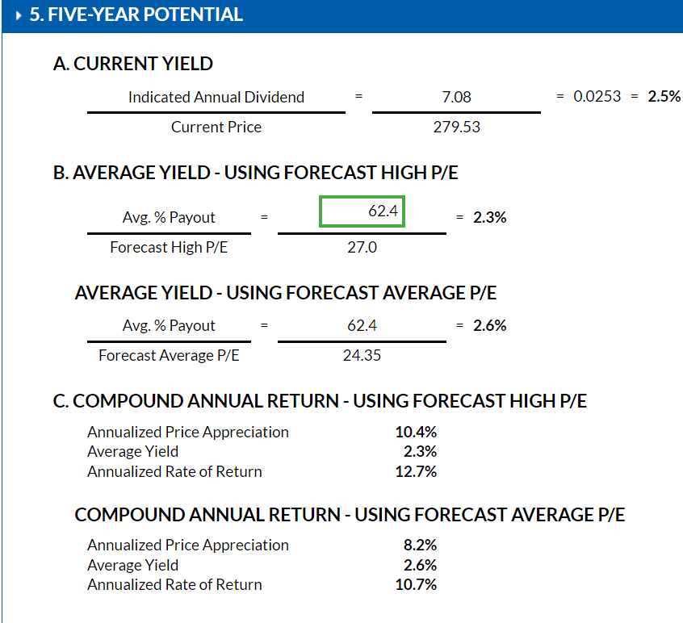

Slide 17
Breaking News June 7, 2024
Notes:
Air Products, worldwide leader in terms of hydrogen supply, has been a first mover, committing more than $15 billion dollars to real, large-scale energy transition projects and launching several large low carbon hydrogen projects in the world, making it a leading and reliable supplier.

Slide 18
If you are looking for a company in the Basic Materials sector, Air Products is an excellent choice to consider. f

