Slide 1
Quality- A Closer Look at Return on Equity (ROE) and Related Metrics MicNova Education, October 8, 2024 by Gladys Henrikson Adapted from BI Ticker Talk, Aug. 1, 2024

Slide 2
DISCLAIMER
The information in this presentation is for educational purposes only and is not intended to be a recommendation to purchase or sell any of the stocks, mutual funds, or other securities that may be referenced. The securities of companies referenced or featured in the seminar materials are for illustrative purposes only and are not to be considered endorsed or recommended for purchase or sale by BetterInvestingTMNational Association of Investors Corporation (“BI”). The views expressed are those of the instructors, commentators, guests and participants, as the case may be, anddo not necessarily represent those of BetterInvesting. Investors should conduct their own review and analysis of any companyof interest before making an investment decision.
Securities discussed may be held by the presenters in their own personal portfolios. BI presenters and volunteers are held to a strict code of conduct that precludes benefiting financially from educational presentations or public activities via any BetterInvesting programs, events and/or educational sessions in which they participate. Any violation is strictly prohibited and should be reported to the CEO of BetterInvesting or the Director of Chapter Relations.
This presentation may contain images of websites and products, or services not endorsed by BetterInvesting. The presenters are not endorsing or promoting the use of these websites, products or services.

Slide 3
Return on Equity (ROE) Definition (Ticker Talk, Aug 1, 2024)

Slide 4
Quality Components Affecting Return on Equity
Formula: Earnings Per Share / Book Value Per Share (end of period)
In the formula there are two factors, but multiple events can impact each factor:
EPS – These events improve Earnings per Share:
• Increased profit margins
• Increased sales assuming no deterioration in margins
• Reduction of shares issued and outstanding
Book Value – These events lead to a reduced Book Value:
• A repurchase of shares by the organization
• An increase in debt
• Dividend payouts
• Net losses each year – if this happens there would be negative ROE

Slide 5
What We Look for on SSG:
A. Quality Components Growing Together
1. Sales
2. Pre-tax Profit
3. Earnings Per Share
4. Free Cash Flow (Operating Cash Flow/Share)
5. Book Value Per Share
6. Return on Equity -improving or steady (over 15%)
B. Other Chart Components we note:
7. Shares Outstanding – Even, Growing, Decreasing?
8. Debt – Even, Growing, Decreasing?
9. Liquidity Ratios: Current Ratio or Quick Ratio > 1

Slide 6
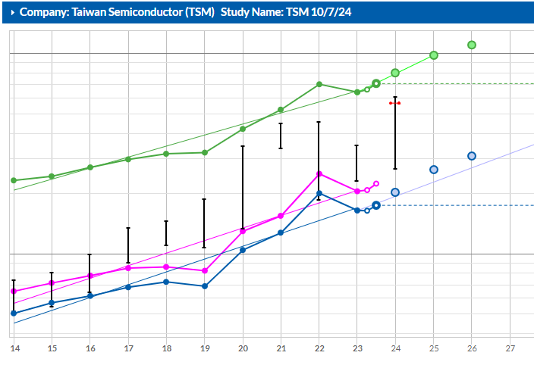
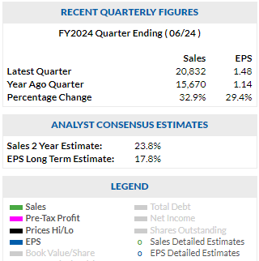
Example (From Watchlist) of Strong Return on Equity & Low Debt:Taiwan Semiconductor
1
2
3
6
7

Slide 7
Another Way to Look at Debt: Liquidity Ratios- Can a Company Pay its short term liabilities within 1 year?
Current Ratio: The current ratio divides current assets by current liabilities The current ratio includes accounts like inventory and accounts receivable, which may be difficult to quickly liquidate or receive (without a discount)..
The higher the ratio the more liquid the company. Should be greater than 1.0 However, a company may have much of these assets tied up in assets like inventory that may be difficult to move quickly without pricing discounts.
Quick Ratio. The quick ratio divides only cash and cash equivalents (highly liquid assets) by current liabilities.
The higher the ratio the more liquid the company. Should be greater than 1.0. However, some companies strive for a quick ratio between 0.1 and 0.25, to better use/vs hold cash.
.

Slide 8
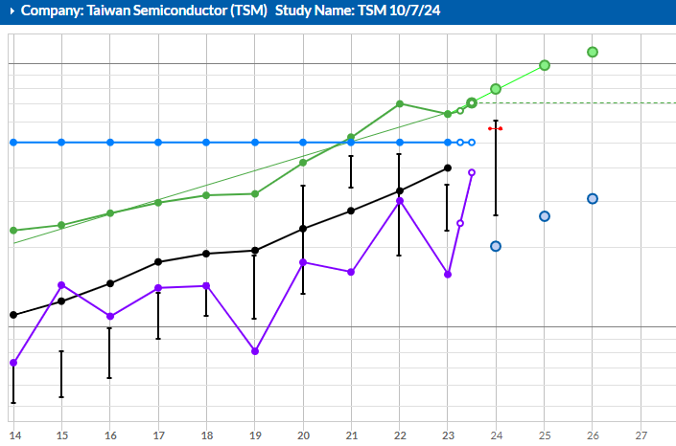
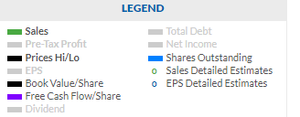
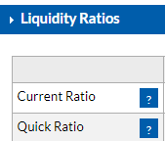
Taiwan Semiconductor, cont. Quality Metrics Rising with Sales (1) & Earnings: Free Cash Flow (3); and Book Value (4). Note: Shares outstanding (7); and * Liquidity Ratios >1
1
7. Shares Outstanding
4
3
*

Slide 9
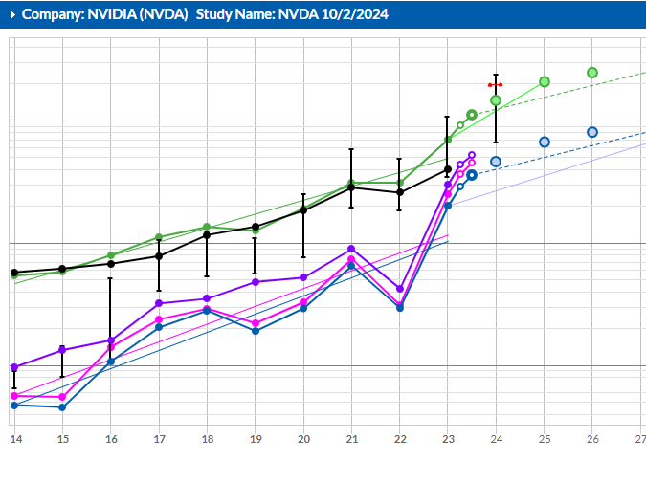
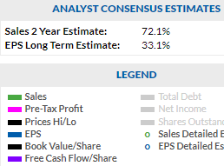
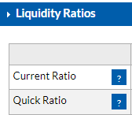
Another Example (from Watchlist) of Strong ROE- NVIDIA (Note rising sales, profit, free cash flow, book value; debt<35%; liquidity ratios >1)

Slide 10
However, Quality Stocks CAN have a Negative ROE (Examples from Ticker Talk)
Return on Equity Fiscal Year Ending 2023
• SBUX -49.1%
• LOW -50.1%
• ORLY -129.1%
• BKNG -646.1%
• DPZ -12.3
• HD 1,048.2%
What do these companies have in common besides low or negative equity?
• A Positive Track Record of Earnings!

Slide 11
Causes of Low/Negative Equity
A young company with low/negative earnings
A mature company with no earnings that uses debt to finance their operation
A mature company that has earnings, and bought-back a significant amount of shares from the market
More prevalent when debt is used to purchase the shares

Slide 12
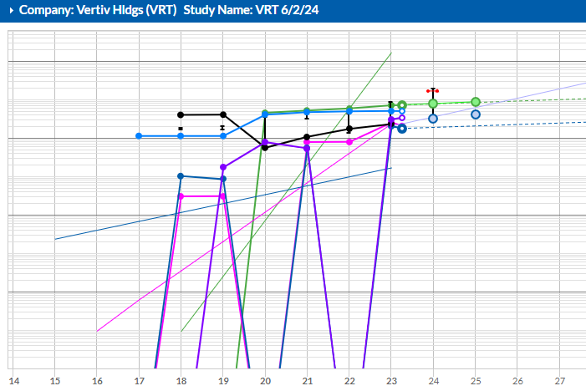
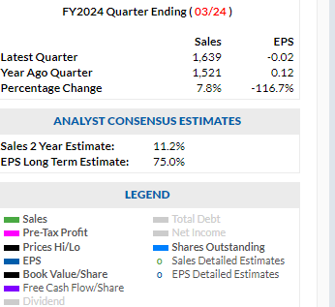
Example of Low/Negative Equity: Vertiv Holdings (VRT), Industry-Electrical Equip & Parts, Industrials (data ctrs), Size-Med- $1-$10B. Went public 2020,. Note 2020 & 2022 Profit, ROE, & Debt (mentioned at BINC)
1. Sales
2. Pre-tax Profit
7
5. Book Value
3. Free Cash Flow
6
8

Slide 13
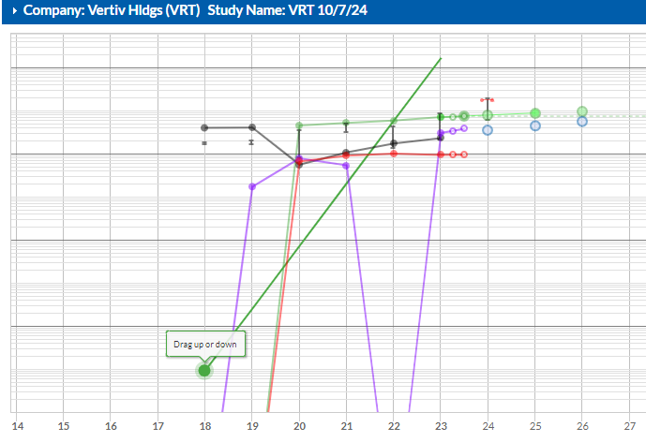
Vertiv Holdings, Cont. (Note high debt, erratic free cash flow, recovering book value; debt>60% liquidity ratios >1)
1. Sales
5 Book Value
8 Debt
3. Free Cash Flow

Slide 14
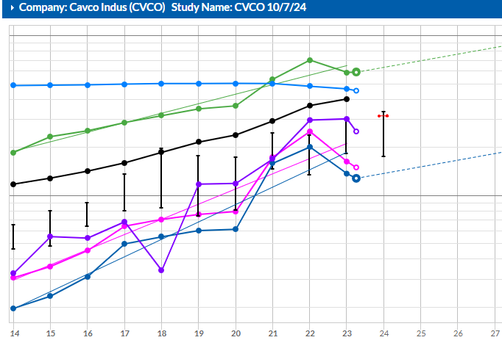
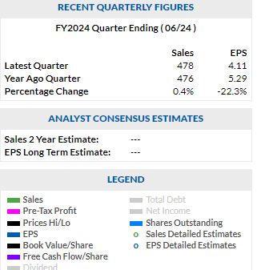
Example: Reducing Shares Outstanding increases Book Value & ROE. See Cavco Industries (CVCO): Consumer Cyclical (Mfg Homes), Size, Med $1-$10B.
7 Shares Outstanding
5.Book Value

Slide 15
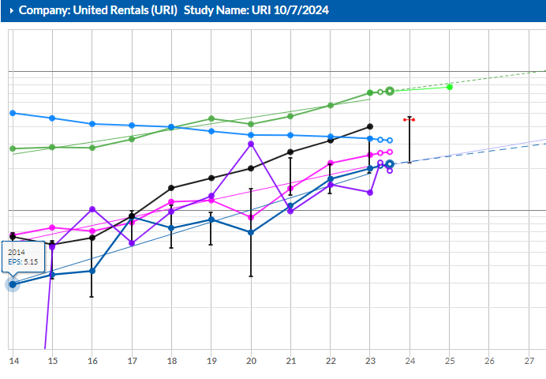
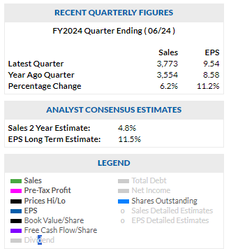
Another Example, United Rentals (watchlist): Influence of Debt on ROE; of share buybacks on Book Value

Slide 16
Conclusions
Return on Equity involves looking at related quality metrics:
Rising sales and pre-tax profit
Rising Free Cash Flow
Book Value per share
Shares Outstanding changes
Debt changes
Liquidity Ratios

Slide 17
Questions?

