Slide 1
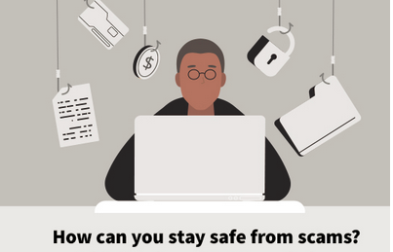
Protect Your Online Investments From Hackers/Spammers
By
Arvind K Krishna
BI- Model Investment Club of Northern VA – MICNOVA Educational Presentation
May 14, 2024

Slide 2
On-Line Hacking has never been so pervasive- objective of this presentation is to familiarize investors with latest Scams - What, Where and How & Best Practices to protect Investments from getting deceived by Scammers
Around the world, hackers are bombarding us with fake emails, phone calls, texts & mail, to steal as much of our money as possible through scamming. Hackers are using the latest technology & their innovation / creativity to swindle your money.
Scamming methods continue to emerge based on new technology & consumer behaviors. Generally, Hackers are able to outsmart fraud detection systems
Emerging Scams, e.g. - Check Cooking; Government/Celebrity Impostors; Voice Printing; Sweepstakes; Cryptocurrency & the use of Generative AI and other innovative tools like ChatGPT as they become more widespread,
Knowledge remains your best defense – Being aware of what is happening & knowing the Red Flags of scams, when suspicious offers come your way
The real secret weapon against this massive financial fraud is YOU. Knowing the criminal’s playbook can help you to identify fraud attempts and avoid them.
Anyone can fall victim to a scam. Research has shattered the stereotypes of investment fraud victims as isolated, frail & gullible. Truth is we are all at Risk.

Slide 3
Smart People can also be Conned by Hackers
77-year-old widow lost $661,000 in a common Tech Scam: ‘I realized I had been defrauded of everything’ – A Federal Government management cadre retiree had wired her nest egg converted into cryptocurrency per the suggestion of someone she believed to be a trusted confidant. He purportedly claimed himself to be a “fraud investigator” at PNC Bank, where she’d been a longtime customer. PUBLISHED SUN, OCT 8 2023
A Journalist (Financial Advice Writer – NY Magazine) fell for an elaborate SCAM that used fear, technology & her stolen personal data - convinced her to withdraw $50,000 cash, which she handed over to swindlers in a shoe box. (WP, Feb 25-2024)
A scam victim in her 60s bilked out of about $789K worth of Gold Bars - swindled by a man, who posed as Federal Investigator from the OIG – FTC, persuaded her to buy Gold bars and turn them over for safekeeping because the thieves might have raided the victim’s bank accounts. Suspect arrested by the Montgomery County, Md Police Financial Crimes Section. (WP, Mar 25-2024)
Realty TV Producer (Andy Cohen) fell for an ‘Imposter Scam’ earlier this year.

Slide 4
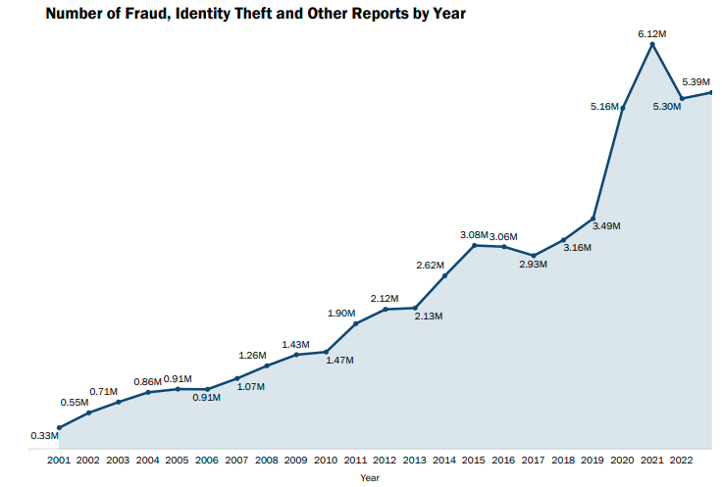
Source: Federal Trade Commission Feb 2024
Consumer Sentinel Network Data Book 2023
NOTE: Hacked incidents reported to Sentinel indicate both cases – money lost & money not lost. Hacked parties make these reports after experiencing a breach even when they successfully avoided losing any money, but they wish to alert others.

Slide 5
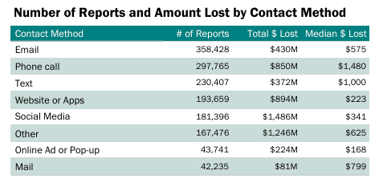
Complaints Filed by Victims to Federal Trade Commission (FTC) - 2023*:
Victims lost more than $10B to fraud in 2023 – a 14% increase over the previous year.
Largest 2023 losses were due to “INVESTMENT SCAMS”, more than $4.6B – a milestone benchmark
Next IMPOSTER SCAMS Loses: $2.7B – (853,935 reports from victims of which 21% reported $ Loss)
These scams include people falsely claiming to be a romantic interest, a Government / Bank – Finan. Officer, a relative in distress, a well-known business, or a technical support expert
Third Largest- Credit Bureaus, Information Furnishers & Report Users SCAMS: (711,802 reports)
*Source: FTC, Consumer Sentinel Network,
Data Book 2023
FEDERAL TRADE COMMISSION ftc.gov/data

Slide 6
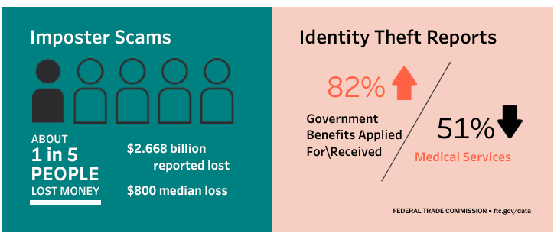
Source: FTC, Consumer Sentinel Network, Data Book 2023, FEDERAL TRADE COMMISSION ftc.gov/data
Imposter scams come in many forms, but share a basic premise: Criminals pretend to be someone you trust to persuade you to send them money, or to get information that can later be leveraged for money.
Identity Theft (19.2% of all 2023 FTC Reports) people filed more reports, in all its various forms, than any other type of complaint. Use of another person's identifying information to commit fraud or theft
Identity Theft Credit Card tops the list of identity theft types reported in 2023. FTC received 416,582 reports from people who said their information was misused with an existing credit card or when applying for a new credit card.
Bank Transfers & Payments accounted for the highest aggregate losses reported in 2023 ($1.86 billion), followed closely by Cryptocurrency ($1.41 billion); Credit Cards used most frequently to pay

Slide 7
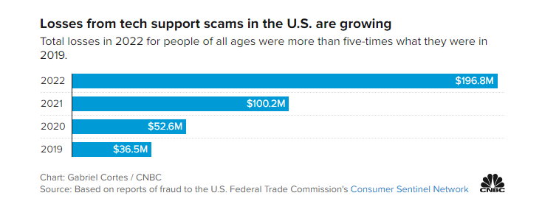
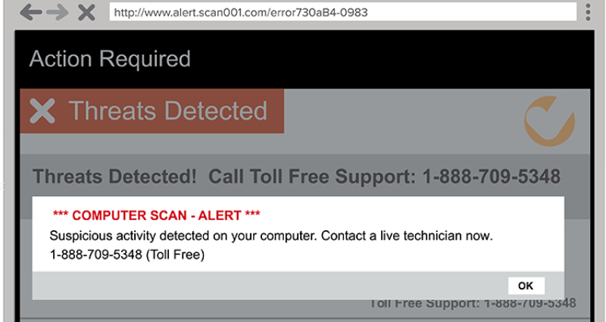
Tech Support Scams
Nearly 18,000 Americans ages 60 + reported being a victim of Scams in 2022 - FBI reports
Tech Support Scams are a type of “call center” fraud, which “overwhelmingly target” older adults FBI. About half of people victimized by illegal call centers are 60 or older, and they experience 69% of the total financial losses relative to other age groups.
FBI Reports – Seniors lost more to these scams than all other age groups combined. The average person lost $33,000, though losses extended to over $1M in some cases.

Slide 8
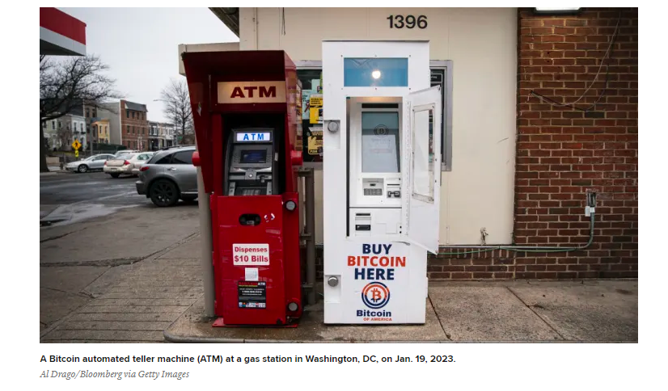
Cryptocurrency Scams
WARNINGS
Crypto ATMs used for $35M in fraudulent transactions in 2022 – Fed Reserve
Cryptocurrency investments- “guaranteed high returns”
SCAM
ATM may be “unlicensed” or “unregistered”
Crypto ATMs are used in many different types of scams – Government Imposter Scams, Romance Scams, Lottery Scams, Fake Online sales, Lottery Scams & for many other fraudulent schemes.
Kiosks quickly move victim’s cash into tough-to-trace cryptocurrency accounts owned by scammers
Scammers love them for many reasons – Anonymity – money on the Block Chain becomes untraceable
“Request to Pay via a Crypto ATM” is a Red Flag – stumbled into a Scam. (Fairfax County Police Dept.)

Slide 9
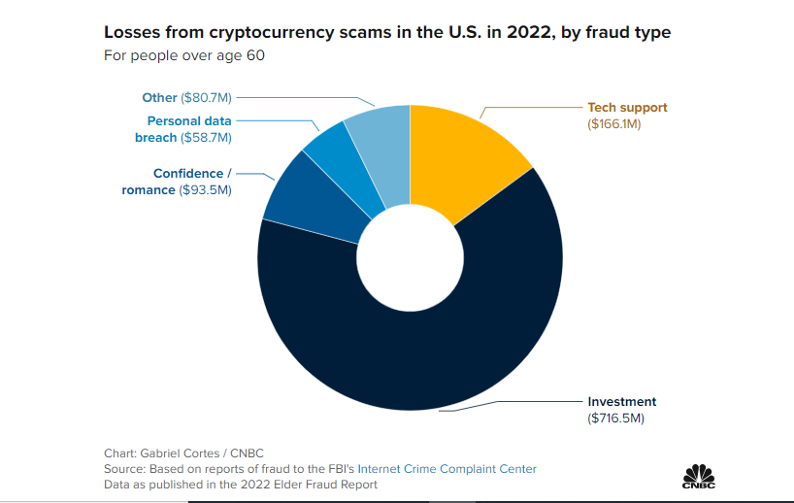

Slide 10
Welcome to the Dark Side of Artificial Intelligence (AI) Source: - AARP FRAUD WATCH NETWORK: “We are entering an Industrial Revolution for Fraud Criminals” – Kathy Stokes, AARP’s Director of Fraud Prevention Programs
With Generative AI (ChatGPT & others), in which a computer can effectively mimic human voices & faces along with movement & writing styles of people you know - can be impeccably faked to steal your money.
AI tools (legitimately useful for many applications) can be weaponized by Hackers to create realistic yet bogus voices, websites, videos & other content to perpetrate fraud
With AI Tools hackers are already taking advantage of some of the endless possibilities for scamming:
Celebrity Scams: – Computer generated “Deepfake” videos of CEOs, Taylor Swift, Oprah Winfrey and others
Fake Romance:- Through a Romance Scammer communicating via a Deepfake video
Sextortion:- Criminals steal photos & videos from Social Media feeds to create Deepfakes to extort money
“AI opens endless possibilities & unfortunately, endless victims & losses” says Kathy Stokes, AARP

Slide 11
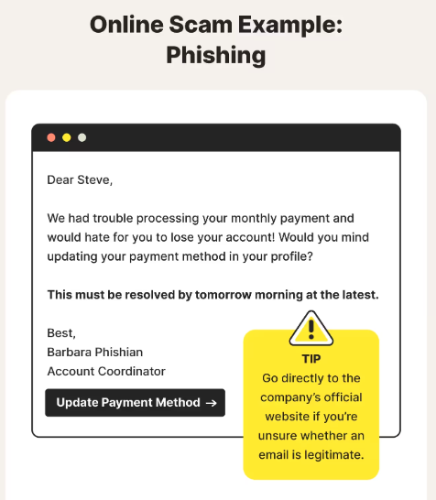
Examples of the Types of Online SCAMS that we can experience
Phishing Scams
Tech Support Scams
Social Media & Imposter Scams
Ransomware Attacks
AI Scams, including deepfakes & Stolen Identities
Romance Scams on Dating Websites & Social Media
Fake GoFundMe & Charity Scams
Mobile Scams/ Online Shopping Scams/ Gift Card Payment Scams/ Social Security Scams

Slide 12
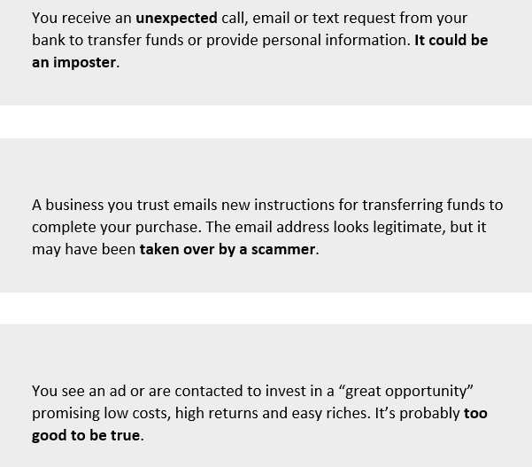
SCAMS Coming Your Way
Common Scam Messages that You Receive Online:
PERSONAL BANK Check-Washing / Cooking Scam:- $815m+ annual Losses. Stolen paper checks by thieves – wash ink of with chemicals except signature - fill in new amount & payee
VOICEPRINTING Scam: - Capture a recording of your voice & then use a Sftw. program to generate an imitation “deepfake” version that impersonates you. Voiceprint can be used to access your Insurance & Financial institution Accts.
CELEBRITY IMPERSONATION: - You get a direct message from someone claiming to be a superstar - be extremely skeptical – most certain to be a scam by an Imposter
DELAYED-ACTION SWEEPSTAKES Scam: - You get a message – “you won a sweepstake with large cash prize”. Your safest bet is just to hang up
FAKE EMERGENCY Scam: - It’s a potentially convincing ruse

Slide 13
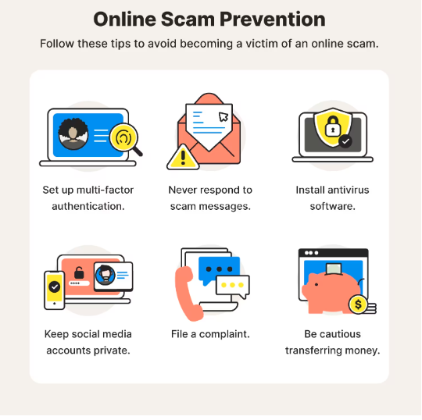
What are Your Defense Strategies to Protect Yourself from Online Financial Exploitation:
Panic & Fear are tools used by Scammers to isolate & prevent you from reaching out to others to consult. Fear is a sign- you are being taken for a ride. Your response becomes Fight-or-Flight
“Decide now to Decide Later” / “Pause and Verify”
Don’t trust Caller ID assuming that it is Legitimate.
Don’t click a link or call a number in an unsolicited message, email or pop-up window; independently go to the respective official website or other to reliable communication channel.
Scammers may already have all your Personal, Financial and Address Information. Hang up and call back using the official number of the organization from its Website.
Weird payment methods used by Scammers are obvious red flags. Never pay over the phone or link someone texts/emails you got. Use your official bank account & “Transfer Money” link.
Scammers use subtle tricks to build Trust by manipulating you.
People who fall for Scams often feel Shame or Embarrassment – that can prevent them from reaching to their friends and family.
Turn the Tables and Ask Questions: You should be the one controlling communications.
Add a Trusted Contact to Your Brokerage Account & place HOLDS when exploitation is expected.

Slide 14
Where do you Report and Seek Help if Scammed?
File a complaint with the “FBI’s Internet Crime Complaint Center (IC3)”, which is the central point for tracking patterns of fraud and abuse related to internet crimes. The IC3 reviews complaints, analyzes data, and creates intelligence reports that highlight emerging threats and new trends.
Federal Trade Commission: File a Fraud Report- call the FTC’s call center or online at ReportFraud.ftc.gov
Use FINRA Resource: Investor Education Foundation for Financial, Visit “FINRAFoundation.org”
Visit FINRA Investor Sites “SaveAndInvest.org” and “FINRA.org/Investors”; provides information to protect yourself from Investment Fraud
FINRA Investor Complaint Center & Tips “finra.org/complaint” and “finra.org/fileatip”
FINRA Investment Fraud, go to www.finra.org/investors/protect-your-money/avoid-fraud
FINRA Broker Check, Visit finra.org/brokercheck
SEC’s EDGAR Database, Check out the Investment using SEC’s EDGAR site - www.sec.gov/edgar.shtml
AARP Call Fraud Watch Network Helpline: www.aarp.org/fraudwatchnetwork; Phone: (877) 908-3360
State Securities Regulator www.nassaa.org Phone: (202) 737-0900
SEC Office of Investor Education/Advocacy www.sec.gov/complaint.shtml Phone (800) SEC-0330
U.S. Dept. of Justice for Elder Abuse & Financial Exploitation www.justice.gov/elderjustice
Call Local State/County Police Dept. – Report when you have been financially defrauded or in danger of becoming victimized
Credit Bureaus: If Scammed, Immediately Call & Report the Scam – Banks & Credit Bureaus to add a Fraud Alert & help prevent Identity Theft
Others include: Better Business Bureau and Microsoft Corporation Cyber Crime Center

