Slide 1
Healthcare Industry Study
Kent Billmyer, Jo Murphy, Phyllis Woodring, Maskey Krishnarao
Jan-June 2016

Slide 2
Healthcare Industry
Parameters:
1) eliminated drug companies & biotech because have well-performing ABBV
2) good quality (over 70 by Manifest)
3) growth rate over 10
4) PAR return of 5 to 10 over MIPAR 5 or 6

Slide 3
Healthcare Industry
Areas in health we screened:
Medical Services
Medical Supplies, includes invasive & non-invasive
Medical Distributors
Healthcare Information Services

Slide 4
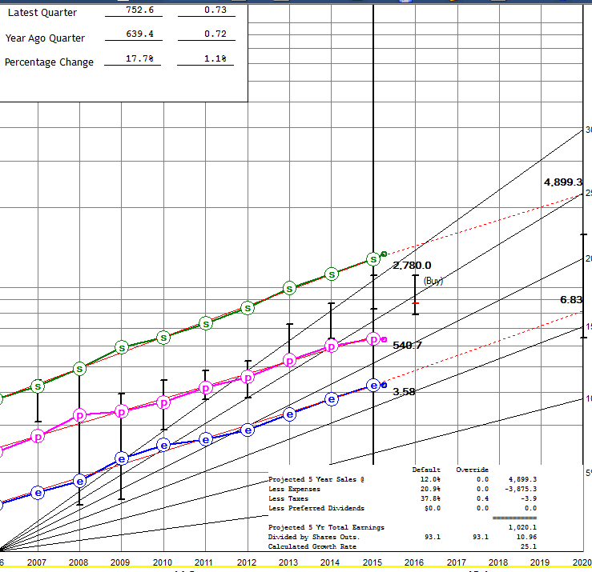
Medical services: Mednax (MD)
Up, straight & parallel
11% growth
No PE expansion; current PE = 19.4
SSG Total return: 10.4, Average return 7.3%
VL est Tot. Ret= 6 to 14%
Manifest PAR = 11.10%
Morningstar n/a

Slide 5
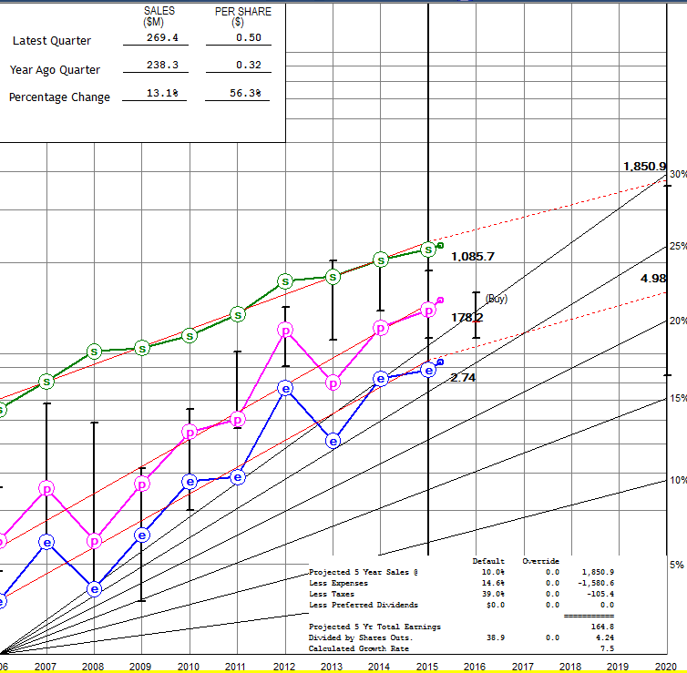
Medical Services: Air Methods AIRM
Sales straight up, ptp & eps a little bumpy
SSG est growth: 10 & 11
Manifest PAR = 19.7
SSG Tot Ret=23, PAR=15
Current PE=12.7
SSG PE’s: 21 and 9
Upside/Downside 5.4 to 1

Slide 6
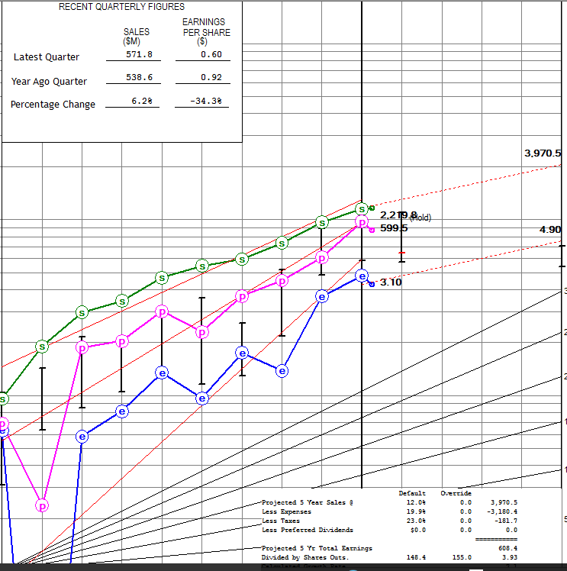
Medical suppliers: Illumina (ILMN)
Sales straight, eps bumpy; latest Q -34.3%, sales slowing to 6%
SSG growth: 12%; Manifest growth18.6%
Current Price $145, M* FV $130; SSG buy to 128
SSG Tot Ret.- 1.8; PAR -0.9
VL Total return range=12% to 23%

Slide 7
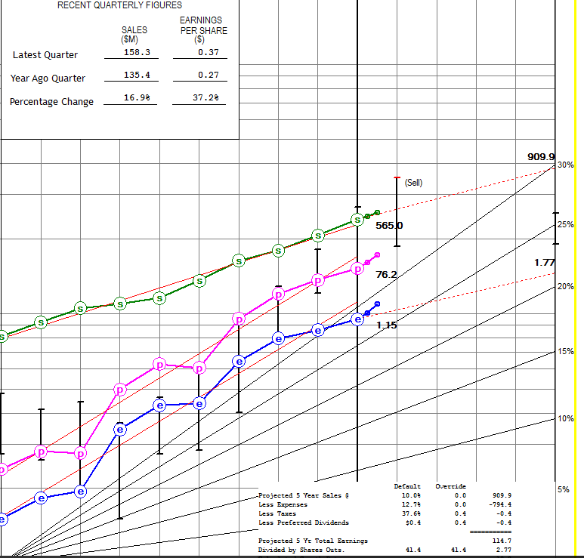
Medical Suppliers: Cantel (CMN)
SSG growth: 11 & 11
Smallest stock reviewed
SSG
PE’s 30 and 18
Buy to $44, current $73
Current PE = 55.7
VL return:-4% to 7%
Manifest Growth: 14.3%
SSG says SELL zone
Manifest PAR only 2%

Slide 8
Healthcare Information: Cerner (CERN)
Price$56.96 (PE 34)
Earnings growing faster than sales (14 vs. 12)
Morningstar FV=$63
SSG Buy to $65
SSG PE’s 40 and 25
4/1 Upside/Downside
Tot Ret 15.8, PAR 11.1
VL return range 6-12%
Manifest PAR 9.8%

