Slide 1
Screening for Quality Stocks within Consumer Discretionary Industry Sector
2016 MicNova Committee Members:
Irina Clements Heidi O’Hara
Gladys Henrikson Paul O’Mara

Slide 2
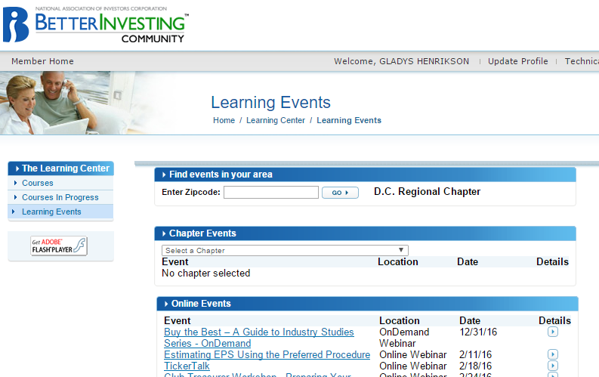
Step One: Review Industries within Sector
References- from BI Website
Morningstar Equity Sectors Classifications: 11 industries listed under Consumer Discretionary
“Buy the Best” Classes – Ken Kavula
Screening Sources Used:
Value Line: Discretionary: Industries/ Co. w. Fin’l rating >B++
Business Week (online): Companies w/in industries having positive earnings for current month & 1 year
Manifest Investing: all discretionary industries, companies with quality and financial strength rating >70

Slide 3
6 Industries and 18 Companies in the First Cut
Industry | Company
Autos and Auto Parts | Pep Boys (PBY)
Entertainment | Activision Blizzard Inc (ATVI)
 | Scripts Network (SNI)
 | Time Warner Inc. (TWX)
Apparel & Furniture (mfg) | Hooker Furniture Corp. (HOFT)
Restaurants | Chipotle (CMG)
 | Starbucks (SBUX)
Retail | Discount: Big Lots (BIG) / Dollar General (DG)/ Five Below (FIVE)/ Price Smart (PSMT)
 | Spec Apparel: Francesca (FRAN)/ Lululemon Athletica (LULU)/TUMI Holdings (TUMI)/ Under Armour (UA)
 | Dept Stores: Kohls (KSS) / Nordstrom (JWN)
Travel & Leisure | Hibbitt Sporting Goods (HIBB)

Slide 4
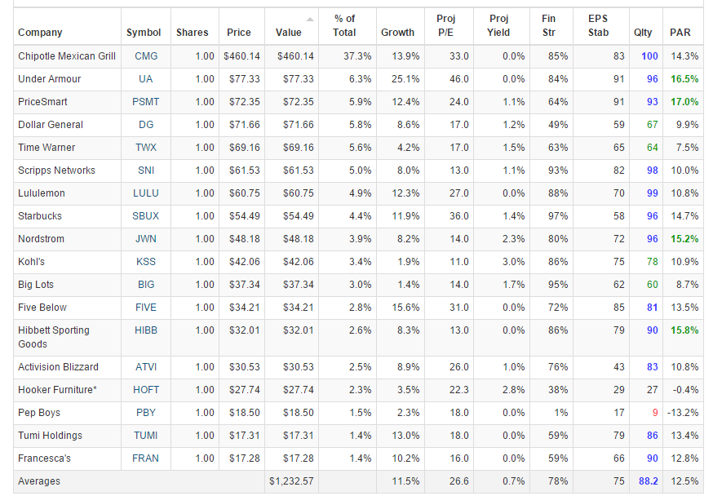
Manifest Investing: Our 1st Cut Discretionary Dashboard

Slide 5
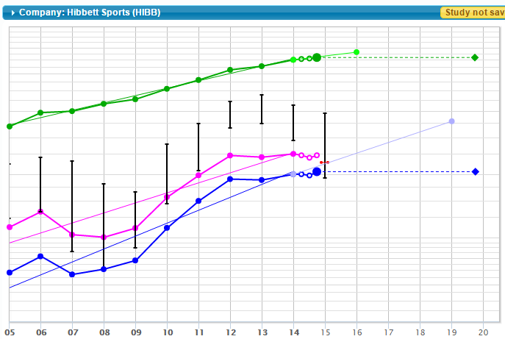
Travel & Leisure: Hibbett (HIBB) Sporting Goods

Slide 6
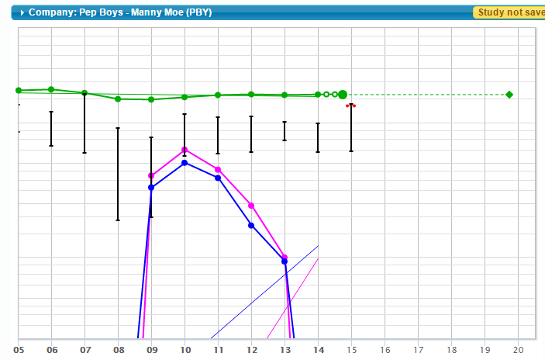
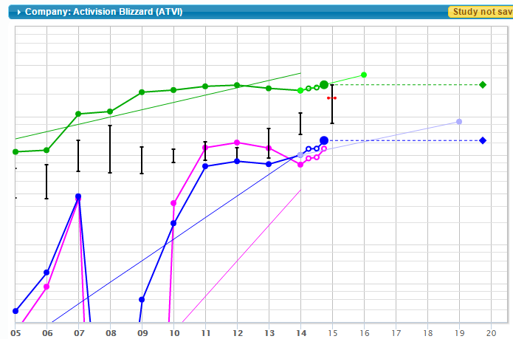
First Look at SSGs: Pep Boys and Activision Blizzard

Slide 7
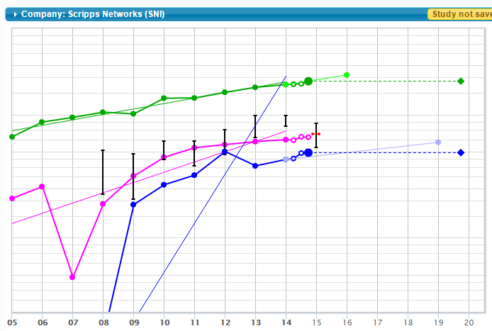
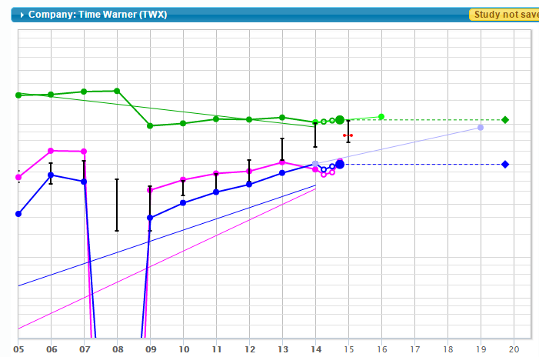
First Cut: Entertainment: Scripts & Time Warner

Slide 8
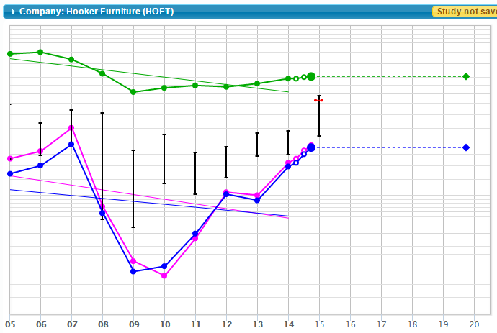
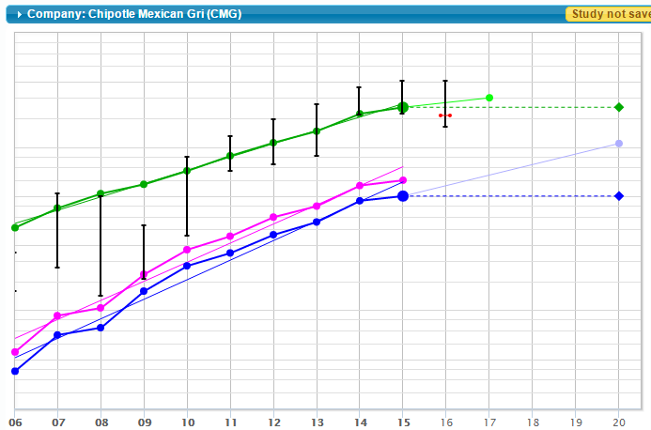
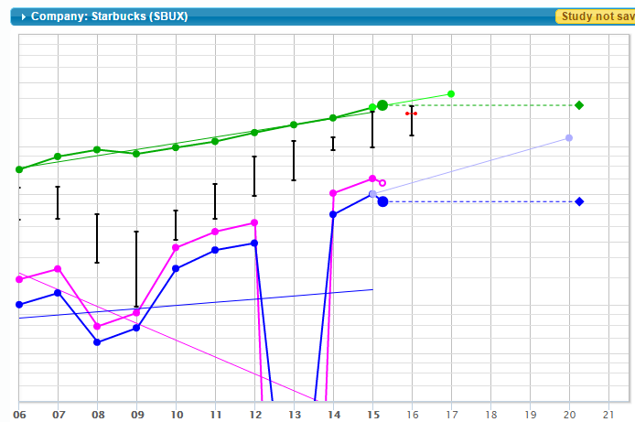
First Cut: Hooker Furn, Chipotle, Starbucks
Hooker
Chipotle
Starbucks?

Slide 9
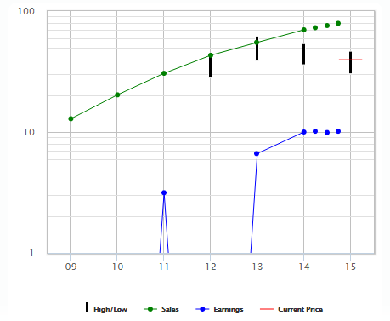
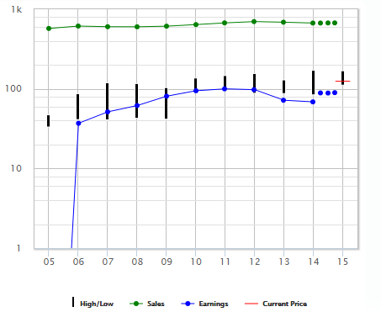
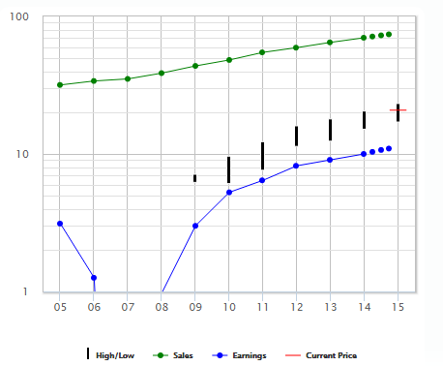
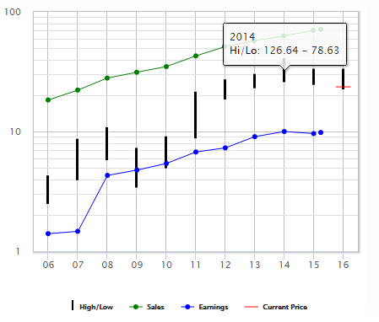
First Cut: Retail Discount
FIVE
BIG;
Quality Low
DG:
Quality Lower
PSMT

Slide 10
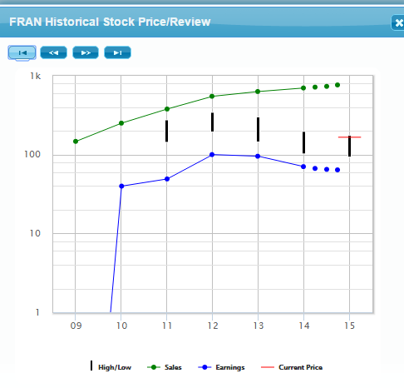
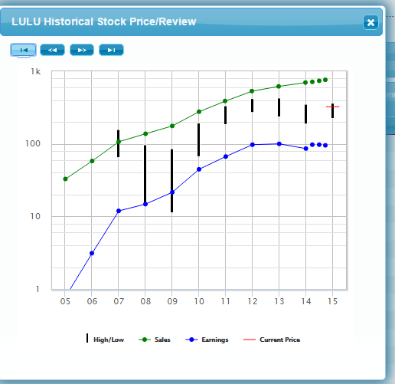
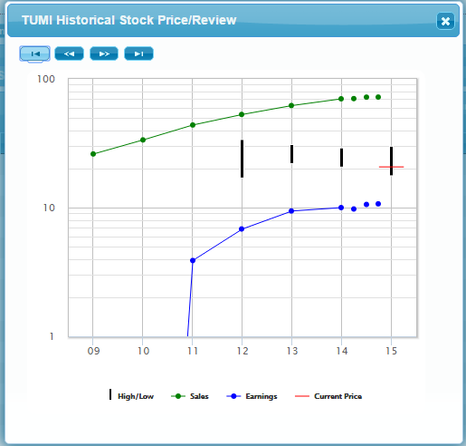
Spec Apparel: FRAN, LULU, TUMI
FRAN ?
LULU ?
TUMI ?

Slide 11
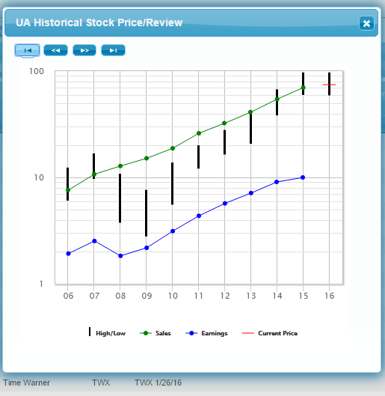
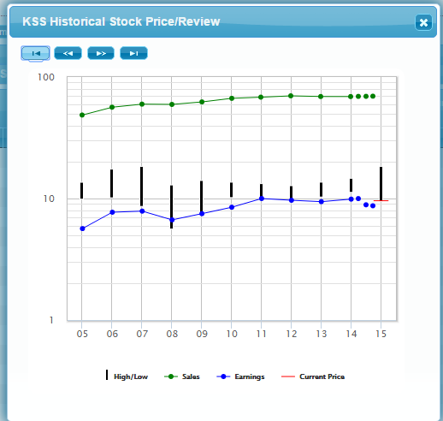
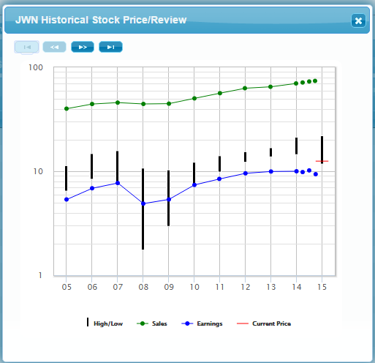
Spec Apparel & Retail: UA, Kohls (KSS) & Nordstrom (JWN)

Slide 12
Next Steps for Discretionary Co:
SSGs for Stocks remaining in study
Review Company Websites
Review Financial Reports
Review Analysts’ Opinion
Present the top 1-4 to MicNova at next meeting.

