Slide 1
MicNova Discretionary Stock Study Co – Results 3-16-2016
Members: Irina Clements Heidi O’Hara
Gladys Henrikson Paul O’Mara

Slide 2
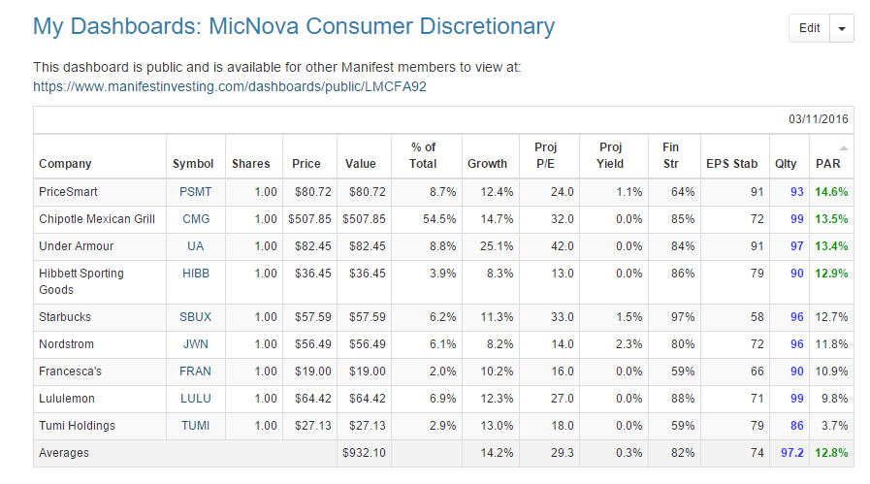
Stocks
Evaluated

Slide 3
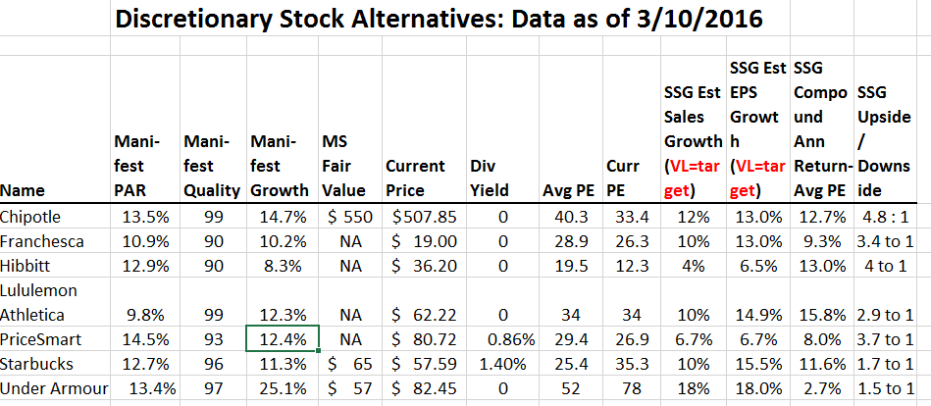

Slide 4
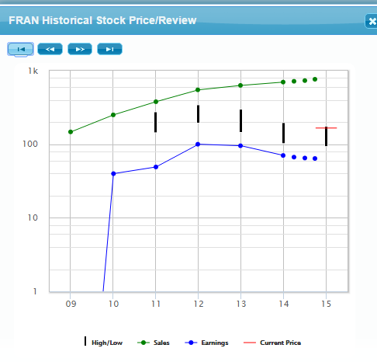
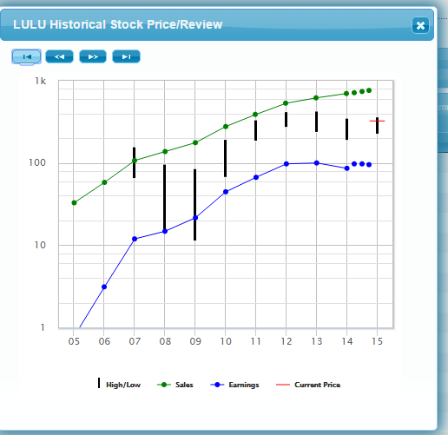
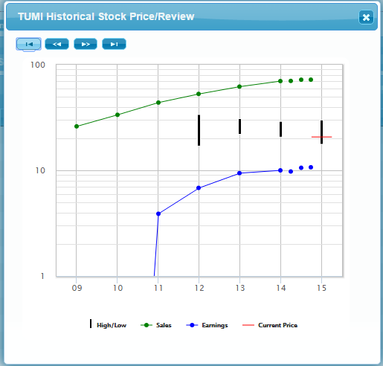
Overview, Retail cont.: FRAN, LULU, TUMI
FRAN P/E~ 25 Com. did not think < 10% growth compelling
LULU price ~ $62/share P/E=35 Com. did not think sustainable
TUMI being acquired by Samsonite ($24/share, P/E>20) for ~ $26/share

Slide 5
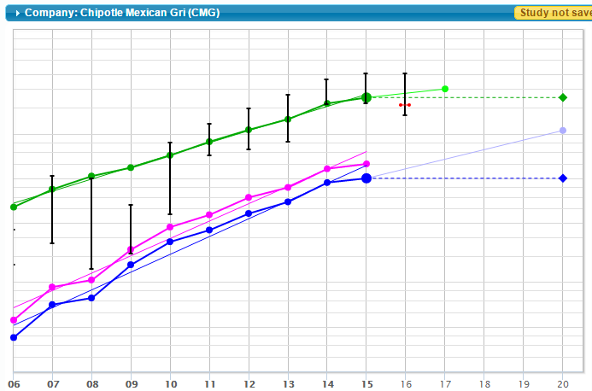
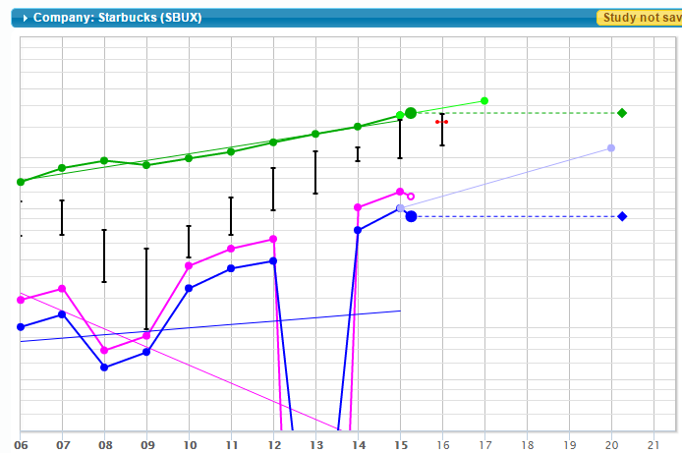
Overview of Financial Performance: Food
Chipotle Mexican Grill
Starbucks
One-time
Litigation
Settlement with
Kraft Foods
Note High Price Ranges & P/Es > 30 for both Stocks

Slide 6
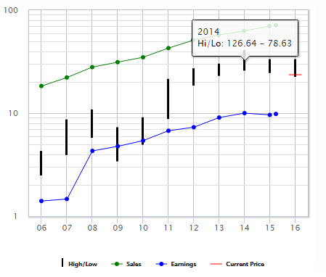
Overview of Financial Performance: Food, Cont.
Price Smart
Note Relatively High Price Range & P/E; Return est less than 10%

Slide 7
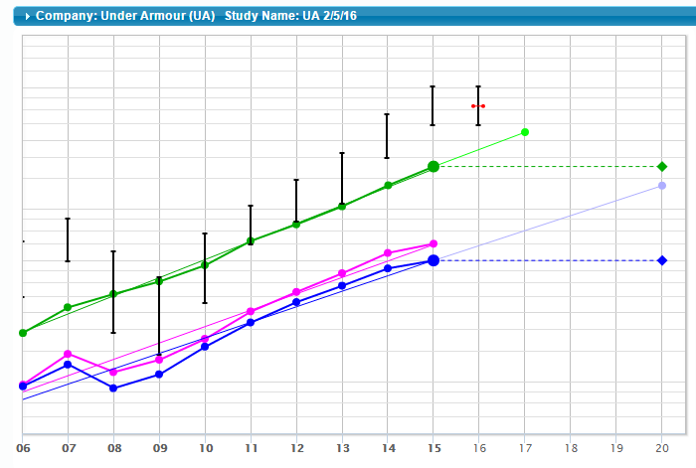
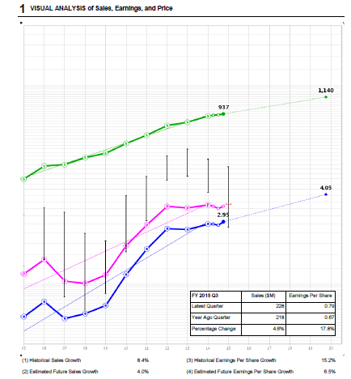
Overview of Financial Performance: Retail
Under Armour
Hibbitt Sporting Goods
HIBB: curr P/E =12; Est PAR = 13%
UA: avg P/E= 52; Current = 78

Slide 8
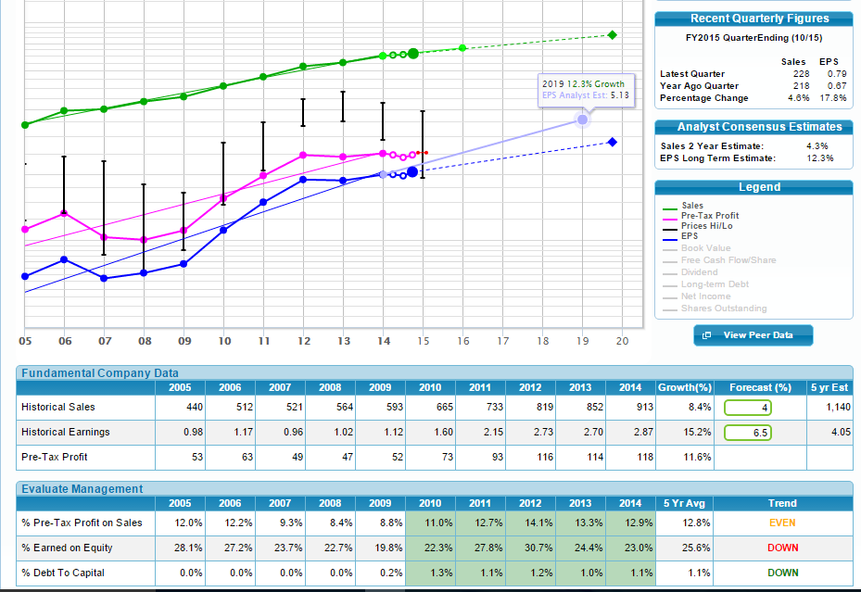
Hibbett 1st
Page of SSG: See Rising Sales &
Profit, very
Low debt.

Slide 9
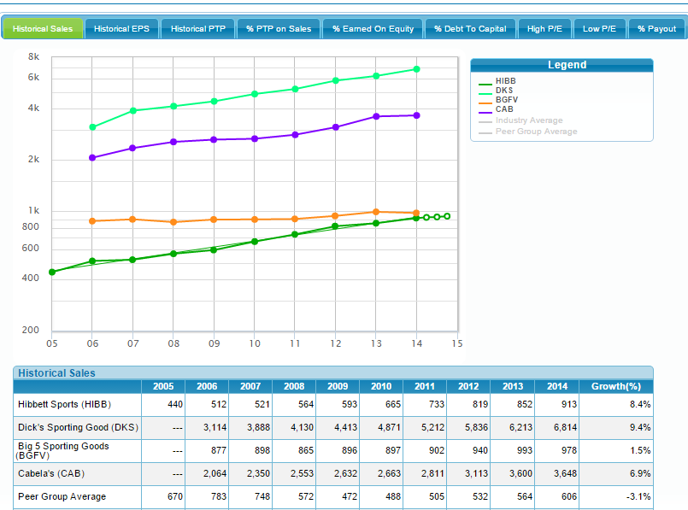
Dick’s
Cabella’s
Hibbett Sales
Performance
Compared to
Peers:
-Dicks
-Big 5
-Cabella’s
Big 5
Hibbett

Slide 10
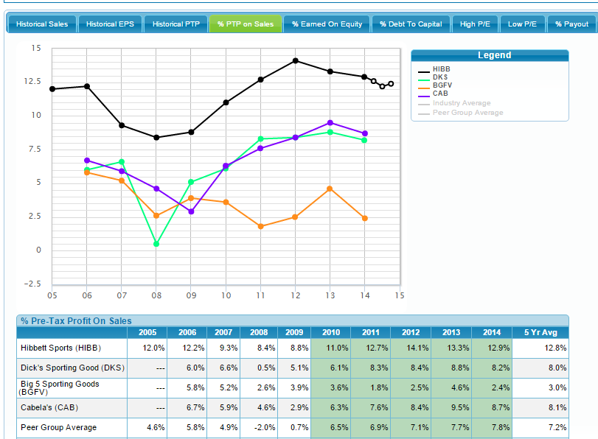
Hibbett
Cabella’s
Dick’s
Hibbett % Profit
On Sales
Compared to
Peers:
-Dicks
-Big 5
-Cabella’s
Big 5

Slide 11
Discretionary Stocks Study Committee Conclusions
Hibbitt Sporting Goods is the only stock that currently meets BI criteria for PAR and price. But not a compelling buy. Committee worries about recent downturn in all Sporting Goods Retail firms
Starbucks, Chipotle, and Price Smart could be on our watch list, to buy when P/Es and prices are lower
Under Armour could also be added to watch list, to buy with much lower P/E and price.

