Slide 1
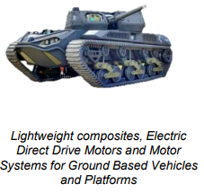
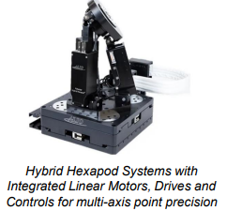
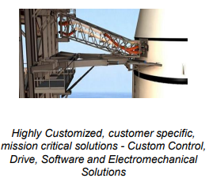
Sheryl Patterson
DC Chapter, The Model Investment Club of Northern Virginia
Allient Corporation (Nasdaq: ALNT)
Small Cap Informer
February New Stock Presentation
Notes:
Good evening, I'm Sheryl Patterson, the president of the DC Regional chapter.
My company tonight is Raytheon – ticker symbol RTX on the NYSE.
It's the February 2024 BI Magazine “Undervalued Stock.”
The stock to study goal is to double an investment within five years with the market price appreciation + dividends.

Slide 2
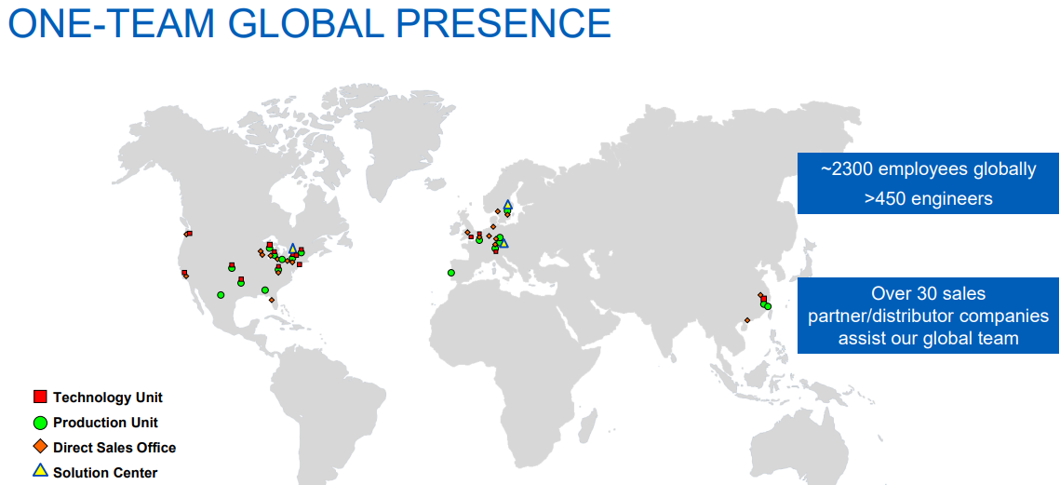
Page 25
Page 30
Kraft Heinz Company
Whether it can retain the loyalty of
increasingly cost-conscious consumers.

Slide 3
WWW.BETTERINVESTING.ORG
Notes:
This slide talks to the issue that reduced the stock’s price in the last few years.. According to Value Line a manufacturing defect was found from a microscopic contaminant in a metal used to make the turbine discs in the engine core. Subsequently, roughly 600 to 700 engines will be removed during shop visits between 2023 and 2026, with a majority on schedule for late 2023 and early 2024.

Slide 5
Notes:
This one time issue adjusted 4th quarter 2023 sales at 10% organic growth, EPS at a 9% increase and an additional $3.9B free cash flow that exceeded expectations.

Slide 6
Notes:
Raytheon Technologies Corp. also merged with United Technologies Corp. and its iconic Pratt & Whitney jet engine brand in 2020. In 4th quarter 2023 organic sales were up 14% and profit or earnings per share were up 26%.

Slide 8
Notes:
The Raytheon segment sales were YOY increase was 3% and EPS were up 8% in the 4th quarter 2023.

Slide 9
Notes:
The full year outlook for 2024 projects $78-79B in sales (organic growth of 7-8% and adjusted EPS of $5.25 to $5.40 and free cash flow of about $5.7B.

Slide 16
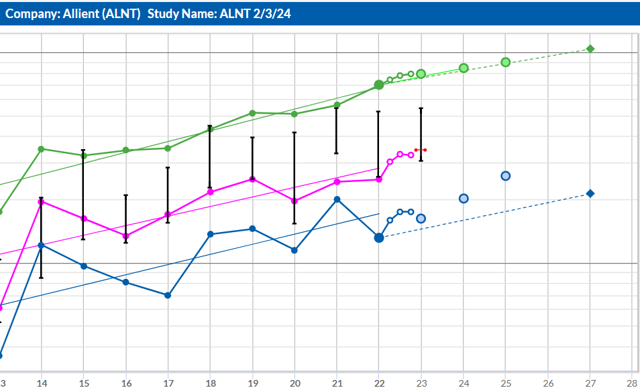
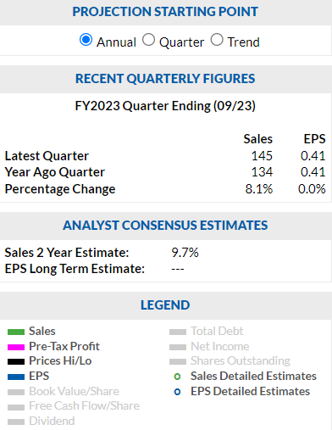

Slide 17
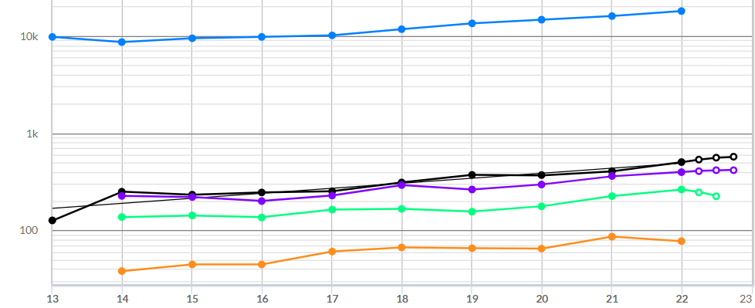
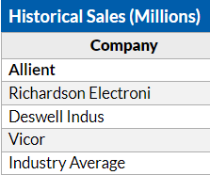
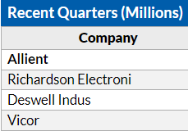
^{CORE}SSG – Historical Sales

Slide 18
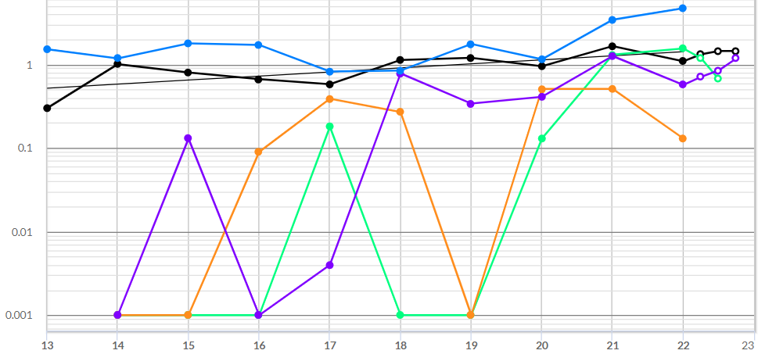
^{CORE}SSG – Historical EPS

Slide 19
^{CORE}SSG – Allient
19

Slide 20
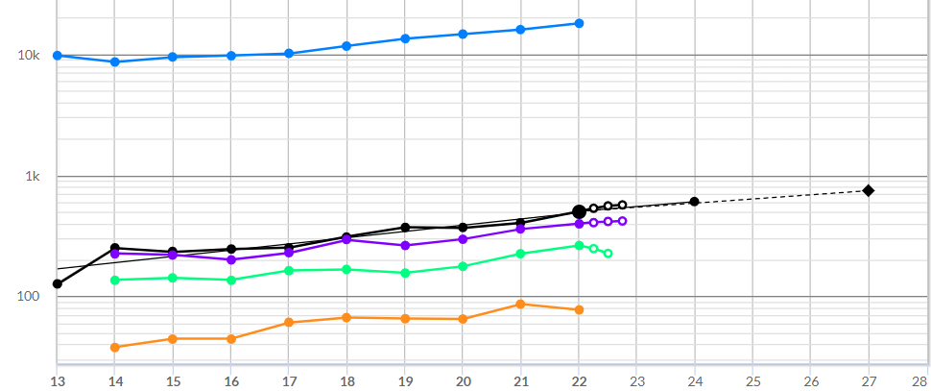
^{CORE}SSG – Sales Forecast

Slide 21
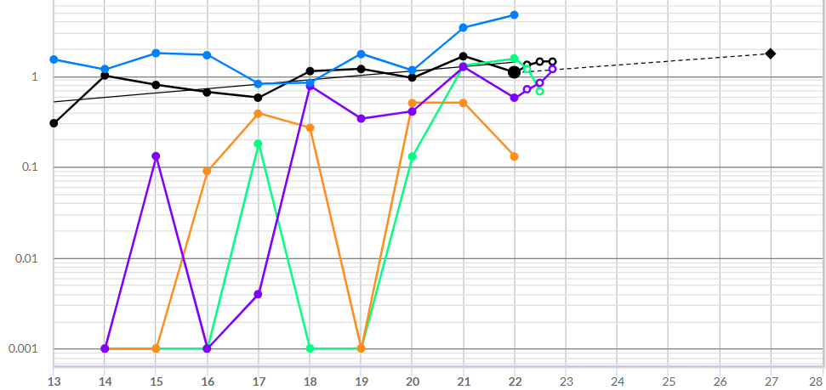
^{CORE}SSG - EPS Forecast

Slide 22
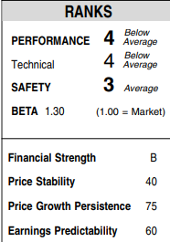
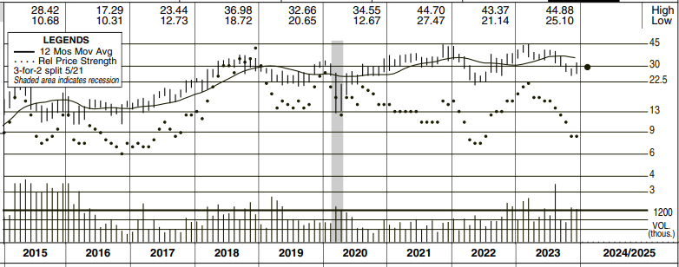
^{CORE}SSG - Forecast High Price

Slide 23
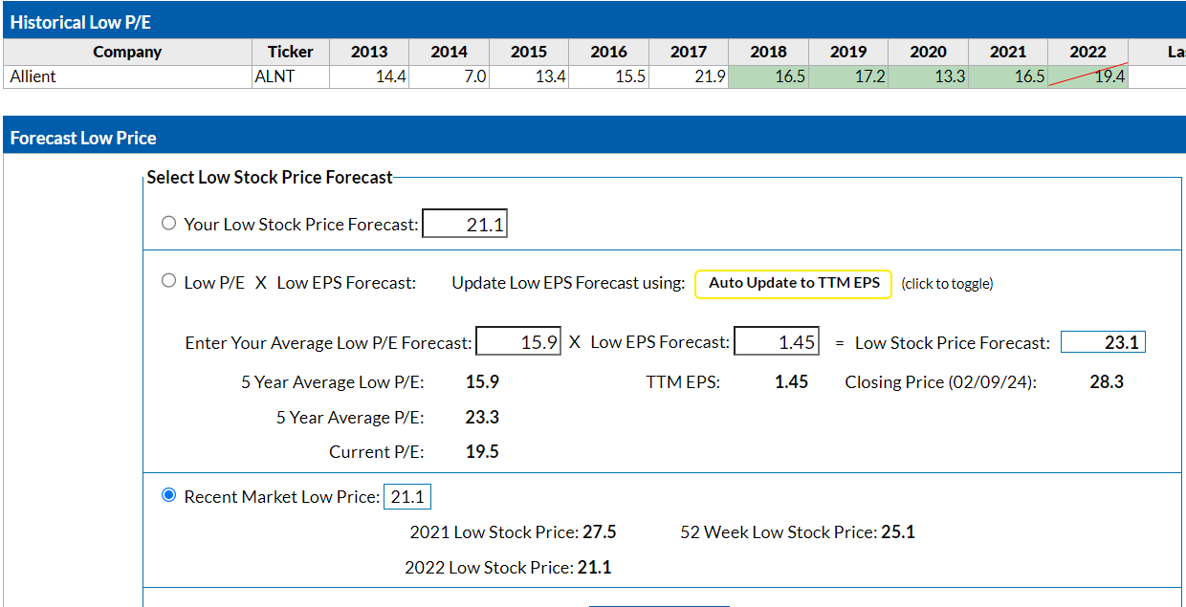
^{CORE}SSG – Forecast Low Price

Slide 24
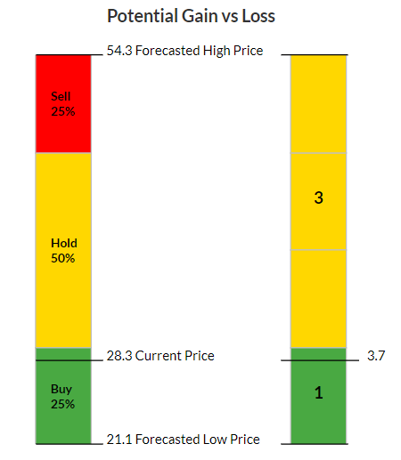
24

Slide 25
Conclusion
ALNT is a small sized company.
ALNT drive long term global growth both organically and through complementary M&A.
ALNT is undervalued (Current P/E 19.7, trading below its 5 year average PE (23.3)).
ALNT $27.30 is Buy price to satisfy 3:1 US/DS & 15% return.
ALNT could be a worthy candidate for purchase.

