Slide 1
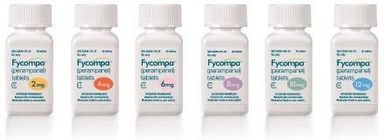
Maskey
Individual Member
Catalyst Pharmaceuticals, Inc. (NAS: CPRX)
Where I Found It: BetterInvesting Search Tool
WWW.BETTERINVESTING.ORG

Slide 2
Catalyst Pharmaceuticals
WWW.BETTERINVESTING.ORG
88
Last Fiscal Year End: 12/2022
Industry: Biotechnology
Sector: Healthcare
Company Size: Small - < $1B in Sales
Morningstar Financial Health Grade: B
Description:
Acquires the rights to commercialize drugs for rare diseases.
Catalyst does all the leg work for pharmaceutical companies, and in return, gets royalties on products sold.

Slide 4
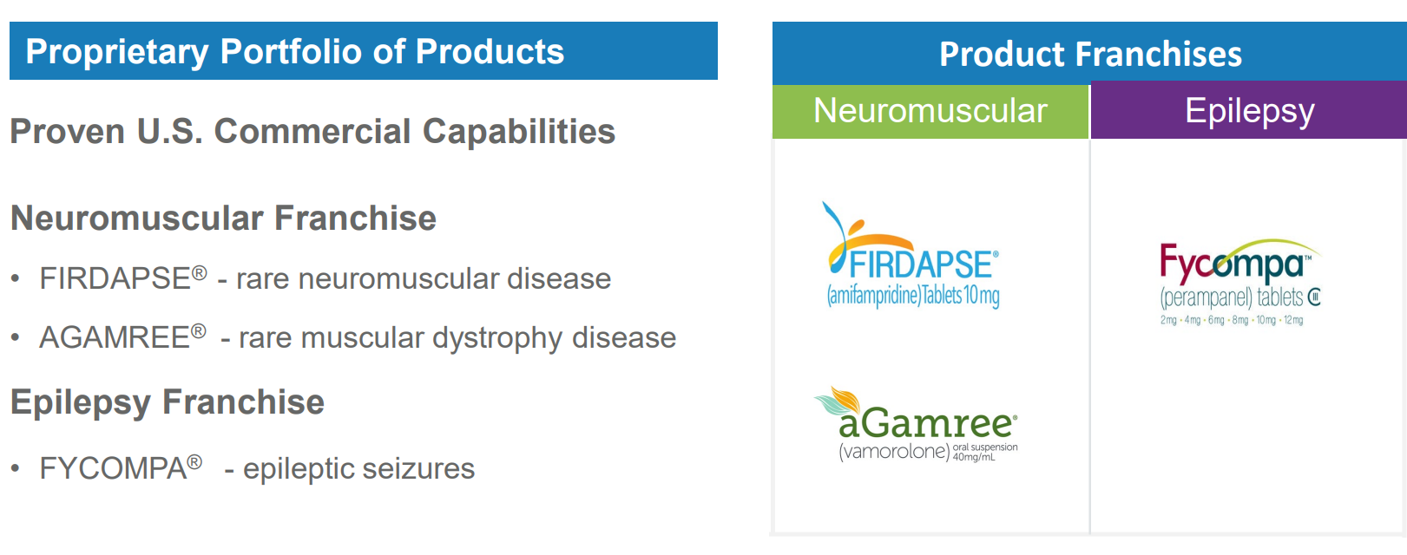
Growing Revenue with a Diversified Portfolio Focus on Rare Neurological and Epileptic disorders

Slide 5
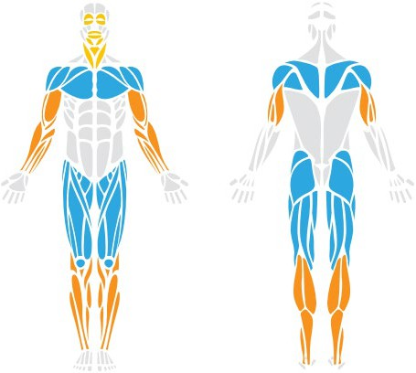
Lambert Eaton Myasthenic Syndrome (LEMS)
A Rare Neuromuscular Autoimmune Disease
Affects Nerve-Muscle Communication
Causing debilitating, progressive muscle weakness and fatigue
May cause:
Weakening of upper arms and shoulders muscles
Severe, debilitating, and progressive weakness in the upper legs and hips
Onset in LEMS patients - 50 to 60 years of age 50% of people with LEMS have underlying cancer Observed in ˜3% of small cell lung cancer patients Affects both women and men
Most affected Sometimes affected Least affected
Life-threatening weakness in respiratory muscles
6

Slide 6
FIRDAPSE - U.S. LEMS Market Opportunity
Affects ˜3,600 - 5,600 people (U.S.)¹
Multiple Growth Drivers
>1100 LEMS-
diagnosed patients ever treated with FIRDAPSE ²
Expanded educational programs to SCLC LEMS HCP’s
100mg label expansion – PDUFA June 4, 2024
Seek to expand global footprint
> 2,900 LEMS
undiagnosed
patients
˜800 LEMS patients diagnosed but not yet treated with FIRDAPSE
Making A Meaningful Difference In Patients’ Lives
7
¹ Lambert Eaton Myasthenic Syndrome is Underrecognized in Small Cell Lung Cancer: An Analysis of Real-World Data; presented IASLC 2023
World Conference on Lung Cancer; authors: David Morrell, Benjamin Drapkin, Guy Shechter, Regina Grebla;² Includes 225 patients now deceased

Slide 7
WWW.BETTERINVESTING.ORG
91

Slide 8
WWW.BETTERINVESTING.ORG
92

Slide 9
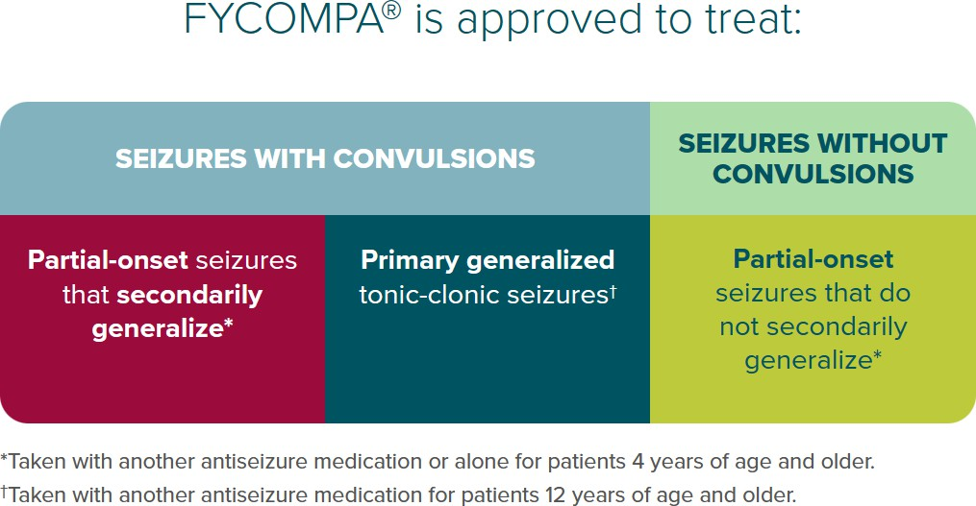
FYCOMPA® (perampanel) CIII
Established, First-In-Class Commercial Epilepsy Asset
Synergistic neurology expansion
Acquired U.S. rights in Jan 2023 Franchise teams fully engaged - May 2023
Franchise physician call points overlap - 45% Compelling product net revenue contribution
Seek to expand into rare epilepsy or neuroscience adjacencies
13

Slide 10
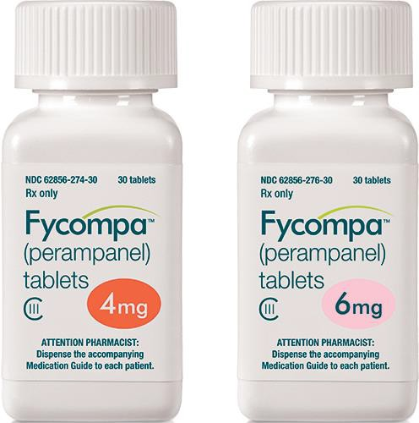
FYCOMPA – Significant Market Opportunity
WWW.BETTERINVESTING.ORG
93
Epilepsy is 4th most common neurological disorder.
˜3.5M patients in the U.S. with active epilepsy.
~500K children.
~150K new patients/year (US).
˜30 - 40% of all people with epilepsy still fail to respond to treatment.

Slide 11
FDA Approved:
Oct 26, 2023
Launch
Q1 2024
Designations:
Orphan Drug Rare Pediatric Disease
10

Slide 12
AGAMREE® - Novel Corticosteroid
Treatment for Duchenne Muscular Dystrophy (DMD)
Potential To Deliver Meaningful Near & Long-term Value, Adding To Continued Growth Momentum
Approved for treatment in DMD patients ≥ 2yrs
May increase ambulation duration & mobility, improving QoL Neuromuscular franchise team to launch product in Q1 2024 Optimize existing capabilities with minimal expansion Comprehensive Patient Assistance Program upon launch Orphan drug designation offers 7 years of market exclusivity Pending patents out to 2040
11
*Acquired North America* License from Santhera Pharmaceuticals, July 2023. North American territories consist of the U.S., Canada, and Mexico

Slide 13
AGAMREE – Addresses Need for Tolerable Steroid
Steroids are the Backbone of DMD Therapy
AGAMREE - Compelling Safety Profile
U.S. DMD patient prevalence: ˜ 11,000 to 13,000
In clinical studies, demonstrated:
DMD diagnosis rate; typically occurs at
Proven efficacy, tolerability, safety, and ease of use
Equivalent efficacy to prednisone
Potential of significant reduction of steroid- associated side effect burden when compared with another corticosteroid, with benefits for
~ 95%
ages 2 - 5 years
DMD patients treated with corticosteroids at some point
˜ 90%
bone health
growth
behavior
Currently treated DMD patients receive concomitant steroid treatment
˜ 70%
¹Guglieri M et al (2022). JAMA Neurol. 2022;79(10):1005-1014.doi:10.1001/jamaneurol.2022.2480; Mah JK et al (2022). JAMA Netw
12 Open.2022;5(1):e2144178.doi:10.1001/jamanetworkopen.2021.44178.; Guglieri M et al (2022) JAMA. doi:10.1001/jama.2022.4315;Heier CR et al (2019). Life Science Alliance DOI: 10.26508; Liu X et al (2020). Proc Natl Acad Sci USA 117:24285-24293

Slide 14
Legal Proceedings
WWW.BETTERINVESTING.ORG
97
Health Canada, U.S. Food and Drug Administration, U.S. federal courts, and competitors.
Aggressive in the defense of its intellectual property rights and largely successful in its cases to date.

Slide 15
Q3 2023 Financial Highlights
FY 2023 Total Revenue of Between $390M - $395M
For the Three Months Ended September 30th | 2023 | 2022 | % Change
Total Net Product Revenues | $102,617 | $57,173 | 79.5%
FIRDAPSE Net Product Revenues | $66,224 | $57,173 | 15.8%
FYCOMPA Net Product Revenues | $36,393 | N/A | N/A
GAAP Net Income (Loss) | $(30,764) | $22,748 | (235.2)%
Non-GAAP Net Income ** | $55,870 | $28,615 | 95.2 %
GAAP Net Income (Loss) Per Share – Diluted | $(0.29) | $0.20 | (242.1)%
Non-GAAP Net Income Per Share – Diluted** | $ 0.49 | $0.26 | 88.5 %
*Non-GAAP financial measures are provided as additional information and not as an alternative to Catalyst's financial statements presented in accordance with
20 U.S. generally accepted accounting principles (GAAP). These non-GAAP financial measures are intended to enhance an overall understanding of Catalyst's current financial performance.

Slide 16
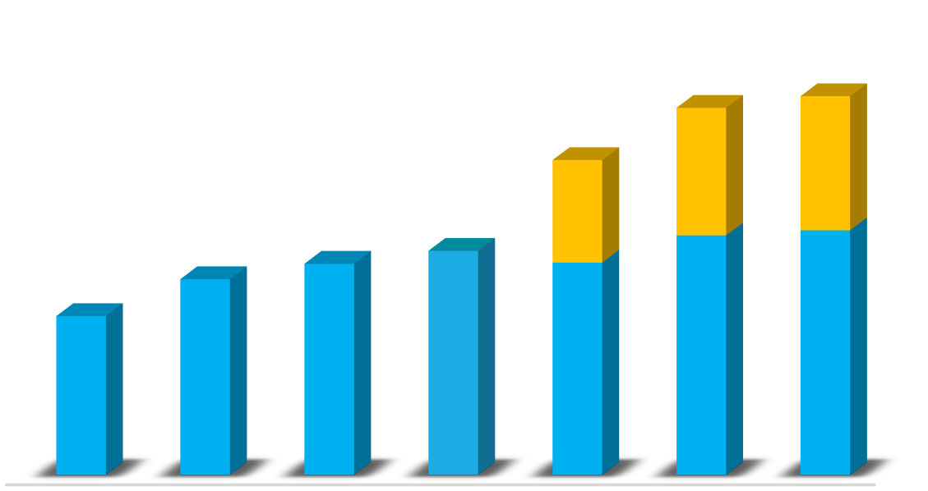
Strong Financial Position
Underscores Successful Execution
(In Millions)
Total Product Net Revenue 2022-YTD
Q3 23 Results
Cash Position as of Sept 30, 2023 | $121.0
Total Revenues | $102.7
YoY Net Revenue Increase | 79.4%
Net Product Revenue Growth Increase
FIRDAPSE YTD | 23.1%
FYCOMPA compared to Q2 ‘23 | 5.2%
FY 2023 Forecast
Total Revenue Guidance | $390 - $395
$120
$100
$80
$60
$40
$20
$0
Q1 Mar- Q2 Jun- Q3 Sep- Q4 Dec- Q1 Mar- Q2 Jun- Q3 Sept-
22 22 22 22 23 23 23
FIRDAPSE FYCOMPA
$ In Millions
21

Slide 17
Strategic Growth Initiatives
Building on the Momentum
Expand Commercial Footprint
Explore commercial add-on assets both in the US & Globally
Synergistic expertise to foster innovations
Harness operational capabilities and industry expertise
Expand Portfolio in Rare & Orphan Diseases
Seek transformational partnerships to accelerate growth into new therapeutic areas and larger markets
Focused on rare neurological and epileptic disease opportunities
Invest in Portfolio Diversification
Strong balance sheet reinforces delivering attractive opportunities Well-positioned to achieve long-term growth
18

Slide 18
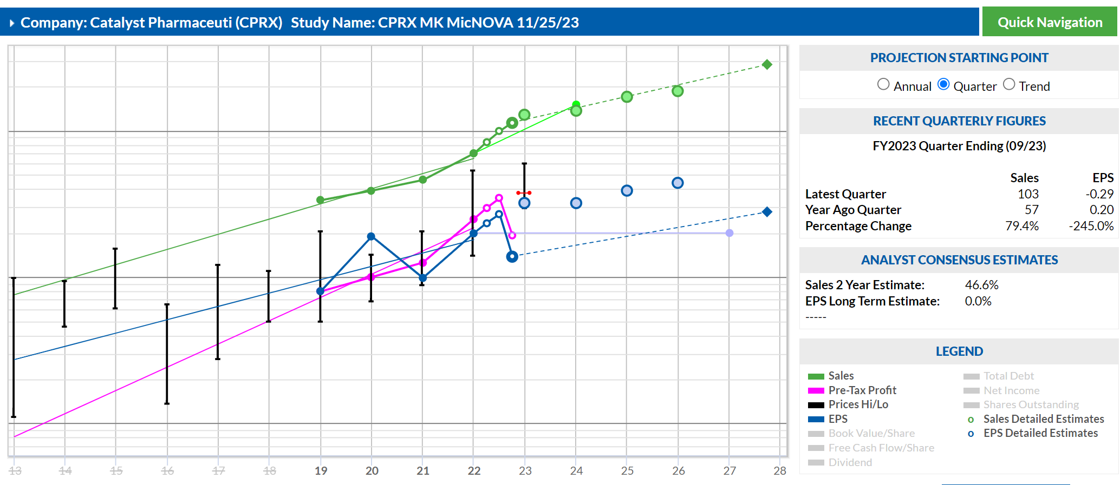
Catalyst Pharmaceuticals - SSG^{Plus}
WWW.BETTERINVESTING.ORG
99

Slide 19
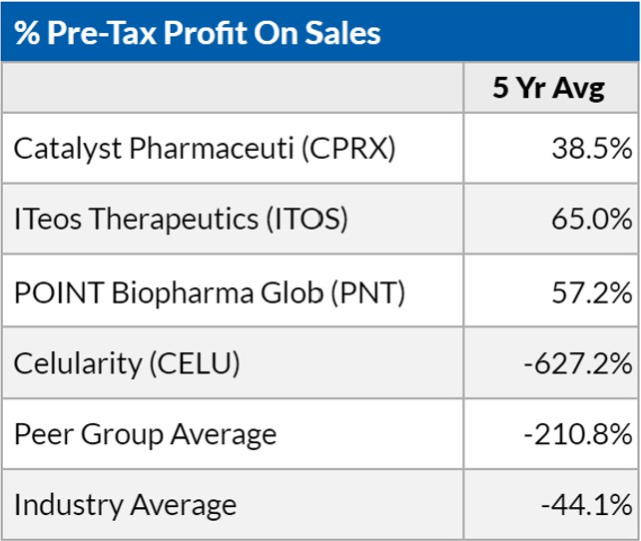
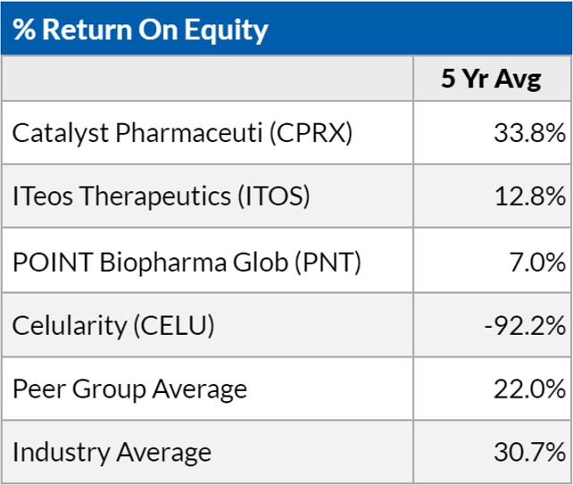
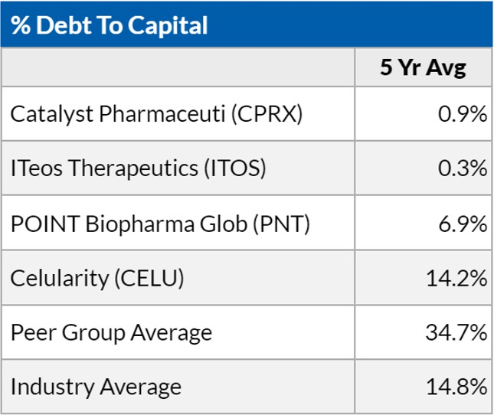
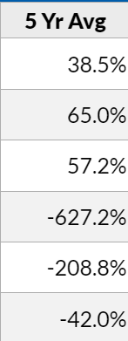
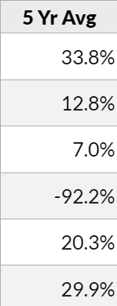
Catalyst Pharmaceuticals - SSG^{Plus}
WWW.BETTERINVESTING.ORG
100

Slide 20
Catalyst Pharmaceuticals - SSG^{Plus}
WWW.BETTERINVESTING.ORG
101

Slide 21
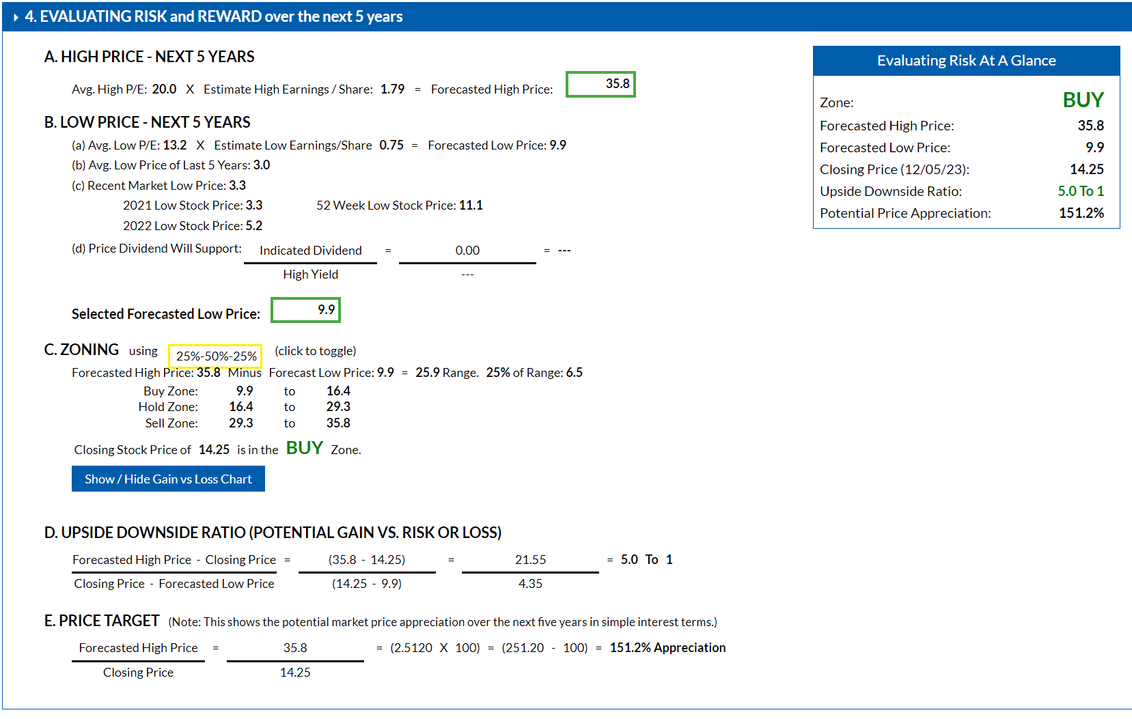
WWW.BETTERINVESTING.ORG
103

Slide 22
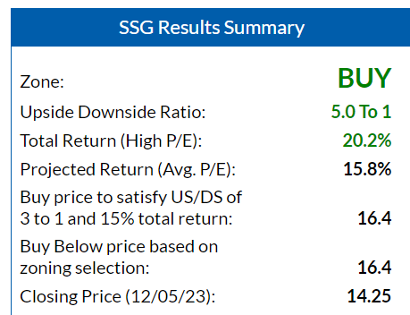
Catalyst Pharmaceuticals - Summary
WWW.BETTERINVESTING.ORG
104
Expect commercial launch of AGAMPREE in Q1 2024.
Expect FIRDAPSE NDA filing in Japan by YE 2023.
Continue to diversify the neuroscience product portfolio further.

Slide 23
Catalyst Pharmaceuticals - Conclusion
WWW.BETTERINVESTING.ORG
oCPRX is a small sized, fast growth company.
oCPRX is a very well managed company.
oCPRX is “fairly valued” trading near its 5 Yr. Avg.
High PE.
oCPRX is a worthy candidate to add to a Watch List but keep an eye on the price. oCPRX is a BUY up to $16.4 (buy price to satisfy 15% Total Return and 3:1 US/DS Ratio is $14.0).

