Slide 1
ACM Research, Inc. (ACMR) Supplies Capital Equipment developed for the Semiconductor Industry – in the Global Wafer Fabrication Equipment (WFE) Market Market CAP: $1.03B NASDAQ : ACMR (Common Stock)
Sector: Technology
Industry: Semiconductor Equipment & Materials
Full Time Employees: 1,209
By
Arvind K Krishna – Better Investing (BI) MICNOVA
November 14, 2023

Slide 2
DISCLAIMER
The information in this presentation is for educational purposes only and is not intended to be a recommendation to purchase or sell any of the stocks, mutual funds, or other securities that may be referenced. The securities of companies referenced or featured in the seminar materials are for illustrative purposes only and are not to be considered endorsed or recommended for purchase or sale by (BI) BetterInvesting™ / National Association of Investors™ and/or MICNOVA.
The views expressed are those of the instructors, commentators, guests and participants, as the case may be, and do not necessarily represent those of BI - MICNOVA. Investors should conduct their own review and analysis of any company of interest before making an investment decision.
Securities discussed may be held by the instructors in their own personal portfolios or in those of their clients. BI - MICNOVA presenters and volunteers are held to a strict code of conduct that precludes benefiting financially from educational presentations or other activities in which they participate.
This presentation may contain images of websites and products or services not endorsed by BI - MICNOVA. The presenter is not endorsing or promoting the use of these websites, products or services.
We may be recording this session for our future use.

Slide 3
Who is ACMR?
Founded in 1998 in Silicon Valley (HQ in Freemont - CA),
Develops most advanced wet processing cleaning technology including electroplating processes & the ultimate in thermal deposition for the semiconductor industry.
Conducts its R&D and Manuf. & Service Support Operations in Shanghai, China.
Provides sales support and customer service operations in Jiangying- China; Wuxi- China; & Icheon, Korea.
Advanced service coverage at strategic locations around the globe, including Beijing, Taiwan, Korea, and the U.S., to provide support for customers worldwide.
Produces equipment for a range of applications that are critical to advanced IC manufacturing
Single-wafer batch wet cleaning,
Electroplating,
Stress-free polishing and thermal processes,
Wafer level packaging.

Slide 4
ACMR Business and Products
Develops, manufactures, and sells single-wafer wet cleaning equipment for enhancing the manufacturing process and yield for Integrated Chips (IC) Worldwide.
It Offers the following proprietary technologies
Space Alternated Phase Shift, SAPS™ cleaning technology: for flat and patterned wafers;
Timely Energized Bubble Oscillation, TEBO™ cleaning technology for high-aspect-ratio 2D and advanced 3D patterned wafers;
Ultra C Tahoe cleaning system, High-performance, eco-friendly Sulphurix Peroxide Mix, SPM cleaning technology;
Ultra ECP, proven electrochemical plating, technology. ECP technology for advanced metal plating. Ultra ECP ap, or Advanced Packaging, technology was developed for back-end assembly processes
Ultra Proven Stress-Free Polishing technology, the Ultra (SFP™) for advanced packaging applications;
Issued 448+ patents in the USA, China (PRC), Japan, Singapore, South Korea & Taiwan.
R&D Driven Co., Process Innovation Speciality – ACMR’s R&D Budget Ratio is also higher than its peers in the semiconductor equipment industry.
Markets and sells its products under the Ultra C brand name through direct sales force & 3rd party Reps.

Slide 5
ACMR Profile in Global WFE Market
2022 Revenue from Wet Cleaning & other front-end processing: $309M (79% of Total)
2022 Revenue from Advanced Packaging, other processing tools, services and spares: $80.3M (20.7% of Total)
2022 Global WFE market is approximately $16 billion – ACMR equipment, a subset of Global Mkt.
Gartner’s Estimates: Total available global market for ACMR Equipment Segments -
increased by (7.6%) from $20.1B in 2021 to $21.6 billion in 2022, and is -
expected to decrease by (19.6%) to $17.4 billion in 2023.
ACMR equipment segments are a subset of the total worldwide semiconductor WFE market ($101B in 2022), which Gartner estimates will decrease by (19.0%) to $81.5 billion in 2023.
Substantial majority of ACMR sales of single-wafer wet-cleaning equipment for front-end manufacturing have been to customers located in Asia,
Anticipate the same trend in Sales will continue with Asian customers in the foreseeable future
ACMR operates state-of-the-art R&D facilities in Shanghai and is constructing a new R&D and Production Facility in Lingang, China (in 2024).
Miletus Research: We are confident that ACMR has a solid global expansion plan that will diversify its revenue sources and reduce its dependence on China

Slide 6
ACMR and its Operations Through its Subsidiaries
ACMR conducts complete R&D, Engineering, Manufacturing, and Support & Services in the PRC (China) through ACM Research subsidiary in Shanghai and in Wuxi, China
Additional product development and subsystem production in South Korea, through ACM Shanghai subsidiary
Sales & Marketing activities focused on sales of ACM Shanghai products in North America, Europe and certain regions in Asia outside mainland China, is done through 2nd subsidiary of ACM Research in Wuxi, China
Advance service coverage at strategic locations around the Globe, including Beijing, Taiwan, Korea, and the USA.
Business of ACM Shanghai is subject to complex laws and regulations in the PRC that can change quickly with little or no advance notice. To date, beyond the COVID-19- related restrictions in 2022, ACM has not experienced such intervention or influence by PRC central government authorities or a change in those authorities’ rules and regulations that have had a material impact on ACM Shanghai or ACM Research
ACM Research is not a PRC operating company – ACMR does not conduct its operations in the PRC through the use of a variable interest entity, or VIE, or any other structure designed for the purpose of avoiding PRC legal restrictions on direct foreign investments in PRC-based companies. ACMR has a direct ownership interest in ACM Shanghai holding 82.5% of its outstanding shares.

Slide 7
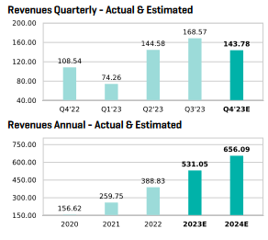
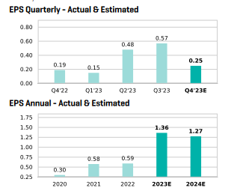
ACMR Revenues
ACMR EPS

Slide 8
ACMR Q3 Financials
+26.1%
{Gross Profit +34.8%}
ACMR 9 Mos. Financials

Slide 9
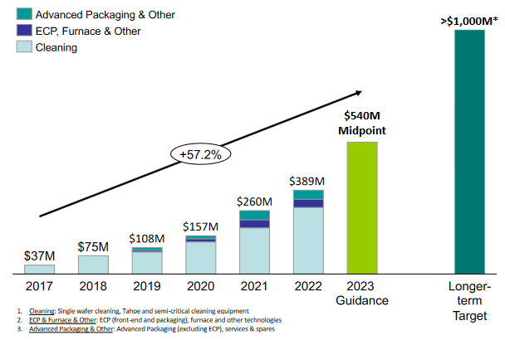
ACMR Long Range Plans for REVENUE Growth

Slide 10
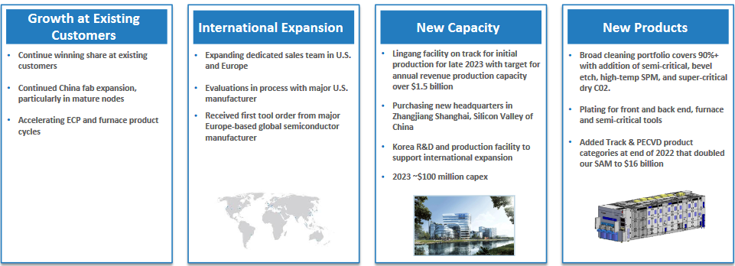
ACMR Long Term Growth Strategy

Slide 11
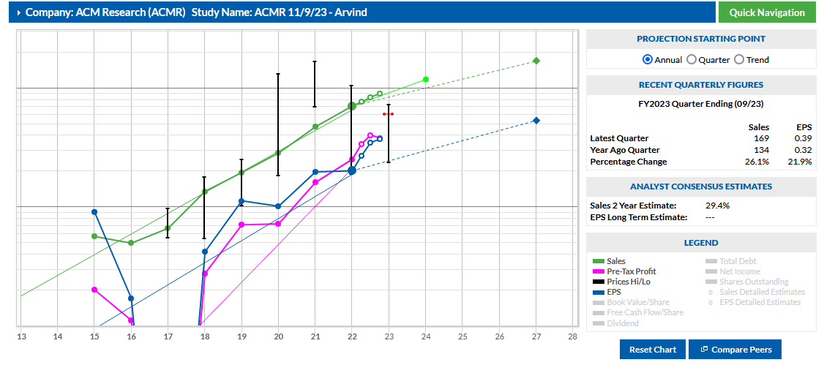

Slide 12
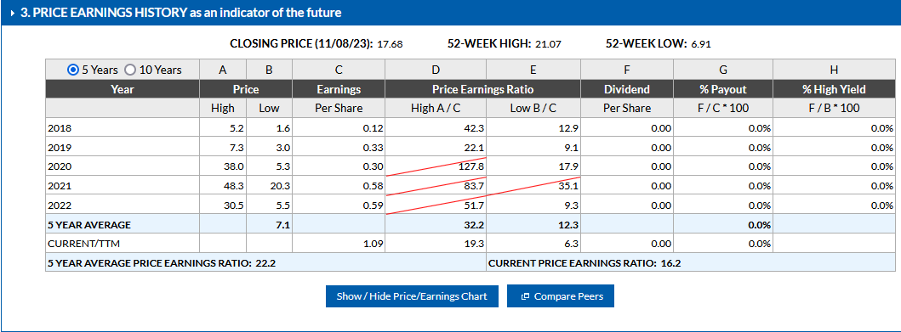

Slide 13
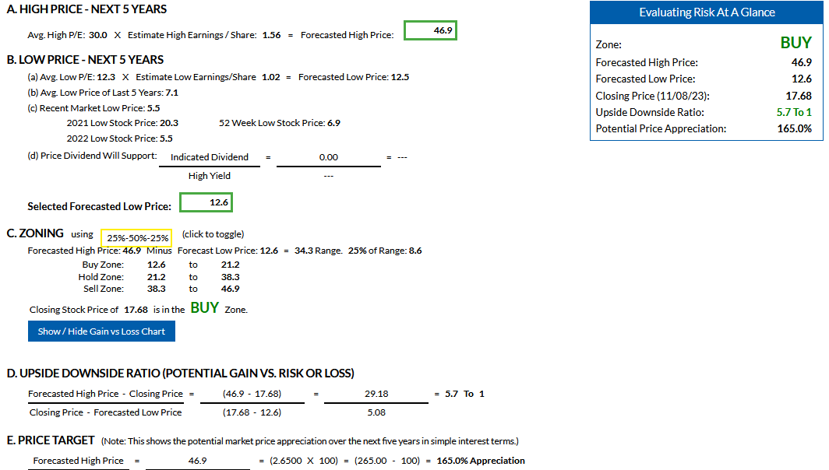
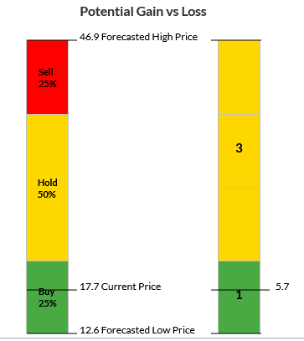
4. SSG ACMR – Evaluate Risk & Reward

Slide 14
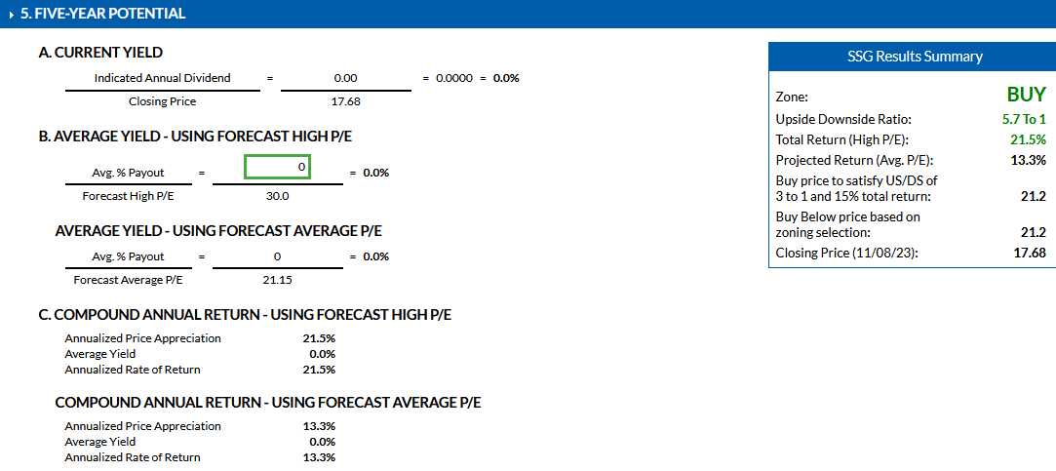

Slide 15
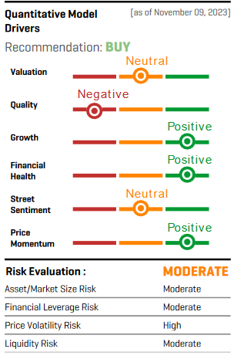
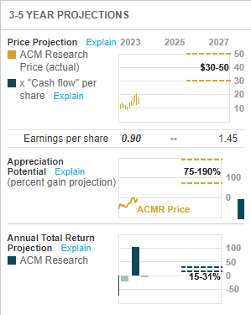
ACMR Analysts’ Ratings
CFRA Rating
Yahoo Finance Nov 13 - 2023
Value Line Model 9/23/23
Manifest Investing, 10/26/23
Quality – 87
Calculated Qual. Rating– 68.6
PAR – 29.3%
Financial Strength – 93; PAR – 23.3
EPS Stability – 72; PAR – 17.9
CAPS Rating – 5 Stars
Other Analysts’ Ratings
Ford Equity Research (11/11) – “BUY”
ISS-EVA (11/14)– “BUY”
Fidelity Equity Rating – “BULLISH”

Slide 16
Some Issues to Consider for “Buying ACMR”
Presents a compelling investment opportunity in the dynamic semiconductor equipment industry – in the rapidly growing Asia
It has higher exposure to China (PRC) for____. Geopolitical tensions or trade disputes (between US & China) could adversely affect its business.
It faces intense competition from established players who have larger scale, resources and customer relationships.
For growth strategy - relies on continuous innovation and R&D investment - May not yield expected results or may be subject to intellectual property disputes

