Slide 1
HEICO CORPORATION
(HEI)

Slide 3
COMPANY PROFILE
HEICO Corporation is a successful, 65-year-old technology-driven aerospace, industrial, defense, and electronics company, headquartered in Hollywood, FL, with multiple locations around the world.
HEICO’s products are found on large commercial aircraft, regional, business, and military aircraft, as well as on a large variety of industrial turbines, targeting systems, missiles, and electro-optical devices.
Listed on the NYSE, HEICO has been ranked by Forbes as one of the 100 “World’s Most Innovative Growth Companies” and 100 “Best Small Companies” over the last decade.
HEICO Corp. operates in two segments: the Flight Support group and the Electronic Technologies group.
The Flight Support group, which accounted for 57% of net sales in fiscal 2022, designs, engineers, manufactures, repairs, distributes and overhauls FAA-approved parts the extend over an entire aircraft, from engines to hydraulic, pneumatic, electromechanical, avionic, structures, wheels, brakes, and even interiors. These engine and aircraft component replacement parts sell for prices than those manufactured by OEMs.
The Electronic Technologies group, which accounted for 43% of net sales in fiscal 2022, produces electric and electro-optical systems and components serving niche markets of the aerospace, defense, communications, and computer industries. Such as laser range-finders, state-of-the-art simulation, testing, and calibration equipment in the development of missile seeking technology, and shipboard targeting and reconnaissance systems.

Slide 4
WHERE DID I FIND THIS STOCK?
Found this company in an article in Reuters back in April entitled “Airlines, repair shops in North America rely on used, generic parts to keep aircraft flying.”
The article noted “HEICO Corp, a major independent supplier of new FAA-approved parts not made by the original manufacturer, expects demand to continue even after supply bottlenecks improve…. Growth will be stronger than pre-pandemic in the next few years….HEICO's profit in its latest fiscal year ending Oct. 31 [2022] rose 16% to a record $351.7 million, helped by booming sales of parts….”

Slide 5
HEICO’s Expanding Products and Services
Consistent High Organic and Acquired Growth by Adhering to Key Principles
Cash generation paramount
Focus on long term sustainable growth (organic + acquired)
Maintain and promote HEICO’s unique culture - entrepreneurial spirit
Maintain flat organization focused on customers
Diversification in products, services and customers avoiding concentration risks
Niche products and services within protected markets (high barriers to entry)
Maintain strong balance sheet with maximum flexibility
1990 October 31, 2022
Compounded Yearly Growth: 15%
Organic: ~60% Acquisition: ~40%
5

Slide 6
GROWTH
HEICO's annual revenue is $2.2B.
HEICO annual revenue for 2021 was 1.9B, a 4.4% growth from 2020.
HEICO annual revenue for 2022 was 2.2B, an 18.37% growth from 2021.
HEICO's revenue growth from 2008 to 2022 is 279.21%.
HEICO reported record net sales in the 3Q of fiscal 2023 (August). Net sales increased 27% to a record $722.9 million, up from $569.5 million in the third quarter of fiscal 2022.
In August 2023, HEICO incurred acquisition costs related to the acquisition of Wencor Group. Wencor is a leading independent supplier of FAA-approved aircraft parts. Acquisition costs were $1.9 billion in cash and stock ($2.05 billion in the aggregate).
HEICO has completed 95 acquisitions since 1990.
HEICO pays a modest dividend of 0.20 per share.

Slide 7
Flight Support Group (FSG)
Designs, Manufactures, Repairs, Overhauls and Distributes Jet Engine and Aircraft Component Replacement Parts.
PMA Parts Pioneer
Flight and Mission Critical Manufacturing
Component MRO
DER Repair
Asset & Repair Management
Distribution and Defense Sustainment
HEICO
Corporation
Flight Support
Parts Group
Repair Group
Specialty Products
Distribution Group

Slide 8
Electronic Technologies Group (ETG)
Designs and Manufactures Electronic, Microwave and Electro-Optical Equipment, High-Speed Interface Products, High Voltage Interconnection Devices and High Voltage Advanced Power Electronics.
Niche High Tech Solutions
Commercial & Military Aircraft Electronics and Fuel Systems
Space Flight Hardware
Satellite Components
Infrared Missile Simulation
X-Ray Power Technology
Laser System Components
Microwave Technology
HEICO
Corporation
Electronic Technologies
Data & Microwave Group
Electro- Optical Group
Electrical Group

Slide 9
Historical Stock Performance
$100,000 investment in HEICO shares in 1990 became worth approximately $62.7 million as of January 9th, 2023 (adjusted for stock splits, stock dividends and reinvestment of cash dividends)
HEICO Common Stock Value
$70,000
$60,000
$50,000
$40,000
$30,000
$20,000
$10,000
$‐
'90 '92 '94 '96 '98 '00 '02 '04 '06 '08 '10 '12 '14 '16 '18 '20 '22
$Million

Slide 10
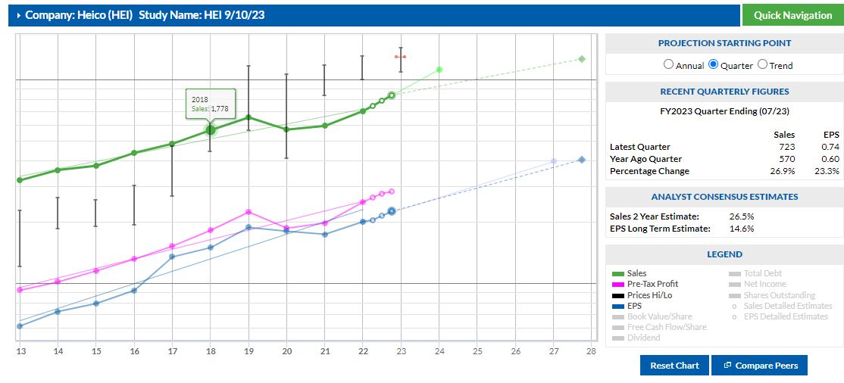

Slide 12
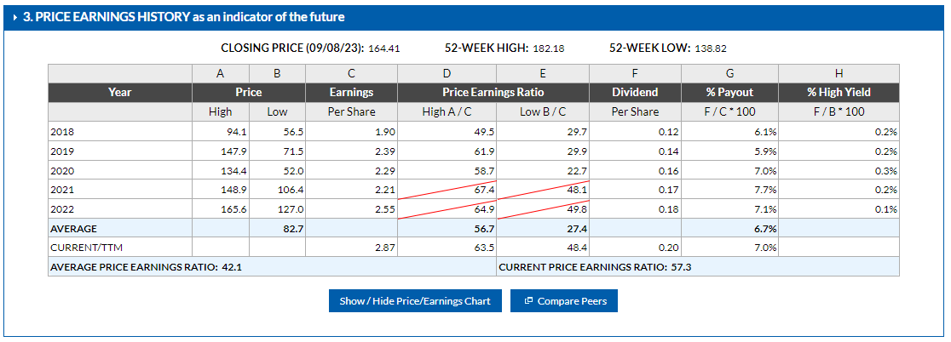

Slide 13
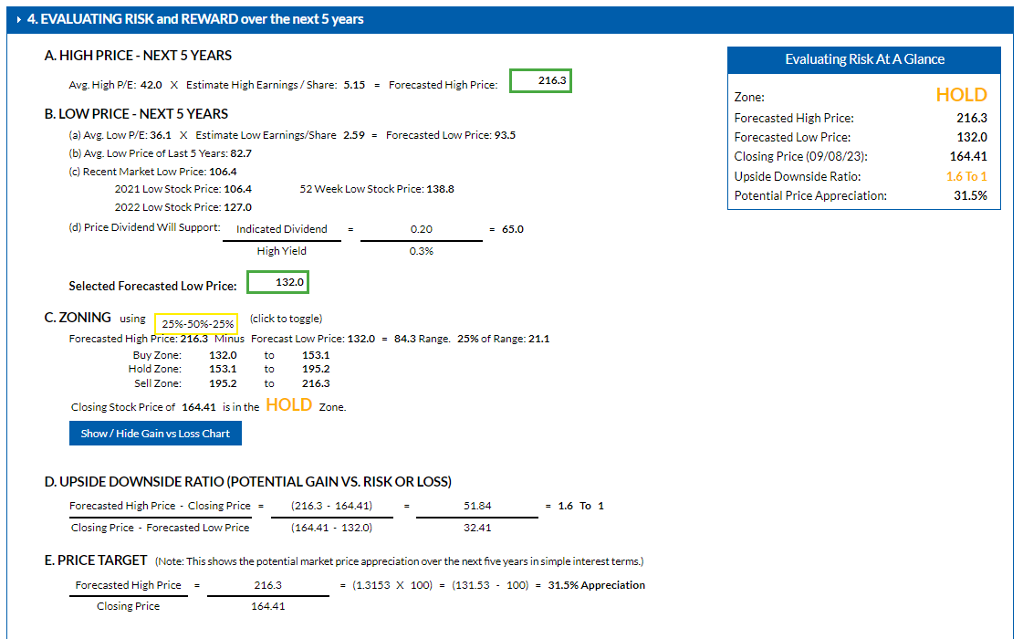

Slide 14
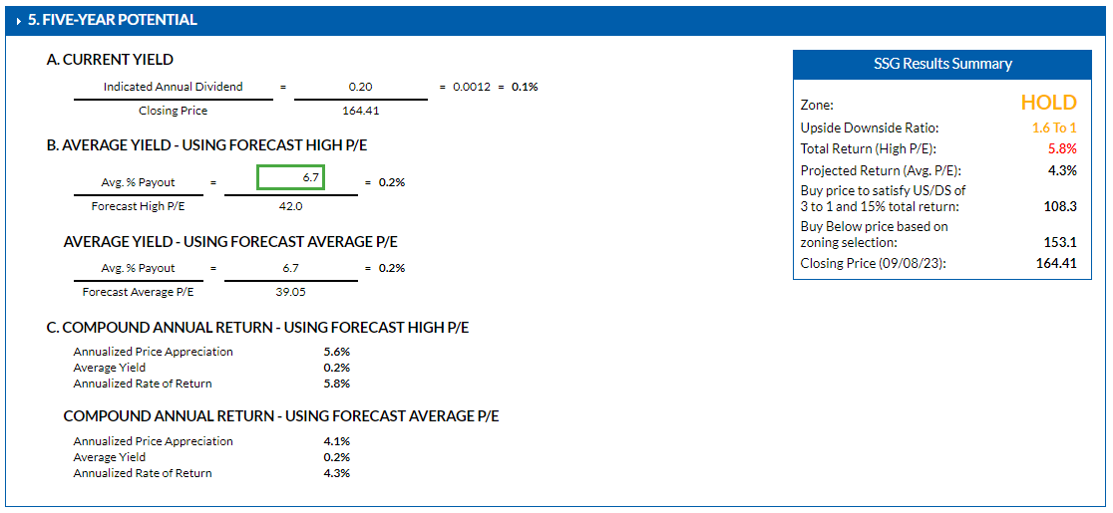

Slide 15
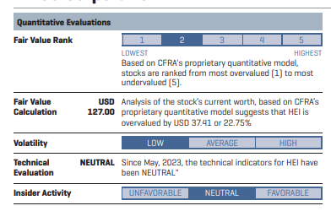
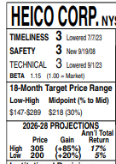
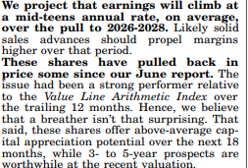
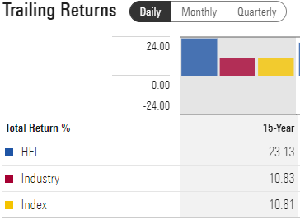
CFRA
Value Line
Morningstar

Slide 16
QUESTIONS

