Slide 1
Toro – NYSE: TTC
New Stock Presentation by Pat Onufrak
August 2023

Slide 2
My Yard

Slide 3
DISCLAIMER
The information in this presentation is for educational purposes only and is not intended to be a recommendation to purchase or sell any of the stocks, mutual funds, or other securities that may be referenced. The securities of companies referenced or featured in the presentation are for illustrative purposes only and are not to be considered endorsed or recommended for purchase or sale.
Investors should conduct their own review and analysis of any company of interest before making an investment decision.

Slide 4
The Toro Co manufactures turf maintenance and landscaping equipment. The company produces reel and rotary riding products, trim cutting and walking mowers, greens rollers, turf sprayer equipment, underground irrigation systems, heavy-duty walk-behind mowers, and sprinkler systems used for professional turf and landscape maintenance and construction. Its products are marketed through a network of distributors and dealers to primarily professional users maintaining turfs and sports fields such as golf courses. Its operating segments are Professional and Residential. The company also produces snow plowers and ice management products. Its largest end market is the United States.
CEO: Richard M. Olson (Nov. 1, 2016–present)
Founded: 1914
Headquarters: Bloomington, MN
Number of employees: 11,287 (2022)
Revenue: 3.96 billion USD (2021)
Subsidiaries: Ditch Witch, Spartan Mowers, LLC, Lawn-Boy, and More

Slide 5
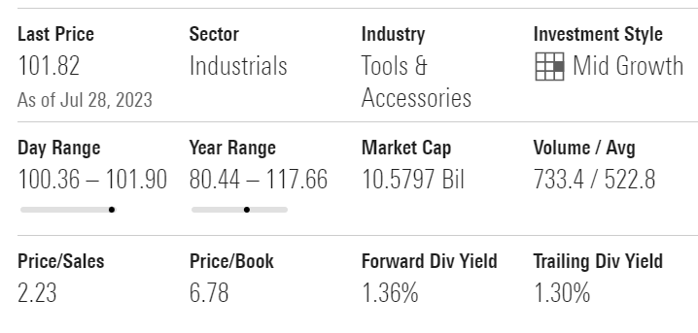

Slide 6
The Toro Company Reports Record Results for the
Second-Quarter of Fiscal 2023
Driven by Strong Professional Segment Performance and Continued Production Improvements
Record second-quarter net sales of $1.34 billion, up 7% year over year
Record second-quarter reported diluted EPS of $1.59, up 28% year over year
Record second-quarter *adjusted diluted EPS of $1.58, up 26% year over year
Full-year fiscal 2023 net sales and *adjusted diluted EPS guidance ranges narrowed

Slide 7
BLOOMINGTON, Minn.--(BUSINESS WIRE)--Jun. 8, 2023-- The Toro Company (NYSE: TTC) today reported results for its fiscal second-quarter ended May 5, 2023.
“We continued our strong momentum in the second quarter, and delivered record top and bottom-line results,” said Richard M. Olson, chairman and chief executive officer. “These results were driven by our professional segment, where continued demand, operational execution, and supply chain improvements drove broad sales volume gains and increased profitability. In our residential segment, sales volume and earnings were pressured by unfavorable weather patterns and macroeconomic factors. Once again, the strength of our diversified portfolio, growing scale, and disciplined team drove positive results overall.”

Slide 8
SECOND-QUARTER FISCAL 2023 SEGMENT RESULTS
Professional Segment
Professional segment net sales for the second quarter were $1,068.7 million, up 15.4% from $925.8 million in the same period last year. The increase was primarily driven by higher shipments of products broadly across the segment, with notable strength for construction, and golf and grounds products, and net price realization.
Professional segment earnings for the second quarter were $227.5 million, up 37.6% from $165.4 million in the same period last year, and when expressed as a percentage of net sales, 21.3%, up from 17.9% in the prior-year period. The increase was primarily due to net price realization, favorable product mix, productivity improvements, and net sales leverage, partially offset by higher material and manufacturing costs.

Slide 16
Residential Segment
Residential segment net sales for the second quarter were $265.8 million, down 16.8% from $319.7 million in the same period last year. The decrease was primarily driven by lower shipments of products broadly across the segment, partially offset by net price realization.
Residential segment earnings for the second quarter were $22.7 million, down 38.7% from $37.1 million in the same period last year, and when expressed as a percentage of net sales, 8.6%, down from 11.6% in the prior-year period. The decrease was primarily driven by lower sales volume, higher marketing expense, and higher manufacturing costs, partially offset by net price realization, and lower freight costs.

Slide 20
OPERATING RESULTS
Gross margin and *adjusted gross margin were both 35.8%, compared with 32.4% and 32.5%, respectively, for the same prior-year period. The increase in gross margin was primarily due to net price realization, favorable product mix, and productivity improvements, partially offset by higher material and manufacturing costs.
SG&A expense as a percentage of net sales for the second quarter was 19.5%, compared with 18.7% in the prior-year period. The increase was primarily due to higher marketing expense, partially offset by net sales leverage.
Operating earnings as a percentage of net sales were 16.3% for the second quarter, compared with 13.7% in the same prior-year period. *Adjusted operating earnings as a percentage of net sales for the second quarter were 16.3%, compared with 13.8% in the same prior-year period.
Interest expense was $14.7 million for the second quarter, up $6.7 million. This increase was primarily driven by higher average interest rates.
The reported effective tax rate for the second quarter was 20.6%, flat with 20.6% in the same prior year period. The *adjusted effective tax rate for the second quarter was 21.1% compared with 20.8% in the same prior year period.

Slide 21
OUTLOOK
“We enter the second half of fiscal 2023 with continuing strong demand and substantial order backlog for our professional segment products in construction, and golf and grounds markets, as well as indications of a steadily improving supply chain,” said Olson. “We expect this will drive our performance in the second half, with a continuation of improved production rates for key categories as we focus on optimizing output to better serve our customers. Even with production improvements, given the pace of new orders we expect our backlog level to remain elevated throughout and beyond this fiscal year. For the residential segment, we expect sales volume in the second half to be challenged by macroeconomic uncertainty and consumer spending patterns, and to also reflect the impact of the unfavorable weather year to date. Importantly, we expect the benefits from this segment’s refreshed product lineup, expanded channel, and strong brand to continue to drive competitive advantage for the long term.

Slide 22
“We have a long track record of managing through economic cycles and weather patterns with agility and resiliency, bolstered by our leadership in attractive end markets and our ability to leverage innovation and synergies across our broad portfolio. These factors, along with our talented team and best-in-class distribution and service networks, give us confidence in our ability to execute well through a range of possible macroeconomic outcomes for the remainder of the year and beyond. We believe we are well positioned to enhance our market leadership and deliver value for all stakeholders now and into the future, guided by our enterprise strategic priorities of accelerating profitable growth, driving productivity and operational excellence, and empowering people."

Slide 23
For fiscal 2023, management is narrowing guidance, and now expects net sales growth in the range of 7% to 8% and *adjusted diluted EPS in the range of $4.70 to $4.80. The estimated *adjusted diluted EPS range excludes the tax benefits recorded as excess tax deductions for stock compensation. This updated guidance is based on current visibility in this evolving and dynamic macro environment, and reflects expectations for continued strong demand across key professional segment markets, reduced volume for solutions geared to homeowners, and continued operational execution. This guidance also assumes steady supply chain improvement, the return to a more typical distribution of quarterly sales, and more normalized weather patterns for the remainder of the year.

Slide 24
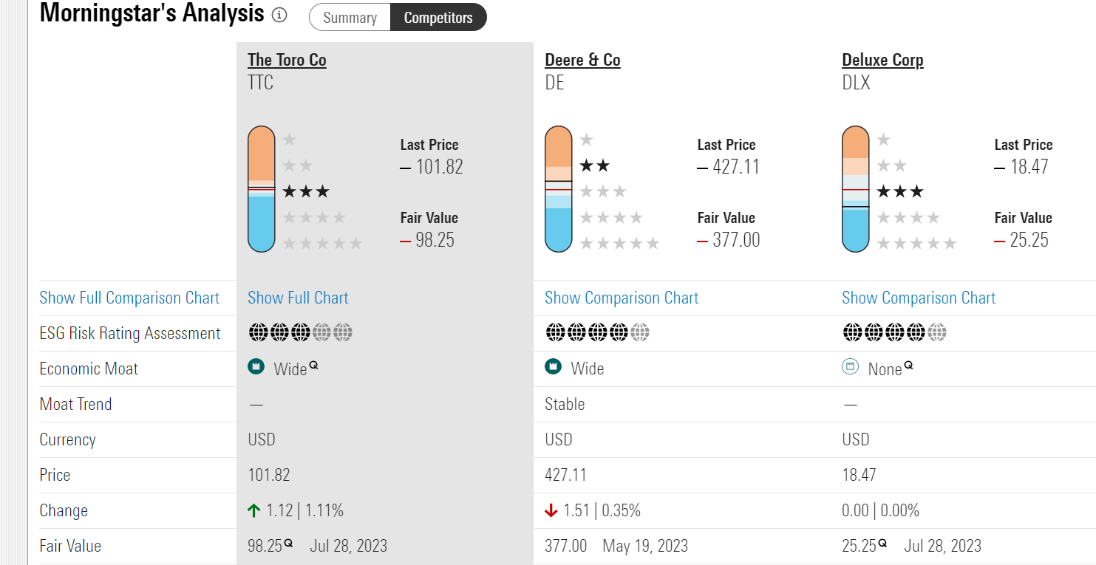

Slide 25
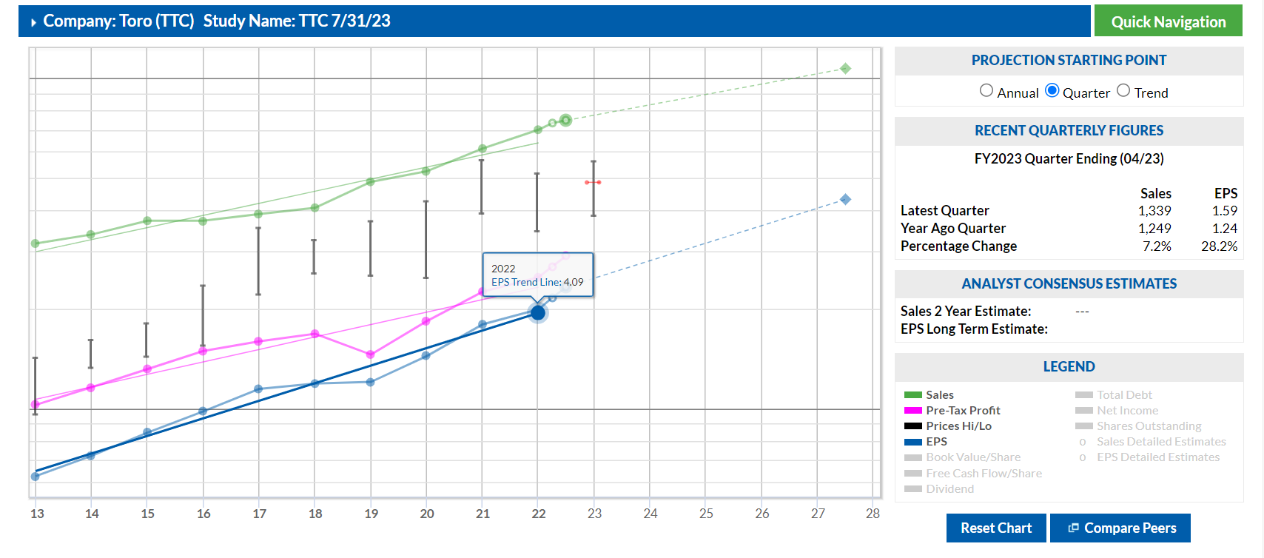

Slide 27
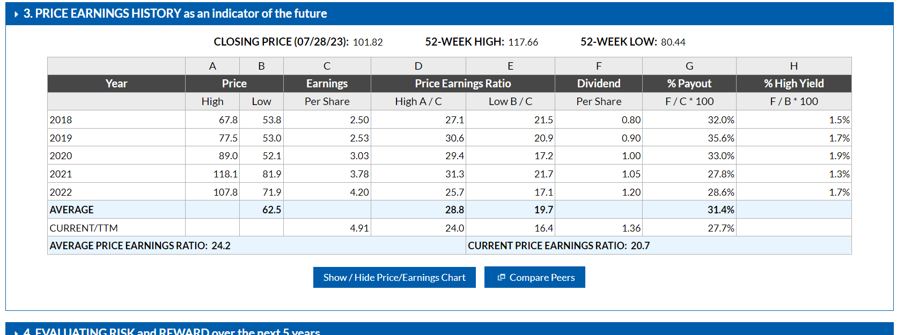

Slide 30
What do you think?

