Slide 1
Gladys Henrikson
Possible Corporate Image
DC Chapter, The Model Investment Club of Northern Virginia
Paychex (PAYX); Nasdaq exchange
Sector: Industrials
Industry: Professional Services
Medium Size ($ 5B Rev) MS Financial Grade = A

Slide 3
Paychex (PAYX) Overview
Where I Discovered this Company (searched for medium-size industrial): BI website -Tickertalk May 2021, Heat Map (light green), and First Cut 09/2020
Company Background:
Founded: 1971; Franchises until 1979; IPO 1983
Headquarters: Rochester, NY
Customers: Medium and Small Businesses
Human Resources Solutions: 740,000 US Customers:

Slide 4
Paychex Attributes – per Morningstar (Equity Analyst Report - June 29 2023)
WWW.BETTERINVESTING.ORG
Wide Economic Moat, with Positive Trend
Exemplary Capital Allocation
Products: Automated Solutions for outsourced payroll, compliance, benefits administration, insurance, plus access support from onsite HR professionals
Client base growing, greater penetration of small businesses: desire for help with growing government regulations amid tight labor market.
Healthy Revenue Growth, and improving margins with greater automation/ digitization/ cloud-based storage.

Slide 5
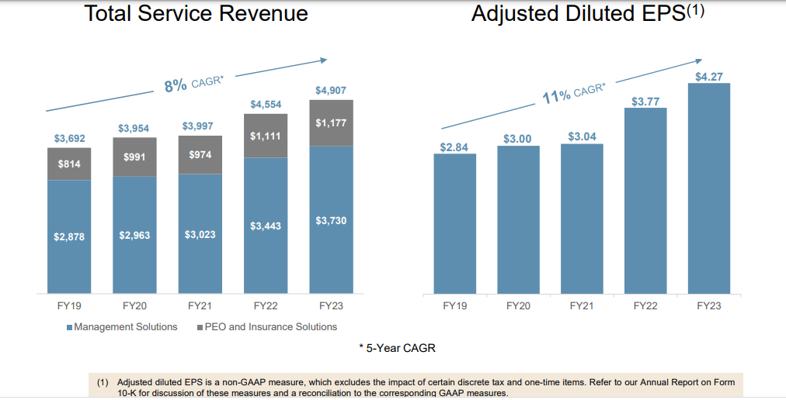
Paychex Growth over Last 5 years

Slide 6
Paychex 2023 Revenue Composition
PEO = Professional Employer Organization; full-service human resource outsourcing known as co-employment
ASO = Administrative Services Only (e.g. managing health benefits)
HCM = Human Capital Management (e.g. recruiting, performance)

Slide 7
PAYCHEX Product and Technology Directions
APIs = Application Programming Interfaces

Slide 8
Recent Awards and Recognition for Paychex’s Innovation and Culture

Slide 9
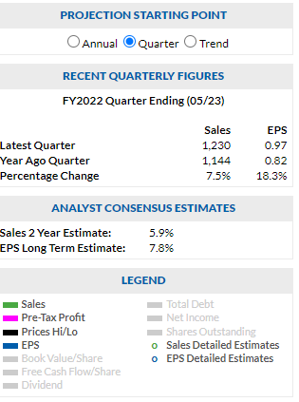
Paychex SSG

Slide 10
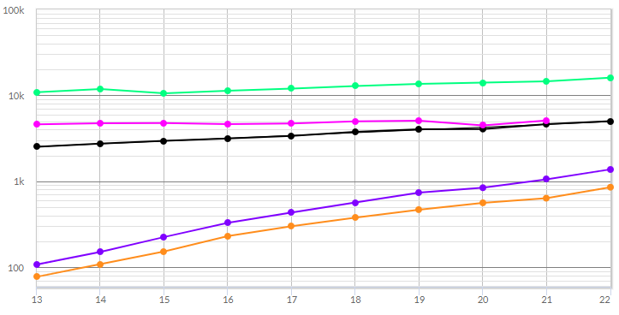
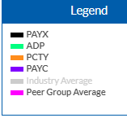
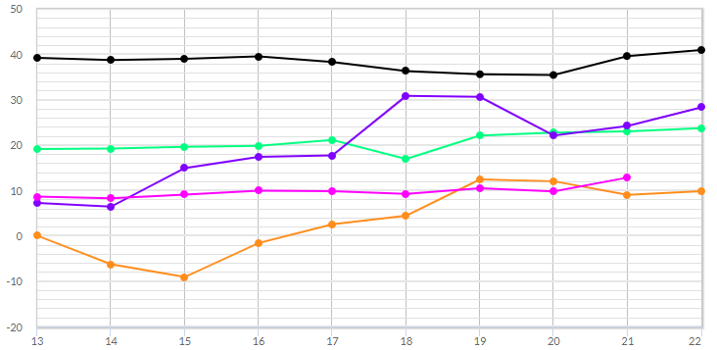
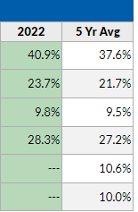
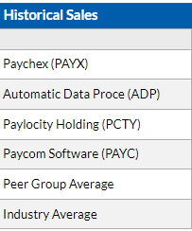
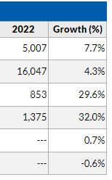
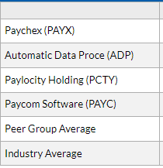
Peer Performance to PAYX (Morningstar)
PAYC: P/E=61, Fin Str = B

Slide 11
Paychex SSG My Judgements
Page 1: Sales and EPS
Page 2: P/Es

Slide 12
Paychex SSG- Price Judgments, High/Low
Choose High Price
Choose Low Price
Value Line Low-High +$130-$175

Slide 13
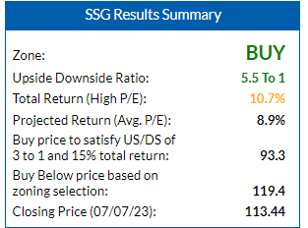
4. Evaluating Risk and Reward Results - Zoning and Five-Year Potential
Notes:
.

Slide 14
Paychex Conclusion
PAYX is a medium sized growth company.
PAYX is a well managed company, as evidenced by its consistent customer growth, low debt (22%), growing dividend (~3%), and increasingly automated human resources solutions.
PAYX is slightly on sale, trading below its average P/E of ~27.
PAYX is a BUY up to $119. (Upside Downside Ratio = 5.5:1).
PAYX could be a candidate for a purchase.

