Slide 1
Sheryl Patterson
DC Regional Chapter Director, MicNOVA Partner
Lululemon Athletica (NDQ: LULU)
BI Ticker Talk– October 2022
Notes:
Good evening, I'm Brian Koenig, a volunteer in the Maryland chapter.
My company tonight is Agnico Eagle Mines Limited - symbol AEM on the NYSE.
??It's the March 2022 BI Magazine “Stock To Study.”
The stock to study goal is to double an investment within five years with the market price appreciation + dividends

Slide 2
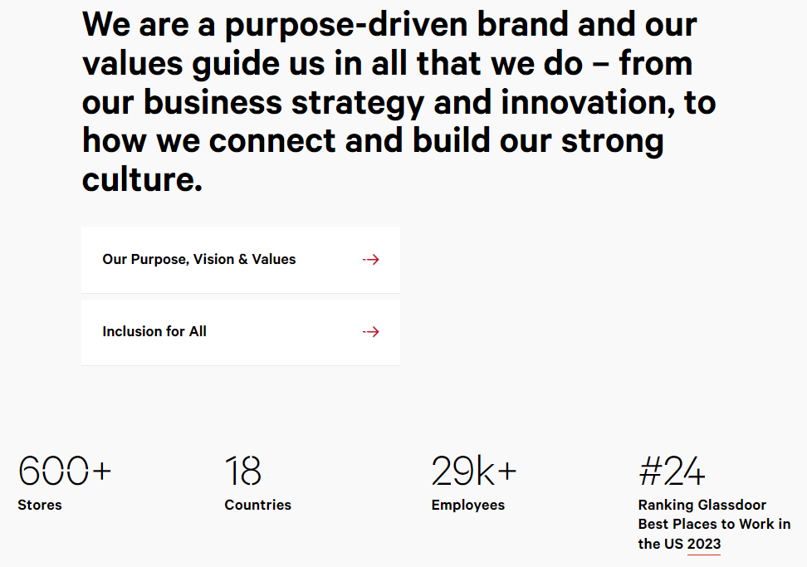
Lululemon Athletica

Slide 10
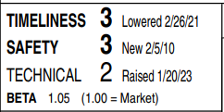
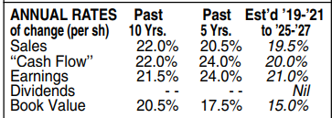
Independent Research
We still view lululemon as a best-in class retailer with a strong brand, seasoned leadership, and loyal customer base. The stock is little changed since our last full-page report went to press in October, but capital appreciation potential remains worthwhile, especially when considering the company’s strong balance sheet. Near term, the shares are neutrally ranked for Timeliness. 1/20/23

Slide 11
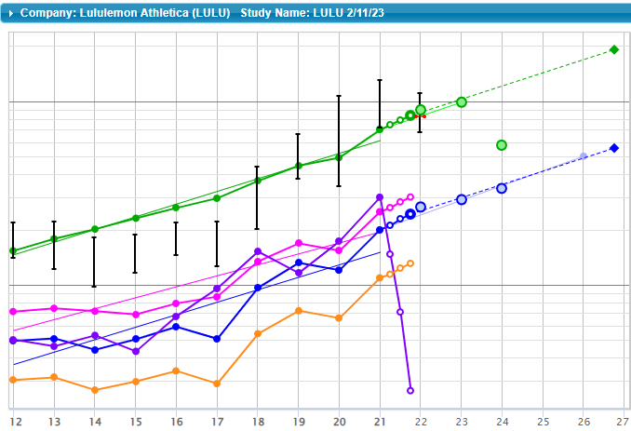
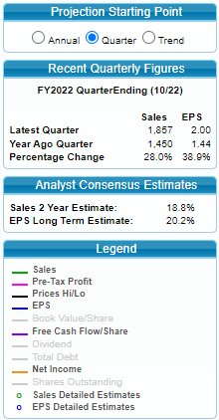
Notes:
Speaker Notes:
Tonight’s presentation will follow the CoreSSG, Tabs and Steps.
Starting with Tab 1, Step 1, we look at the historical Sales data. On this and further slides, I’ve included data plots for both Visa, the Industry Leader, and the Industry Peers for comparison.
Mastercard is the black line, Visa the orange line, and the Peer Group Average the Magenta line.
The trend line shows steady trendline growth of 10.9%.

Slide 12
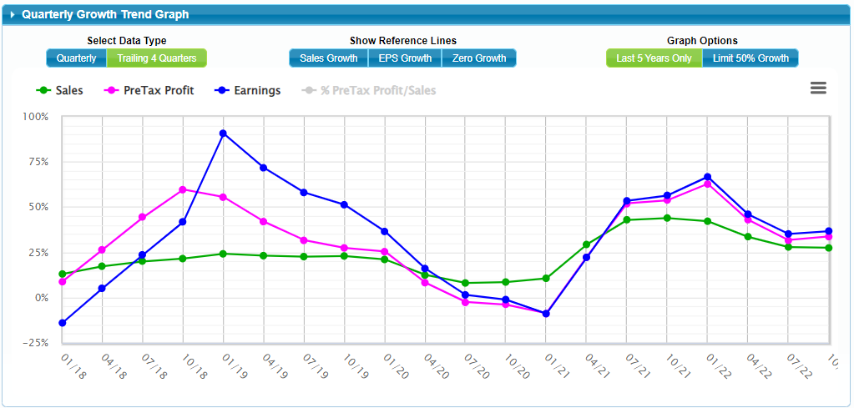

Slide 13
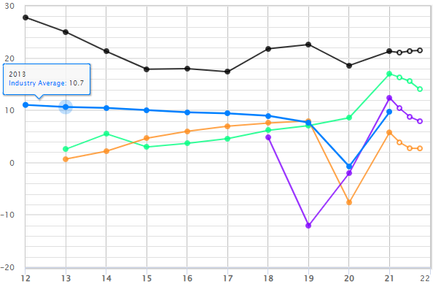
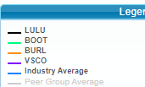
^{Core}SSG Tab 2: Evaluate Management
Step 1: % Pre-Tax Profit on Sales (Profit Margin)
Notes:
Speaker Notes:
Now we’ll Evaluate Management under Tab 2.
Step 1 is the %Pre-Tax Profit on Sales (also called Profit Margin). It shows steady results of a little over 50%, a few percentage points below Visa.

Slide 14
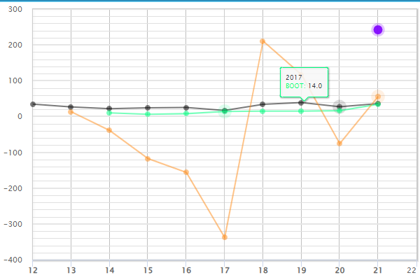
^{Core}SSG Tab 2: Evaluate Management
Step 2: % Return on Equity (ROE)
Notes:
Speaker Notes:
Step 2 is the % Return on Equity. Here you’ll note Mastercard’s returns are significantly higher than Visa or the Peer Group. Even with a couple of outliers in 2017 and 2019 removed, the 5 year % ROE average is over 100 %.

Slide 15
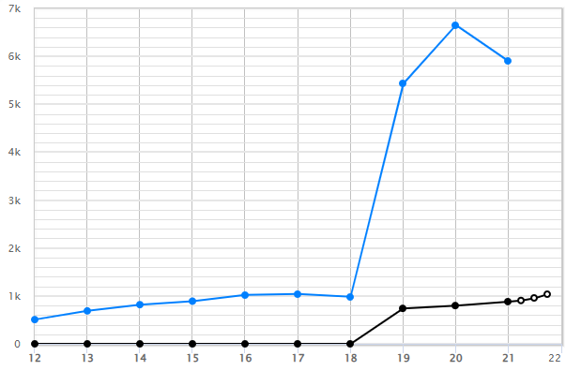
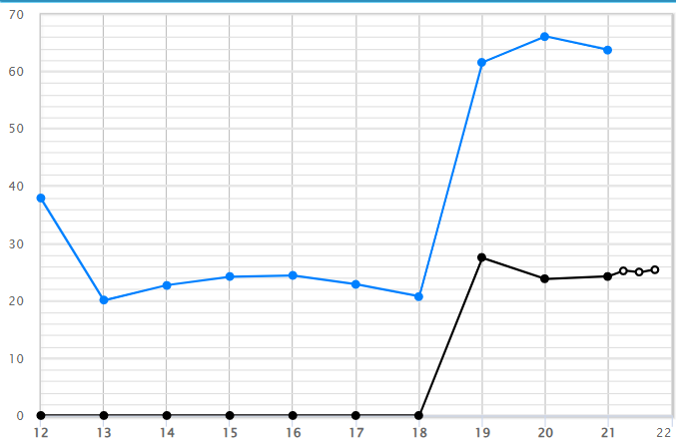
^{Core}SSG Tab 2: Evaluate Management
Step 3: Total Debt and Step 4: % Dept to Capital Step 3: Step 4: Total % Debt Debt to Capital
Notes:
Speaker Notes:
One indicator of management skill is how debt is employed. Looking at Total Debt and % Debt to Capital together lets us understand how the company is managing debt.
I’ve plotted them both here so you can easily see that, even though Mastercard has a lower Total Debt (Step 3 on the left graph), it has a higher % Debt to Capital (Step 4 on the right). In general, debt percentage greater than 33% is risky, however, when compared to Visa and Industry Peers, Mastercard’s debt is reasonable.
Mastercard’s % Debt to Capital leveling off in the last year is a positive trend and should be monitored.

Slide 16
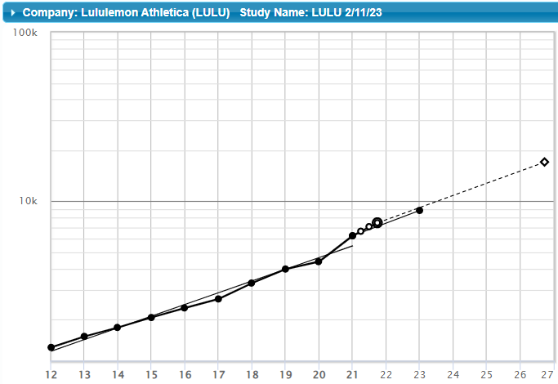
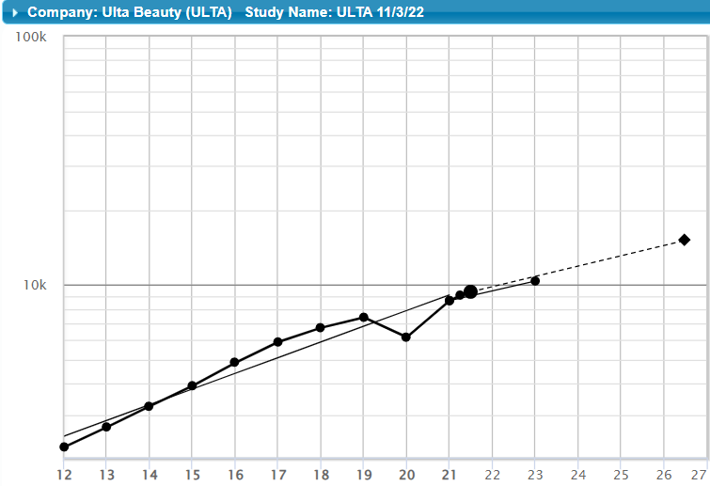
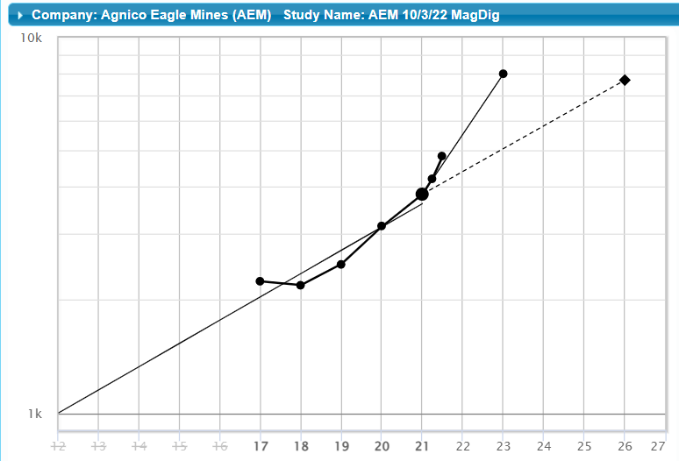
^{Core}SSG Tab 3: Forecast Sales / Earnings
Step 1: Forecast Sales
17.3%
15%
18%
Notes:
Speaker Notes:
Here is the Historic Sales plot showing a 10.9% trendline growth. With the Member Sentiment result of 14.3% in mind, I decided to be a bit more conservative and chose 11% for the 5 Year Sales Growth Rate Forecast.

Slide 17
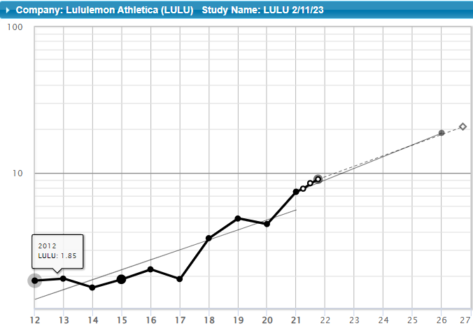
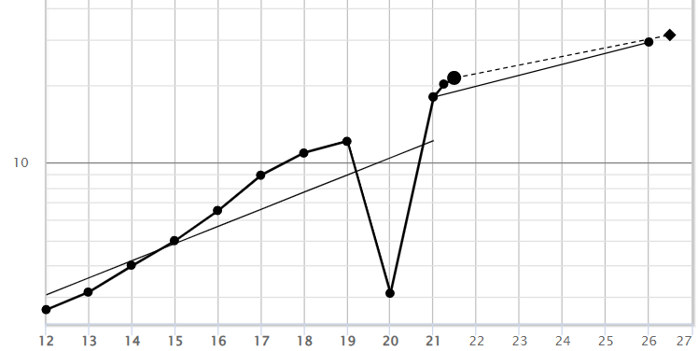
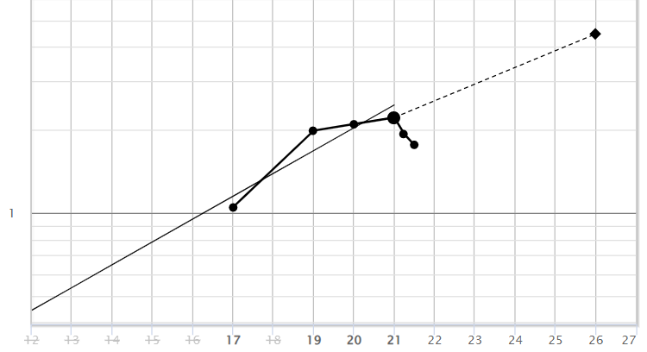
^{Core}SSG Tab 3: Forecast Sales / Earnings
Step 2: Forecast Earnings
16.9%
15%
$4.47
17.5%
Notes:
Speaker Notes:
Even though both the Member Sentiment and the Historic growth rates were 16.0% and 16.4% respectively, I decided to also be a bit more conservative here and selected a 5 Year EPS Growth Rate Forecast of 15%. This resulted in a 5 Year Projected EPS of $17.62 shown in green. (Also known as the Frontside Connector as it’s the only value from the SSG frontside used in backside calculations.)

Slide 18
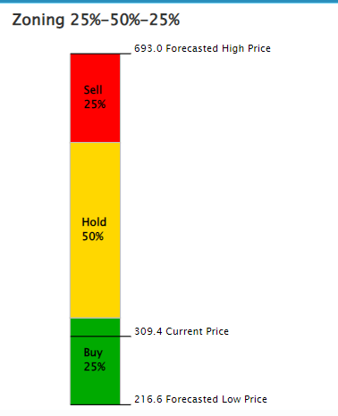
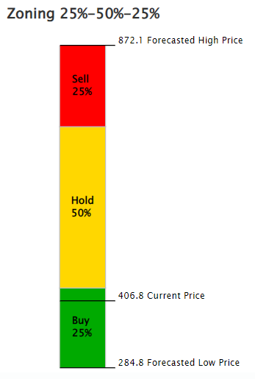
^{Core}SSG Tab 4: Assess Risk and Reward
Step 3: Assess Stock Price
$693.0
$573.9
$335.7
$309.4
$216.6
Notes:
Speaker Notes:
In Tab 4, Step 3, we determine the prospective price ranges. With a High Price of $622 and Low Price of $275, the resulting ranges are: 25% Buy range 275 to 361; 50% Hold range 361 to 535; and the final 25% Sell range 535 up to 622.

Slide 19
Lululemon Athletica Conclusion
Medium size, growth company
Well managed company
Currently is “on sale”
Trading below its 5 Year Average PE
Closed 2/11/23 at $309.40; is a BUY up to $335.70 (4.1 to 1 U/D & 17.5% Total Return)
With the market being near a bottom(???)
Could be a Medium size, Consumer Cyclical purchase candidate - if it improves your portfolio (watch 2024 sales, free cash flow, and quarterly data)
Notes:
Speaker Notes:
So, in conclusion, Mastercard is a well-managed, Large size, Growth company that is “on sale” based on its currently trading near or below its 5 year average P/E.
On Friday, Mar 4, Mastercard closed at $330.76 (~$14 below the Study price of $344). The Upside/Downside moved to 4.9 to 1 with a Compound Total return of 15%. At the current price, Mastercard could be a purchase candidate if it improves your portfolio.

