Slide 1
Stock Presentation
Maskey Krishnarao, McNoVA
-- December 13, 2022

Slide 2
Costco Today
3rd Largest Global Retailer
11th Largest in Fortune 500
Sales $222.7B – FY2022
$236 Billion Market Cap
304K employees worldwide
122M Sq. Ft. (146K per Warehouse)

Slide 3
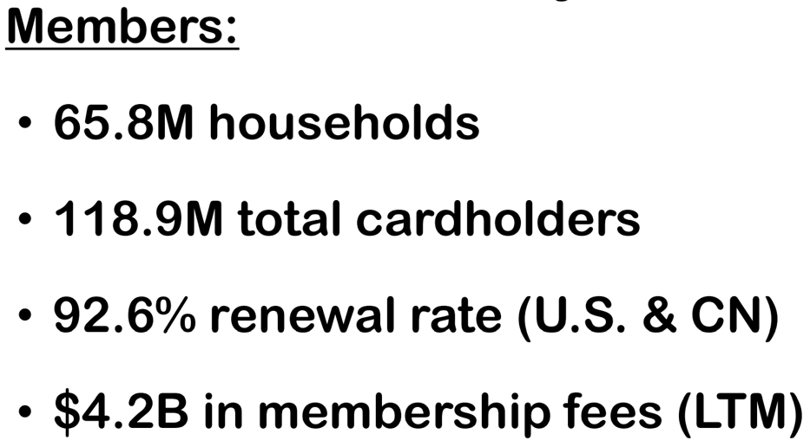
COSTCO Today

Slide 5
Store Locations

Slide 7
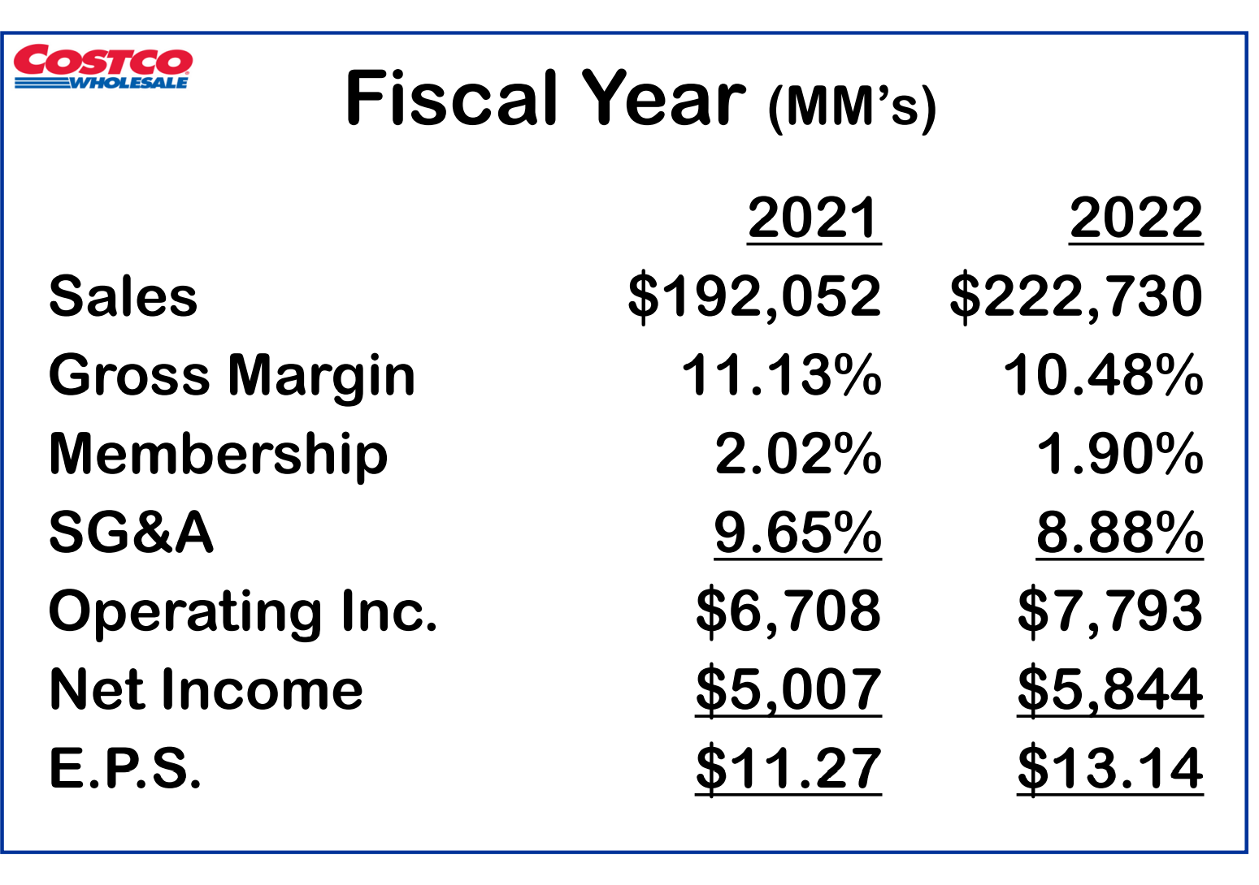

Slide 8
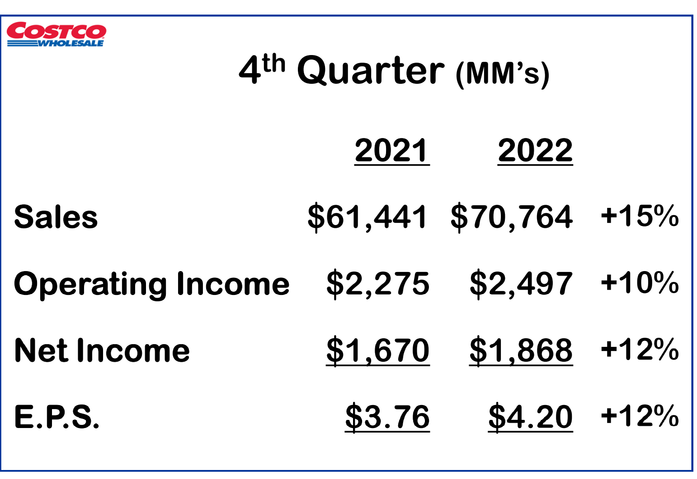

Slide 10
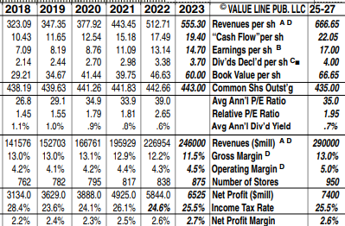
Value Line Projections
Costco Wholesale’s customers continue to spend a healthy amount. Same-store sales (less foreign exchange & gas) were 8.6% in September, up from 8.0% in August. Traffic up 4.7% worldwide and 2.6% in US.
Inflation may well have peaked. Management recently highlighted a slowdown in inflation for gas, corn, beef, and more. Supply conditions have improved a little. On-time deliveries are better, and container prices are coming down. No longer seeing big capacity problems or container shortages, and domestic port delays have improved. Timely shares should interest momentum investors. Performance has held up remarkably well despite challenges. Although the shares are trading at a high valuation, we think the stability of the business is worth the price premium given current market conditions.

Slide 11
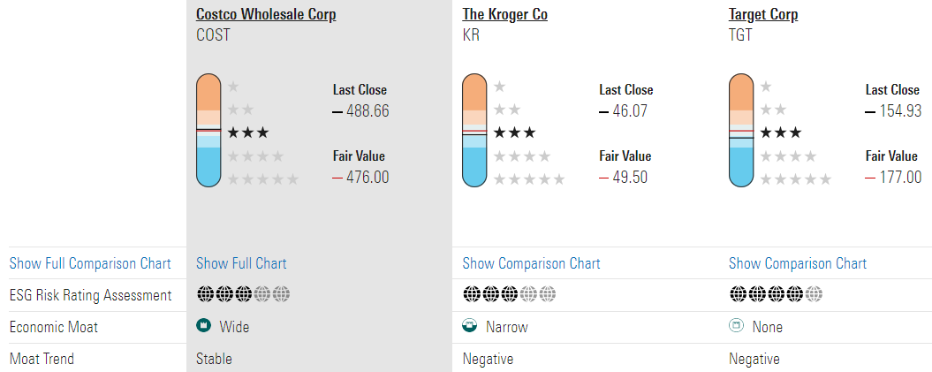
Morningstar
Fair Value and Profit Drivers We are lifting our valuation of Costco to $476 per share from $454, reflecting the time value of money after Costco’s fourth-quarter earnings (period ended Aug. 28) approximated our expectations. Our valuation implies forward 2023 enterprise value/adjusted EBITDA of 18 and adjusted P/E of 31.
Fiscal 2023 should be volatile as Costco laps exceptional prior-year sales and inflation remains high. We expect mid-single-digit percentage adjusted comparable expansion, roughly in line with our long-term forecast as Costco’s attractive values drive store traffic and its international operations deliver member growth. We expect the firm to build to a roughly 1,100-warehouse global footprint over the next decade, from 838 locations in fiscal 2022. International expansion should drive mid-single-digit growth in paid members, with Costco executing material membership fee increases in fiscal 2023 and fiscal 2028 (consistent with its recent cadence; we anticipate fees rise by a high-single-digit percentage with no impact to renewals, and that increases take about two years to be fully reflected).

Slide 12
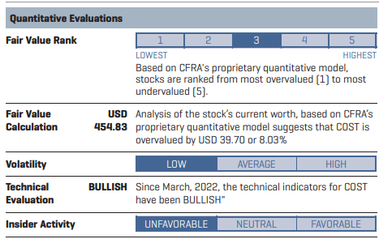
COST - Proven to be a resilient retailer as its intense value perception and treasure-hunt approach to spur customer traffic, spending, and membership renewal rates, have positioned the company for strong long-term growth, in our view. However, our Hold opinion is due to valuation as the shares are trading at a sizable premium to historical averages. While we believe this premium is justified from healthy customer traffic growth, strong membership renewal rates, and plenty of store growth runway, we see limited upside on the shares from a multiple expansion standpoint. Instead, we think COST will have to consistently outperform on the top and bottom line to sustain its valuation. Sub-Industry Outlook CFRA’s 12-month fundamental outlook for the Hypermarkets and Super Centers sub-industry is neutral. On the positive side, we see the subindustry continuing to benefit from consumers consolidating shopping trips, shopping closer to home, and seeking value amid inflationary pressures. The sub-industry is also poised to benefit from the pandemic-induced pull forward in online shopping. We also like that the sub-industry is evolving beyond core retail and expanding into higher-margin services (e.g., advertising, fulfilment, subscriptions, data monetization). Our view is tempered by ongoing cost pressures, excess inventory issues, intensifying promotions/ discounts, and weaker consumer spending within more discretionary categories (e.g., apparel, electronics, home goods, etc.).

Slide 13
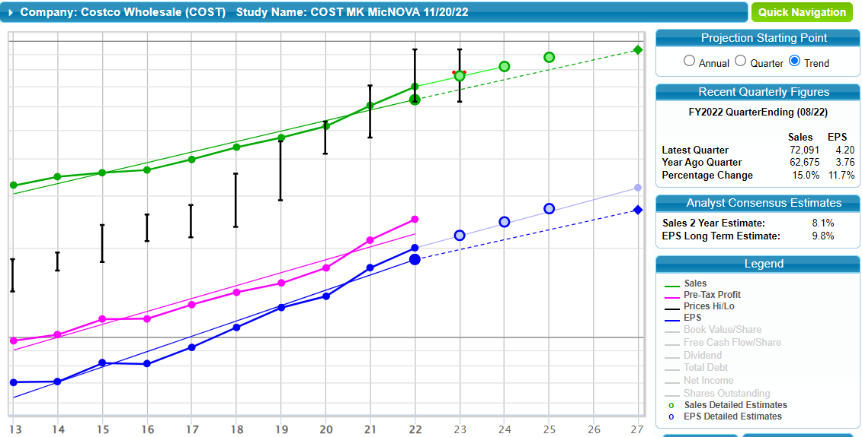
SSG Visual Analysis

Slide 14
SSG Quality and Management

Slide 15
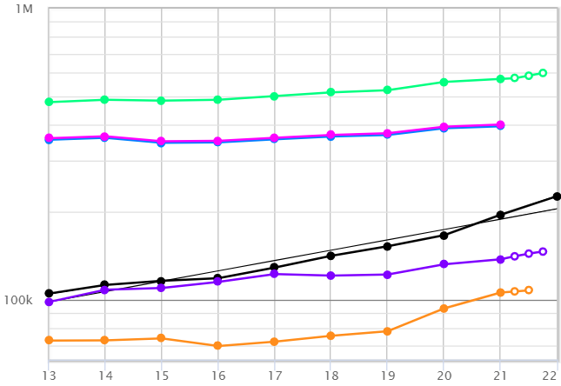
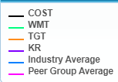
PEER Comparison with Costco

Slide 16
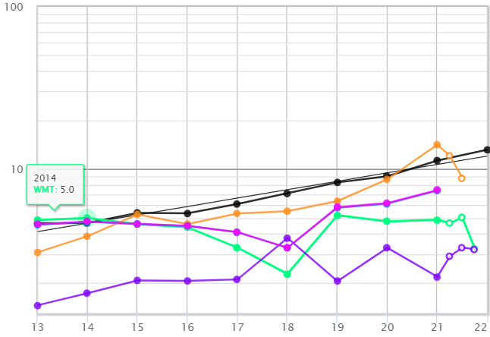
Peer Comparison with Costco

Slide 17
Price to Earnings History

Slide 18
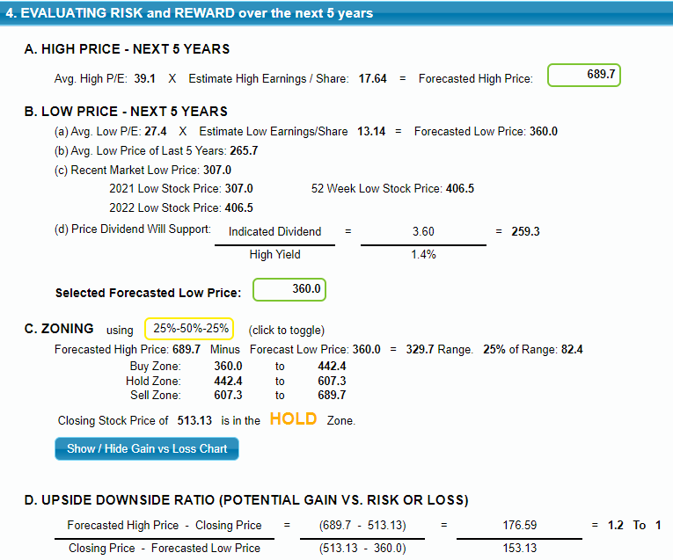
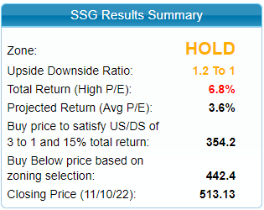
SSG Risk and Reward

Slide 19
Conclusion
COST is a large sized slow growth company.
COST is fairly well-managed company.
COST is trading above its Proj 5 Year Avg. P/E (33.3).
COST is a BUY up to $354.2 (3:1 & 15.0% TR).
COST could be a candidate for your watch list.

