Slide 1
PayPal Holdings Inc (PYPL)
NASDAQ – Large CAP Growth (PYPL is in the S&P 500)
Sector: Information Technology Industry: IT Services Sub-Industry: Data Processing & Outsourced Services
By
Arvind Krishna – MICNOVA (BetterInvesting – BI)
Nov 08 - 2022

Slide 2
DISCLAIMER
The information in this presentation is for educational purposes only and is not intended to be a recommendation to purchase or sell any of the stocks, mutual funds, or other securities that may be referenced. The securities of companies referenced or featured in the seminar materials are for illustrative purposes only and are not to be considered endorsed or recommended for purchase or sale by (BI) BetterInvesting™ / National Association of Investors™ and/or MICNOVA.
The views expressed are those of the instructors, commentators, guests and participants, as the case may be, and do not necessarily represent those of BI - MICNOVA. Investors should conduct their own review and analysis of any company of interest before making an investment decision.
Securities discussed may be held by the instructors in their own personal portfolios or in those of their clients. BI - MICNOVA presenters and volunteers are held to a strict code of conduct that precludes benefiting financially from educational presentations or other activities in which they participate.
This presentation may contain images of websites and products or services not endorsed by BI - MICNOVA. The presenter is not endorsing or promoting the use of these websites, products or services. •
We may be recording this session for our future use.

Slide 3
What is PayPal’s Business
PYPL operates a technology platform that enables digital payments on behalf of merchants and consumers worldwide.
PYPL provides payment solutions under the PayPal, PayPal Credit, Braintree, Venmo, Xoom, Zettle, Hyperwallet, Honey, and Paidy names.
Its payments platform allows consumers to:
send and receive payments in approximately 200 markets & in approximately 100 currencies,
withdraw funds to their bank accounts in 56 currencies, and hold balances in their PayPal accounts in 25 currencies.
Founded in 1998 and is headquartered in San Jose, California.
PYPL was spun out of eBay in July of 2015, becoming an independent publicly traded company.

Slide 4
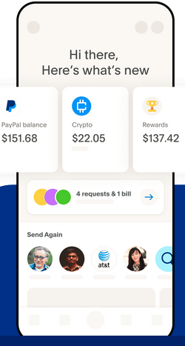
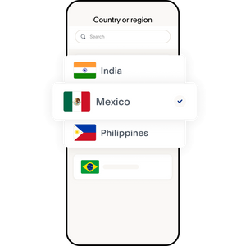
PayPal’s Capabilities
It enables consumers to exchange funds –
On-line or in-Person, with merchants
using a range of funding sources:
a bank account,
a PayPal or Venmo account balance,
PayPal and Venmo branded credit products,
a credit card, a debit card,
Certain cryptocurrencies,
other stored value products - gift cards & eligible credit card rewards.
It also offers consumers person-to-person (P2P)
payment solutions.
Send money across
the table or across the globe

Slide 5
PYPL Revenue – Where & How it is being derived?
PYPL core product is a two-sided network - both merchants & consumers have PayPal accounts.
PYPL primary source of revenue (roughly 93% of net revenues) is derived from charging fees for completing payment transactions, based on volume of activity.
Other 7% of net revenue is derived from - other fees and value-added services such as subscription fees, interest earned on PayPal loans/credit, & interest earned on customer account balances.
US Revenues totaled $3.9 billion (57%) ; International Revenues $2.9 billion (43%)
PYPL does not currently charge consumers to fund or draw from their accounts, but does generate some revenue from fees for foreign currency exchange.

Slide 6
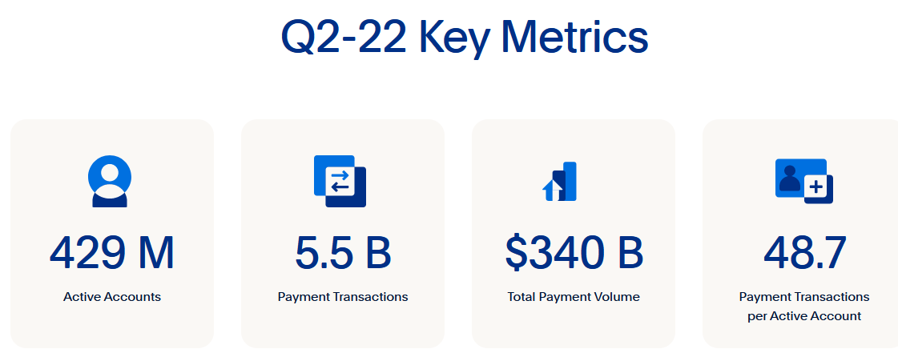
PYPL - Shaping the future of digital payments
Empowering millions of people and businesses across the globe through 429 million active accounts
in more than 200 markets to join and thrive in the Global Economy

Slide 7
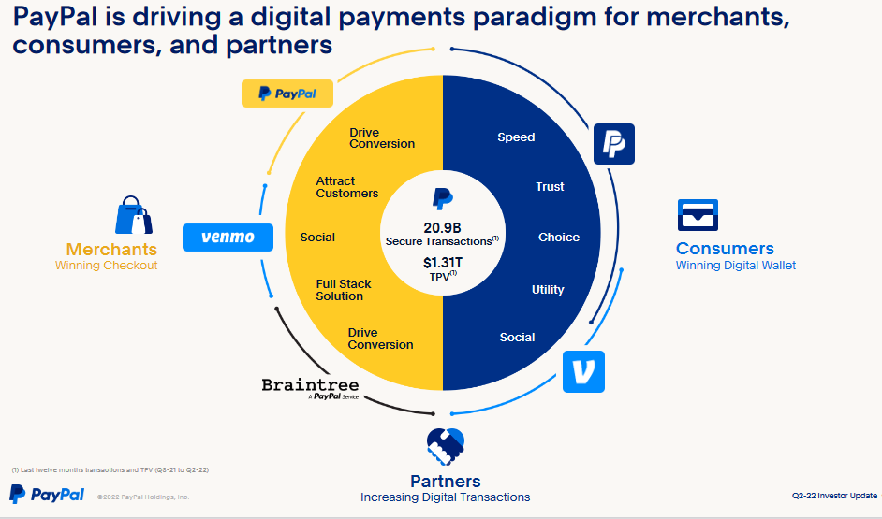
TPV – Total Payment Volumes

Slide 8
PYPL Stock – 1 Year Performance
As of Nov. 04, 2022 Current Price: $75.18 -153.3(-67.17%)
PYPL stock is now below pre-pandemic levels, following multiple estimate revisions, combined with removed medium-term growth targets, as inflationary pressures disproportionality crimped user activity.

Slide 9
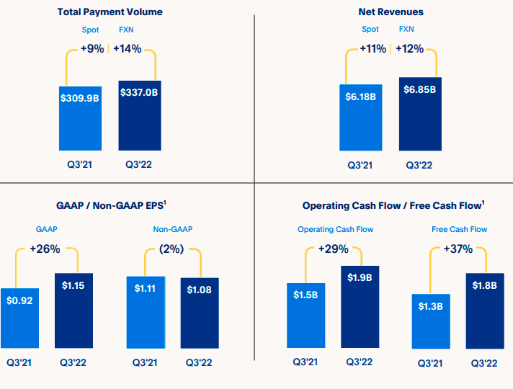
PYPL 3rd Qtr
2022
Key Results
Nov 04, 2022

Slide 10
PYPL – Nov 04, 2022

Slide 11
Friday After - PayPal Q3 Results Announced on Nov. 3 - Thursday
PYPL shares were down over 4% on Friday afternoon following the release of Q3 results on Thursday – even after delivering better than expected Q3'22: Solid Financials, w. Revenue and EPS outperformance
Barron’s Take: PYPL Stock Is Down now, but Wall Street Likes the Long-Term View
Wall St. appeared more concerned about the company’s slight downward revision—100 basis points—on its revenue guidance for 2022.
PYPL also announced more collaboration with Apple (AAPL) in processing payments to enhance offerings for PayPal and Venmo merchants & consumers.

Slide 12
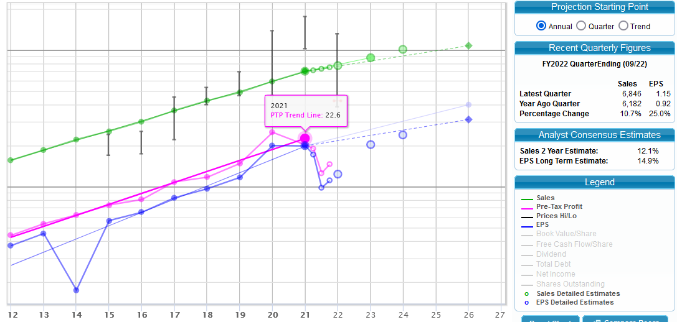
PYPL SSG – Nov 04, 2022 (Arvind Krishna)

Slide 14
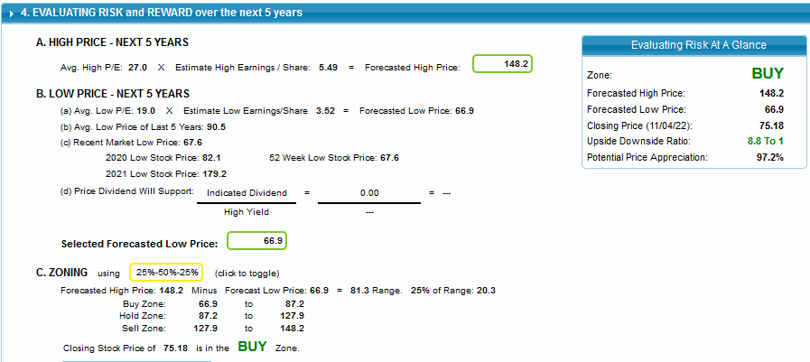
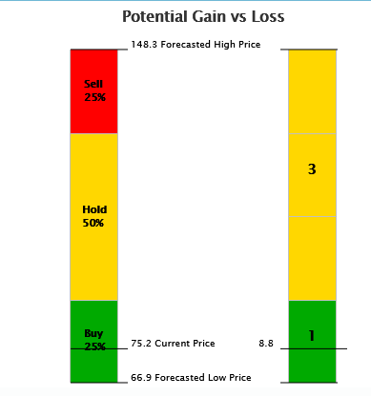

Slide 15
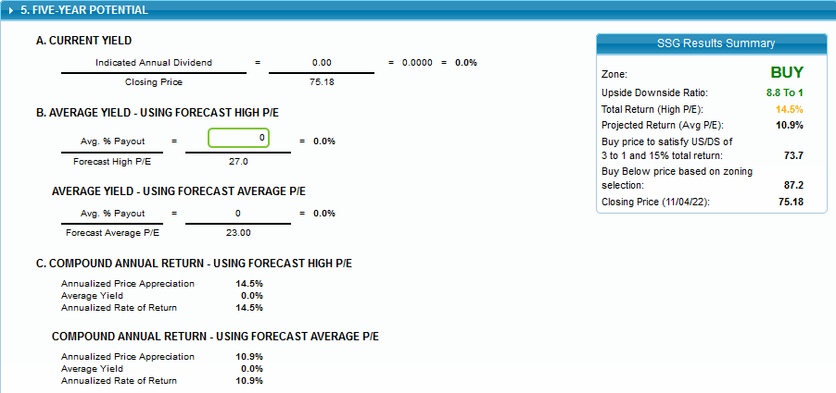

Slide 16
PYPL continues to make strides to enhance its service capabilities (Strategic Initiatives)
Provides an expansive Return Bar network with more than 5,000 retail locations that offer consumers the ability to return items in-person, without needing to box the items or print a label.
Launching of Venmo live as a new payment option on Amazon, select customers now & full by Holidays
Introduced in-store Tap to Pay functionality in some locations,
Released updated mobile software developer kit (SDK), enabling merchants to provide a seamless, in-app checkout experience
Expanded Zettle Terminal to the U.S., an all-in-one POS solution for small businesses - successfully Launched in France and the Netherlands earlier this year
Introduced new Rewards Program to the digital wallet, giving customers an easy way to shop and earn rewards all in one place
Broadened Charity Products and Services: launched Grant Payments to deliver money from grant makers quickly and electronically; began onboarding charities to Venmo charity Profiles
Launched Crypto Transfers between PayPal and other wallets,
Further expanded its buy-now-pay-later offerings.

Slide 17
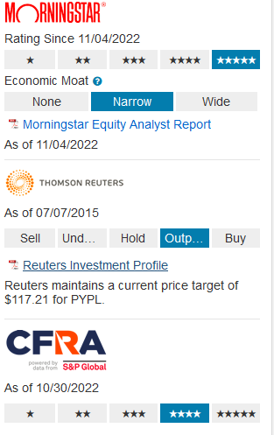
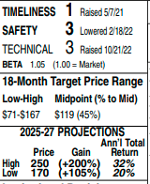
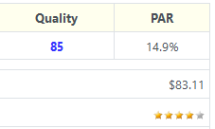
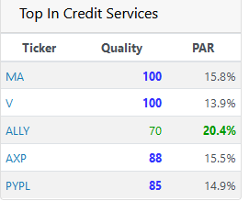
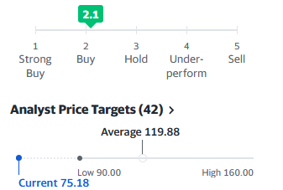
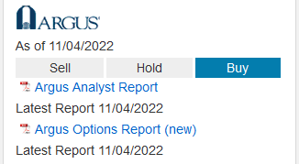
Value Line – 11/04/2022
FVE - $135
PYPL Analysts’ Projections
ManifestInvesting
PYPL as of Nov 01, 2022
Current Price
CAPS Rating
Oct 29, 2022
New Target $109.12
12 mos. Target
$95
Yahoo - Finance
As of Nov 04, 2022
Target Price
$97

Slide 18
PYPL Morning Star Report (Nov 03, 2022)
Plenty of runway for growth in electronic payments. Electronic payments only surpassed cash payments on a global basis – 2 yrs. ago
Scalable nature of the business should allow PYPL to improve its margins over time
Its long-running experience in online payments is a unique asset - more valuable as e-commerce becomes a bigger piece of the pie.
Separation between online and POS transactions is blurring, and PYPL may increasingly come into competition with larger companies in the future.
Alipay and WeChat are examples of how Govts. could favor local players, and this could shut PYPL out of some emerging market opportunities.
Opportunities to monetize Venmo could be limited.
ECONOMIC MOAT – Narrow, within the e-commerce space, PYPL is a clear leader
Morning Star BULLS
Morning Star BEARS

Slide 19
Value Line LT Projections, Nov 4, PYPL is pegged to outperform the broader market averages over the coming six to 12 months (Timeliness: 1). Too, capital recovery potential is wide out to mid-decade.
CONCLUSIONS
OTHER PYPL POSITIVES-
PYPL safety and simplicity of transactions and the fact that it’s both brand and technology pioneer differentiates it from its competitors remain strong
PYPL two-sided platform enables it to develop & maintain direct financial relationship with both customers & merchants – deep & trusted
PYPL continues to forge strategic partnerships
Venmo continues to bolster PYPL’s stake in mobile payments - is the key catalyst behind the solid growth in its total payment volume (TPV)
Well managed and sound Balance Sheet even after taking on some Debt; Cash Reserves are healthy, and the company remains active on the stock buyback front
PYPL NEGATIVES-
PYPL operates in the highly competitive global payments industry with its participants such as Square, Google, Amazon, Apple as well as traditional financial services companies
The nature of PYPL International Business makes it vulnerable to foreign exchange risk.
PYPL is exposed to interest rate risk from its interest rate sensitive assets and investment portfolio.
Risks due to global macro volatility and inflationary pressures & in generating out-year estimates
Emerging competitive and regulatory threats - a key consideration in various payment solutions (i.e., digital wallet, point of sale, and installment loans)

