Slide 1
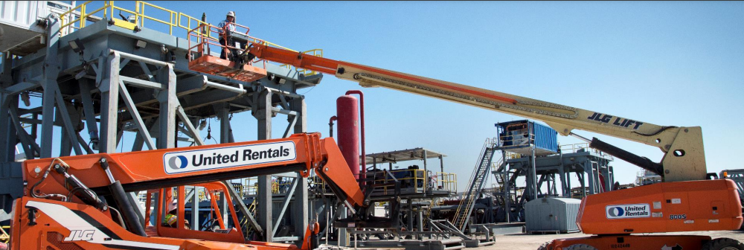
Gladys Henrikson
Possible Corporate Image
DC Chapter, The Model Investment Club of Northern Virginia
UNITED RENTALS, INC (NYSE: URI)
BetterInvesting Magazine, August, 2022 Undervalued-Featured Company

Slide 2
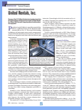
Where I Found It: BI Magazine August 2022

Slide 3
BI Magazine Rationale for URI UV choice Price at time of selection: $274.15/share
WWW.BETTERINVESTING.ORG
URI: world’s largest provider of rental construction equipment.
Federal Infrastructure Investment & Jobs Act (ILJA), passed in fall 2021, provides funding for projects requiring heavy equipment.
Renting equipment preferable to ownership: geopolitical uncertainties, inflation. higher borrowing costs
Late-pandemic demand among oil and natural gas customers = solid. Management predicts growth through 2023.
Caution: this is a highly cyclical industry. Share prices volatile. But stock seems attractive as an infrastructure play.

Slide 4
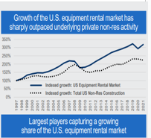
United Rentals, Inc (URI) Overview
Industry= Rental and Leasing Services
Sector = Industrials
Co. Size = Medium ($1B-$10B), 2021 sales =$9.7B
Founded 1997; Customers: commercial construction (46%), Industrial (50%), residential 4%
Description: Provides Equipment Leasing to Industrial and Construction Customers
.

Slide 5
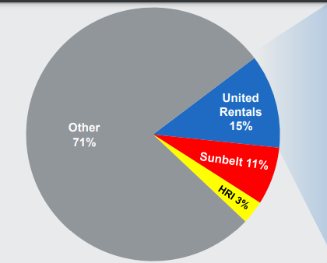
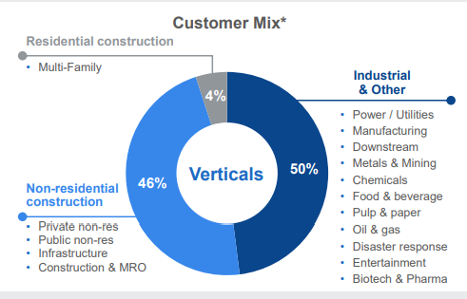
URI’s Competitive Landscape & Customer Mix within Leasing Growth ~ 5-10%.yr

Slide 6
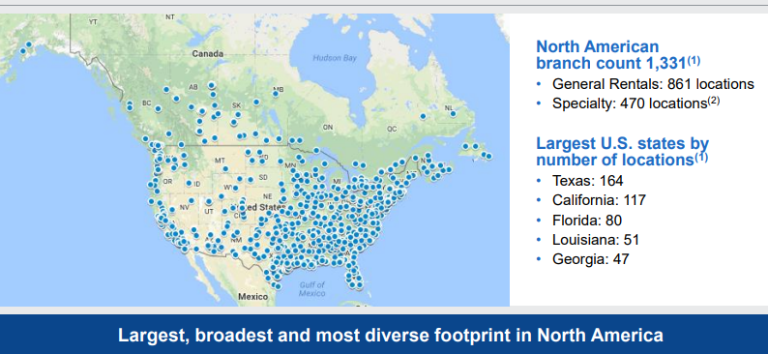
URI Locations: 85% in 49 US States & 10 Canadian Provinces.15% in UK/Europe & Australia area

Slide 7
URI 2021 Revenue by General vs Specialty Rental and Services Mix

Slide 8
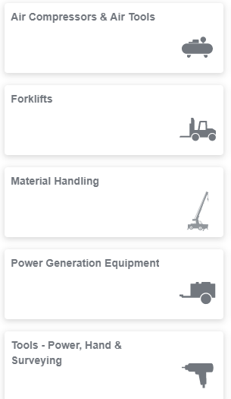
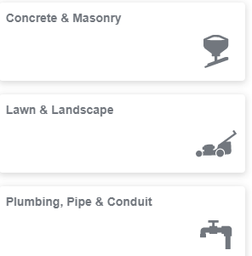
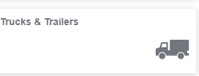
URI General Rentals (75.7% of 2021, $9.7B, revenues)

Slide 9
URI Investing in Specialty Rentals by Acquisitions E.g. General Finance (Canada, Australia, New Zealand) in May 2021 and BakerCorp International (Europe) in July 2018

Slide 10
URI’s Growth & Profitability Strategy

Slide 11
URI’s Competitive Advantages
URI Customer Service includes focus on: Being a One-Stop Shop; Ensuring Safety, Reliability, and Making rental fleet productive.
URI is investing in a Greener Fleet: ordered 500 of Ford’s new battery-electric F-150 Lightning pickup trucks and 30 E-Transit vans. New POWERBANK lithium battery packs will replace some of the diesel fuel used by the generators that co. leases.

Slide 12
URI Capital Allocation Objectives
Notes:
.

Slide 13
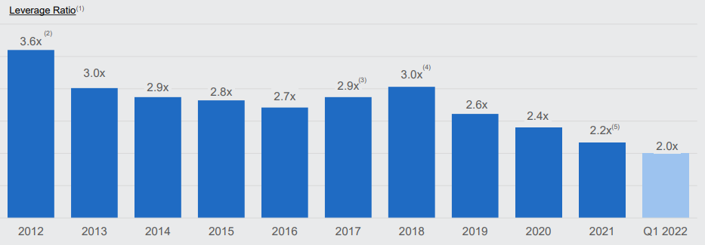
URI Manages for Financial Goals, such as Improving Balance Sheet & Profit Margins
Balance Sheet – Debt Reduction
Fleet Productivity measures the effect of changes in: rental rates, Utilization time, and customer/product mix.

Slide 14
URI Management Forward Statements for YE 2022 & Q2 2022
Total Revenue = $11.1 to $11.5B (14% increase over 2021)
EBIDA (Earnings before Interest Depreciation and Amortization, or ) = $5.2 to $5.4B (26% increase over 2021)
Free Cash Flow = $1.7B to $1.9B (13% increase over 2020 and 250% increase over 2021)
From Q2 2022 Earnings Call, 7/28/22: Expect revenues to be $11.4 B by 2022 YE, ~15% growth
Strong Backlog through 2023 through plant building, power and mobile storage projects.
Notes:
new, thin, foldable displays.

Slide 15
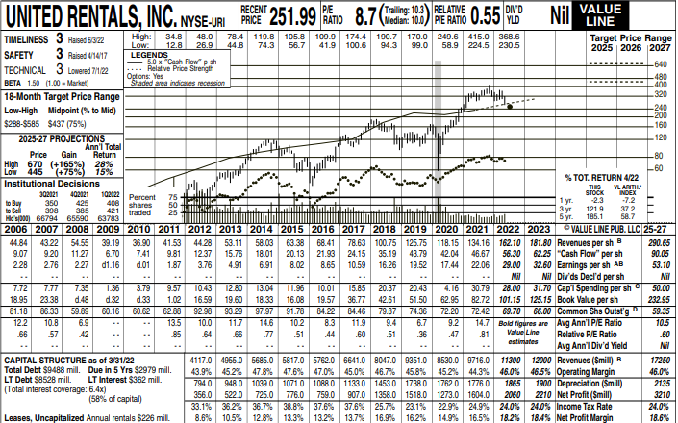
Value Line Review of URI 7/22

Slide 16
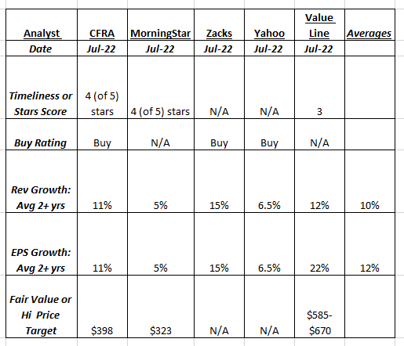
Summary of URI’s Analyst Reviews

Slide 17
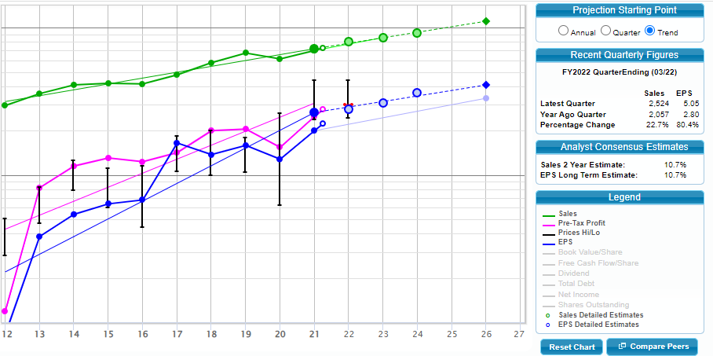
United Rentals Inc SSG

Slide 18
United Rentals (URI) SSG- Cont
Section 3: P E History

Slide 19
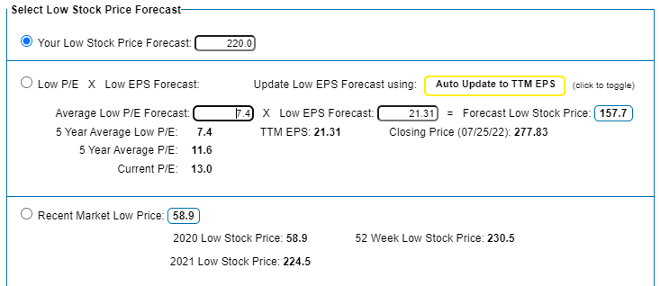
SSG Section 4, A & B: Choosing High and Low Prices Next 5 Years
High= between VL $585-$670
Low= 20% below current price & under 52 wk low

Slide 20
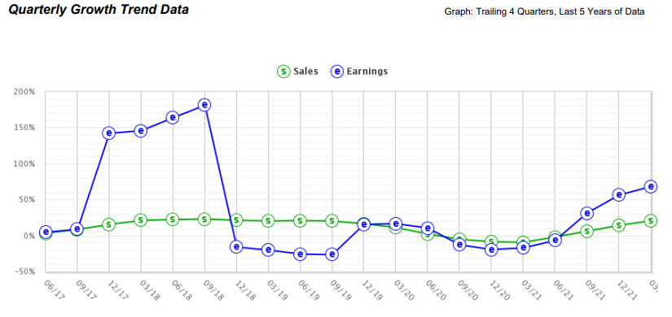
2022 Quarterly Data Confirms + Trend

Slide 21
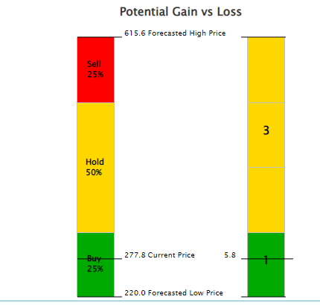
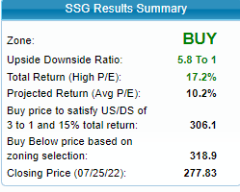
SSG Section 4 C: Zoning- Evaluating Risk & Reward over Next 5 Years

Slide 22
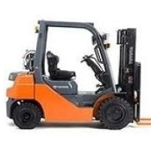
United Rentals (URI) Conclusion
URI is a medium sized growth company.
URI is a well managed company: has become the world’s largest equipment leasing company in a fragmented industry through careful acquisitions, financial management, and customer service
URI, while in the volatile and cyclical industrial sector, is growing sales and profit.
URI is a BUY up to $306 (for Upside Downside Ratio of ~5:1).
URI stock could be a short-to-medium range Infrastructure play for purchase.

