Slide 1

Copart
(CPRT)
New Stock Presentation, July 2022
Pat Onufrak

Slide 2



Disclaimer
The information in this presentation is for educational purposes only and is not intended to be a recommendation to purchase or sell any of the stocks, mutual funds, or other securities that may be referenced. The securities of companies referenced or featured in the presentation are for illustrative purposes only and are not to be considered endorsed or recommended for purchase or sale.
Investors should conduct their own review and analysis of any company of interest before making an investment decision.

Slide 3




NASDAQ: CPRT
Sector: Consumer Cyclical
Industry: Auto & Truck Dealerships
Investment Style: Mid Growth
Market Cap: 26.1844 Billion
Economic Moat: Wide
Fair Value: 115.25 (Currently: $112.76)
Uncertainty: High

Slide 4

Copart Inc. is a provider of online auctions and vehicle remarketing services targeted primarily at insurance companies, car dealerships, fleet operators, and vehicle rental companies.

Slide 5
Based in Dallas, TX, Copart, Inc. was founded in 1982. The company processes and sells salvage and clean title vehicles.
This is done mainly over the Internet, through its Virtual Bidding Third Generation (VB3) Internet auction-style sales technology.

Slide 6
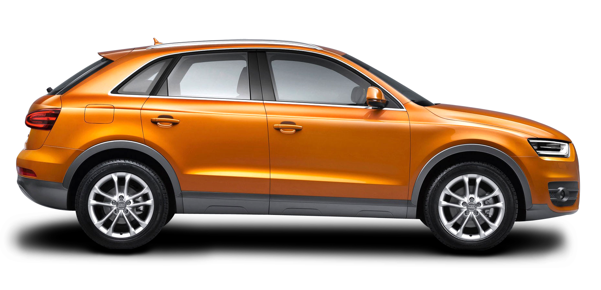
The majority of the vehicles sold through Copart's services are either damaged or recovered stolen vehicles.
Copart principally sells to vehicle dismantlers, rebuilders, used vehicle importers and exporters and the general public.
The company generates revenue from fees paid by vehicle sellers and buyers and/or purchasing and reselling vehicles on its own account.
Its main markets include North America and the British Isles.
This Photo by Unknown Author is licensed under CC BY-NC
Walt Disney

Slide 7

Zacks (May 30, 2022)
. . . “A stock to watch”
. . . “A top growth stock for the long-term”
VGM Scores
[Based on their value, growth, and momentum characteristics, each stock is assigned a rating of A, B, C, D, or F. The better the score, the better chance the stock will outperform; an A is better than a B, a B is better than a C, and so on.]
Currently, Copart has a Growth score of B, with the same score on Momentum. However, the stock was given a grade of D for Value, putting it at the bottom 40% for this investment strategy.
“Overall, the stock has an aggregate VGM score of B. If you aren’t focused on one strategy, this score is the one you should be interested in.”
This Photo by Unknown Author is licensed under CC BY
Walt Disney

Slide 8

Zacks also says . . .
“Additionally, the company could be a top pick for growth investors, forecasting year-over-year earnings growth of 19.5% for the current fiscal year.
Two analysts revised their earnings estimate upwards in the past 60 days for fiscal 2022. The Zacks Consensus Estimate has increased $0.05 to $4.42 per share. CPRT boasts an average earnings surprise of 7.8%.
With a solid Zacks Rank and top-tier Growth and VGM style scores, CPRT should be on investors’ short list.”
Walt Disney

Slide 9
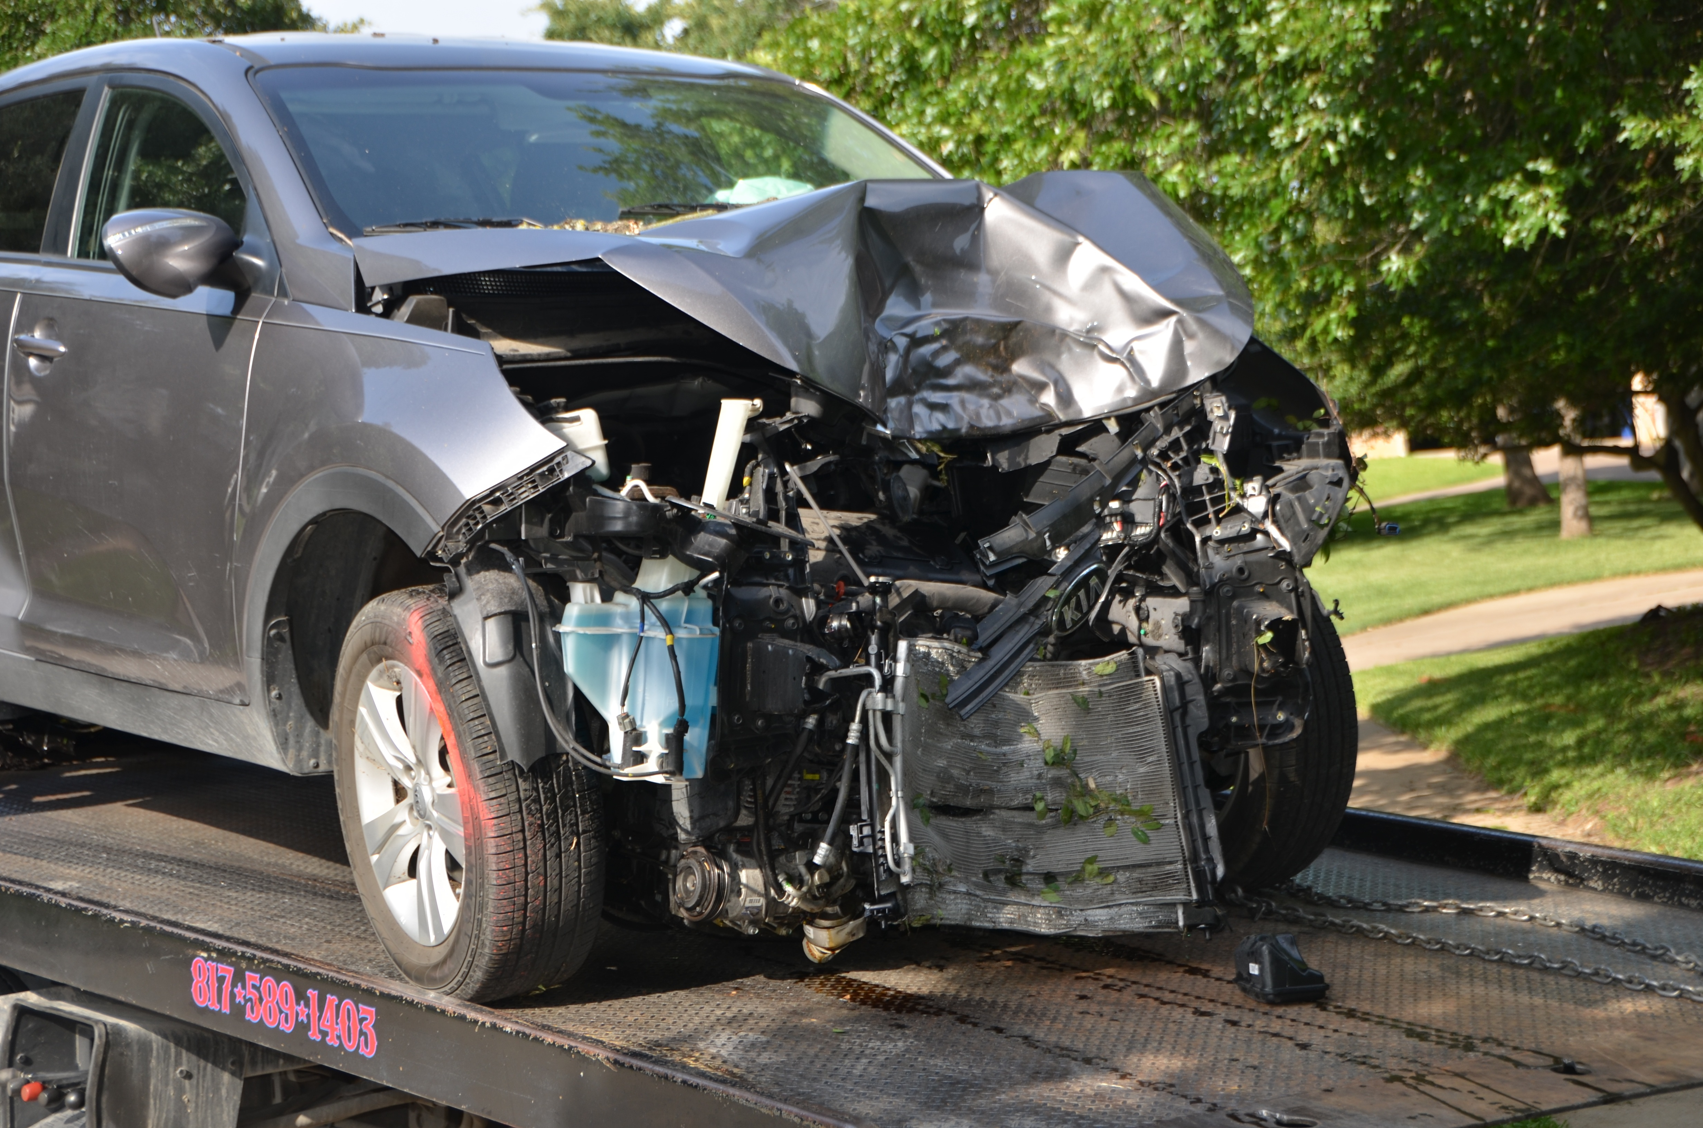
Are we in “Bargain” territory yet ? ? ?
Zacks (June 17, 2022)
Copart Down 7.3% Since Last Earnings Report: Can It Rebound?
A month has gone by since the last earnings report for Copart. Shares have lost about 7.3% in that time frame, underperforming the S&P 500.
Will the recent negative trend continue or is Copart due for a breakout? . . . Let’s take a quick look at the most recent earnings report in order to get a better handle on the important drivers.
Walt Disney

Slide 10
Third Quarter Report (April 30, 2022)
- Earnings beat estimates, revenues up year over year.
- Reported 3rd quarter adjusted earnings per share of $1.17, topping the Zacks Consensus Estimate of $1.15.
Outperformance was due to higher-than-anticipated revenues from the service and vehicle segments.
- The bottom line also rose 7.3% Y/Y from $1.09 reported in the prior-year quarter.
- Generated revenues of $939.9 million, beating the Zacks Consensus Estimate of $860.4 million. The top line also increased 28.1% from the year-ago reported figure of $786.9 million.
Walt Disney

Slide 11
- Service revenues came in at $766.3 million, up from $623.8 million recorded in the year-earlier period. Service revenues accounted for 81.5% of the total revenues.
- Vehicle sales totaled $173.6 million in the quarter, up from the prior-year level of $110.1 million.
- Gross profit was up 14.4% year over year to $436.3 million.
- Total operating expenses flared up 39.8% to $567.2 million. General and administrative expenses jumped 28.1% from the prior-year quarter to $50.2 million. Nonetheless, operating income increased to $372.7 million from $328.1 million. However, net income fell to $278.6 million from $286.8 million.
- Copart had cash and cash equivalents of $1,454.8 million as of Apr 30, 2022, compared with $1,048.3 million as of Jul 31, 2021. Long-term debt was $402.7 million at the end of the reported quarter, increasing from $397.6 million as of July 31, 2022.
How Have Estimates Been Moving Since Then? . . . It turns out, fresh estimates have trended upward during the past month.
Walt Disney

Slide 12

SSG
Let’s look at the SSG . . .

