Slide 1
What do you think of GENERAC?
Stock Study Guide
Sector: Industrial
Industry: Specialty Industrial Machinery
Medium Company by Sales of 3.7B (so a Workhorse)

Slide 2
Your neighbors may have one, but GENERAC has other products, too.
This Photo by Unknown Author is licensed under CC BY-ND

Slide 3
Founded in 1959, it completed its initial public offering in 2010. A Wisconsin Company.
Generac Holdings Inc. designs and manufactures a wide range of generators and other engine-powered products for the residential, light commercial, industrial, and construction markets. Its products are fueled by natural gas, liquid propane, diesel, and Bi-Fuel. (Value Line March 2022)

Slide 4
It has a strong SSG visual analysis

Slide 5
So why is the price so low?

Slide 6
Per InvestorPlace: “One reason could be the specter of rising interest rates.
Backup generators are needed at any time. And with extreme weather events becoming more
commonplace, demand should remain solid. In fact, the company says it has a backlog of projects that are worth over $1 billion. To put that in context, Generac generated just over $1 billion in revenue in the last quarter. Nevertheless, the price tag makes them a discretionary purchase. And it’s one that could be affected by interest rates.
That’s not the kind of softening investors will see for another quarter or two. But with institutional investors scrambling to reprice equities to account for what could be an increase of up to 1.25% by June, no stock is safe right now. ”
Another may be that the entire market is moving downward right now or in correction mode to more normal rates. Investors may be running scared right now due to uncertainty in economy, activities in the Ukraine, increasing Covid cases in China, and emotional reacting to stock market prices.
So, let’s look at the fundamentals of GENERAC or GNRC, a mid size revenue, but high sales growth and earnings company!

Slide 7
PRIMARY BUSINESS DYNAMICS. GNRC operates in two segments: Domestic and International.
Within each of those segments, products are broken down into three classes: Residential, Commercial & Industrial, and Other.
(By the way, AirPlus in Northern Virginia installs Generac power cells and has a video about the system).

Slide 8
That 85% domestic sales just taps a minor part of the potential US market available!
GNRC designs and manufactures stationary, portable, and mobile generators with single-engine outputs ranging between 800W and 3,250kW.

Slide 9
As the largest player in a market with limited penetration, Generac views itself as responsible to drive market growth.

Slide 13
Value Line

Slide 14
GNRC does not pay a dividend (and historically has not). But Value Line is predicting a $6.00 dividend within 5 years could be possible. GNRC did not repurchase any shares in 2020, but the current board-approved repurchase program allows for $250M of repurchases through October 2023. Over the years it has been growing by acquisitions, as well as through its products and service of those products. This is building its international presence. It will face competition as it focuses on clean energy products, solutions and services, solar being one of them. During 2020, GNRC entered the market for grid services involving distributed energy optimization and control software that helps support the operational stability of the world’s power grids. Generac is in the midst of a transition to an energy technology solution company. Unlike peers, GNRC has a primary focus on power equipment with a key emphasis on standby, portable and mobile generators with broad capabilities across the residential, light-commercial, and industrial markets.

Slide 15
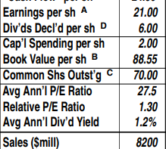
My judgements versus Value Line’s Sales of 8,200 and Earnings of 21.00

Slide 16
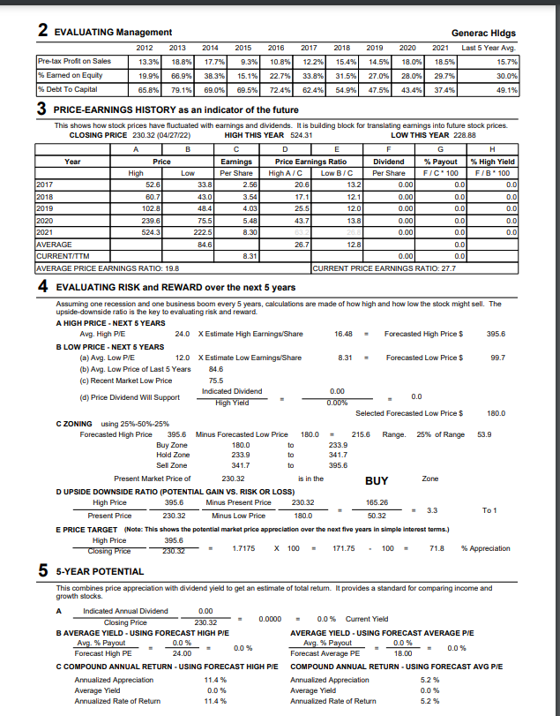

Slide 17
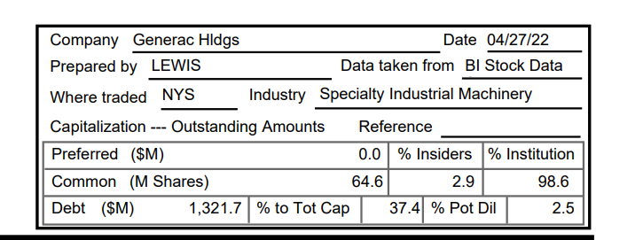
A medium sized, high growth company, low debt, officers/directors have skin in the game

Slide 18
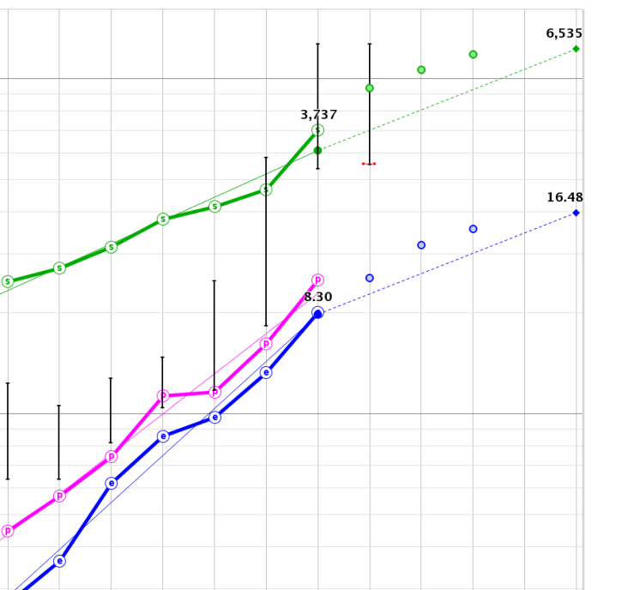
Upward trends very nearly UP, STRAIGHT AND PARALLEL
My estimates were more
conservative than were
analysts’ projections in
the green circles

Slide 19
CFRA: We forecast 2022 revenue growth of 32%-36%, supported by the sustained high demand for generators. In 2023, we forecast revenue growth to return to more “normal” levels and to rise by 12% to 17%. Extreme and volatile weather continues to increase shipments of portable generators. We think residential customers will continue to prioritize spending on home standby generators over the next few years, as improving the power and electrical grid is a multiyear process. We also expect revenue to benefit from GNRC’s investment in energy storage systems and power grid optimization.

Slide 20
Stable growth and controlled debt.

Slide 21
As the economy continues to be worrisome and stock prices contract I felt better making the high 2021 P/Es outliers. We are seeing prices become more normalized, too. (Already below 2021 low price).

Slide 22
I decided to set 24 as my high P/E (my standard high I was willing to pay before nose bleed prices became commonplace). That high price result of $395.60 is below Value Line’s low $460.00 3-5 year prediction, but above Morningstar’s Feb 2022 $301.00 Fair Value. Folio has Strong Buy by 14 analysts.

Slide 24
Maybe we are having a Fire Sale!

Slide 25
So, bottom line for me? Buy if price hits $196.70 or lower for best return.

Slide 26
Today’s Price= $241.69 (I will change) BUY ZONE: $180-$233.90
For SSG control/click
https://ssg.betterinvesting.org/study/ssgplus.aspx?studyid=14729219&sk=33640

