Slide 1
Universal Health Services Ticker: UHS (NYSE) Size: Large Sector: Healthcare Industry: Medical Care Facilities
By Amy Laing
MicNova Meeting: May 18, 2021

Slide 2
Disclaimer
The information in this presentation is for educational purposes only and is not intended to be a recommendation to purchase or sell any of the stocks, mutual funds, or other securities that may be referenced. The securities of companies referenced or featured in the seminar materials are for illustrative purposes only and are not to be considered endorsed or recommended for purchase or sale by BetterInvesting™ National Association of Investors Corporation (“BI”) or the National Investors Association, its volunteer advisory board (“NIA”). The views expressed are those of the instructors, commentators, guests and participants, as the case may be, and do not necessarily represent those of BetterInvesting™ or NIA. Investors should conduct their own review and analysis of any company of interest before making an investment decision.
Securities discussed may be held by the instructors in their own personal portfolios or in those of their clients. BI presenters and volunteers are held to a strict code of conduct that precludes benefiting financially from educational presentations or public activities via any BetterInvesting programs, events and/or educational sessions in which they participate. Any violation is strictly prohibited and should be reported to the President of BetterInvesting or the Manager of Volunteer Relations.
Notes:
2

Slide 3
Agenda
Company Description
What Does UHS Do?
Industry Outlook
SSG Analysis
Why UHS – Analysts’ Opinions
The Competition
Conclusion

Slide 4
Company Overview
One of the nation’s largest and most respected providers of hospital and healthcare services. It owns and operates through subsidiaries, acute care hospitals, outpatient facilities and behavioral health care facilities.
40 YEARS OLD
400 FACILITIES; most owned, some leased
90K EMPLOYEES
3.5M PATIENTS PER YEAR

Slide 5
Industry Accolades

Slide 6
Fortune Magazine 2020 Ranking

Slide 7
At a Glance

Slide 8
U.S.(+ Puerto Rico) and U.K.(+ Ireland) Locations

Slide 9
Diversified Revenue (mostly from goverment and insurance payments)

Slide 10
Industry Outlook: Growth of Behavioral Health
Behavioral Health is: depression, anxiety, bipolar, mental illnesses, such as personality disorders, psychosis, drug abuse disorders, eating disorders or addictive behaviors
UHS is a leading behavioral health provider ranked by total hospitals, total beds and net patient revenue (UHS)
According to Acumen Research and Consulting, the global behavioral health market is forecasted to reach around $ 240 billion by 2026.
Estimated 73 million people in the U.S. with diagnosable mental illnesses (UHS)
Demand is significantly outstripping services supply. (Acumen)
Stable pricing and increasing admissions and occupancy trends (UHS)
$1.37B of Venture Capital money poured into mental-health startups through Q3 2020 (The Hustle Newsletter “Big questions for small businesses” published on Jan 23, 2021.)

Slide 11
Behavioral Segment Overview

Slide 12
Acute hospitals take advantage of demographics

Slide 13
Acute Segment Overview

Slide 14
Future Growth Specifics
Building a new hospital in Reno, Nevada to expand presence Building two new behavioral hospitals as part of joint ventures with SouthEast Health and Mercy One located in Missouri and Iowa, respectively
Additional joint venture behavioral hospitals planned
Opened Canyon Creek Behavioral Hospital in Texas
Building 5 additional free standing emergency departments for a total of 22

Slide 15
Why UHS?
Many hospital Institutions are currently depressed or just starting to bounce back due to postponed surgery procedures because of Covid. (Manifest Sept, 2020 Roundtable, Wanda Groves PT at INOVA)
Expected to pick up after Covid and improve 1.5-3 years in future.
Unique Diversified business model: Behavioral (mental) health and acute care hospitals
Disciplined balance sheet management with a track record of maintaining
conservative leverage profile
Consistent top-line growth coupled with strong cash flow profit

Slide 16
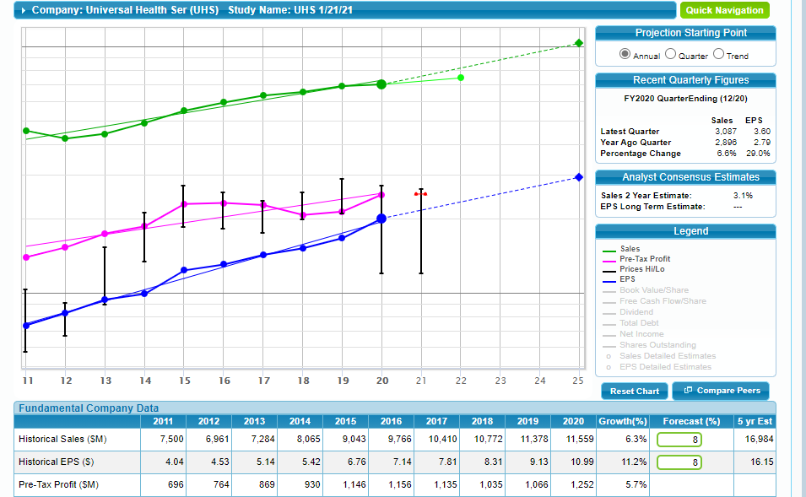
SSG Analysis, P 1

Slide 17
SSG Analysis, P 2

Slide 18
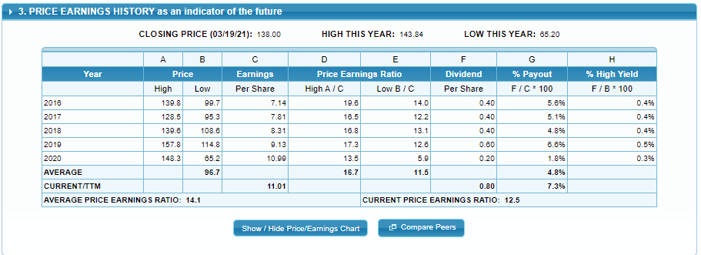
SSG Analysis page 3

Slide 19
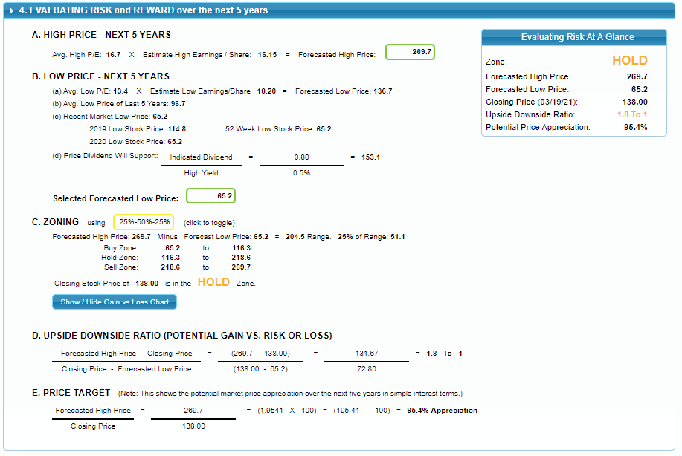
SSG page 4

Slide 20
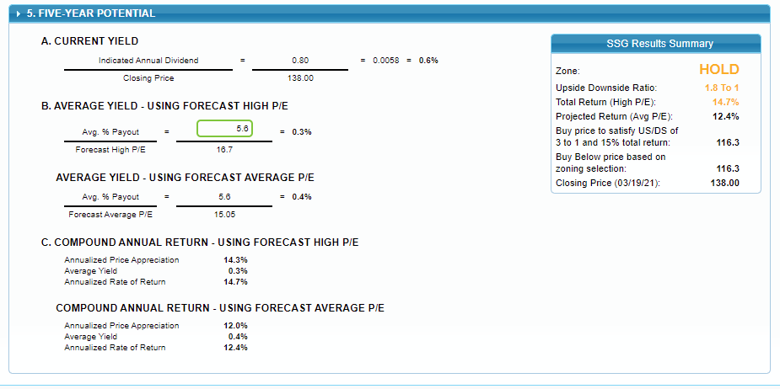
SSG page 5

Slide 21
Consistent Growth & Strong Cash Flow

Slide 22
Consistent Conservative leverage Profile

Slide 23
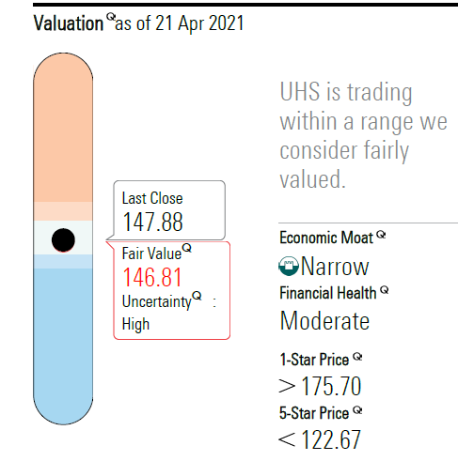
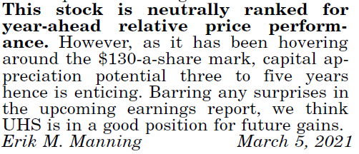
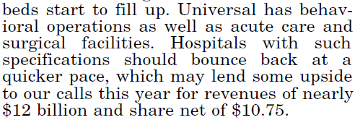
Analysts Opinions

Slide 24
Triple play -- #1

Slide 25
Possible triple play -- #2

Slide 26
Triple Play -- #3

Slide 27
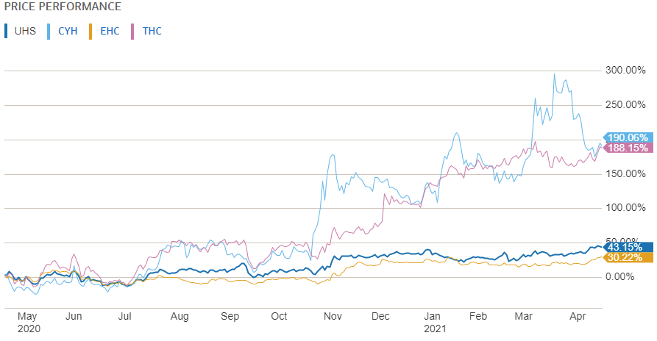
Underperforming now but expected gains in 2-5 yrs (Merrill Edge research site)
Encompass Health Corp (EHS), Tenent Healthcare (THC),
Community Health Systems (CYH)

Slide 28
Peers (Merrill Edge)

Slide 29
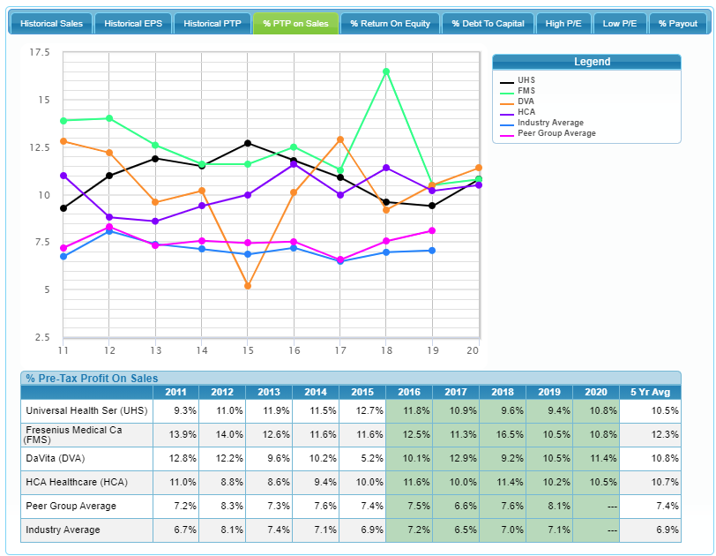
Competitors (BI SSG)

Slide 30
UHS Conclusions: Company is Well Positioned for Health Care payments in Future
UHS has experience in UK with offering a single payer health care system and in U.S. our standard health care system, so two different systems
Successful with both government and insurance payment systems
Should the U.S. move to a single payer system, UHS will be ready

Slide 31
2021 Q1Earnings Call: On Track!
“Q1 results were just slightly ahead of our internal forecast, which is partly why we’ve chosen not to make any changes to guidance. We feel like we’re largely on track.” –Steve G. Filton , EVP and CFO taken from Q12021 Earnings Call on April 27,2021.
Adjusted net income attributable to UHS per diluted share was 2.44 for the quarter ended March 31, 2021. (April 27,2021 Q1 Earnings call)

