Slide 1
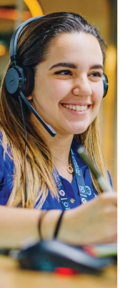
Superior Group of Companies (SGC) Sector (GICS®) Consumer Discretionary Industry (GICS®) Textiles, Apparel & Luxury Goods
Market Capitalization | $389.83M
By
Arvind K. Krishna
October 12, 2021

Slide 2
What is SGC and What Do They Do?
SGC is a combination of companies that help customers unlock the power of their brands.
Create brand engagement experiences for their employees and customers.
Operates in Uniforms and Related Products segment - manufactures & sells a wide range of uniforms, career apparel and accessories.
Primary products are service apparel, such as scrubs, lab coats, protective apparel and patient gowns - to the healthcare industry,
Service apparel (uniforms) provided to workers in various industries - retail, hotels, food service, transportation, and other industries.
Remote Staffing Solutions segment (a/k/a The Office Gurus ) - operates in El Salvador, Belize, Jamaica, and the US,
Supports the company’s back office needs while improving overall efficiencies & lowering operating costs.
Promotional Products Segment - sales on a limited basis to existing Uniforms and Related Products customer base.

Slide 3
SGC Product Brands & Company Legacy
Uniform &Related Products segment sells its products under the Fashion Seal Healthcare, HPI, and WonderWink brand names.
The Remote Staffing Solutions segment provides multilingual telemarketing and business process outsourced solutions through the recruitment and employment of qualified English-speaking agents.
The Promotional Products segment produces and sells promotional products and branded merchandise under the BAMKO, Public Identity, and Tangerine brands to corporate clients and universities.
The company was formerly known as Superior Uniform Group, Inc. and changed its name to Superior Group of Companies, Inc. in May 2018.
Founded in 1920 and is headquartered in Seminole, Florida.

Slide 4
FY 2020 38% 55% 7%
FY 2020 Net Sales: $527M
BAMKO Named Top 3 Best Place To Work In Los Angeles For Third Time in Four Years among medium-sized companies for 2021 - LA Business Journal. 08/09/2021
The Office Gurus (TOG) Named #1 Best Place to Work in Call Center Industry in El Salvador
GlobeNewswire - 10/05/2021

Slide 5
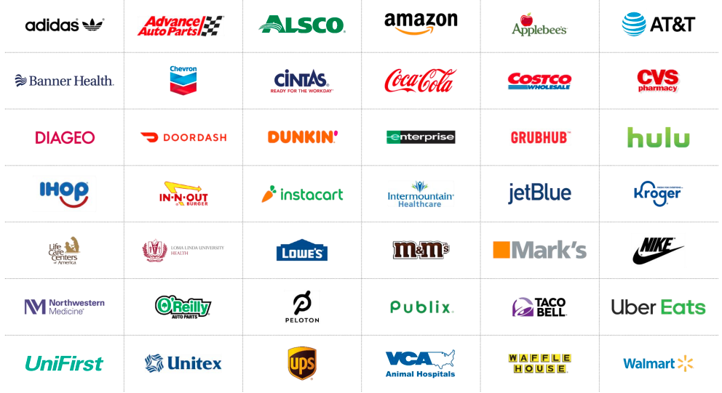
SGC - DIVERSIFIED CUSTOMER REACH
Executing against an Omni-Channel Sales Strategy

Slide 6
SGC
Revenue Growth - Annual
EPS Growth - Annual

Slide 7
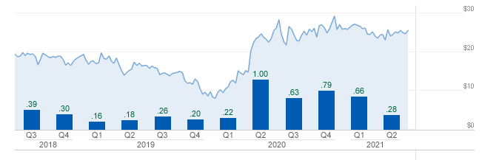
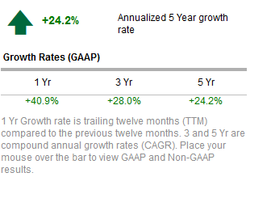
SGC
Revenue Growth Quarterly (m)
EPS Growth Quarterly

Slide 8
SGC Revenue & Earnings Growth Picture
For the fiscal year ended in 2020, SGC revenues increased 40% to $526.7M.
Net income increased from $12.1M to $41M.
Promotional Products segment Revenue increased by 88% to $202.2M,
Uniform and Related Products segment Revenue increased by 21% to $287.3M
2020 Revenues included $131 million of PPE, up from under $4 million in 2019 and 2018. PPE sales continued to surge to $26.8 million in the 1st QTR. 2021. It then declined to $6.7 million in the 2nd QTR. 2021
True growth & Earnings picture is masked by all the PPE sales in 2020 & in the first Qtr. Of 2021
2021 Second Qtr. Returned to more normal levels of PPE sales and had strong earnings.
Earnings in the second quarter of 2021 were $0.67 adjusted for a one time pension termination charge of $6.9 million.

Slide 9
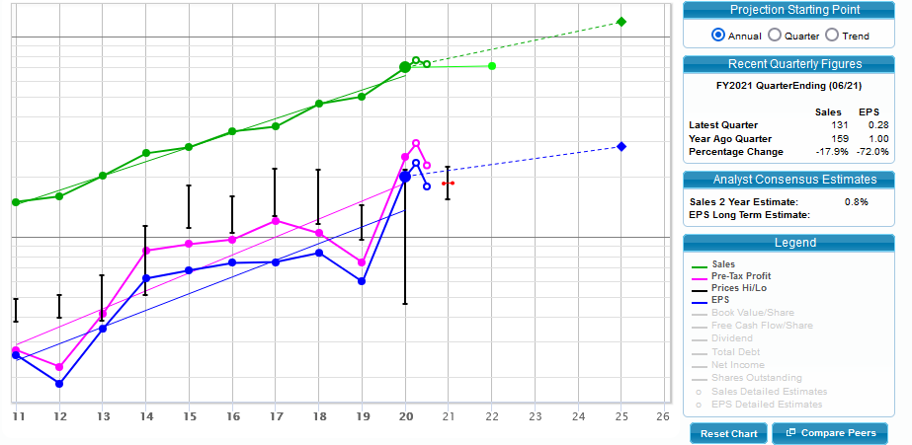
SGC – SSG 1

Slide 10
SGC – SSG Contd. (2&3)

Slide 11
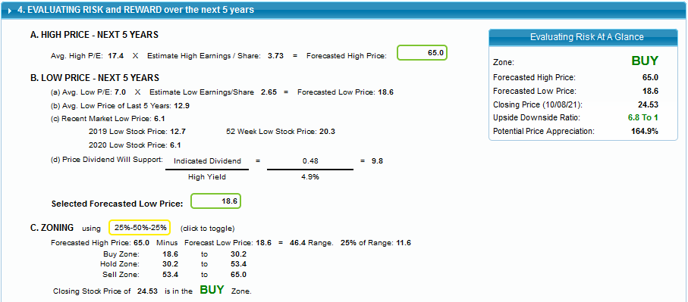
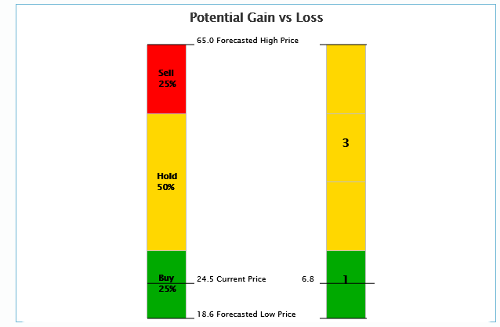

Slide 12
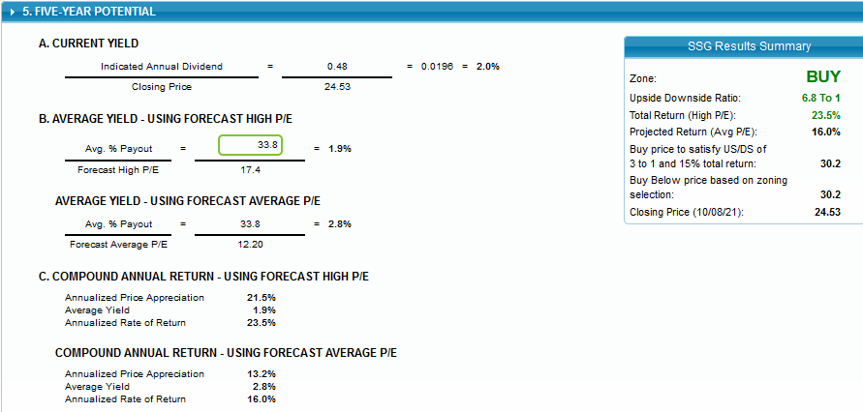
SGC – SSG 5, Conclusion

Slide 13
SGC Growth Plans
BAMKO has enjoyed a CAGR of 31.5% over the last three years, excluding PP&E sales in 2020 and 2021, and annualizing the first six months of 2021 – PPE Excluded
BAMKO grown revenue at a CAGR of 45.7% over the past five years if the first half of 2021 is annualized - PPE Excluded
BAMKO had a backlog of $67.6 million on June 30, 2021, up 66% from just one quarter earlier.
BAMKO's salespeople also successfully converted 30% of their new PPE customers with no other relationship into promotional products customers.
BAMKO has no Competitor Peers
TOG Revenues are accelerating – Competitors (Support.com & StarTek are two peers) losing money or had declining revenues for years. Net sales in TOG segment increased 72.6%
TOG Revenues grown at a 30.8% CAGR over the past five years if 2021 is annualized. Growth was all organic. During the second quarter of 2021 Superior added 437 billable agents across all sites. That is on top of 184 agents in the first quarter for a total of 621 agents for the first half of 2021.
The Stagnant Uniforms Segment remains the largest by revenues. However, it no longer provides the majority of earnings. SGC Not expect the kind of growth they are seeing in the other two segments.
Management does not expect flat Uniform revenues going forward in the Post COVID PPE Stage.
They believe that with PPE sales returning to normal and the 2018 acquisition fully integrated, it can grow uniforms revenues at least 12% organically annually going forward. New sales expected more from medical customers & also grow revenues overseas ($30M - $100M over the next few years).

Slide 14
SGC Positives and Negatives
POSITIVES -
SGC has two rapid growth product segments besides a flat revenue legacy uniforms business - growing revenues and earnings over 30% per year that have reached almost 50% of total revenues.
The market has not recognized the past growth and future potential as the SGC is trading at an insane EPS run-rate with low PE ratios.
Superior has a strong balance sheet, long-term effective management, Positive Financial Health, long-term success, and accelerating growth plans
Synergies between the three Product Segments is a competitive advantage during Sales
Dividend Payout Ratio - 14.70 (%)
NEGATIVES –
Facing the same supplier logistics problems and labor shortages.
May be a short term issue and the fact they hired 621 call center employees in the first half of the year bodes well going forward.
logistics problems cost SGC about $4-5 million in revenues last quarter, about 2%
Market still sees SGC as a slow growth UNIFORM CO. Industries where SGC is getting growth are slower growth ones.

Slide 15
SGC Analyst & Research Report Ratings
MarketEdge (10/08/21) “BUY”
The current technical condition for SGC is strong and the underlying indicators should keep the current uptrend intact. Power Rating 80 - Bullish
MACD-LT, an intermediate-term trend indicator to show Stock Trend reversals, is bullish at this time.
SGC's chart formation indicates a strong rising trend. Upside momentum, as measured by the 9-day RSI indicator is very strong. Over the last 50 trading sessions, there has been more volume on up days than on down days, indicating that SGC is under accumulation, which is bullish.
The stock is trading above a rising 50-day moving average. This validates the strong technical condition for SGC.
The stock is above its 200-day moving average which is pointed up indicating that the intermediate term trend is bullish.
Reuters Investment Profile (10/08/2021): “BUY”
Yahoo Finance 10/11/21: “BUY”
Manifest Investing 7/23/21: Quality: 66; PAR:19.0%; Projected Avg. Price $52.60
CFRA Quantitative Rating Only 9/24/21: “Sell” No Rating and FMV
Value Line 8/20/21: No Rating, Analysis & Projections; Performance 3; Technical 3; Safety 3
Morning Star: No Rating & FMV
SCHWAB Equity Rating 10/8/21: B- Outperform for “BUY”
Verus Analytics 10/8/21: “BUY”

Slide 16
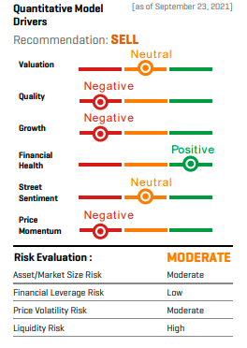
SGC
CFRA Quantitative Model Assessment
NOTES:
Growth and Valuation model sub-categories are the two largest drivers of NasdaqGM: SGC's SELL recommendation.
Growth includes factors that measure EPS growth and stability and cash flow growth and stability.
Valuation includes factors such as price to earnings, price to EBITDA, and price to cash flow.

Slide 17
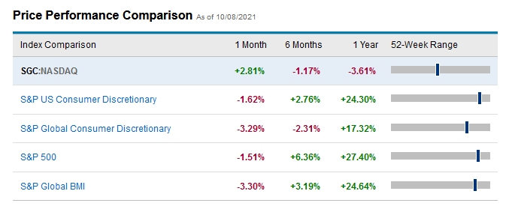
SGC Comparison with Industry Indexes

