Slide 3
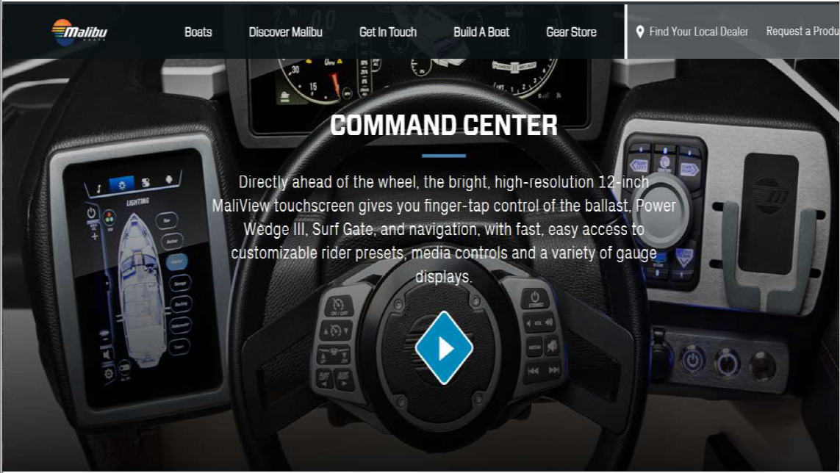

Slide 6
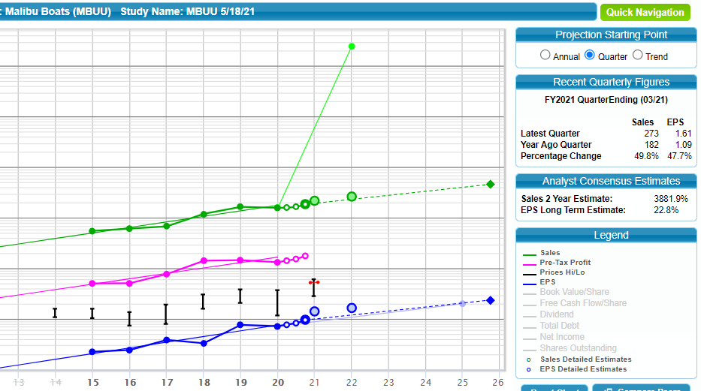

Slide 8
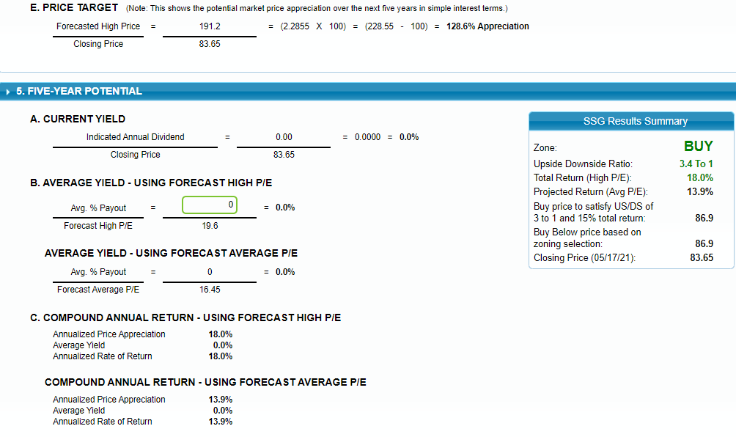

Slide 9
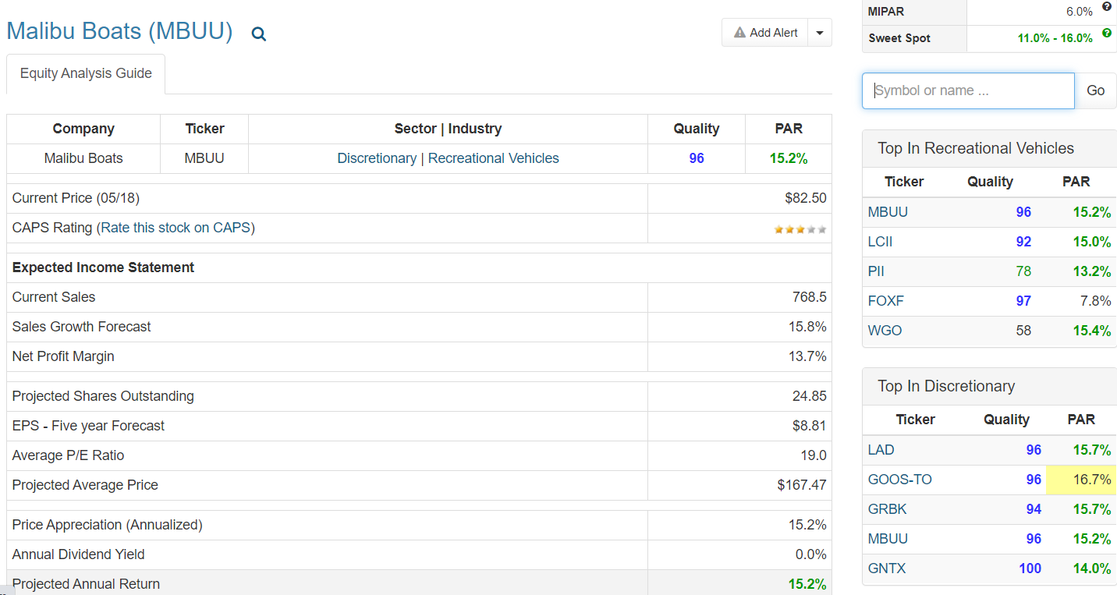

Slide 10
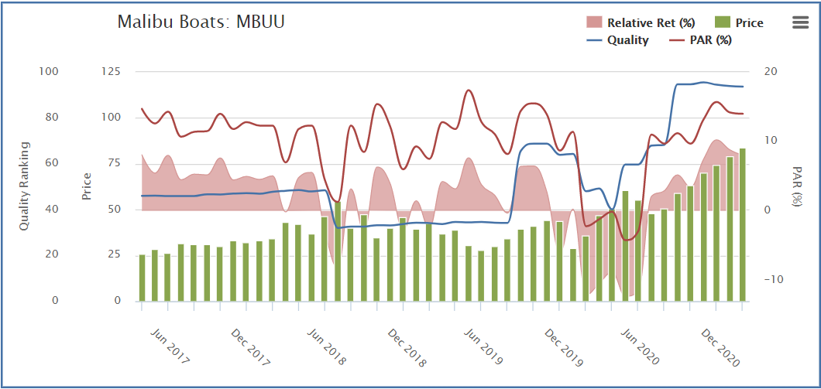

Slide 11
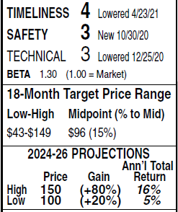
Malibu Boats, Inc. is a designer, manufacturer, and marketer of performance sport boats and accessories. The company’s boats are used for water sports, including water skiing, wakeboarding, and wake surfing. It has four brands of boats: Malibu, Axis, Cobalt, and Pursuit. Retail prices of the company’s boats typically range from $60,000 to $800,000. Malibu operates through a network of independent dealers in North America, South America, Europe, Asia, Australia, and New Zealand. Has 1,795 employees. Officers and directors own 2.9% of comm. stock;
Malibu Boats continues to ride the wave of soaring boat demand. Indeed, boat sales have risen significantly industrywide, thanks, in part, to the impact of COVID-19. With travel and indoor gatherings
largely restricted over the past year, many have turned to outdoor, water-based activities. The end result has been strong financial results for Malibu and a rising stock price.
The outlook for 2022 and beyond is promising. The company has strong brand recognition within the sport boat industry, especially the Malibu and Cobalt lines. Too, the acquisition of Maverick should help gain more traction with the fishing crowd. As long as Malibu can keep up with deliveries, we expect double-digit sales and earnings gains in fiscal 2022. Looking further out, our projections out to 2024-2026 suggest sustained growth. Finances are in good shape. The debt load is not concerning, and management
should have the flexibility to pursue other strategic acquisitions, should any opportunities arise.
These shares have slipped one notch in Timeliness to 4 (Below Average). Nonetheless, from our perspective, the company’s long-term fundamentals are sound and the current entry point is suitable for buy-and-hold investors. Kevin P. O’Sullivan April 30, 2021

Slide 12
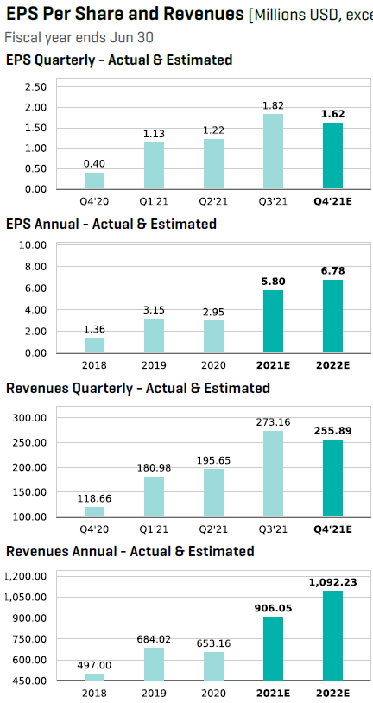
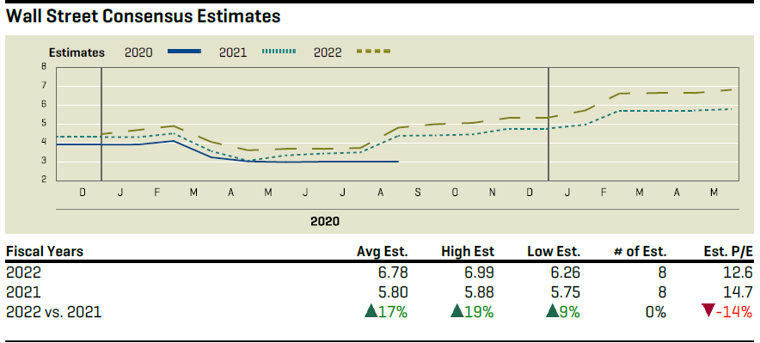

Slide 13
Fair Value and Profit Drivers Jaime M. Katz, 14 May 2021
We have raised our fair value estimate for Malibu to $97 per share from $90, which implies fiscal 2022 price/adjusted earnings of 15 times and EV/EBITDA of 11 times. While fiscal 2020 sales declined 4.5%, hindered by supply chain disruption from COVID-19, we forecast a robust restoration of sales growth in fiscal 2021. Specifically, we are lifting our fiscal 2021 estimate to high-30% sales growth in the current fiscal year (including Maverick, and from the mid-30% range prior). Over the next five years, our sales growth outlook averages 18% and includes similar-size acquisitions in both 2023 and 2025. As we expect the corporate tax rate to lift to 26% from 21% under the Biden Administration, we have included a 24% tax rate in our model, moderated by the relatively small portion of sales Malibu captures internationally.
On an organic basis, we believe that Malibu’s emphasis on innovation and vertical integration will drive continued sales and operating profit growth over the next decade. Malibu consistently releases new models with updated features across its brands, stimulating sales from both new and returning customers, which we posit has allowed Malibu to consistently capture pricing power. And we anticipate this will persist, as evidenced by our gross margin forecast, which rises from an estimated 25.5% in 2021 to 27% by 2030. We expect the operating margin to stabilize at a higher rate than in the past, benefiting from more efficient production, including new manufacturing capacity and better supply chain flexibility (with engines and towers produced in-house). Thanks to cash flow, we expect Malibu will be able to finance strategic acquisitions about every 2 years, largely via cash on hand and using existing credit facilities.
Bulls Say Jaime M. Katz, CFA, Senior Equity Analyst, 14 May 2021
u Vertical integration across the brand portfolio could provide margin expansion that is ahead of our forecast.
u The firm’s long-term annual sales growth goal of 10% should be easily attainable and could rise materially faster if category expansion and acquisitions occur faster than we anticipate.
u Malibu’s strong balance sheet, with low leverage and healthy free cash flow/equity, should offer the company the flexibility to withstand cyclical downturns and finance bolt-on acquisitions from cash on hand.
Bears Say Jaime M. Katz, CFA, Senior Equity Analyst, 14 May 2021
u EBITDA margin goals of 20% could be difficult to obtain if Malibu acquires OEMs with less favorable initial return profiles. Additionally, management's desire to keep making acquisitions could prove to be a poor use of capital.
u Malibu competes with some formidable brand names, such as Sea Ray and Chaparral, which may innovate faster and threaten market share leadership.
u Dealers rely on floor plan financing (with 85% in North America made with such a plan in 2020). The limit of any financing sources could prevent inventory from moving through the retail channel easily.

