Slide 1
MKS Instruments (MKSI) MicNova, December 2021 by Gladys Henrikson
Size: Medium/ MidCap - Revenues $2.3B in 2020
Exchange: NASDAQ
Sector: Technology
Industry: Scientific and Technical Instruments
Founded: 1961, HQ in Andover, MA

Slide 2
MKSI – How I found this Stock
Josephine Murphy Recommendation
BI Website: 3 First Cut analyses in 2021
BI Ticker Talk, Sept 1, 2021 “Five in Five” – Ken Kavula
BI Ticker Heat Map – Green under Technology
Manifest Investing: Roundtable Published Dashboard 2021
Quality: 97
PAR: 15.2

Slide 3
MKSI – Critical Subsystem Provider in Wafer Fabrication Equipment (WFE)

Slide 4
MKSI Products: Critical Solutions and Equipment
Sealed Wafer
Environ

Slide 5
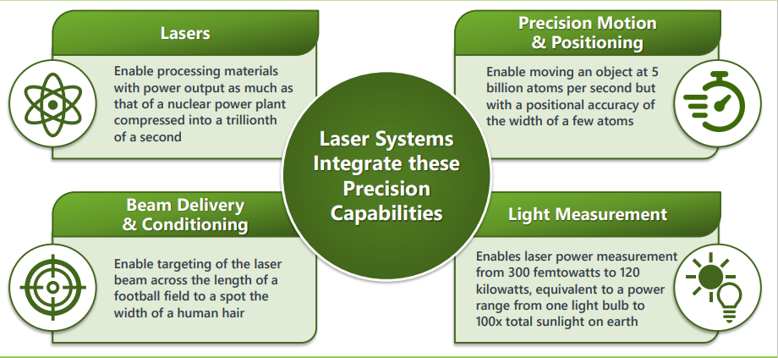
MKSI Equipment Addresses Precision Manufacturing

Slide 6
MKSI Services and Products
Miniaturization and Technically Complex Manufacturing Sub-System Equipment and Services in Semiconductor and Advanced Markets (from MKSI Investor Presentation, Nov 2021)

Slide 7
Business/Industry Growth Drivers
In Semiconductor arena- Strong demand and requirements for increased complexity in wafer fabrication equipment (WFE). Customers need:
Miniaturization – e.g. for smartphones, wearables
Density – e.g. very fast processing
New Materials – e.g. for greater interconnectivity
Accelerating shift from mechanical to laser-based manufacturing for printed circuit boards (PCBs) and rapid adoption of laser, optics and photonics
Proliferation of 5G networks and Internet of Things (IoT) connectivity is driving production of smaller, feature-rich advanced electronics

Slide 8
MKSI Growth Strategy (Acquisitions): Atotech approved for 2022

Slide 9
MKSI Revenue and Profit, 2016-2021(TTM, $M) (Data from BI: Morningstar Financials: Note some cyclicality)

Slide 10
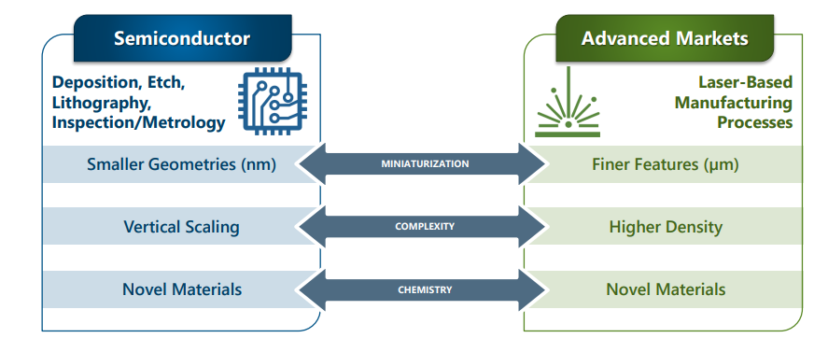
MKSI Leverages its Expertise in Precision Engineering and Technology into Advanced Markets: Wafers to Workpieces

Slide 11
Newest Acquisition –Atotech-Specialty Chemistry Solutions ($5.1B, cash & stock): Advanced Printed Circuit Boards (PCBs), Integrated Circuit(IC) Packaging, & Surface Finishing.($1.2B Rev 2020)

Slide 12
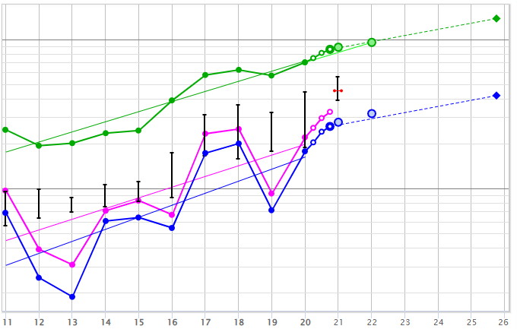
MKSI SSG: Sales, EPS, PreTax Profit
Acquisition: ESI
Acquisition: Newport

Slide 13
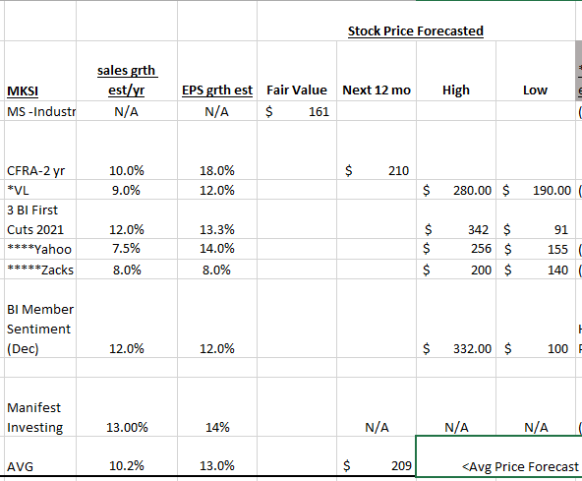
Analysts Projections for MKSI

Slide 14
MKSI Mgmt: Sales, Cash Flow, Debt, Return on Equity (15%)
Sales: $2.8 B TTM
Cash Flow: $592M TTM
30% Debt (due in 5 yrs: $36M)

Slide 15
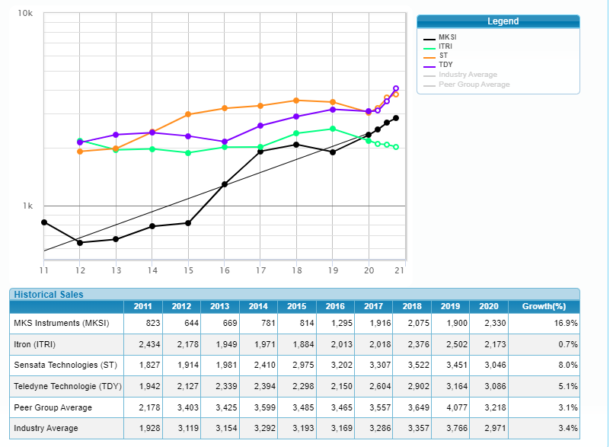
Compare Peers (from BI) Sales
MKSI

Slide 16
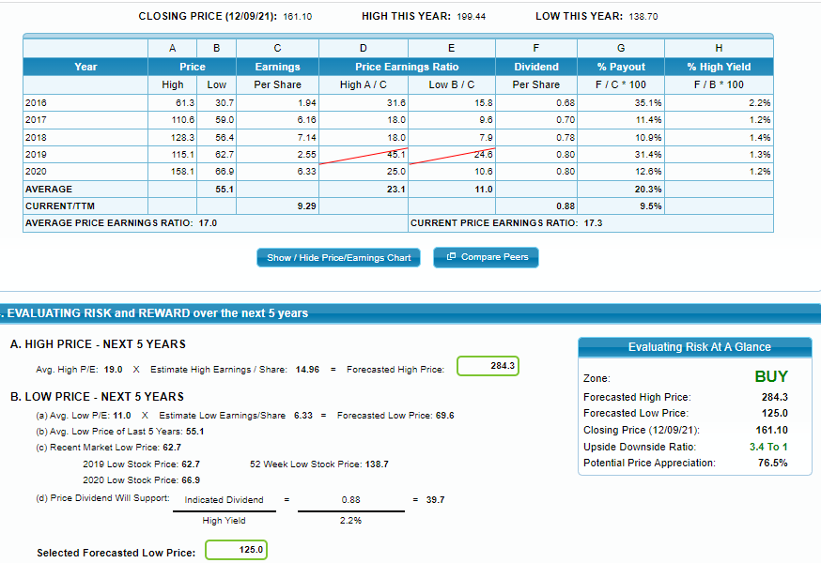
SSG Judgements
20.3
20.3
H
Hi=$284
Hi PE=19
Lo=$125

Slide 17
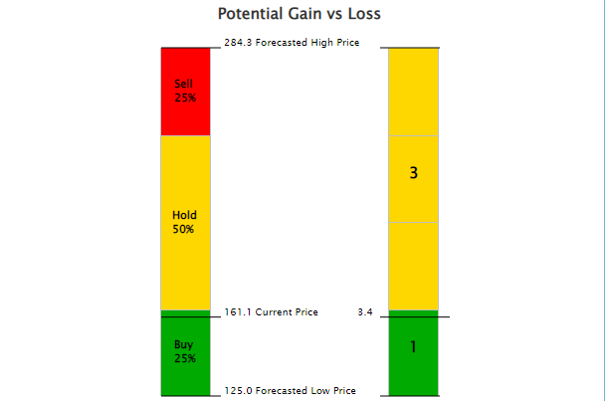
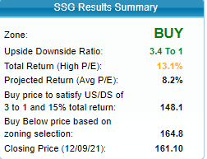
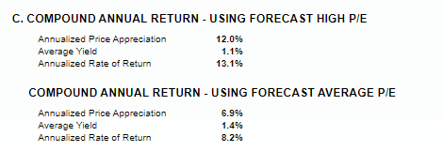
MKSI SSG Results

Slide 18
Conclusions
MKSI is a well-managed, quality, company in the normally cyclical semiconductor arena
Newest acquisition, Atotech, a chemical specialty company, should smooth out some of the cyclicality with new business customers and synergies
Strong financials: Lower debt to capital (30%) than the industry average (39%); Strong cash flow to handle acquisitions
Strong and continued double digit growth forecasts
Provides a dividend
A Buy up to $164/share

