Slide 1
The World of Stocks
Infrastructure
Caterpillar (CAT)
Martin Marietta (MLM)
Construction Partners (ROAD)

Slide 2
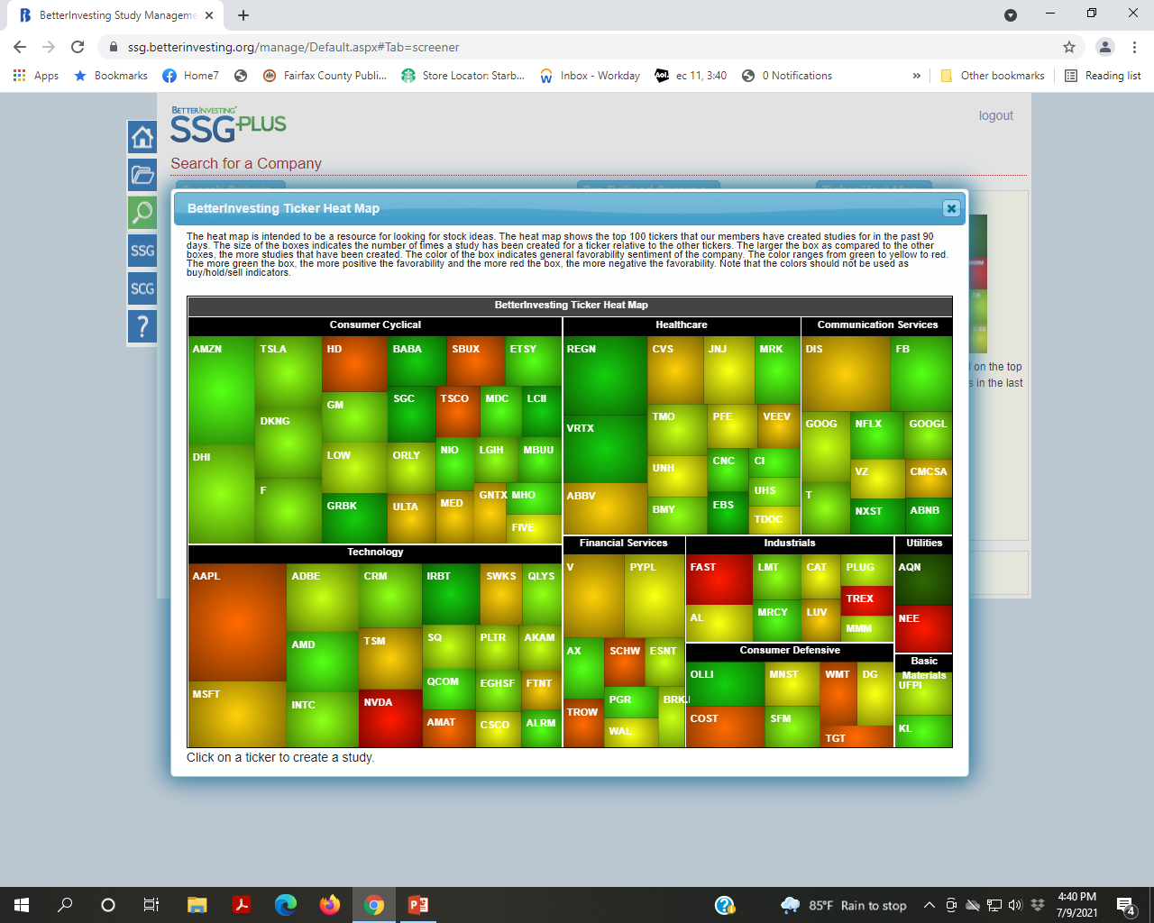
Better Investing Ticker Heat Map

Slide 3
Algonquin Power & Utilities Corp.
AQN (NYSE)

Slide 4
Algonquin
Algonquin Power & Utilities Corp. is a Canadian renewable energy and regulated utility conglomerate with assets across North America. Algonquin actively invests in hydroelectric, wind and solar power facilities, and utility businesses, through its two operating subsidiaries: Liberty Power and Liberty Utilities.

Slide 5
Algonquin (cont.)
Algonquin Power and Utilities Corp
Type | Public
Traded as | TSX: AQN
Industry | Electric generation Transmission water, Natural gas and electric utilities
Founded | 1988
Founder | Ian Robertson
Headquarters | Oakville, Ontario , Canada
Area served | North America
Key people | Arun Banskota, CEO
Revenue | U$1.6 B (2020)
Total assets | U$11.7 B (2020)
Number of employees | 3,400 (2020)

Slide 6
Public Listing
Algonquin Power Income Fund was established in September 1997 and first listed its trust units on the Toronto Stock Exchange on December 23, 1997. Having raised nearly $75 M, Algonquin used $27.5 M to purchase 14 hydroelectric generation facilities located in Ontario, Québec, New York and New Hampshire.
Algonquin Power & Utilities Corp. was added to the TSX 60 Index* on June 22, 2020.

Slide 7
TSX 60 Index
* The S&P/TSX 60 Index is a stock market index of 60 large companies listed on the Toronto Stock Exchange. Maintained by the Canadian S&P Index Committee, a unit of Standard & Poor's, it exposes the investor to 10 industry sectors.

Slide 8
Business Overview
Regulated Services Group Provides regulated wastewater, water, natural gas and electric utility services to over 1 million customer connections through operations in North America, Bermuda, and Chile.
Renewable Energy Group Owns and operates a portfolio of North American renewable and clean energy power generating facilities representing ~2.3 GW of gross installed capacity. Also has investments in generating assets with ~1.1 GW of net generating capacity.

Slide 9
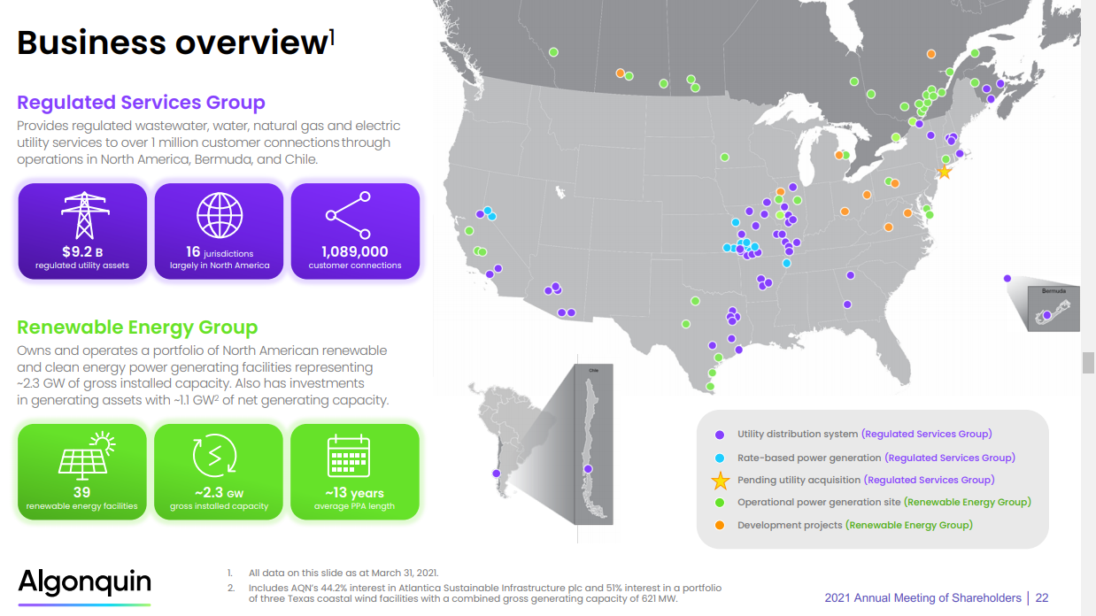

Slide 10
Liberty Utilities operates in the following U.S. locations
Earlier and later acquisitions
Arizona (water)
Acquired Boulders Carefree Sewer Company in Carefree in 2001
Acquired Entrada Del Oro Sewer Company in 2008
Arkansas (water)
Acquired the Arkansas operations of United Water in 2012
Acquired natural gas, water and electric distribution operations of Empire District Electric Company in 2017
California (electricity, water)
Acquired NV Energy's California operations, serving the Lake Tahoe Basin, with Emera in 2009; bought out Emera's stake in 2011
Acquired Mesa-Crest Water Co., serving La Canada Flintridge, in 2019

Slide 11
Georgia (gas)
Acquired the natural gas operation of Atmos Energy in Columbus and Gainesville in 2013
Illinois (gas, water)
Acquired the water operations of Silverleaf Resorts in 2005
Acquired the natural gas operations of Atmos Energy in Illinois in 2012
Iowa (gas)
Acquired the natural gas operations of Atmos Energy in Iowa in 2012
Kansas (natural gas, water electric)
Acquired natural gas, water and electric distribution operations of Empire District Electric Company in 2017

Slide 12
Massachusetts (gas)
Acquired New England Gas Company in Fall River and North Attleborough from Laclede Group in 2013
Missouri (gas, water, electric)
Acquired the water operations of Silverleaf Resorts in 2005
Acquired electric, natural gas and water operations of Empire District Electric Company in 2017
New Hampshire (gas, electricity)
Acquired Granite State Electric and EnergyNorth Natural Gas from National Grid in 2012
Oklahoma (electric, natural gas, water)
Acquired electric, natural gas, and water operations of Empire District Electric Company in 2017
Texas (water)
Acquired the water operations of Silverleaf Resorts in 2005

Slide 13
From The 2021 Annual Shareholders’ Meeting

Slide 15
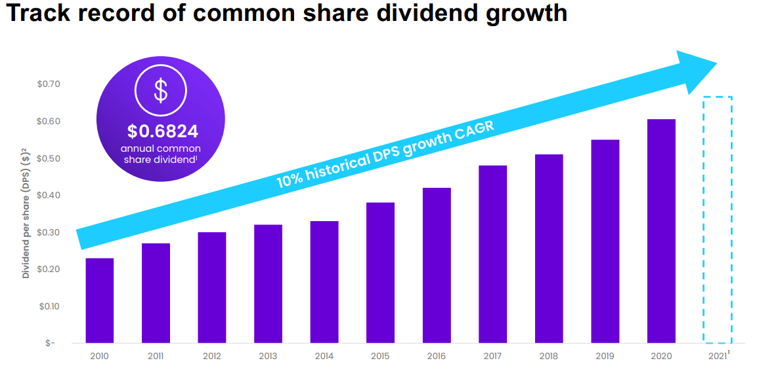

Slide 18
Yahoo! Finance
AQN is one of the “Top Alternative Energy Stocks for Q3 2021”
These are the alternative energy stocks with the best value, fastest growth, and most momentum for Q3 2021.

Slide 19
Motley Fool Stock Advisor Canada
The balance sheet of the company is rock solid, and since a significant portion of its revenue comes from its stable utility business, we can be reasonably sure about the consistency of net income. This, along with a 44.2% payout ratio, makes its dividends incredibly safe. And the 3.8% yield is reason enough to consider this amazing stock, especially if you factor in its decent dividend-growth rate (33% in the last four years).
But the most compelling reason this stock is a must-buy is its powerful capital growth prospect. The company has a 10-year Compound Annual Growth Rate of 20.3%, and its growth has been eerily consistent for the past decade.
Algonquin combines a lot of features you might look for in a stock you are considering keeping long term. It has a dependable revenue source (utility business), is future-focused (green energy), has a stable balance sheet, has consistently growing income, and has a diversified portfolio of assets. If it can sustain its growth rate, Algonquin will most likely prove to be an amazing long-term holding.

Slide 20
SSG
DEDICATED TO GURU SHERYL
(WITH NO HELP FROM MORNINGSTAR OR Value Line)

Slide 21
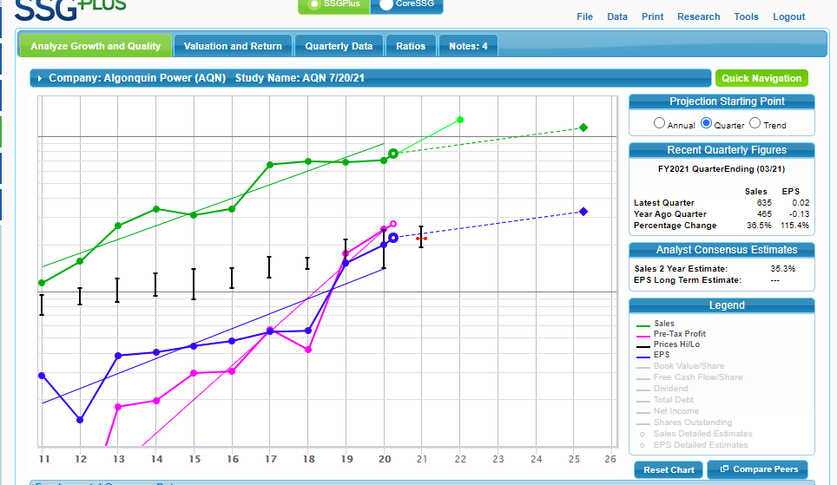

Slide 22
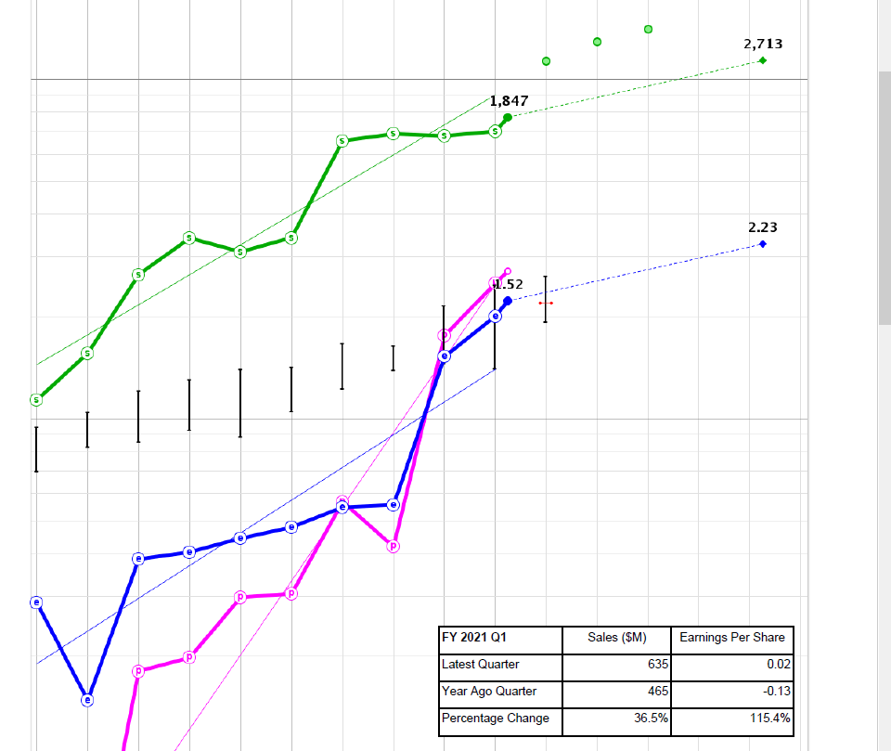

Slide 23
