Slide 1
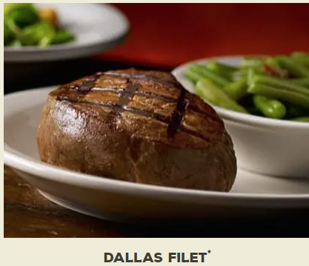
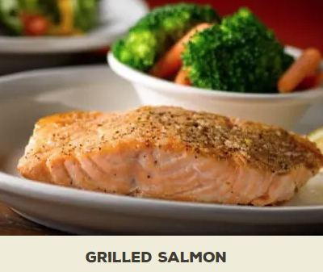
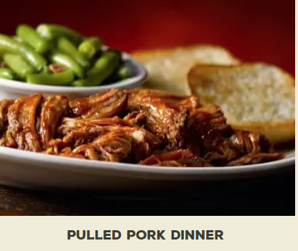
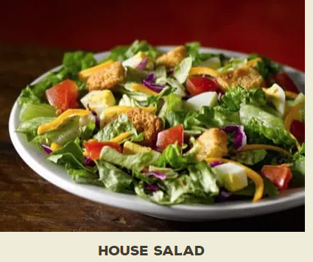

Slide 2
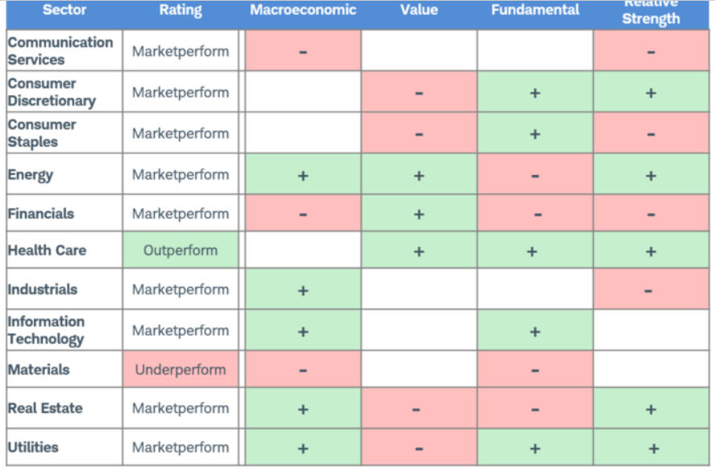
Schwab Sector Performance 2020

Slide 3
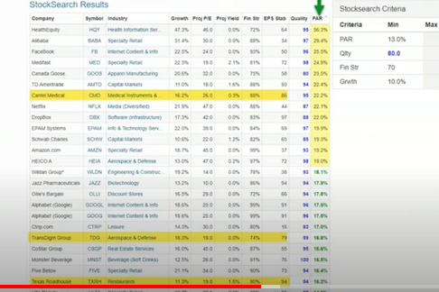
From Manifest Investing Roundtable, October 2019
Note: TXRH PAR 14.2%

Slide 4
Discussed in Q4, October 2019, Manifest RoundTable as a possible buy
Texas Roadhouse, Inc. is a growing restaurant company operating in the casual dining segment.
Founder, Chairman and Chief Executive Officer, W. Kent Taylor, started the business in 1993 with the opening of the first Texas Roadhouse restaurant in Clarksville, Indiana.
Today, the Company operates over 610 restaurants system-wide in 49 states and 10 foreign countries, including 581 Texas Roadhouse restaurants and 28 Bubba’s 33 restaurants.
Their focus: High quality, affordable meals served with friendly service
Customer Quote: “We go to Texas Roadhouse because their steaks are just as good as the high end steak houses and the prices are more affordable.”

Slide 5
Growing Strong (info from fiscal year ended Dec. 31, 2019 MD&A)
2019 opened 22 restaurants
2020 slated to open 30 new restaurants
December 2019 signed franchise and/or development agreements in the Middle East, Taiwan, Philippines, Mexico, China and South Korea. Now have 28 international restaurants
February, 2020 pays quarterly dividend of .36 per share of common stock
Dec, 2019 $160.4 Million remains authorized for stock repurchase

Slide 6
TXRH Compared to Competitors (Merrill Edge, 4-25-20)

Slide 7
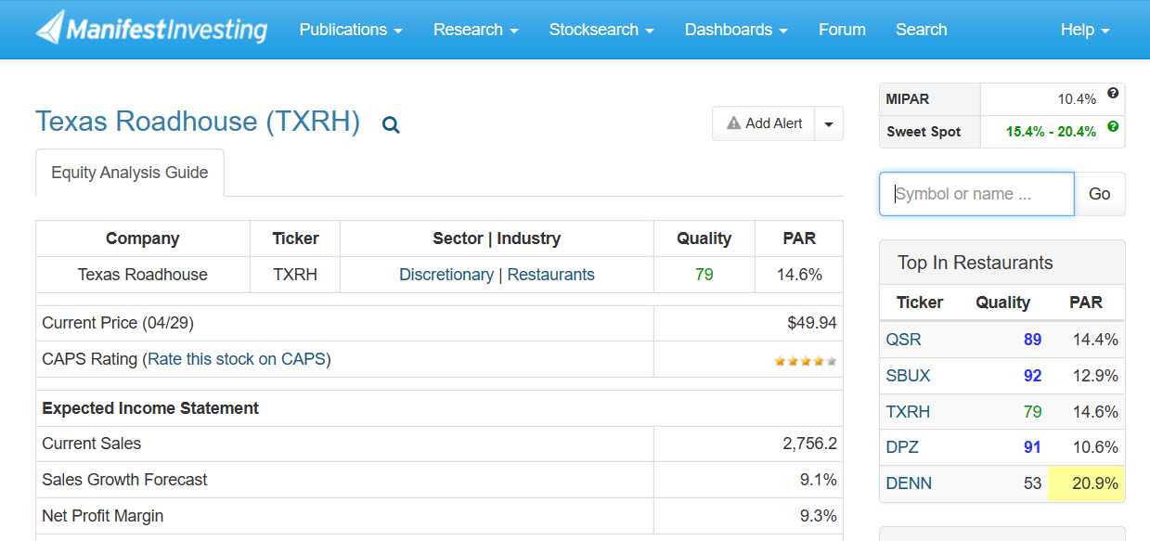

Slide 8
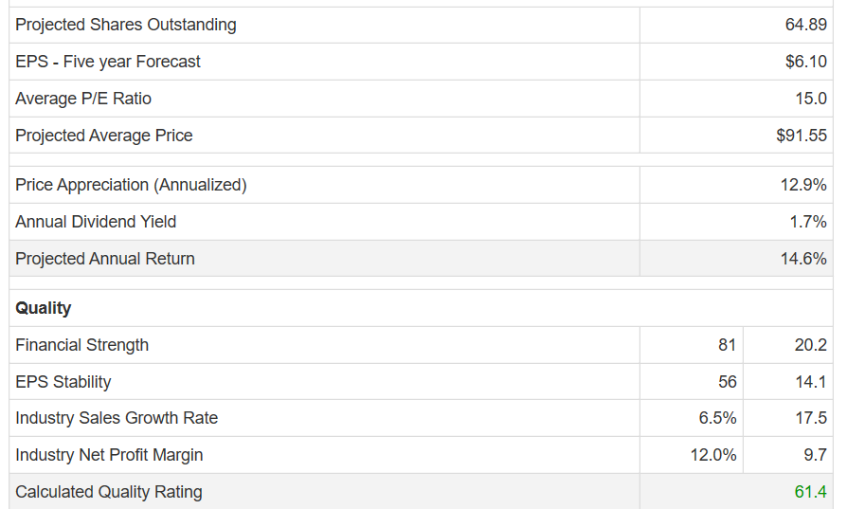
Manifest Investing Assessment of TXRH, cont.

Slide 9
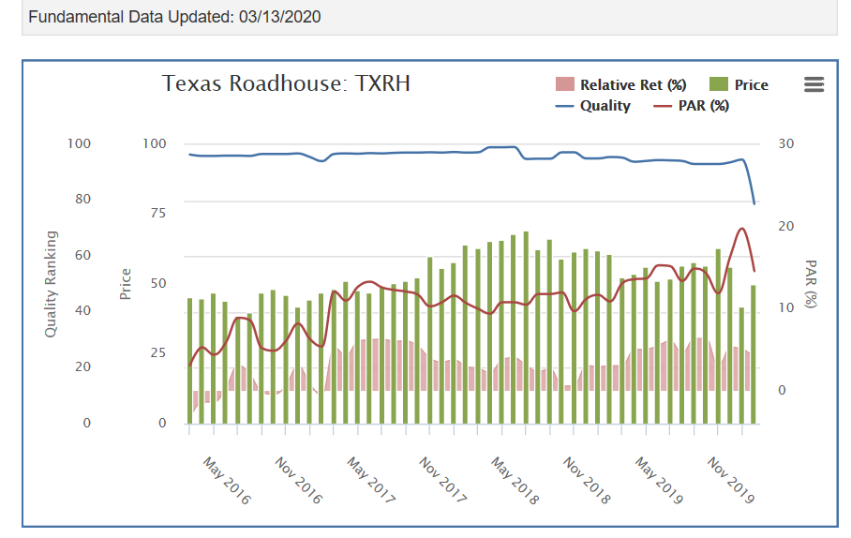
TXRH Quality and PAR – From Manifest Investing
See Quality Line

Slide 10
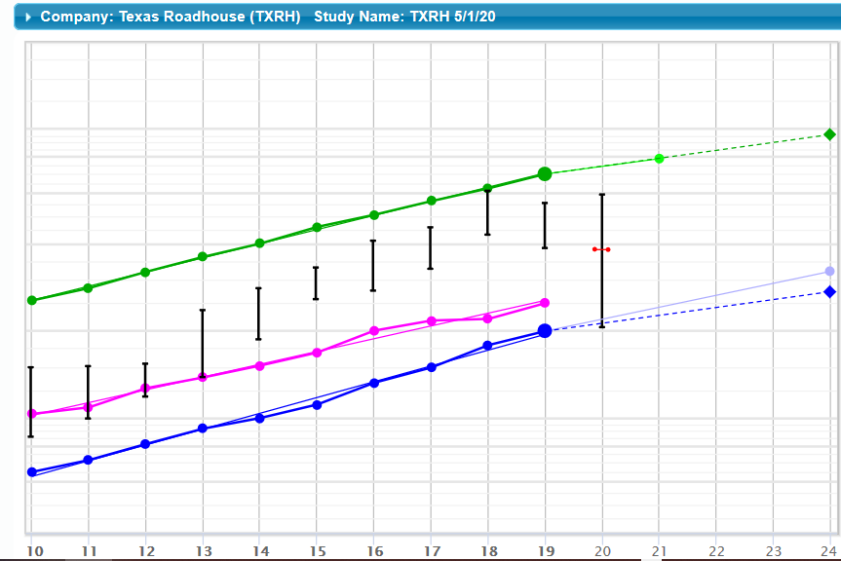
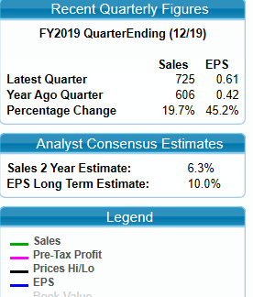
My Analysis of TXRH: 1st page of SSG (5/1/20)

Slide 11
My Sales & Earnings Judgements in these years of Pandemic & Recovery (2020+)
Analysts Estimates for Sales Growth:
Value Line = 4.5% over 5 yrs
Analysts’ Consensus = 6.3% next two years,
Manifest Investing =9.1%
I chose estimate close to Analysts’ Consensus.
Note: Debt = New Lease Accounting

Slide 12
My P/E Judgements reflecting falling P/E ratios, due to Shuttered Restaurants serving only Take-Out (Eliminated all but Current High and Low P/Es. Note Average PE at 23.4 and Current P/E at 19.1)

Slide 13
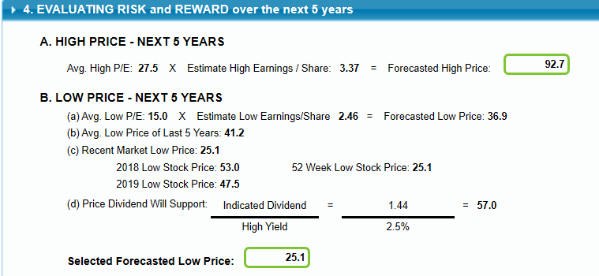
Forecast-ing High and Low Stock Price

Slide 14
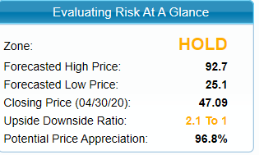
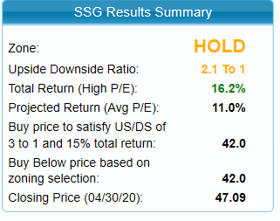

Slide 15
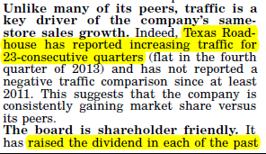
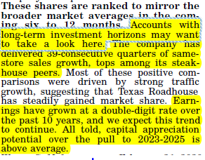
Value Line

Slide 16
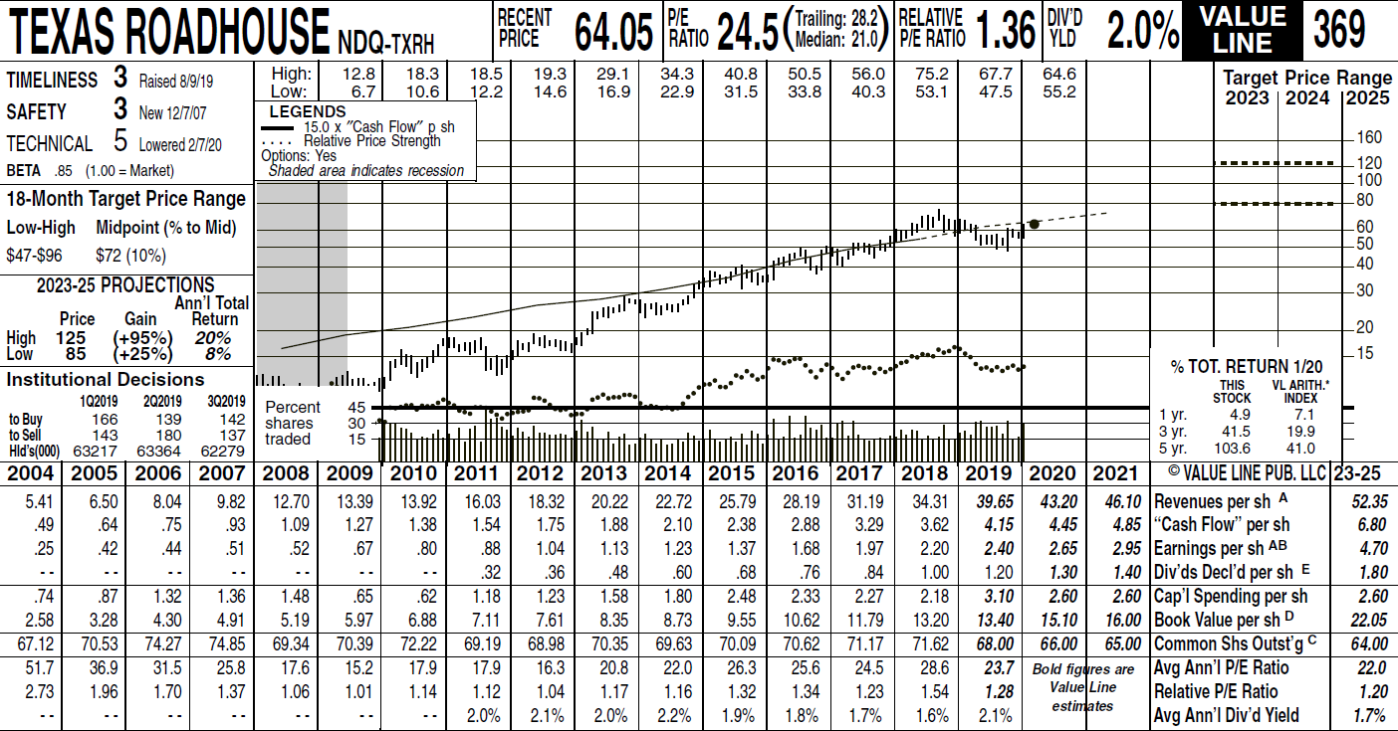
Value Line

Slide 17
UPDATE: May 4, 2020 TXRH Q1 2020 (Mar 31, 2020) Financial Results – Coronavirus Impact
Impact of Covid-19 on 1st quarter sales at TXRH company restaurants:
January sales increase = 8%
February sales increase = 4.2%
March sales increase/(decrease) = (29.7%)

Slide 18
Steps TXRH is Taking to Survive & Recover
Selling restaurant fare without dine-in: To Go/Curbside service; hot and cold “Family Value Packs;” Ready-to-Grill Steaks
Avg restaurant’s weekly dine-in sales, week ending 3/3/20 = $118,512
Avg restaurant's weekly To-Go Sales from 3/3 to 4/28 = $9,115 - $54,937 (although impressive, To-Go sales can’t replace dine-in sales)
Reducing Expenses:
Decreased capital expenditures – only finishing 9 restaurants
Suspended all quarterly cash dividends & share repurchases
Decreased salaries, bonuses & feeds (including executive & leadership teams)
Increased borrowings under revolving credit facility by $190 million
Supporting Employees and Communities
For Employees: Provided “stimulus package” to front-line employees in March: allow early vacations; paid health insurance premiums; provide relief grants; secured personal protective equipment (helps cover some lost hours and supports employee retention)
For Communities: Has Donated funds to provide assistance to community customers in need. (partners with their communities and customers)

Slide 19
Conclusion: Add to Watch List
TXRH has developed a re-opening framework for US stores – using a hybrid business model of limited dining rooms and enhanced To-Go, as permitted by local guidelines.
As of May 4, Company has re-opened dining rooms in 25 restaurants (following limited capacity local restrictions)
Due to unprecedented economic conditions, the Company cannot yet provide an updated financial outlook for its performance.
However, TXRH has been a Best-of-breed, midsize company, in restaurant industry
Value Line feels it is positioned to survive the pandemic:
Good cash flow, good growth
Solid Fundaments For the long term investor

