Slide 1
Presentation & Data as of: May 6, 2020
Sector: Industrials/ Aerospace and Defense
Background:
Merger: Raytheon Technologies Corporation (NYSE: RTX) announced its all-stock merger of Raytheon Company and United Technologies Corporation (UTC) on April 3, 2020
Size: Raytheon Technologies is (now) one of the largest aerospace and defense companies in the world with approximately $74 billion in pro forma 2019 net sales
Ranking among Defense Contractors: Raytheon already ranked number two on the most recent Defense News Top 100 list, with $23.5 billion in defense revenues, 93 percent of its overall revenue total; UTC had $7.83 billion in defense revenues, a mere 13 percent of its overall figures.
Business Customers of Merged Company: 50% commercial and 50% defense; plans $8B for R&D, mostly for defense

Slide 2
Business Segments from United Technologies Corp.
Collins Aerospace Systems specializes in aerostructures, avionics, interiors, mechanical systems, mission systems and power controls that serve customers across the commercial, regional, business aviation and military sectors. The segment, headquartered in Charlotte, NC, had approximately $26 billion in 2019 net sales.
Pratt & Whitney designs, manufactures and services the world's most advanced aircraft engines and auxiliary power systems for commercial, military and business aircraft. The segment is headquartered in East Hartford, CT, had approximately $21 billion in 2019 net sales.
Business Segments from Raytheon Co.
3. Raytheon Intelligence & Space specializes in developing advanced sensors,…cyber and software solutions — delivering the disruptive technologies its customers need to succeed in any domain, against any challenge. The segment, headquartered in Arlington, VA, had approximately $15 billion in pro forma 2019 net sales.
4. Raytheon Missiles & Defense provides the industry's most advanced end-to-end solutions to detect, track and engage threats. The segment is, headquartered in Tucson, AZ, had approximately $16 billion in pro forma 2019 net sales.

Slide 3
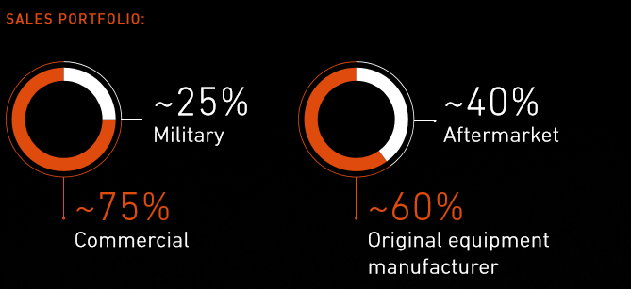
1. Collins Aerospace Segment (Components)
Was 33% of UTX Revenues before merger with Raytheon
Examples of Innovations:
3D printed headbands for face shields for healthcare workers
Hybrid-Electric Propulsion to reduce aviation’s carbon footprint (in process)

Slide 4
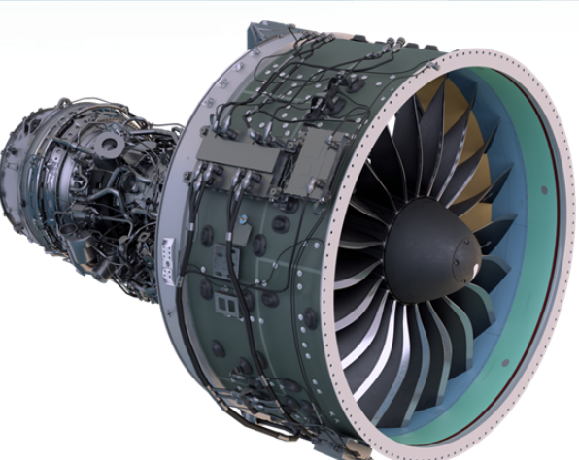
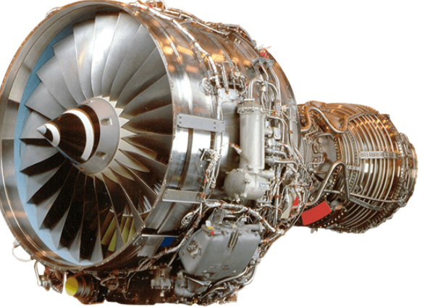
2. Pratt and Whitney Segment (Aircraft Engines & Parts)
PRATT & WHITNEY Is a world leader in the design, manufacture and service of aircraft engines and auxiliary power units. (Note: was 27% of UTX Before Raytheon Merger)
Commercial Engines:
13,000 installed engines in nearly 30% of world’s mainline passenger aircraft fleet
Military Engines:
>7,000 installed engines with 34 armed forces world wide.

Slide 5
3. Raytheon Intelligence & Space Segment
Key capabilities include:
Acoustic signal processing.
Quantum computing.
Artificial Intelligence.

Slide 6
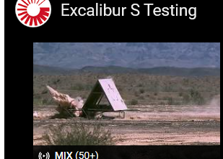
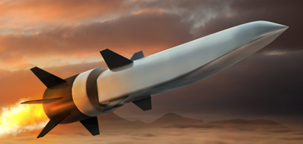
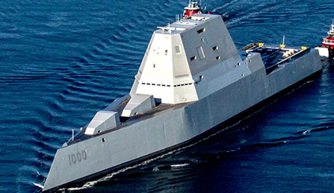
4. Raytheon Missiles and Defense Segment
Excalibur® S munition use
GPS/lasers to hit moving targets
Hypersonics (weapons & defense missiles) travel at 5X speed of sound.
Zumwalt-class destroyers, DDG 1000,
feature Raytheon technologies: Total ship, encrypted, computing network;
Electronic Modular Enclosures ; MK57 Vertical Launching System
RM&D is producing SM-3 Block IB interceptors under a $2.1 billion, multi-year U.S. Missile Defense Agency contract. It is the first multi-year contract for the SM-3 program, and covers fiscal years 2019–2023.
SM-3 is the only ballistic missile interceptor that can be launched on land and at sea. It is deployed worldwide and has achieved more than 30 exoatmospheric intercepts against ballistic missile targets.

Slide 7
Some Analysts’ Observations
Byron Callan, Capital Alpha Partners defense analyst, (June 2019)
“ (this merger) may be a signal that 1) this U.S. defense cycle is peaking, and firms need to start repositioning for growth in 2021 and beyond; 2) the commercial aerospace outlook is looking wobbly .]. 3) Defense firms need to fund more of their own R&D in the future so (being) a larger firm will limit margin pressure, (appearing) in the 2020s,”
Colin Scarola, CFRA analyst, (May 2, 2020)
Buy recommendation. Price target $71/share.
RTX possesses an attractive combination of non-cyclical Defense businesses with strong long-term growth prospects in commercial aerospace, and that it is currently undervalued.
We expect RTX's commercial aerospace businesses to decline during the coronavirus downturn ... Our analysis shows Defense earnings are not correlated to economic downturns or budget deficits.
“We see [RTX] outperforming most industrial peers,…due to the stability of its Defense businesses (51% of revenues) through recessions.”
Manifest Investing, (May 6, 2020) (NOTE: Q1 2020 Earnings Call on May 7, 2020)
Quality = 94; PAR= 20.8%; Sales growth =10%; Avg P/E=9; Proj Avg Price =$135; Annual price appreciation = 18%
Top in Aerospace & Defense

Slide 8
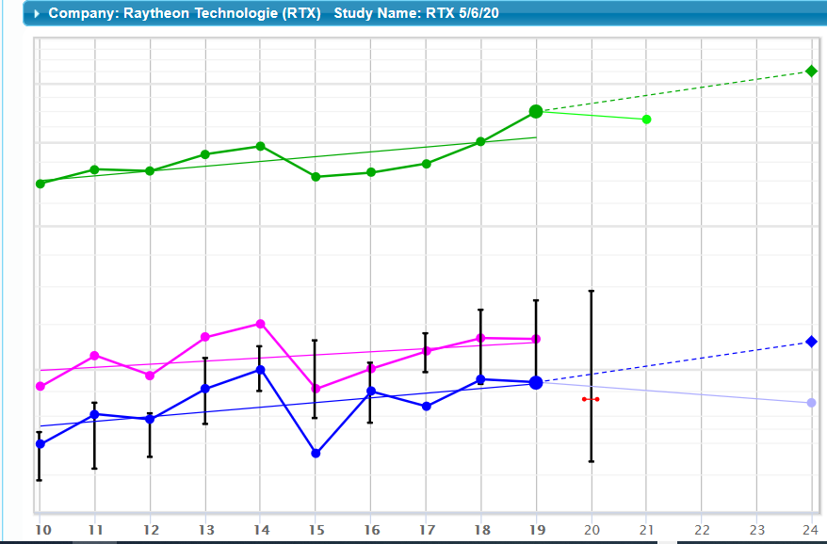
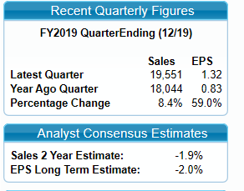
Est. 4% growth;
2018-19 ~ 8% growth

Slide 10
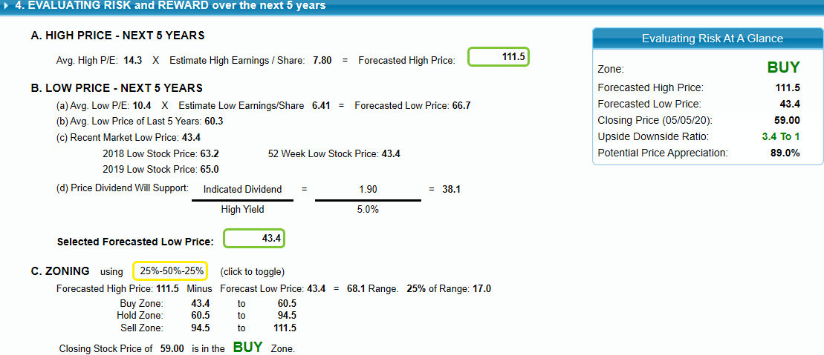
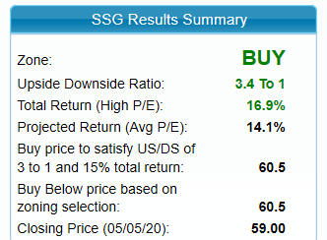

Slide 11
RTX Study Conclusions
There is much economic uncertainty with the pandemic, although Defense Spending should be fairly steady
This study used conservative estimates, but hampered by lack of:
Merger newness – no combined financial history, except pro forma
Earnings reports –Q1 2020, the first, to be issued tomorrow, May 7,2020
Current analyst coverage of merged company
Proposed Next Steps
Add RTX to Watch List, together with GD (from last month)
Next Month, with Q1 earnings, do a Stock Comparison between RTX and GD
Choose which stock to keep on the Watch List.

