Slide 1
OMNICON GROUP INC. NYSE – OMC
Presented by
Kent Billmyer

Slide 2
OMC Investor slides 3rd qtr 2020

Slide 3
OMC Investor slides 3rd qtr 2020

Slide 4
OMC Investor slides 3rd qtr 2020

Slide 5
OMC Investor slides 3rd qtr 2020

Slide 6
OMC Investor slides 3rd qtr 2020

Slide 7
OMC Investor slides 3rd qtr 2020

Slide 8
VALUE LINE – OMC – October 30, 2020

Slide 9
VALUE LINE – OMC – October 30, 2020

Slide 10
Mornigstar’s Analysis – OMC - Oct 27, 2020

Slide 11
Mornigstar’s Analysis – OMC - Oct 27, 2020

Slide 12
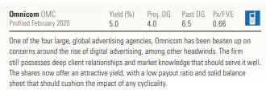
Morningstar DividendInvester – OMC - February and November 2020

Slide 13
Morningstar StockInvester - OMC November 2020

Slide 14
OMC – SSG 16 Nov 2020

Slide 15
OMC – SSG 16 Nov 2020

Slide 16
OMC – SSG 16 Nov 2020

Slide 17
OMC – SSG 16 Nov 2020

