Slide 1
Maximus MMS
MicNOVA Stock Study
December 15, 2020
Jo Murphy

Slide 2
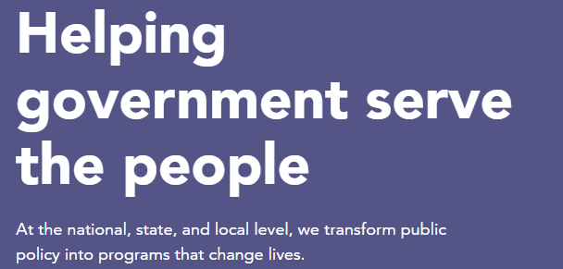
Maximus Mission
Creates innovative business process management for higher levels of productivity, accuracy, accountability and efficiency of government-sponsored programs.

Slide 3
Maximus
Administers federal, state & local government-sponsored programs, such as
Medicaid and Medicare
Children’s Health Insurance Program (CHIP)
Affordable Care Act (ACA) exchanges
CDC Center operation and helpline
CARES Act inquiries
Unemployment Insurance Programs
U.S. Census Questionaire Assistance
Federal Student Loan Programs
Covid-19 Contact Tracing and test result notification

Slide 4
Maximus
Founded 1975
Reston, VA headquarters
Sector: Industrial
Industry: Specialty Business Services
Medium-sized company $3B sales
33,000 employees
Officers/directors own 2% of company

Slide 5
Maximus
Operates in three segments:
U.S. Services: (38% of Revenue) business process services such as program administration, appeals and assessments work, and clinical offerings in public health, health insurance eligibility support and enrollment services, multilingual contact centers, digital self-service options
Federal services: (47% of Revenue) census assistance, CDC Helpline, inquiries regarding CARES (Coronavirus Aid Relief & Economic Security), support centers for Medicaid and Medicare (CMS), supports the federal exchange under the ACA as its primary support engagement
Outside the U.S. (15% of Revenue) business services transitioning from gov’t. assistance to sustainable employment and economic independence. Has operations in Canada, England, Australia, Sweden, Italy, Saudi Arabia

Slide 6
Maximus competitors
U.S Services: 1) government in-sourced operations, then 2) Conduent, Automated Health Systems, Faneuil, KePro, MTX group.
U.S. Federal: Serco, General Dynamics Information Technology (recent purchase), Cognosante, Conduent.
Outside the U.S. 1) MMS is leading service provider in United Kingdom and Australia, and 2) Atos, Capita, Interserve, Virgin Care, Staffline, Shaw Trust, Telus-Health, and many other private and nonprofit groups.

Slide 7
Maximus
Long-term outlook & revenue visibility
Contracts of 5 years or longer: backlog can predict up to 90% of revenue
40% of current backlog to be realized in 2021
Deep customer relationships lasting decades create continuous contracts
Leader in markets & barriers to entry
Largest provider of Medicaid enrollment services, more than 65% of all those enrolled in Medicaid managed care.
Leading provider of CHIP services and state-based health insurance exchange operations.

Slide 8
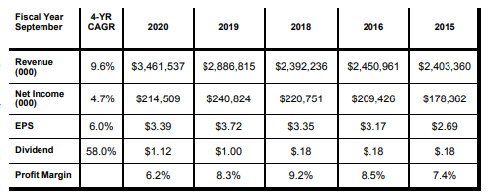
Maximus
From Hendershot Investments, Dec. 2020 p. 12.

Slide 9
Maximus

Slide 10
Maximus and Value Line
November 20, 2020
Value Line

Slide 11
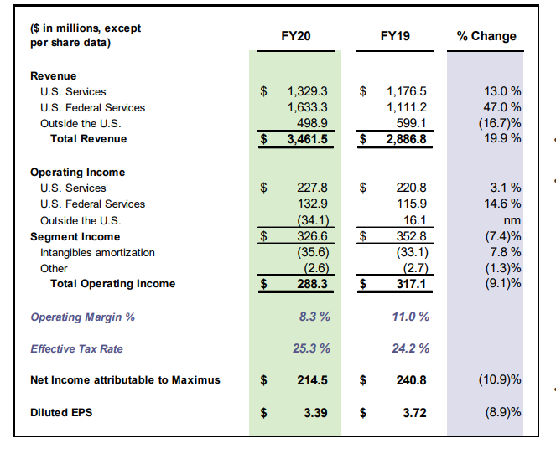
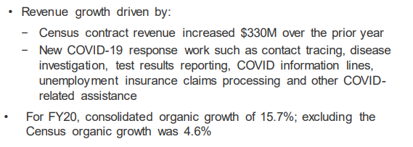
Maximus: Fiscal 2020 Results

Slide 12
MAXIMUS: Cash Flow
Free cash and cash equivalents of $71.7M and no draw on credit facility.
Raised dividend from $1 to $1.12

Slide 13
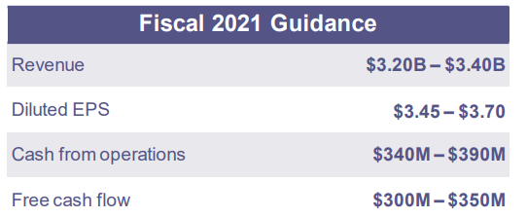
Maximus: Guidance for 2021
Organic growth of 10% (excluding Census work decline) from:
Increase of $175M from Outside the U.S. segment
New work on unemployment services contracts
Resumption of activities in U.S. Services segment
Reduction in 2Q rev. and eps as Covid-19 response work concludes.

Slide 14
Maximus Pipeline
Signed contracts 2020 $2.7 Billion
Sales pipeline $33 B
$1.5 B proposals in preparation
$2.0 B proposals pending
$29.6 B in opportunities tracking
Expected 2021 revenue between $3.2--$3.4 Billion
or 10% organic growth (adjusting for census wind-down)

Slide 15
Maximus
Value Line

Slide 16
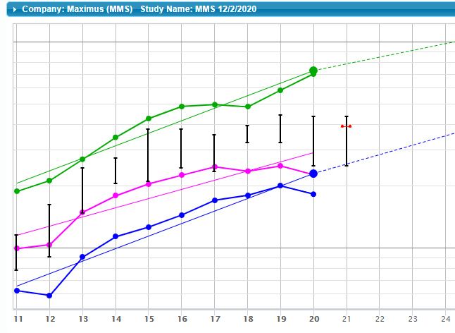
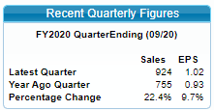

Slide 17
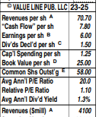
VL Estimates vs. my SSG
6
6.36
4,267

Slide 18
Switch to Maximus SSG now.

