Slide 6
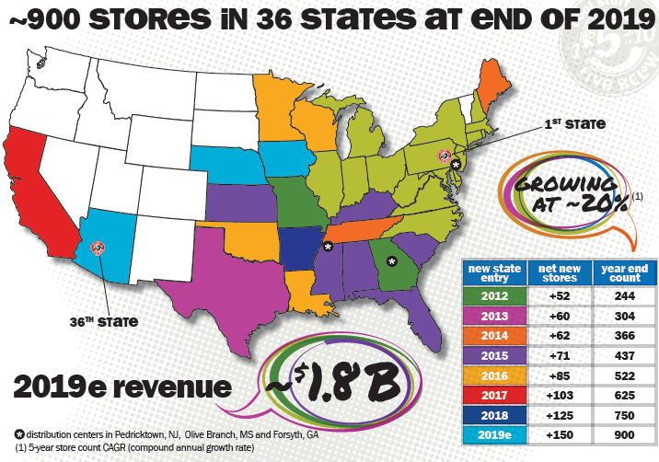

Slide 7
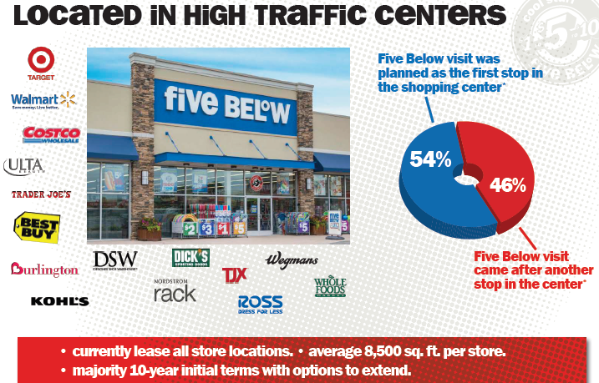
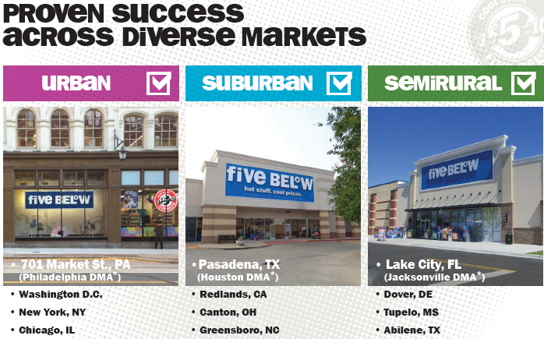

Slide 8
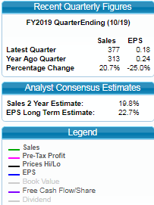
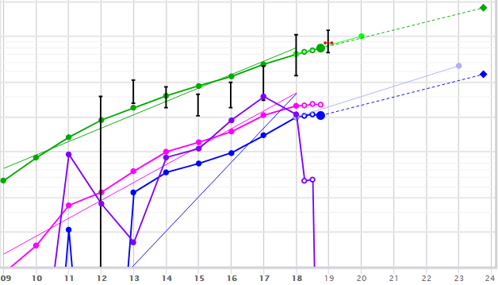

Slide 10
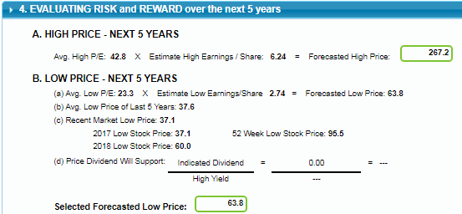
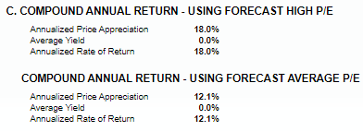
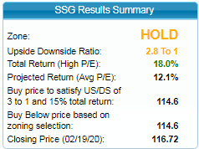

Slide 12
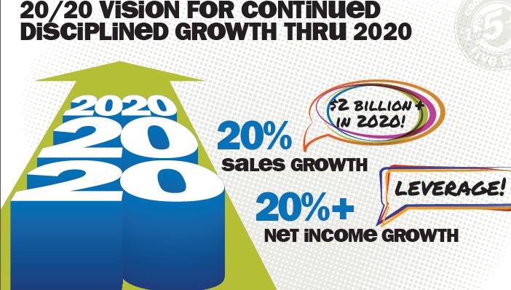

Slide 13
GROWTH NOTES
VALUE LINE – January 24, 2020
Nasdaq – Strong Buy based on 10 analysts in the last 3 months
12 month price targets low – $110 average - $134 High - $159
Sales Growth Next Year 2021 – 21.1%
EPS Growth - Next 5 years – 17.5%
ZACKS
EPS Growth Estimates – Next 5 years – 24.2%

Slide 14
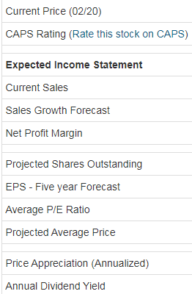
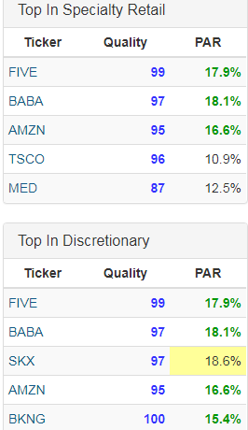

Slide 15
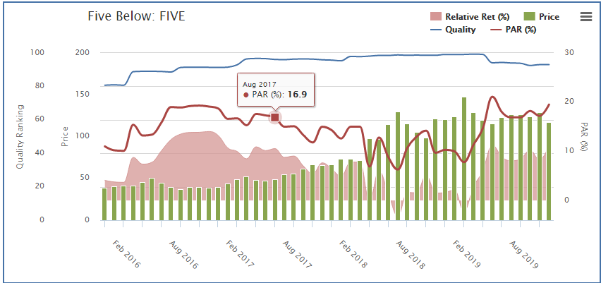

Slide 16
Favorable fundamental outlook and bullish prospects, average roughly 20% top and bottom line growth thru FY 21 due to: 1) expand store remodels (comps up "mid-single-digit" in 3rd qtr. 2) rollout of Ten Below in most stores;
3) rapidly expanding footprint, amid thousands of store closures year to date; 4) leveraging of omnichannel go-forward like buy online pick up in store and e-com-merce platform Hollar.com, 1/13/20; 5) focus on experiences. Introduction Localhost esports locations, announced Oct 10, 2019.
As the chain matures, we anticipate comparable-store sales growth to moderate somewhat from its 4% five-year historical average (to around 3% on average over the next decade, with roughly 2% from transactions upticks and just under 1% from ticket expansion). Ongoing investment in the store experience and assortment should drive results, as should the eventual emergence of a loyalty program. However, we do not anticipate online sales will be a large part of the story, as Five Below's relatively small ticket size and low-priced assortment makes shipping costs difficult to absorb (for example, the firm currently charges at least $5 per order for shipping). Combined with store growth, we expect mid-teens percentage revenue growth over our explicit forecast.
Downside risks to our view include margin pressure from List 3 and 4A tariffs. We foresee
70 bps of net unmitigated tariff costs in FY 20 and 50 bps in FY 21. A prolonged outbreak of
the coronavirus will also present challenges from a material, factory and logistics perspective. We estimate roughly 25% of FIVE's total receipts will be negatively impacted. Per Value Line: Despite the stock’s recent price pullback, capital appreciation prospects out to 2022-2024 are just average. FIVE is also untimely.at 4.

