Slide 1
Cboe Global Markets Inc
By
Arvind Krishna
Oct 20, 2020

Slide 2
CBOE
Chicago Board of Options Exchange (Cobe)
Mid Cap Growth
Financials sector
Sub Industry: Financial Data and Stock exchanges

Slide 3
Cboe Global Markets, Inc. (“Cboe Global Markets” or “Cboe”)
One of the world’s largest exchange holding companies, offering cutting-edge trading and investment solutions to investors around the world.
Offers trading across a diverse range of products in multiple asset classes & geographies,
Options – 34.9% of 2019 Revenues (Trading on Market Indexes & VIX Index}
U.S. Equities, Includes Cash & Exchange-Traded Products (ETPs) – 48.6%
European Equities, Includes ETPs – 4.4%
Futures – 5.4% (Includes trading on VIX Index, Bitcoin & Other Futures)
Global Foreign Exchange (FX) – 2.1% (Includes Institutional FX services on Cboe FX Platform)
Most popular proprietary products of Cboe are the SPX Options (options on the S&P 500 Index) and Cboe VIX (Cboe Volatility Index) Options and Futures.
VIX Index (Fear Index) - Recognized as the world’s premier gauge of U.S. equity market volatility.
Created in 1993 and has become one of the most watched barometers of market volatility
Capability to Trade multi-asset volatility products based on VIX Index.
Chicago based with a network of domestic / global offices across the Americas, Europe, UK & Asia and hubs in major cities including New York, San Francisco, Kansas City, Singapore, London & Amsterdam

Slide 4
CBOE’s Business and Competition
Cboe's revenue is primarily derived from transaction fees on the contracts or shares traded on its various exchanges. Approximately 70% of operating revenues were generated by transaction fees. These fees are a product of both the volume traded as well as the rate per contract.
COMPETITIVE LANDSCAPE. CBOE Subsidiaries include:
Largest Options Exchange in the U.S. based on both total contract volume and notional value of contracts traded with nearly 40% market share.
It competes with Options Exchanges:
- operated by Nasdaq (approximately 36% market share) &
- the NYSE (owned by ICE) - approximately 17% market share, as well as other smaller players
Third (3rd) Largest Stock Exchange operator in US Equities by volume.
NYSE 21% NASDAQ 19% Cboe 16%
Operates one of the Largest Stock Exchanges by value traded in Europe & is a leading market globally for ETP listings and trading (approx. 16% market share)
Cboe has exclusive right to offer options contracts on the S&P 500 index, the S&P 100 Index and the S&P Select Sector Indexes as a result of its licensing arrangement with S&P Dow Jones Indices.

Slide 5
CBOE Major Acquisitions
OCT. 16, 2020: Cboe Global Markets Agrees to Acquire BIDS Trading, the Largest Independent Block Trading ATS in the U.S. Planned transaction provides Cboe with a meaningful presence in the substantial off-exchange segment of the U.S. equities market. Expected to contribute $0.05 - $0.06 to adjusted earnings per share in 2021
BATS acquisition in Feb. 2017: BATS Global Markets, a Stock Exchanger Operator in Kansas becomes wholly owned subsidiary known as CBOE BATS LLC and its subsidiaries. Acquired for $3.4B in Cash and Stock Transactions
Strategic acquisitions have helped the company to gain a competitive edge by diversifying as well as adding capabilities to its portfolio - The buyout of MATCHNow will help venture into Canada. On the other hand acquisition of Hanweck and FT Options and Silexx helped boost its service portfolio.

Slide 6
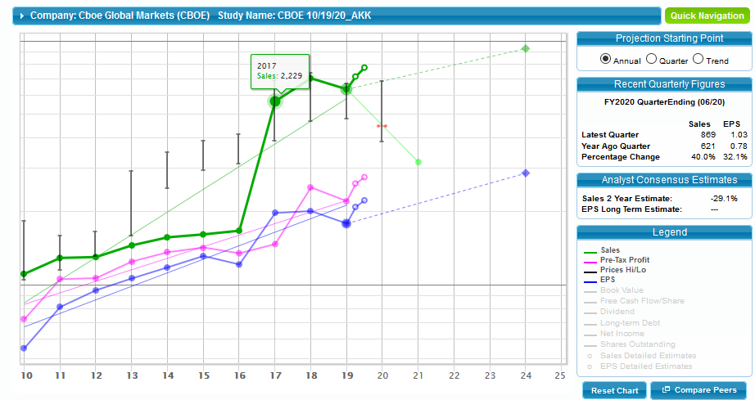

Slide 9
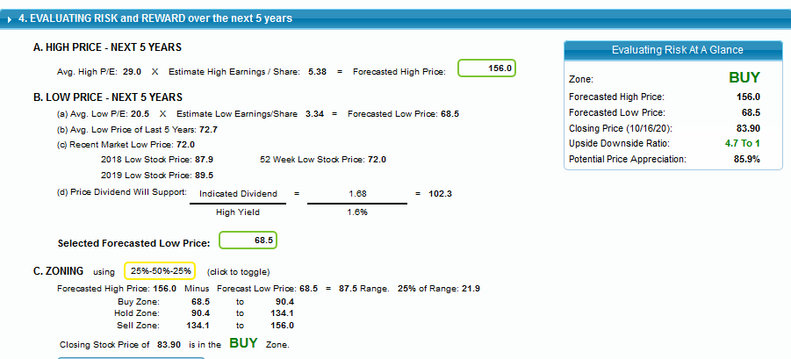

Slide 10
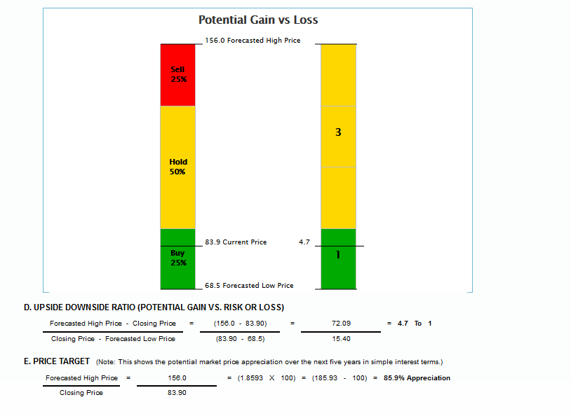

Slide 11
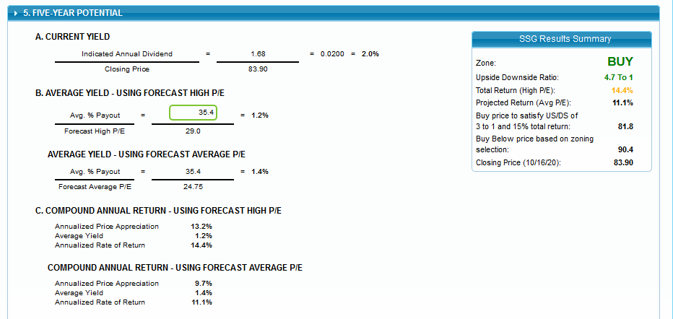

Slide 12
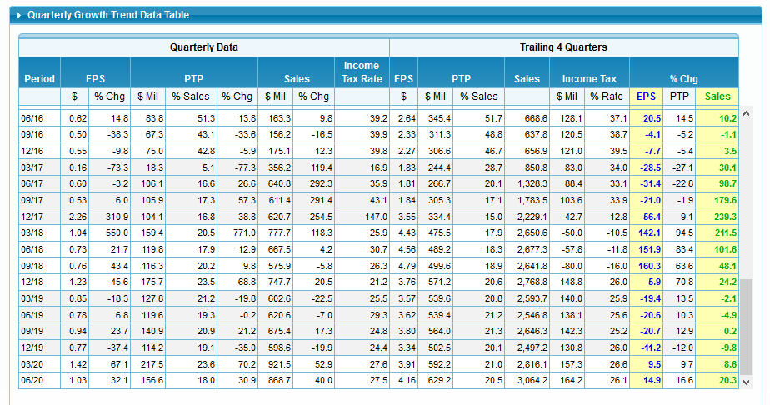

Slide 13
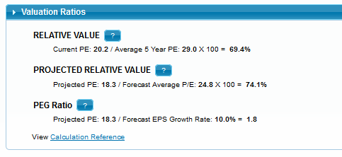

Slide 14
Index Comparison | 1 Month | 6 Months | 1 Year | 52-Week Range
CBOE: Cboe Consolidated Listings | -5.84% | -14.49% | -27.21% | $72 ---------------- $128
S&P US Financials | +2.29% | +16.81% | -11.99% | $113 --------------- $202
S&P Global Financials | -0.74% | +14.46% | -15.24% | $89 --------------- $153
S&P 500 | +3.76% | +24.42% | +16.28% | $2192 ------------$3588
S&P Global BMI | +1.33% | +25.55% | +10.06% | $187 -------------- $290
Price Performance Comparison As of 10/15/2020 with Key Indexes

Slide 15
CBOE’s Liquidity Position & Debt Reduction
Previous to the BATS acquisition in Feb. 2017, CBOE had no debt, but then secured $1.65 billion in debt to finance the cash portion of the acquisition. However, as of Q2 2020 debt has been decreased to approximately $900 million. We think Cboe's balance sheet is reasonable at 31% debt-to-equity and 0.7x net debt-to-EBITDA compared to the peer average of 2.1x.
This is offset by CBOE's dominant market share for the options market (40%) & U.S. Equities (20%) market share trading with the BATS acquisition.
After acquiring BATS, Cboe has reduced leverage to a healthy 1.2x Moody's debt/trailing-12 months' EBITDA at June 2020. This improvement in leverage - derived from debt pay-downs, organic growth and cost reductions extracted from the business combination. Cboe's credit profile reflects a strategy of pursuing growth opportunities.
Cboe anticipates to achieve $50 million in annualized expense synergies from the Bats buyout within three years.
Cboe Global Markets enjoys strong liquidity position despite cash outlays to enhance operating leverage. It will continue to generate ample cash flow to either continue reducing debt, return to shareholders, or both. However, as of Q2 2020 debt has been decreased to approximately $869 million.
Moody’s Rating as of 3 Sept 20 (Cboe) has an A3 senior unsecured rating, supported by a strong financial profile and a diverse products' suite, which includes its highly profitable proprietary options and futures products (notably the Cboe Volatility Index and S&P indices). Cboe's credit profile also benefits from its offerings in multiply-listed options, US and European cash equities exchanges and a foreign exchange trading platform.

Slide 16
The COVID-19 pandemic (March 11, 2020) and its effects could have a material adverse effect on CBOE business, financial condition, operating results and cash flows (Annual Report 10-Q)
Interfere with the ability of our employees, vendors, technology equipment suppliers, data and disaster recovery centers, and other service providers to perform their respective responsibilities and obligations relative to the conduct of our business.
March 13, 2020 - June 14, 2020, temporarily suspended open outcry trading in response to COVID-19.
Uncertain expenses incurred due to COVID-19 for providing a safe and healthy work and trading environment and in connection with eventual return to our offices,
Subject to claims from employees or customers alleging failure to maintain safe premises and restrictions with respect to protocols relating to COVID-19.
Future developments caused by the effects of COVID-19, including a re-occurrence of cases, could impact trading volumes and the demand for CBOE products, market data and services.
CBOE does not expect COVID-19 to have a material impact on its liquidity or capital resources, including cash from operations or uses of cash, or change our ability to access capital markets in the near term or the foreseeable future (10-K Q2 Report).

Slide 17
Near & Long Term Performance Expectation
(VL) This good-quality issue offers substantial near- and long-term appeal. The stock has gained a lot of momentum over the past few months, and is ranked 1 (Highest) for Timeliness. What’s more, these shares have plenty of room to grow over the next 3 to 5 years.
(VL) Near term - Higher trading volume, contributions from recent acquisitions, and ongoing strategic growth measures, including diversification and globalization, should enable Cboe to gain steam in the coming quarters.
(CFRA) current expectations for the shares are relatively low and are not indicative of CBOE's long-term growth prospects, especially with institutional investors set to move out of cash positions and into CBOE’s products.
CBOE's dominance in the options market, traders and investors continuing to go to CBOE’s proprietary products for risk management and speculation.
CBOE has realized the majority of the synergies with the BATS acquisition and, with the increased revenue - adjusted operating margins up by 270 basis points to an impressive 71.1% for Q2 2020.

Slide 18
Manifest Investing - Cboe
CAPS Rating: **** 4/5
Top In Financial Data & Stock Exchanges
Ticker | Quality | PAR
CBOE | 67 Good with quality 60 - 80 | 16.5% Within target range of MIPAR
MCO | 95 | 7.8%
CME | 95 | 7.1%
ICE | 94 | 7.4%
FDS | 95 | 4.6%
MIPAR | 7.7%
Sweet Spot | 12.7% - 17.7%
Quality
Financial Strength | 69 | 17.1
EPS Stability | 36 | 8.9
Industry Sales Growth Rate | 7.5% | 18.9
Industry Net Profit Margin | 26.5% | 9.5

Slide 19
CBOE Research Reports & Analysts’ Projections
VALUE LINE
18-Month Target Price Range
Low-High
$74-$162 Midpoint -$118 (35%)
VL 2023-25 PROJECTIONS
(Price Gain) - Annual Total Return
High 190 (+115%) 22%
Low 140 (+55%) 13%
VALUE LINE
Financial Strength A
Stock’s Price Stability 85
Price Growth Persistence 90
Earnings Predictability 45
Source 12 Mos. Target Price Rating
CFRA $112 **** (BUY)
ARGUS $115 BUY
Yahoo $96.69
ZACK NEUTRAL
Morning Star No Rating Provided

Slide 20
Summary Conclusions
SSG (Oct 19, 2020) Concludes “BUY”
Wait until 3rd QTR. Earnings are going to be announced on Oct 30, 2020
Shares have underperformed industry by 27% over 12 mos. Period (Potential Room to Grow)
Reasons Why CBOE Stock Will Bounce Back:
Organic Growth a key strength – Revenues have increased CAGR 32% over the last 5 yrs. (2014-19)
Compelling Inorganic Growth through Strategic Acquisitions – Adding Synergies & Multiple Capabilities
Diversified Product Portfolio in Multiple Asset Classes
Wide Geographies & Exploring New Markets – Middle East, Asia, Scandinavia and others
Competitive advantage because of its Proprietary Products & Dominant Market Share
Strong Liquidity aiding Capital Deployment
Debt has been decreasing since 2017
The Headwinds that CBOE Will face are:
Expenses to rise in the second half of 2020 due to ramped up growth initiatives thus weighing on margin expansion & sluggish credit quality
Intense Competition due to increased market consolidation – Reducing Market Share & Leverage
Lower than anticipated Volume in Options – Industry Volatility to continue
Increased Challenging Regulations & Investigations regarding COBE’s Products

