Slide 1
MicNova
Stock Presentation
Sandy Caster

Slide 2
Veeva Systems - VEEV
Notes:
Chose FND because it is a stock I hadn’t heard of, with an understandable growth concept. It is the low cost supplier so provides value ,

Slide 3
BetterInvesting-StockUp
http://www.betterinvesting.org/Members/Tools/StockUp/archive.htm
Date: March 6, 2019 Title: Stock Study on Veeva Systems (VEEV) Description: In this session, Betsy Wills takes a close look at Veeva Systems (VEEV).

Slide 4
DISTINCTION
Veeva has been widely recognized as one of the world’s top growth companies, including:
Fortune Future 50,
Forbes Fast Tech 25
Fortune 100 Fastest-Growing Companies.
Hoovers Handbook Emerging Companies
Notes:
Prosumers are professional installers.

Slide 5
PROFILE
Veeva Systems provides cloud-based software to customers in the life sciences industry,
Software-as-a-service (SaaS) provider,
Expanding its client base to sectors outside life sciences, including chemicals and industrials.
Founded in 2007
IPO, October 2013, @20$/share
Notes:
IPO Insider options Lock-up period ended October 12,2018.

Slide 6
MANAGEMENT
FOUNDER, CEO: PETER GASSNER
Pioneered the industry cloud category when he founded Veeva in 2007.
With nearly 30 years of industry experience, Peter has been at the forefront of every major transition in enterprise software,
from the mainframe at IBM Silicon Valley Lab,
to client-server at PeopleSoft,
the cloud at Salesforce, and
industry cloud software at Veeva.
Notes:
CEO Tom Taylor started working at HD at 16 years old. Worked his way up the ladder to VP.

Slide 7
Formula for Success
Notes:
Very good and assessing a strategic market. Only want Big Opportunities.
Bring Innovation and have the best Product in the Market
Get Early adopters to ensure customer success- Results in customer referrals, limits need for sales and marketing spend.

Slide 8
Niche Cloud

Slide 10
Notes:
Commercial Cloud is for customers’ Sales and Marketing Functions. On Salesforce.com Platform. = 50% of VEEVA Sales

Slide 11
Growth
FY19
332
Notes:
Currently 332 Commercial Cloud customers

Slide 12
AI Opportunity
Notes:
Most recent product offerings Nitro currently has 6 early adopters. Biggest opportunity for growth in Commercial Cloud

Slide 13
Proprietary Platform
Notes:
Development Cloud is for customers’ R&D functions. Proprietary Veeva platform. Approaching 50%Veeva Sale.
Clinical Data Management= LAB Data, Genomic Data, Wearable Data, Patient written data

Slide 14
Growth
FY19
572

Slide 15
Customer Growth

Slide 16
Growth

Slide 17
Vault Opportunity

Slide 18
Future Solution

Slide 19
Outside Life Sciences
Notes:
Outside Life Sciences= Consumer package goods, Chemicals, Cosmetics. 10 million in sales currently. 1 big company EARLY DAYS

Slide 21
MARKET- TAM
Notes:
Current revenues are 862mi..ion. Less than 10% of market.

Slide 22
Opportunity

Slide 23
Customers

Slide 24
ECOSYSTEM
Notes:
Any number above 50 means more responders believe next quarter will be better than present quarter.

Slide 25
Competitors

Slide 27
GROWTH

Slide 28
FY 2019 Results
Subscription revenue retention was 122%.
Annual customer count grew to 715, up from 625. 332 Veeva Commercial Cloud customers, up from 311, and 572 Veeva Vault customers, up from 449.
Subscription revenue was 80% of total revenue and increased 25% year over year.
Gross margins on the company's subscription revenue widened by 380 basis points, to 85.2%
The company ended 2019 with $1.1 billion in cash and $0 in long-term debt.

Slide 29
Results Cont.
Deferred revenue increased 33% and came in higher than the quarterly revenue growth during that same period.
Billings of $394 million were $21 million ahead of guidance driven by strong bookings, billing duration, and strong services revenue.
Normalized operating margin of 36% increased from 30% year over year as management scales the business.

Slide 30
Competitive Advantage
Veeva has a Wide Moat according to Morningstar
To leave the Veeva ecosystem customers would:
pay to migrate all data and
retrain their workforce, and
risk losing mission-critical information
With each new tool a customer adds, the switching costs get higher
Notes:
High switching costs and network affect

Slide 31
SSG Visual Analysis
Notes:
My Judgment: Sales growth= 17; EPS growth= 15%

Slide 32
SSG Quality and Management

Slide 33
SSG PE History

Slide 34
SSG Risk & Reward

Slide 35
SSG Summary

Slide 36
Value Line Projections
March 8, 2019
Price = 119.72

Slide 37
Insider Ownership
Notes:
Class B shares have 10 times the vote.

Slide 38
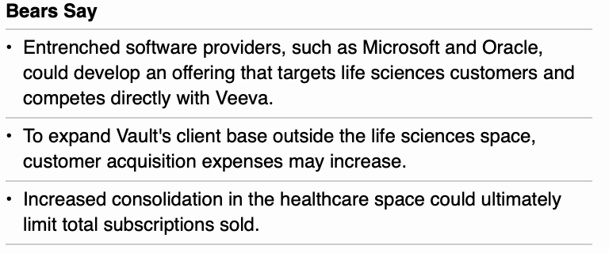
Risks

Slide 39
VEEV Study Tools
BetterInvesting- StockUp Stock Presentation- March 6, 2019 Presenter- Betsy Wills
BetterInvesting- SSG PLUS
ValueLine – 3/8/2019
Morningstar-2/27/2019
VEEV- Investor Relations website
VEEV- 10K, 14A & 10Q Reports- SEC.gov
JP Morgan Healthcare Conference January 10, 2019
Morgan Stanley 2019 Technology, Media & Telecom Conference- February 27, 2019
CFRA - S&P

