Slide 1

Stock Presentation
Wilbert Nixon, McNoVA
-- February 13, 2019

Slide 2
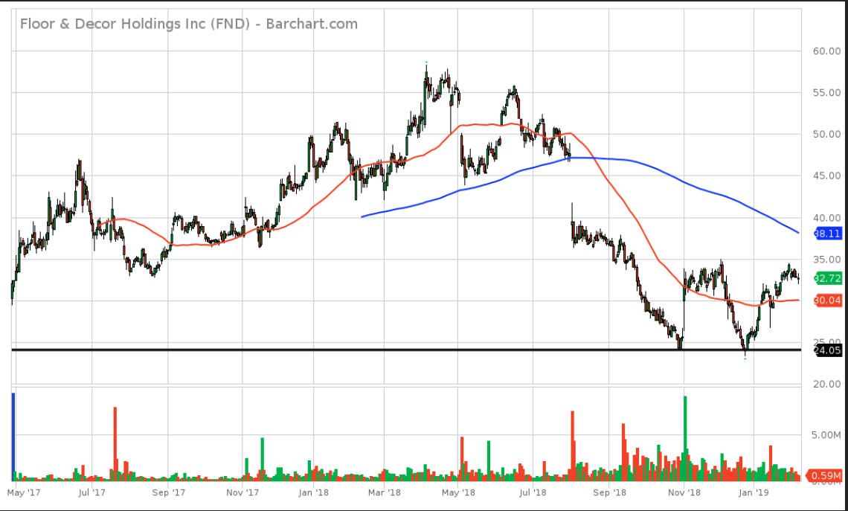
OLD BUSINESS
Floor & Décor (FND) 2-year Chart

Slide 3



Slide 4
Where Do Stock Ideas Come From?
There are lots of ways to get stock ideas
  Quantitative Stock Screens
  News, Newsletters, Financial Newspapers and other Media
  Blogs and other websites
  Industry Focus
  Company Familiarity
  Uncle Fred, etc.

Slide 5
Stock Selection Criteria
In selecting a stock or any asset, you must first determine what you want that asset to do.
Will it be part of a portfolio or will it be a “one-off” investment, trade or speculation?
In this case, I’m selecting a stock to be part of an existing portfolio.
I’ll need to determine what the needs of the portfolio are, if any, and have an opinion on how my selection will fit the portfolio.

Slide 6
Stock Selection Criteria
Specifically, I’ll make my selection for this exercise using a top-down approach (market > stock) based on the company’s size, its industry (or sector), its defensive characteristics (because of my concerns re: possible market slowdowns and downturns) and my familiarity with the company.

Slide 7
BETTER INVESTING PRINCIPLES
Invest regularly for the long term
Reinvest earnings
Invest in good quality growth companies – at a reasonable price
Diversify your holdings (by size & industry)
Notes:
Don’t try to time the market (different than looking for good valuations of a specific company) Investing earnings not necessarily in same stock (disadvantages of DRIPs)

Slide 8
Define Size
SMALL: $500 Million or less in SALES
Sales Growth greater than 12%
MEDIUM: $500 Million to $5 Billion in SALES
Sales Growth between 7% - 12%
LARGE: $5 Billion or more in SALES
Sales Growth less than 7%
Watch your size diversification
25% Small, 50% Medium, 25% Large

Slide 9
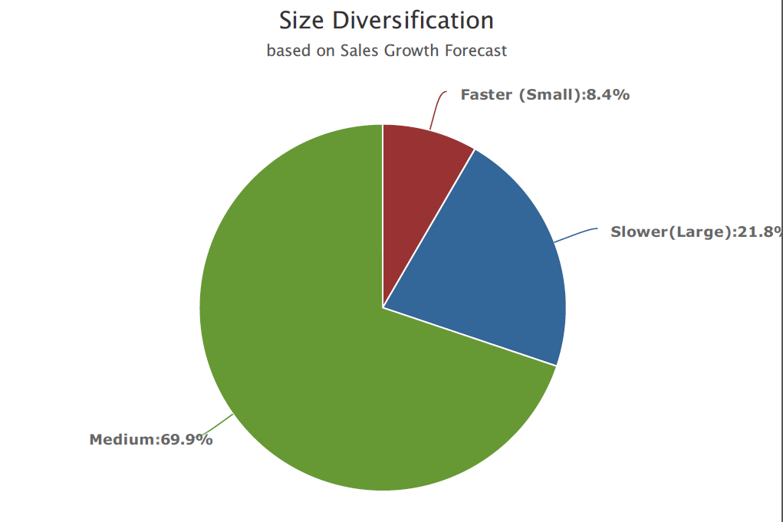
McNoVA’s Current Size Diversification
Although we could argue that I should be choosing a faster growing small company, I do have concerns about possible market weakness ahead, so I’ll choose a large company whose stock may still appreciate in the next 5 years sufficiently to meet our needs.

Slide 10
Define Industry
Value Line organizes its universe of companies into nearly 100 industries
S&P organizes its universe of companies into 69 industries and 158 sub-industries (GICS: Global Industry Classification Standard)
Perhaps following that many industries is a bit unmanageable for our purposes. Let’s look at market sectors instead.
S&P organizes the S&P 500 into 11 market sectors

Slide 11
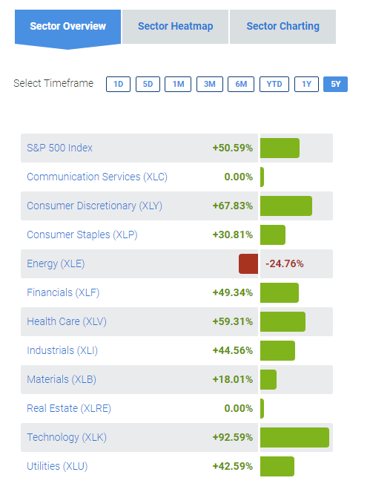
Define Sector

Slide 12
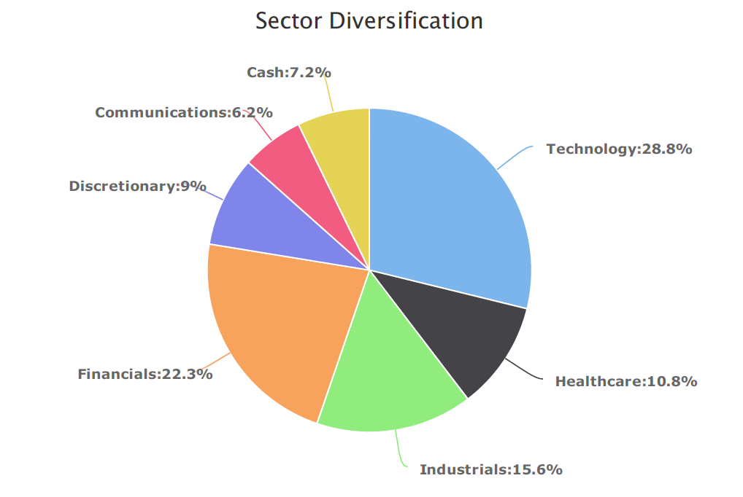
McNoVA’s Current Sector Diversification

Slide 13
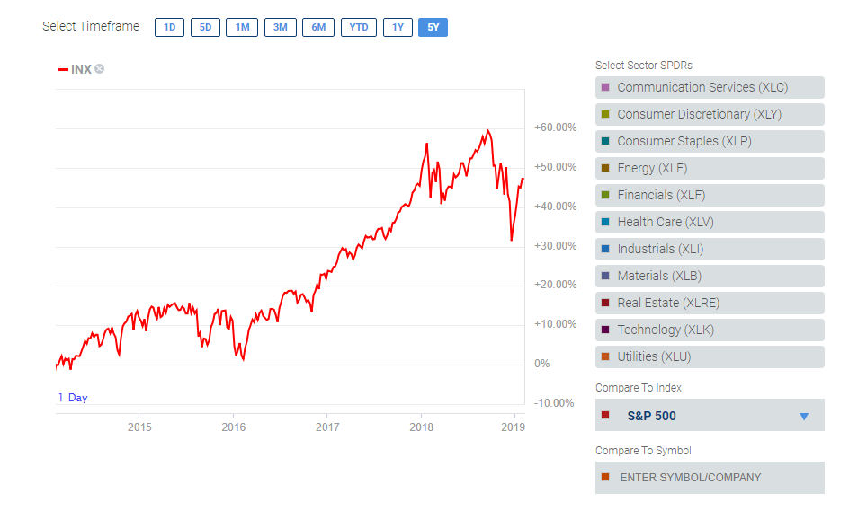
What Sector Should We Choose a Candidate From?
S&P 500 (5-year chart)

Slide 14
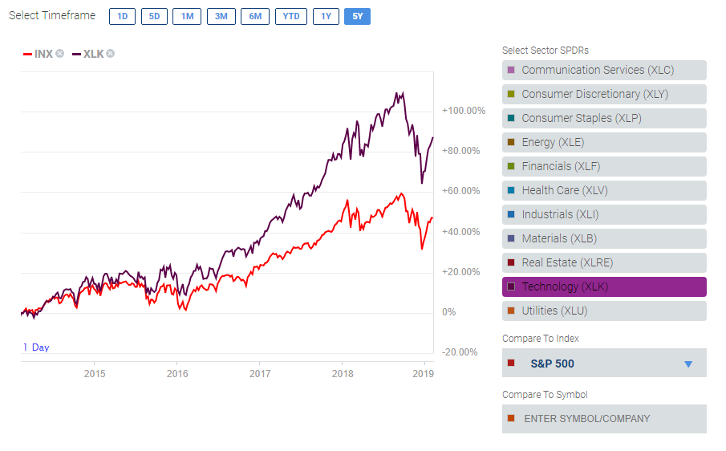
What has Worked in the Past?
Technology Sector (XLK) vs. S&P 500 Index (5-year chart)
Although the Technology Sector has done well consistently over time, McNoVA has lots of technology stocks in its portfolio (AAPL, MSFT, V, etc.)

Slide 15
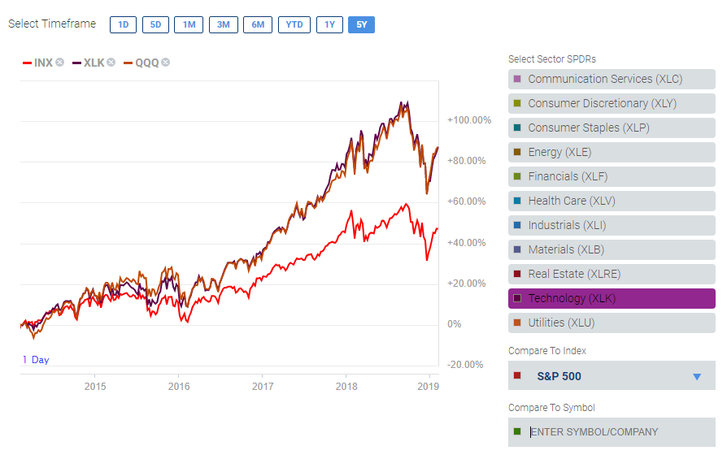
The Technology Sector ETF (XLK) performs nearly identically to the QQQ
Technology Sector (XLK), QQQ vs. S&P 500 Index (5-year chart)

Slide 16
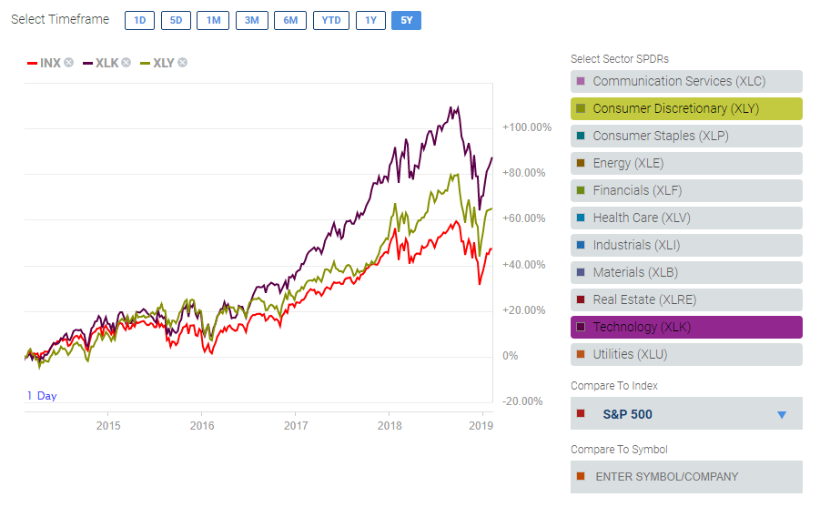
How about Consumer Discretionary?
Technology Sector (XLK), Consumer Discretionary (XLY) vs. S&P 500 Index (5-year chart)
… but what if I’m concerned with about a market slowdown? Should I consider a candidate from the Consumer Staples sector?

Slide 17
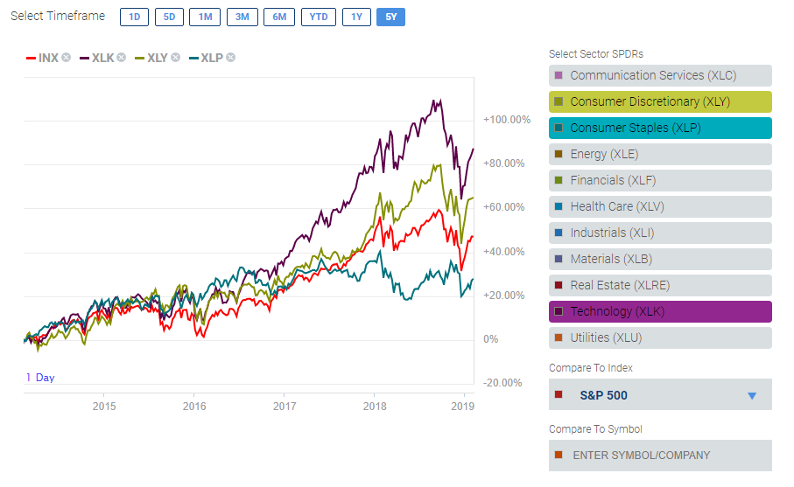
What about Consumer Staples?
Technology Sector (XLK), Consumer Discretionary (XLY), Consumer Staples (XLP) vs. S&P 500 Index (5-year chart)
Not much growth in Consumer Staples over the last 5 years, but it may provide some protection from possible market downturns going forward. Can we find a stock that has some of the defensive characteristics of a Consumer Staple and the growth characteristics of a technology stock?

Slide 18
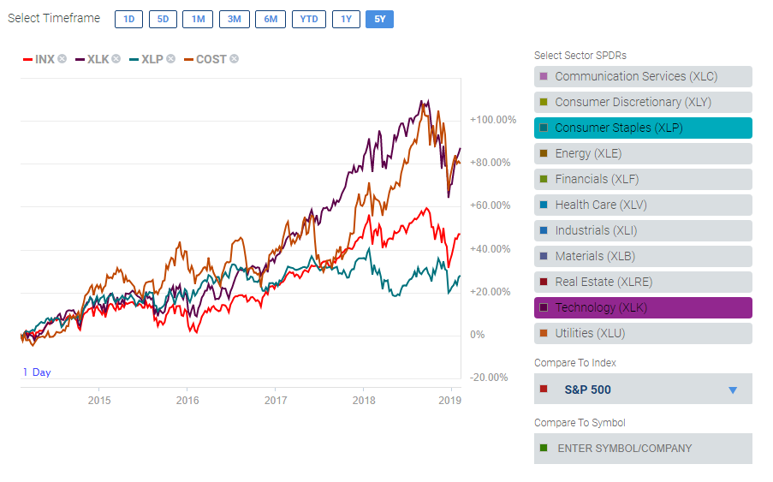
Here’s one.
Technology Sector (XLK), COST, Consumer Staples (XLP) vs. S&P 500 Index (5-year chart)

Slide 19
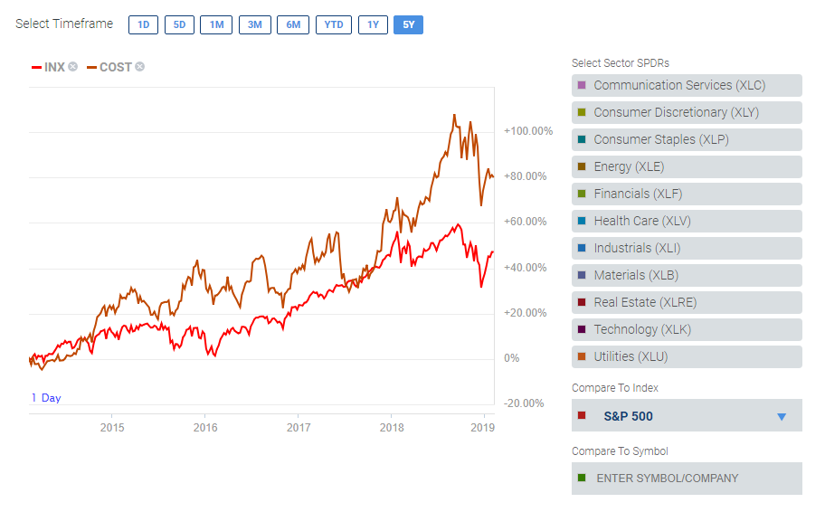
Costco Wholesale Corporation
COST vs. S&P 500 Index (5-year chart)

Slide 20
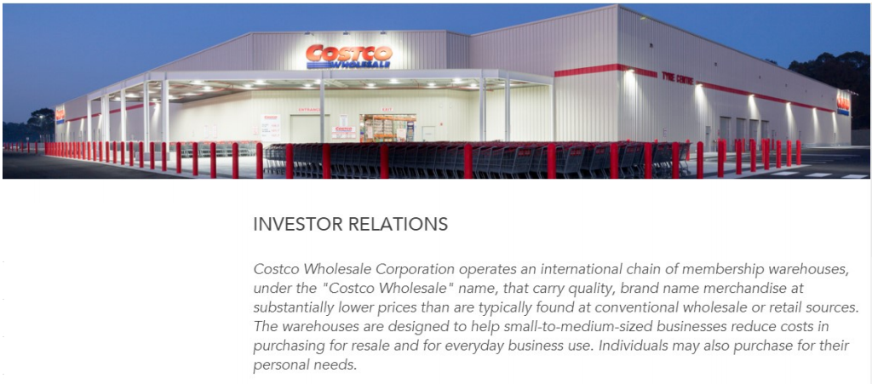
Costco Wholesale Corporation

Slide 21
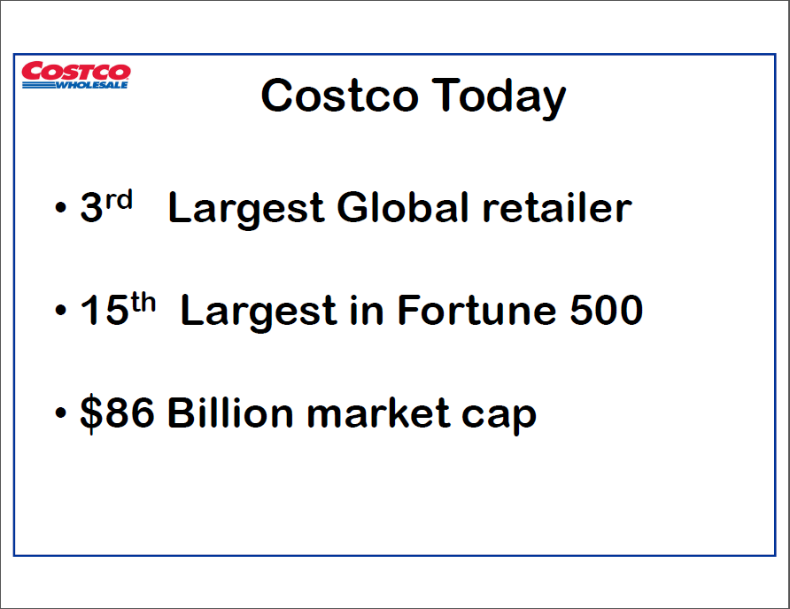

Slide 22
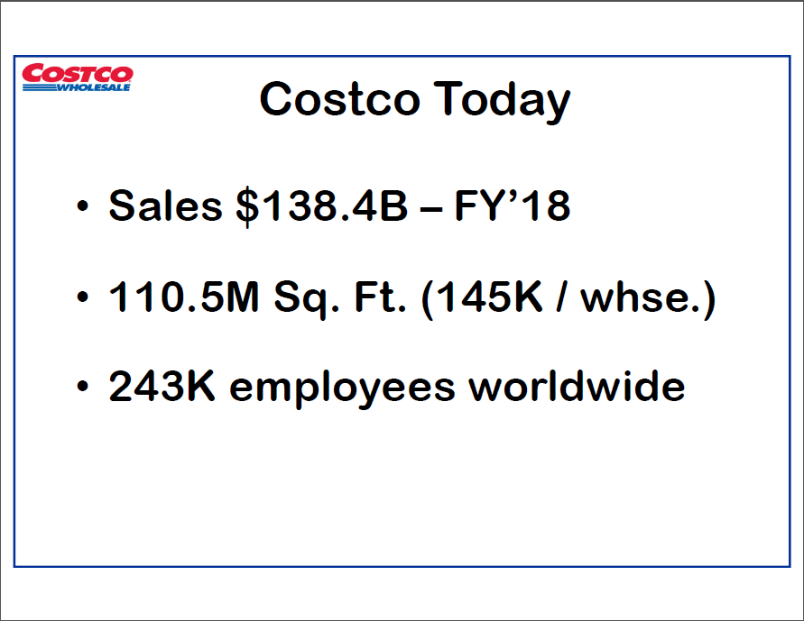

Slide 23
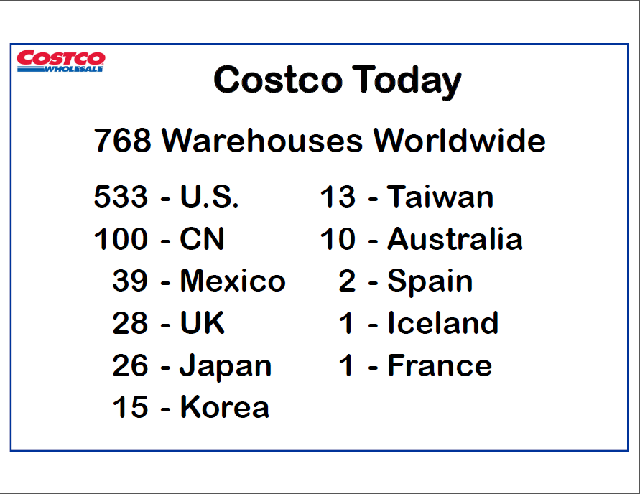

Slide 24
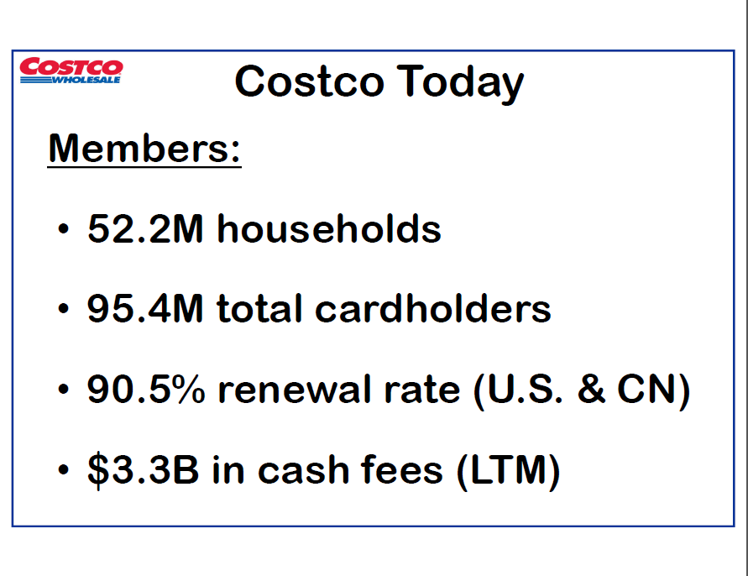

Slide 25
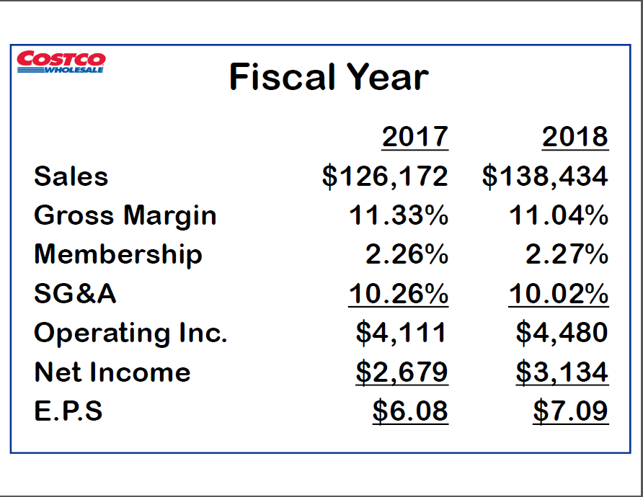

Slide 26
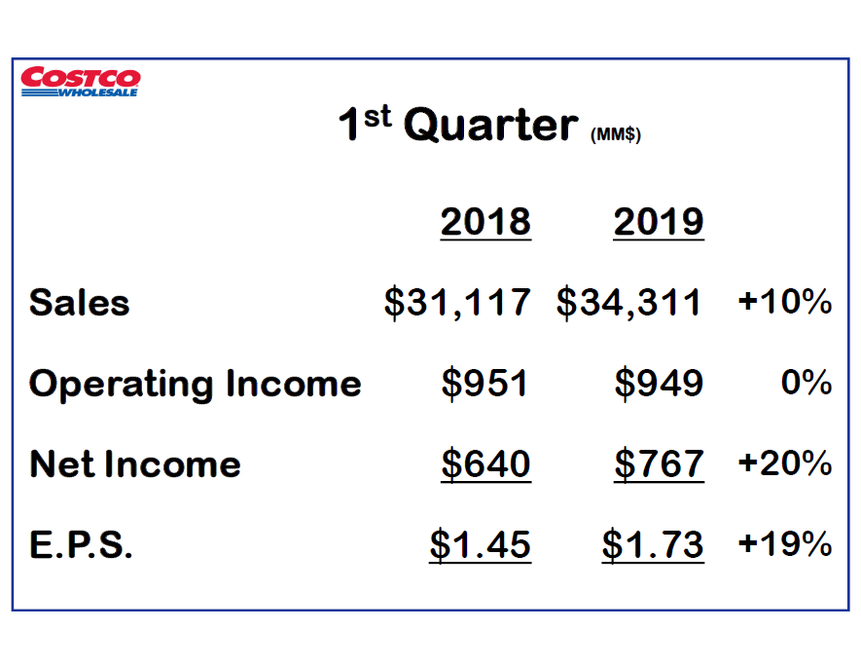

Slide 27


Slide 28
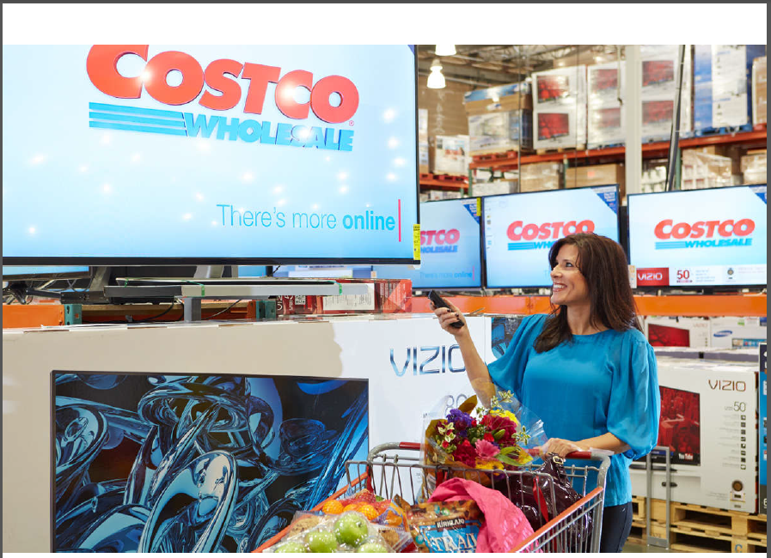

Slide 29
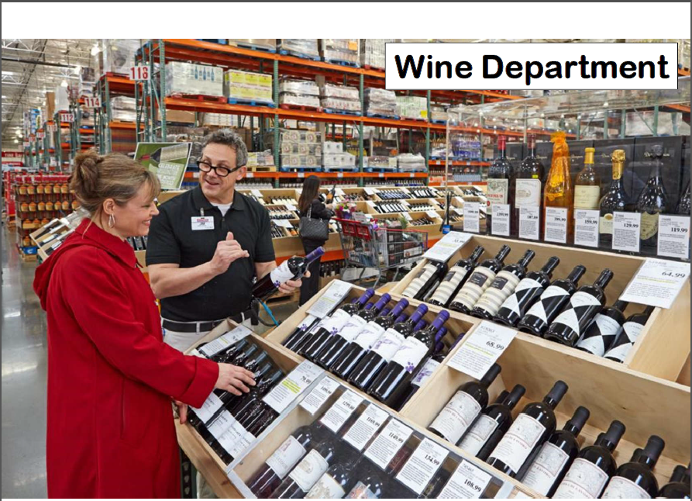

Slide 30
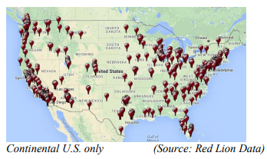
Store Locations

Slide 31
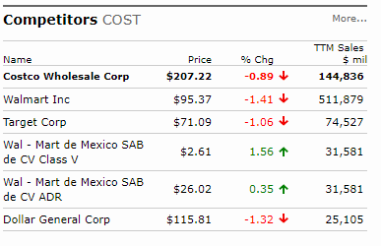
Competitors

Slide 32
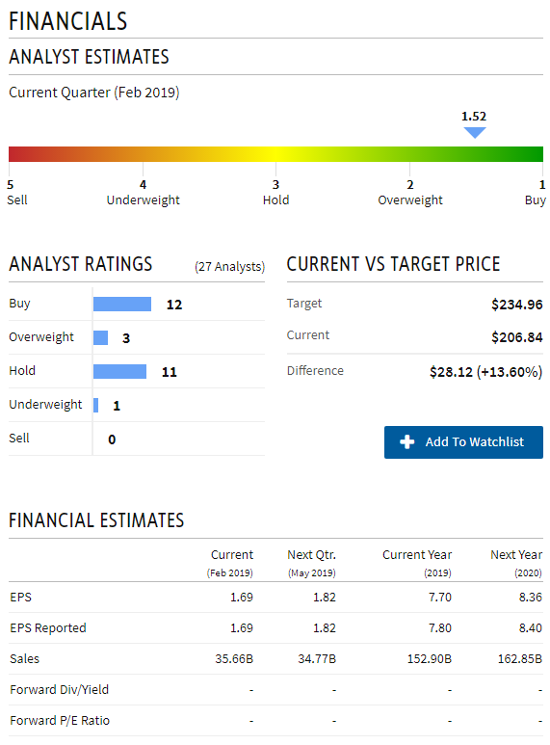
Analysts Estimates (Investopedia)

Slide 33
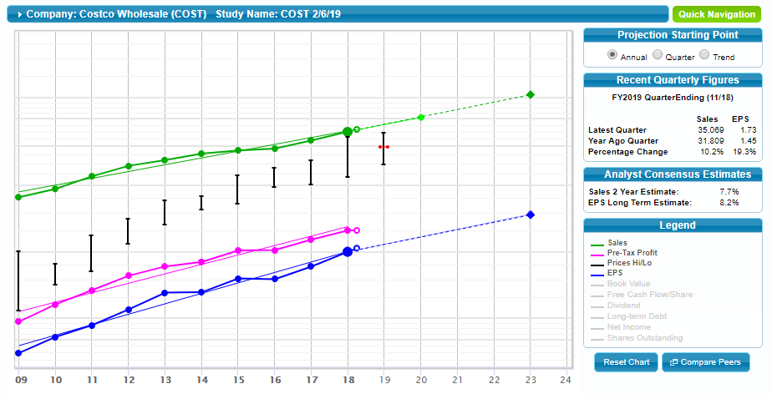
SSG Visual Analysis

Slide 34
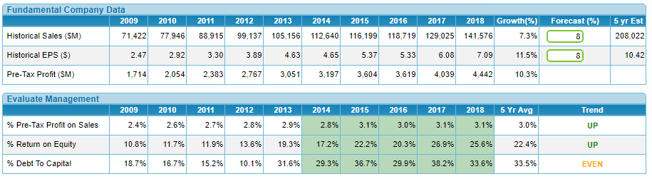
SSG Quality and Management

Slide 35
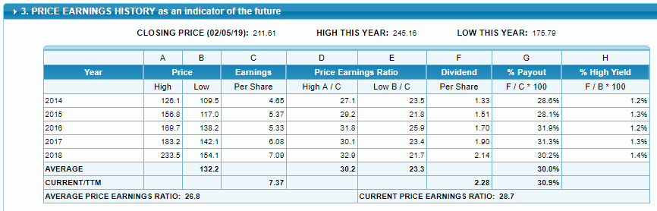
SSG P/E History

Slide 36
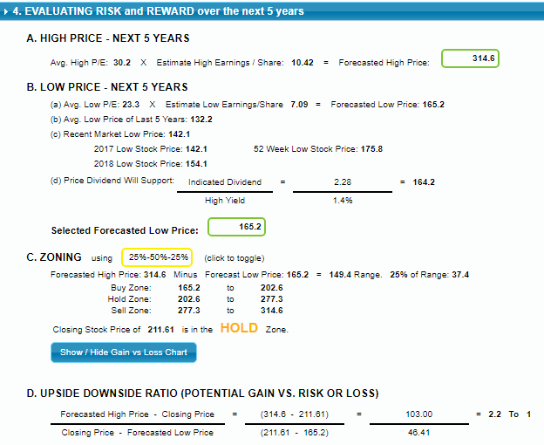
SSG Risk and Reward

Slide 37
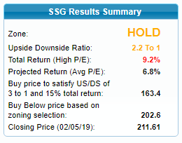
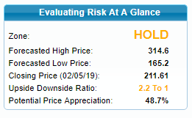
SSG Summary

Slide 38
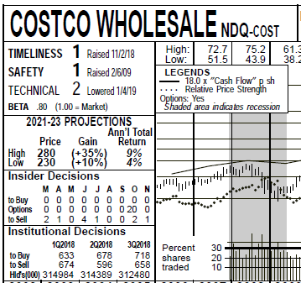
Value Line Projections

Slide 39
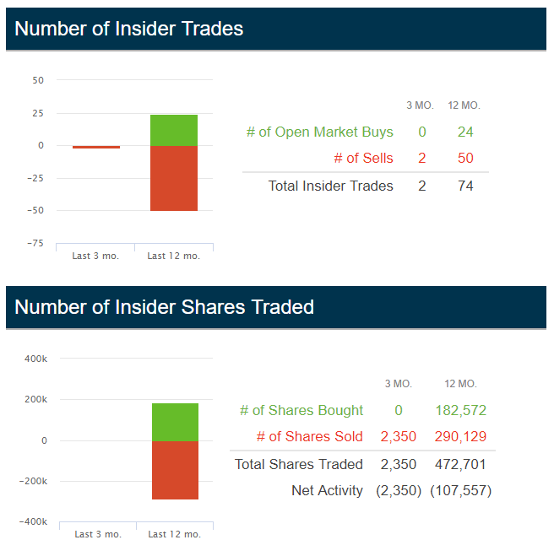
Insider Trades

Slide 40
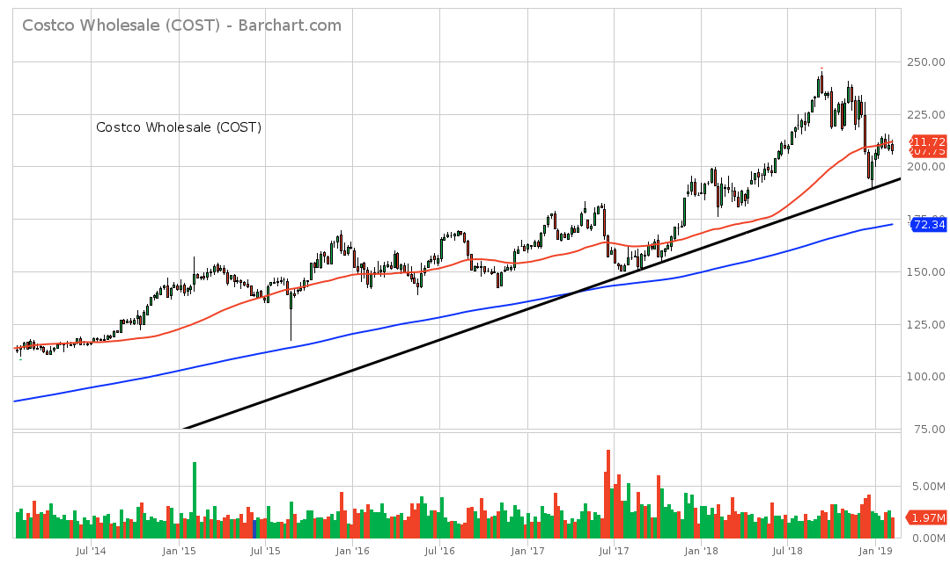

Slide 41
Risks
Business model highly dependent on maintaining membership base (recurring fees provide nearly three quarters of company’s operating profit)
No signs yet that periodic (every 5 to 6 years) membership fee increases are hurting retention rates
However, there is a risk that Amazon’s popular Prime membership (100 million worldwide, 72 million US) might eventually pose a threat
Target also launching its own membership model as well

Slide 42
Risks
Another risk is commodity price volatility, especially as it relates to Costco’s popular private label Kirkland brand (30% of company sales). Input costs are cyclical over time and could reduce margins.
Costco’s biggest long-term growth opportunities are overseas, however there are lots of risks associated with international expansion.
The popularity of the suburban warehouse shopping model is unproven in other countries, where homes and vehicles are smaller.

Slide 43
Resources and References
MicNova Stock Presentation, 1/9/19, Sandy Caster
BI SIG SSG Class, 9/20/18, Jo Murphy & Sheryl Patterson
Costco Today, Q1-FY’19, Costco’s quarterly report presentation
Argus Research, “Costco Wholesale Corp.”, 12/24/18
Krause Fund Research, “Costco Wholesale,” 11/8/18
CFRA – S&P
Intelligent Income by Simply Safe Dividends
Investopedia
MorningStar
Value Line

Slide 44


Slide 45


Slide 46
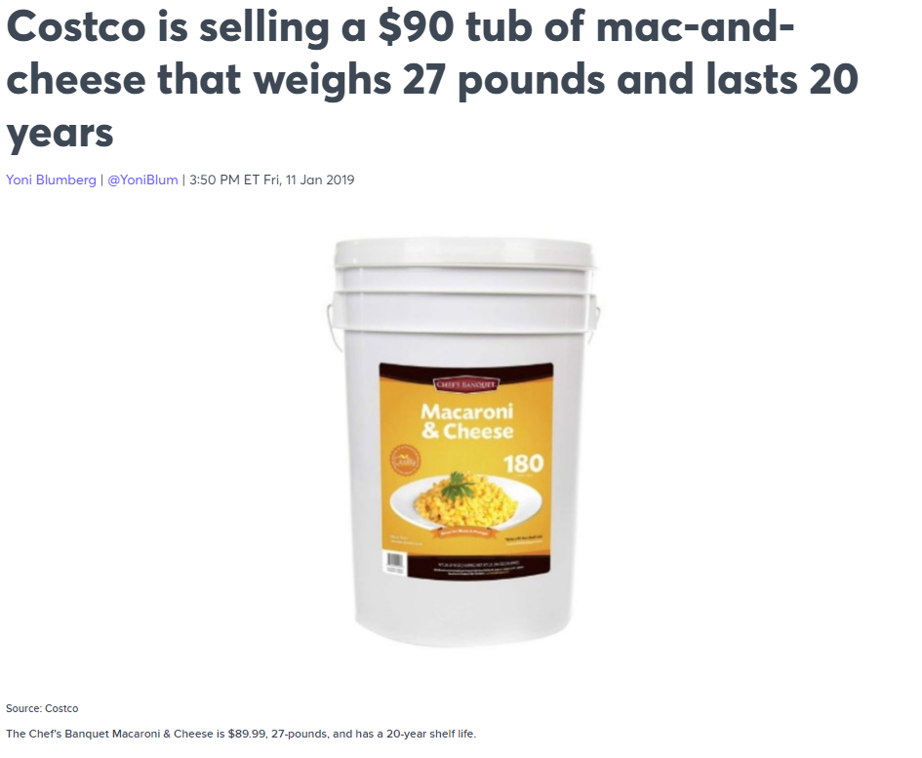
Only in America, Only at Costco

