Slide 2
The forward-looking statements include statements concerning, among other things, the opportunity for minimally invasive non-surgical treatment XIAFLEX in several potential pipeline indications; the expected revenue growth for XIAFLEX in 2019; the Company’s ability to achieve its future growth initiatives with regard to Dupuytren’s Contracture; the expansion of the market for XIAFLEX for the treatment of Peyronie’s Disease and Dupuytren’s Contracture through future growth initiatives; the timing of Endo’s BLA submission and potential FDA approval in connection with and the potential commercial launch of XIAFLEX for the treatment of cellulite; whether treating uterine fibroids with XIAFLEX will achieve the advantages over major surgery identified by the Company and the timing of future clinical trials and the publication of results of clinical trials; Endo’s interest in currently unlicensed indications; whether XIAFLEX will be the only FDA approved nonsurgical therapy for adhesive capsulitis; the projected receipt of payments from Endo and sublicense income payments based on Endo’s partnerships; and the strength of the Company’s IP portfolio.

Slide 4
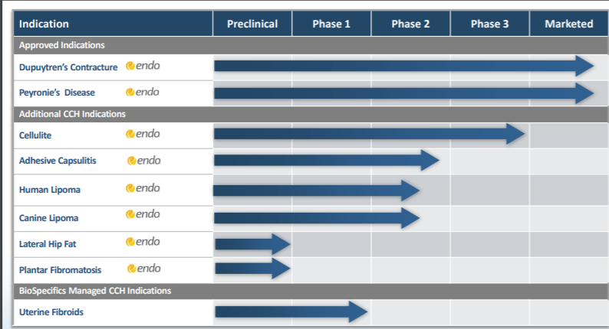
XIAFLEX® Pipeline

Slide 5
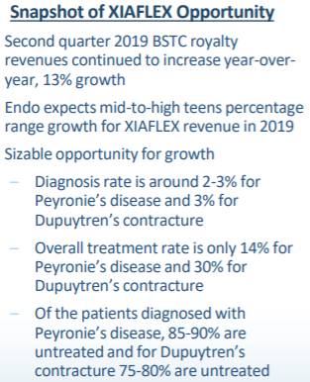
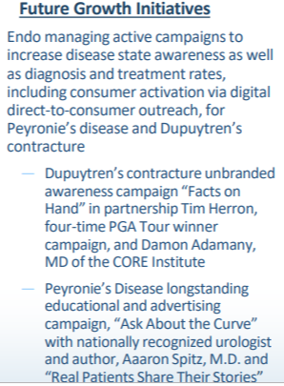
XIAFLEX Marketed Indications Future Growth Opportunities

Slide 6
Overview of CCH for Uterine Fibroids

Slide 7
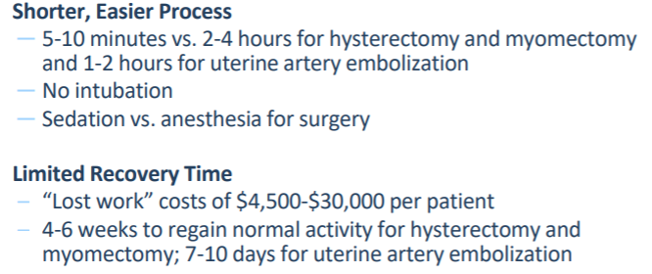
Potential Advantages of XIAFLEX®Injection vs Major Surgery

Slide 8
Overview of CCH for Cellulite

Slide 9
Other
Human Lipomas - ~600,000 patients in the U.S. annually ▪
20% of patients have multiple lipomas
Adhesive Capsulitis Potential to be Only FDA Approved Nonsurgical Therapy - Affects 20 - 50 million people worldwide ▪ 300K cases diagnosed annually in the U.S.; 10% treated invasively ▪ Condition can last approximately 1 year to up to 3.5 years ▪ Estimated to occur in 20% of diabetics
Plantar Fibromatosis - ~200,000 patients in the U.S

Slide 10
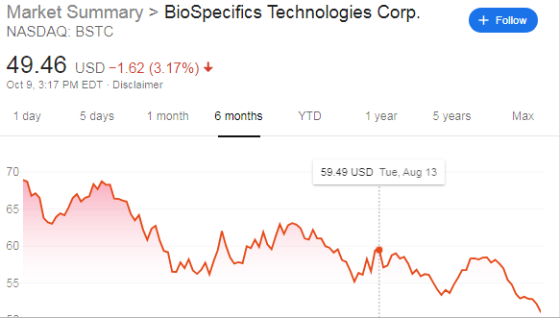

Slide 11
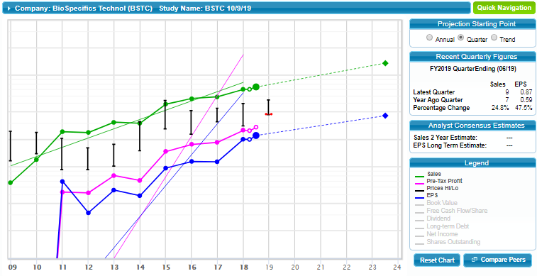

Slide 12
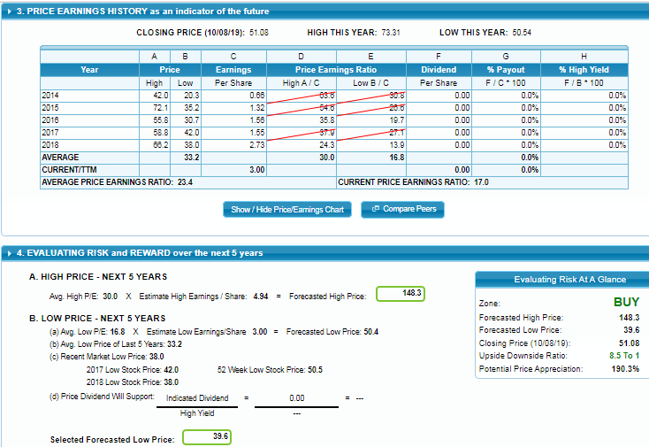

Slide 13
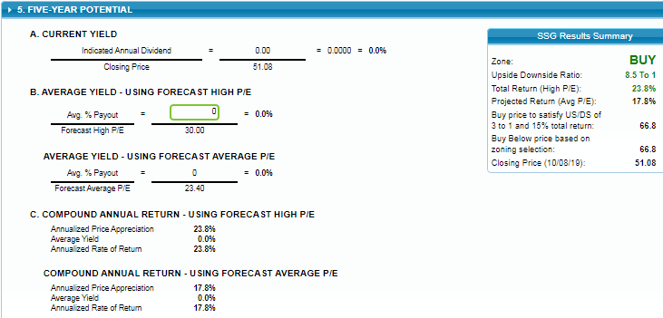

Slide 14
Small Cap Advisor - October 2019 Issue

Slide 15
BioSpecifics Technologies Corp.
About the Company
BioSpecifics Technologies Corp. is a biopharmaceutical company that is the originator of collagenase-based therapies that are currently used to treat twelve clinical indications. Collagen is a structural protein that exists between cells in various connective tissues in the human body, but these proteins sometimes don’t function properly leading to several kinds of disorders. Collagenase (collagenase clostridium histolyticum or CCH) is an enzyme that breaks the peptide bonds in collagen. BioSpecific’s injectable form of collagenase is marketed as Xiaflex in the U.S. by the company’s partner, Endo International plc. Xiaflex is presently used for two collagen-based disorders, Dupuytren's contracture (affecting the fingers and hand) and Peyronie's disease (affecting the male genitalia).
Xiaflex is commercialized in Japan, Europe, Canada, and Australia for Dupuytren’s contracture, and for Peyronie's disease in Canada, Europe, and Australia. BioSpecific’s Xiaflex/CCH research and development pipeline includes several additional promising indications: cellulite, adhesive capsulitis, human and canine lipomas, lateral hip fat, uterine fibroids, and plantar fibromatosis.
BioSpecifics Technologies was incorporated in 1990. The unique partnership with Endo allows it to maintain a very lean corporate structure, with just five full-time employees and three independent contractors at year-end 2018.
Growth Analysis
Since 2011, BioSpecifics Technologies’ revenues, primarily comprised of royalties, have grown at an annual average rate of 18.4%, reaching $33.0 million in fiscal 2018, making it the smallest company by revenues in the SmallCap Informer coverage universe. In the same period, EPS grew at an annualized
21.0% rate, Earnings growth is well supported by free cash flow. In the first quarter ended March 31, 2019, BioSpecifics reported revenues growth of
14.7% to $8.1 million, while EPS grew 11.1% to $0.60. The company reported positive results of Phase I and Phase 3 testing for the use of Xiaflex in treating uterine fibroids and cellulite. Endo reported that it expects to file its Biologics License Application (BLA) with the FDA for Xiaflex for the treatment of cellulite in the second half of 2019 with an expected commercial launch in the second half of 2020 subject to FDA approval.

Slide 16
BioSpecifics’ commercial partner Endo expects mid-to-high teens percentage growth for Xiaflex revenue in 2019. Future “sizable” growth is possible as diagnosis rates and treatment rates for both Peyronie’s disease
and Dupuytren’s contracture are extremely low. Endo is working to educate medical personnel and patients about the use of Xiaflex as non-surgical treatment options. Progress in treatments for uterine fibroids and cellulite
look promising and could begin contributing to revenues in 2020. Looking further ahead, Endo and BioSpecifics
are working on developing treatments for human lipomas, adhesive capsulitis, plantar fibromatosis, and lateral hip fat. Any of these could be significant contributors to royalty revenues. We project revenue and earnings growth to run at an approximate 15% annual pace over the next few years. The only analyst covering BSTC on Wall Street sees the potential for annual EPS growth to be as high as 22% a year through 2023, and EPS in the next two fiscal years to be slightly ahead of our 15% projection. Quality Analysis The company’s Intellectual Property (IP) portfolio is strong, with patents and drug protection extending as far out as 2034. The company’s corporate structure allows for very high pre-tax profit margins, which have been trending up over the past eight years and reached 75.2% in fiscal 2018. Return on equity is also strong and stable, ending 2018 at 30.3%. BioSpecifics Technologies has no debt and insiders own around 19% of outstanding shares.
Value Analysis
The current P/E ratio of 21.2 is well off the highs reached in recent years, but we factor in a bit of P/E ratio contraction in our expectations. Paying a P/E of 21 for 15% growth is a rational action. Our target is for EPS to reach $5.47 in five years. At a high P/E of 25, a future high price of $136 is indicated. On the downside, if EPS stagnate at the TTM mark at $2.72 and the price drifts down to a P/E of 14, then a low price of $38 would be reached. From the current price of $57.60, there is 4.1 times the upside to $136 than to the downside of $38, above our 3:1 minimum ratio. The total annual return from the current price come out to 18.9%. As a very small company, BioSpecifics Technologies brings with it some additional volatility, but share prices have had a good upward trajectory over the last half-decade. As long as earnings growth persists, share price will eventually follow. * * *
BioSpecifics Technologies trades on the NASDAQ Global Market with the symbol BSTC. Pays no dividends.

Slide 17
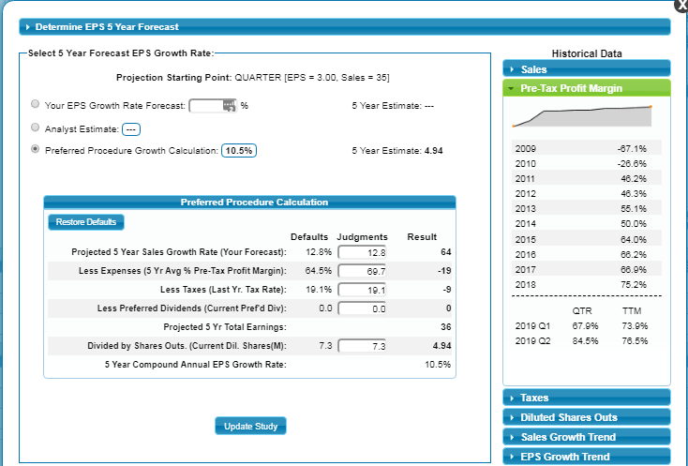

Slide 18
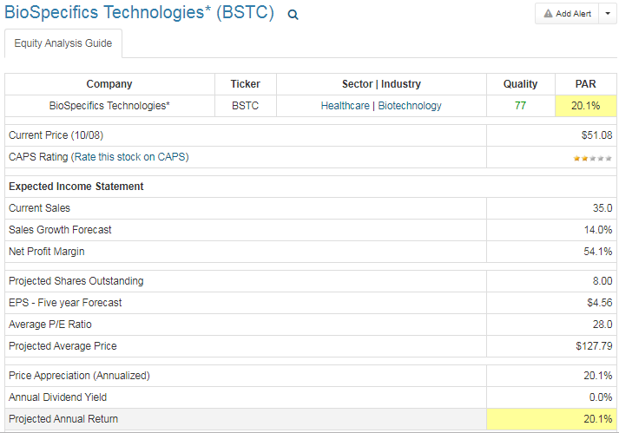
Manifest Investing.com

Slide 19
