Slide 1
BOFI Holding, Inc. BOFI Holding, Inc. Bank of the Internet Federal Bank
January 2018
Jo Murphy

Slide 2
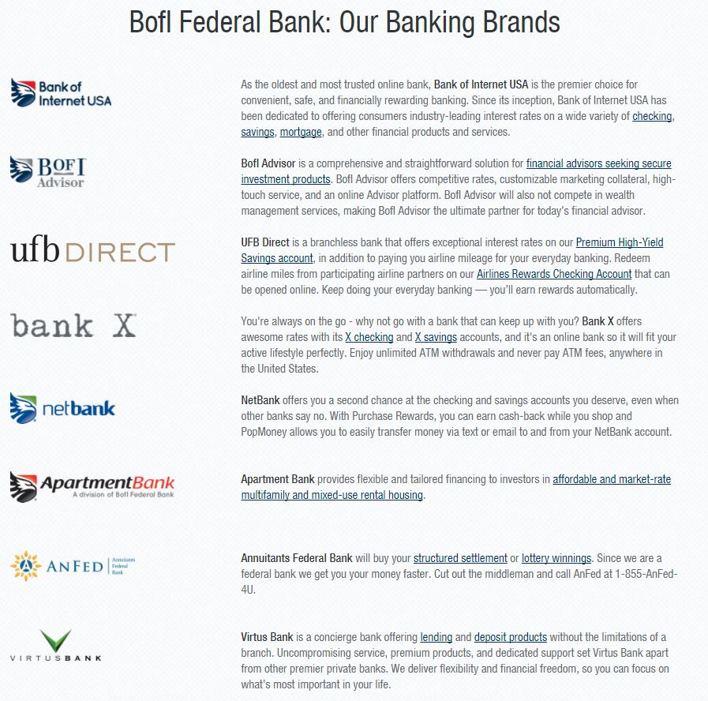

Slide 3
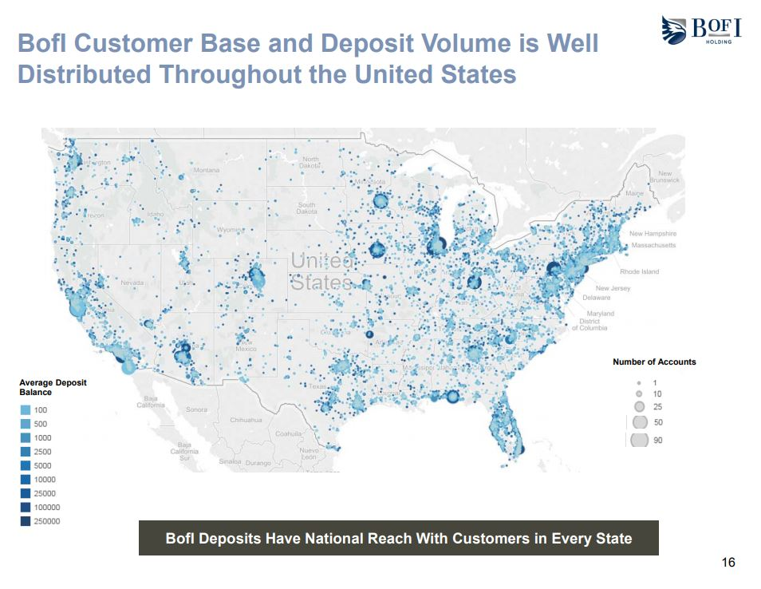

Slide 4
Awards and Recognitions
Product Recognitions
GoBankingRates 10 Best Business Checking Accounts - 2016 10 Best Checking Accounts - 2016, 2015 (for Bank of Internet brand)
Kiplinger Best Banks for Students - 2017 (for Bank of Internet brand) Best Deals in Online Banking - 2017 (for Bank of Internet brand)
NerdWallet Best Banks for ATM Lovers (for Bank of Internet brand) Best in Checking Accounts - 2016 (for Bank of Internet brand) Best in Money Market Accounts - 2016 (for Bank of Internet brand) Best in Rewards Checking Accounts - 2016 (for Bank of Internet brand)
WalletHub Best Overall Online Checking Account – 2016
Financial Strength
Bank Rate 5 Star Safe & Sound Rating
Bauer Financial 5 Star Rating
IDC Financial Publishing 300 / Superior
Kroll Bond Rating Agency A- Rating Deposits A- Rating Senior Unsecured Debt
Weiss Ratings A- Recommended

Slide 5
Awards and Recognitions
Company Awards
AdvisoryHQ Best Banks to Bank With In America - 2017 (for Bank of Internet brand) Top 12 Best Online Business Banks - 2017
Bank Director Bank Performance Scorecard for Banks $5-50 Billion - 2nd place 2017, 3rd place 2016, 4th place 2015
Bank Rate Best Online Bank - 2017 (for Bank of Internet brand)
Fortune Magazine 100 Fastest Growing Companies - 68th place 2017, 48th place 2016, 56th place 2015, 69th place 2014
GoBankingRates 10 Best Online Banks - 2017, 2016 (for Bank of Internet brand)
Money Magazine The Best Online Bank - 2017, 2016 (for Bank of Internet brand)
Raymond James Community Bankers Cup - 2016, 2015, 2014
Sandler O’Neill + Partners Sm-All Stars - 2017, 2016, 2015, 2014, 2013
SNL Financial Best of the Biggest Public Thrifts - 2016, 2015, 2014, 2013, 2012

Slide 10
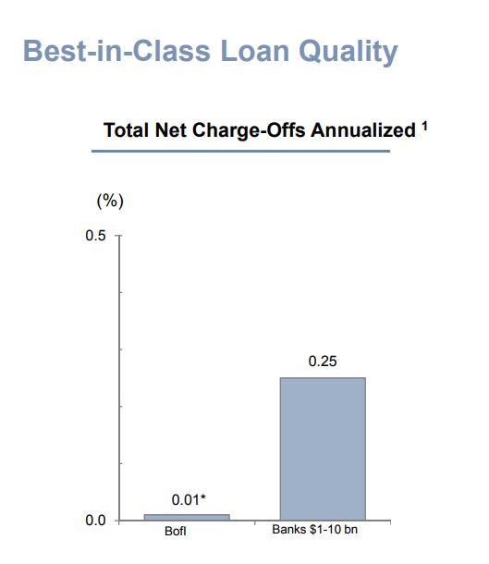

Slide 11
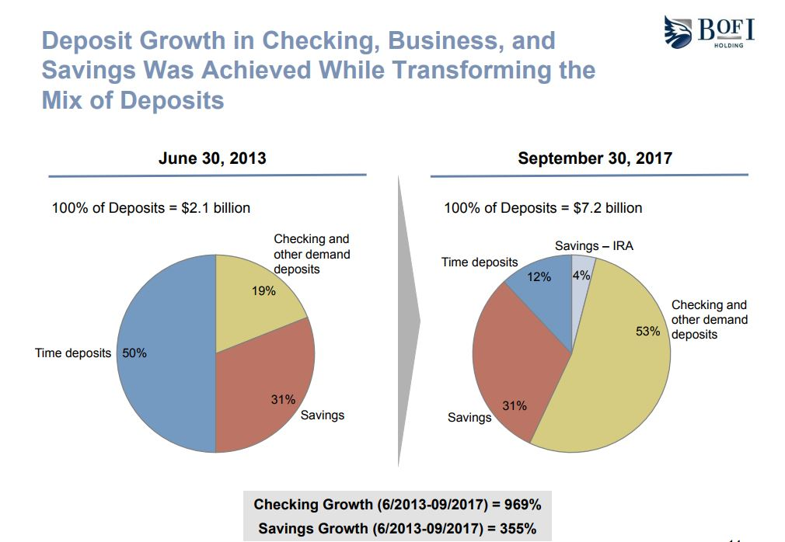

Slide 12
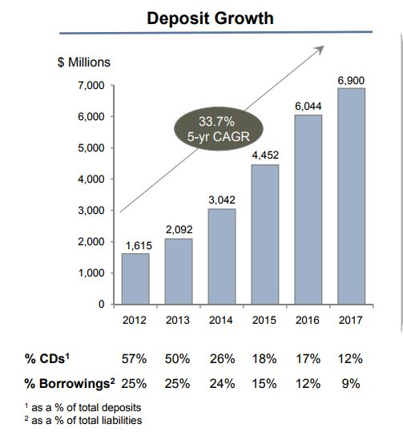

Slide 13
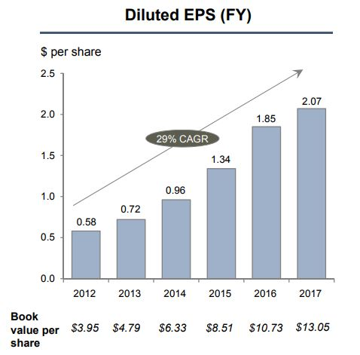

Slide 14
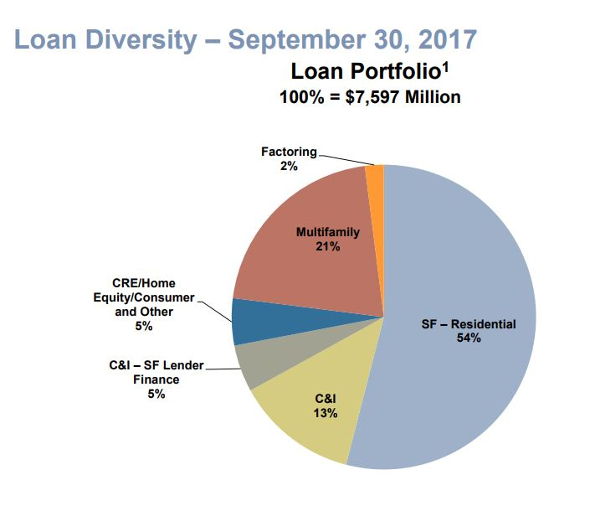

Slide 16
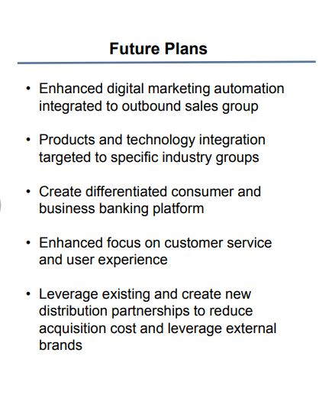

Slide 18
Independent Coverage
Value Line Coverage: Small & Midcap Section. Shows book value increase each year.
Morningstar: no analyst coverage; but financial ratios, etc.
Manifest Investing: 18% growth in Bk value estimated
5 yr. forecast EPS = $4.96
Projected average price= $54.52 (12.6% annual price appreciation)
PAR – 12.6%
Average PE = 11
CFRA (12/29/2017) STRONG BUY. positive valuation, positive quality. Ranked in 5th %-ile of all stocks in its model universe.

Slide 19
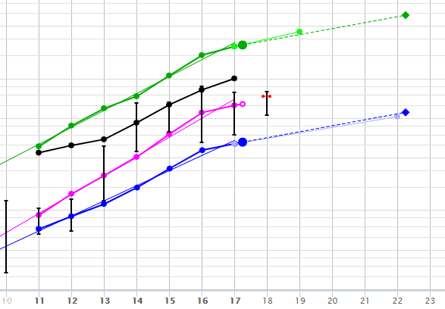
BOFI Holding SSG
Black line is book value

Slide 20
BOFI Holding SSG
Return on average assets
Over 1.50 is excellent

