Slide 1
Bank of the Ozarks
Susan Tanoe

Slide 2
Special Thanks
Credit for much of this presentation goes to Ross Meredith, Director, Rocky Mountain Chapter
Thanks goes to Marion Richburg for his unflagging assistance in creating this presentation.

Slide 4
How to Determine Loan Quality
We want banks that make good loans and maintain the best profitability.
Two numbers to pinpoint good banks:
– Loan Loss Provision expense (LLP) ratio
– Return on Average Assets (ROAA)
To calculate LLP: Loan loss provision expense / Total loans
Provision for Loan Losses expense (income statement)
Total loans (balance sheet)
If loan losses are well below 1% of loans for 8‐10 years, we have a good lender

Slide 5
Turning Loans into Profits
Bank must earn enough to cover overhead and cost of funding
Today, approximately 3% of the interest rate earned is overhead
Funding costs are about 1% in the current market
Banker must charge more than 4% to make a profit
Average interest rate is currently 4.78% on loans
Average net interest spread is 3.78% (4.78% ‐ 1%)
When interest rates rise, banks’ earnings go up

Slide 6
Value Line Data for OZRK
As you can see from the numbers highlighted above, LLP increased in 2009 but has quickly stabilized.

Slide 7
Return on Average Assets
Today, the average bank earns a return on assets of about 0.79%.
Over 1.25% is good, only 9% of banks do that.
Over 1.5% is VERY good, less than 4% of banks do that
A high ROAA is indicative of good management

Slide 8
HISTORICAL INFORMATION
Bank of the Ozarks, Inc. OZRK, headquartered in Little Rock, AR, is a bank holding company for Bank of the Ozarks, with $18.9 billion in total assets as of December 31, 2016. OZRK provides various retail and commercial banking products and services in Arkansas, Georgia, Florida, North Carolina, Texas, Alabama, South Carolina, New York, and California.
OZRK operates 249 branches and lending offices in nine states. Almost half are in Arkansas. Another 42% are spread roughly equally among Georgia, North Carolina, and Texas. Acquisitions of small banks have been a key part of the bank’s growth.
Since 2011, it has completed 13 deals. Seven of those were the purchases of failed banks with Federal Deposit Insurance Corporation assistance and loan-loss guarantees, and six were traditional bank M&A deals. The Little Rock, Ark.-based bank now has 173 branches in nine states, mostly in the Southeast

Slide 9
FUNDAMENTALS
Revenue Strength: Bank of the Ozarks’ revenues have risen at a compounded annual growth rate (“CAGR”) of 31.2% over the last five years (2012–2016). The strong top-line improvement is backed by its de novo branching strategy as well as inorganic growth.
Revenue Strength: Bank of the Ozarks’ revenues have risen at a compounded annual growth rate (“CAGR”) of 21.3% over the last five years (2007–2016).

Slide 10
Visual Analysis

Slide 11
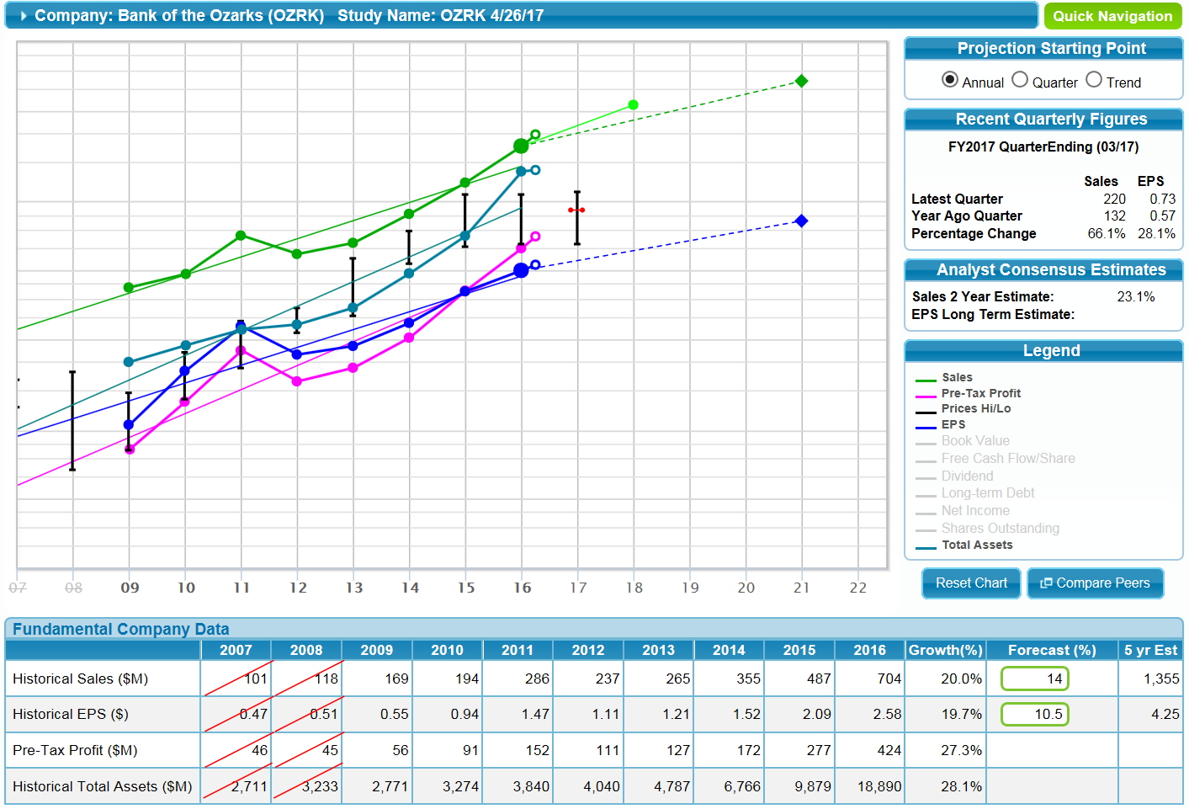

Slide 12
RECENT QUARTERLY INFORMATION
During the quarter ended March 31, 2017, Bank of the Ozarks' net interest income surged 69.5% to $190.77 million from $112.52 million in Q1 FY16. Furthermore, net interest income on fully taxable equivalent (FTE) basis came in at $194.37 million in Q1 FY17 compared to $114.43 million in Q1 FY16. The Company's non-interest income also increased 46.3% to $29.06 million in Q1 FY17 from $19.87 million in the year ago same quarter. Meanwhile, the non-interest expenses were up by 64.1% to $78.27 million in Q1 FY17 from $47.69 million in Q1 FY16.
The Little Rock, Arkansas-based bank reported a record net income available to common stockholders of $89.19 million, or $0.73 per diluted common share, in Q1 FY17, versus $51.69 million, or $0.57 per diluted common share, in Q1 FY16. Wall Street had expected the Company to report net income of $0.71 per diluted share

Slide 13
Visual Analysis with Competitors

Slide 14
Comparison of Growth Prospects

Slide 15
Projections Discussion
Based on its historical growth, strategy of new branch openings supplemented by acquisitions, and return on capital, we believe that Bank of the Ozarks can produce 14% annual earnings growth. Five years of such growth could lead to EPS as high as $4.20 in five years. A repeat of the average high P/E ratio of 20.4 may result in a stock price approaching 86. This would represent a potential total return exceeding 17% annually.
However, projected earnings growth is showing a flattening due to the annual increase in shares outstanding.

Slide 16
Visual of High and Low P/Es

Slide 19
Risks
Risk factors include the reliance on real estate lending and the interest rate risk common to all banks. Since 1979, Bank of the Ozarks has been led by George Gleason who is now 62 years old. As recently as 1994, it had only five branches so substantially all of its growth occurred during his tenure. While many companies have CEOs of comparable age, few have had just one CEO in the past 37 years. This represents a risk for shareholders as the need to eventually replace Mr. Gleason will be an entirely new challenge to the company.

