Slide 1
Back to Basics and the SSG
USING BetterInvesting SSG Criteria
and
Value Line

Slide 2
Disclaimer
The information in this presentation is for educational purposes only and is not intended to be a recommendation to purchase or sell any of the stocks, mutual funds, or other securities that may be referenced. The securities of companies referenced or featured in the seminar materials are for illustrative purposes only and are not to be considered endorsed or recommended for purchase or sale by BetterInvestingTM National Association of Investors Corporation (“BI”). The views expressed are those of the instructors, commentators, guests and participants, as the case may be, and do not necessarily represent those of BetterInvesting. Investors should conduct their own review and analysis of any company of interest before making an investment decision.
Securities discussed may be held by the presenters in their own personal portfolios. BI presenters and volunteers are held to a strict code of conduct that precludes benefiting financially from educational presentations or public activities via any BetterInvesting programs, events and/or educational sessions in which they participate. Any violation is strictly prohibited and should be reported to the CEO of BetterInvesting or the Director of Chapter Relations.
This presentation may contain images of websites and products, or services not endorsed by BetterInvesting. The presenter is not endorsing or promoting the use of these websites, products or services.
This session is being recorded for future use.
Notes:
As appropriate for live sessions, remove last line about session being recording.

Slide 3
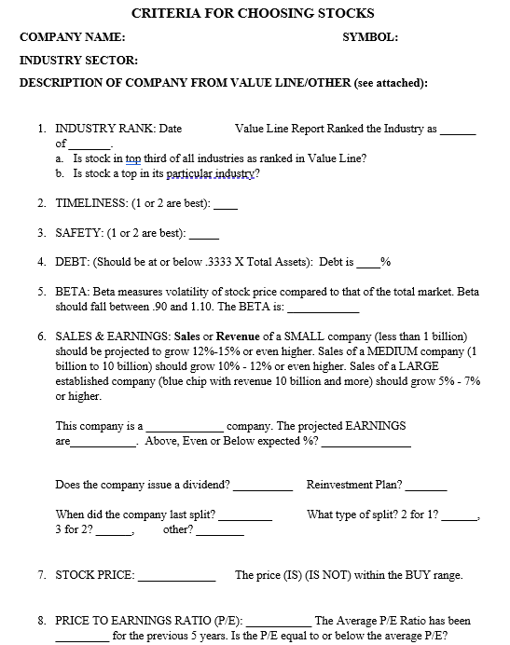
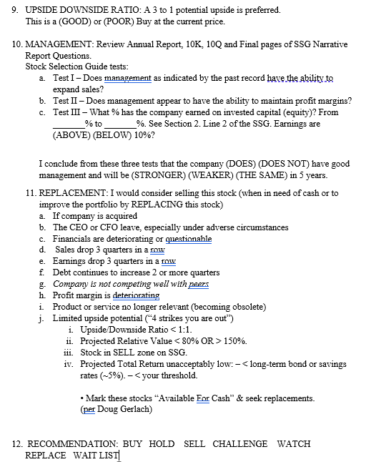

Slide 4
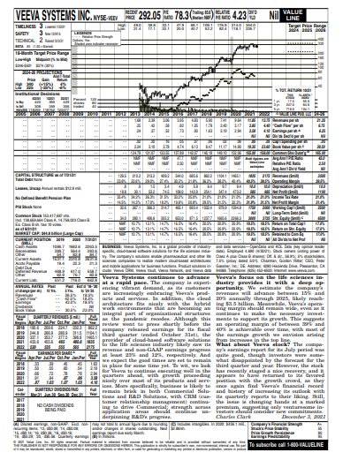
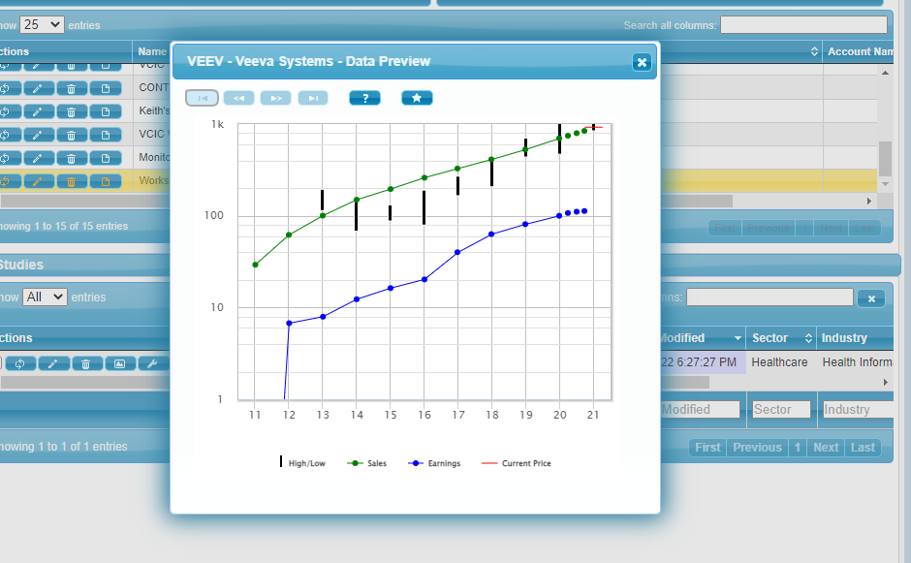
Start an SSG and look at the Visual Analysis
Like what you see? UP, STRAIGHT & PARALLEL?
Go to Value line, read and print an analysis report
Note the date at bottom of page
Read under the graph
Read the analyst’s report
Pay attention to specific data needed for the SSG and highlight it

Slide 5
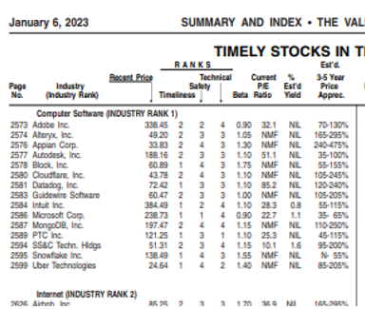
CRITERIA FORMAT FOR CHOOSING STOCKS Answer these Questions
COMPANY NAME: SYMBOL:_____________
INDUSTRY SECTOR:___________________
Date: ________
DESCRIPTION OF COMPANY FROM VALUE LINE/OTHER (or see attached):
INDUSTRY RANK:
Value Line Report Ranked the Industry as #_____
of _______. Yahoo! ranked company as ___________ of ______ in that Industry.
a. Is stock in top third of all industries as ranked in Value Line: _______
b. Is stock a leader in its particular industry? _____

Slide 6
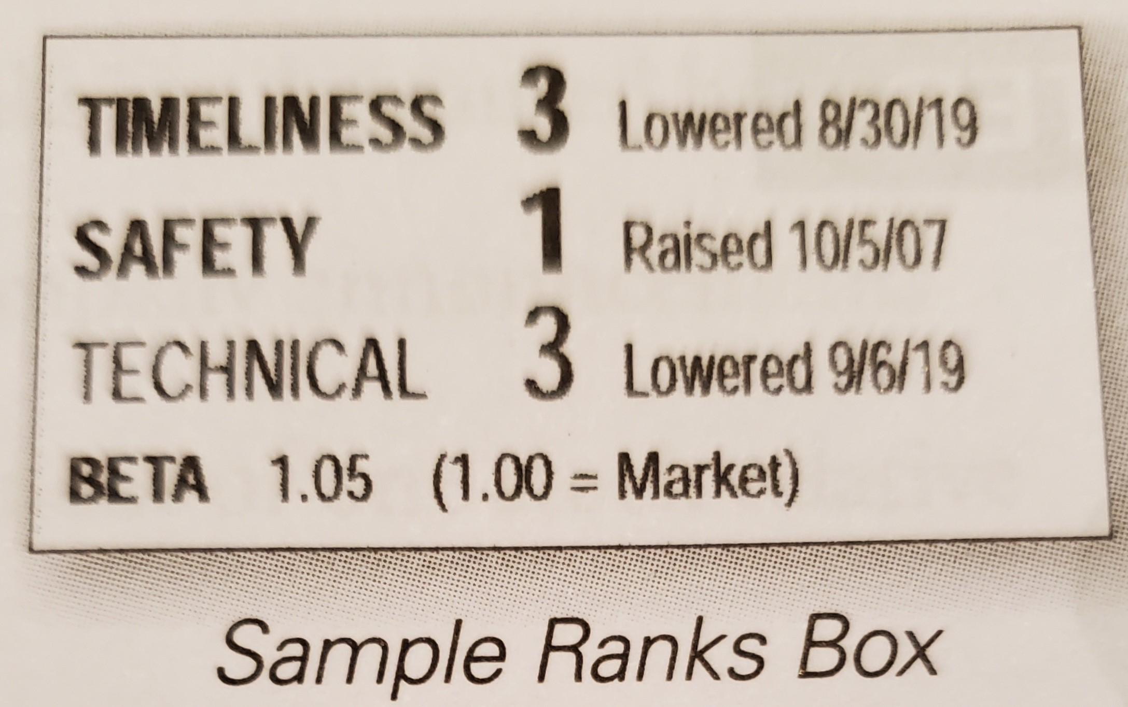
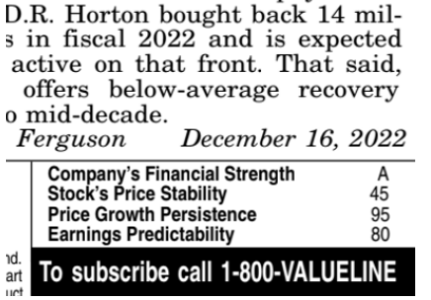
Value Line Ranks on the Company’s Page

Slide 7
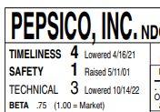
2. TIMELINESS: (1 or 2 are best):
3. SAFETY: (1 or 2 are best):

Slide 8
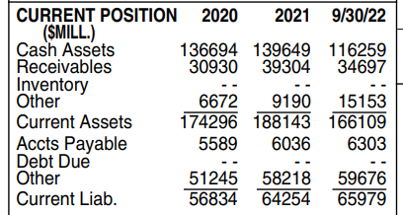
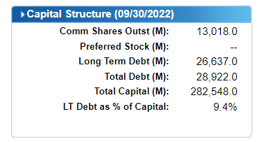
4. DEBT: (Should be at or below .3333 X Total Assets):
a. Total Assets __________ X .3333 = _________
b. Debt IS IS NOT within our guidelines.

Slide 9
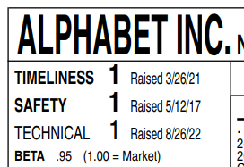
5. BETA, the measure of volatility of the stock price compared to that of the
total market should fall between .90 and 1.10. The BETA is: ____________

Slide 10
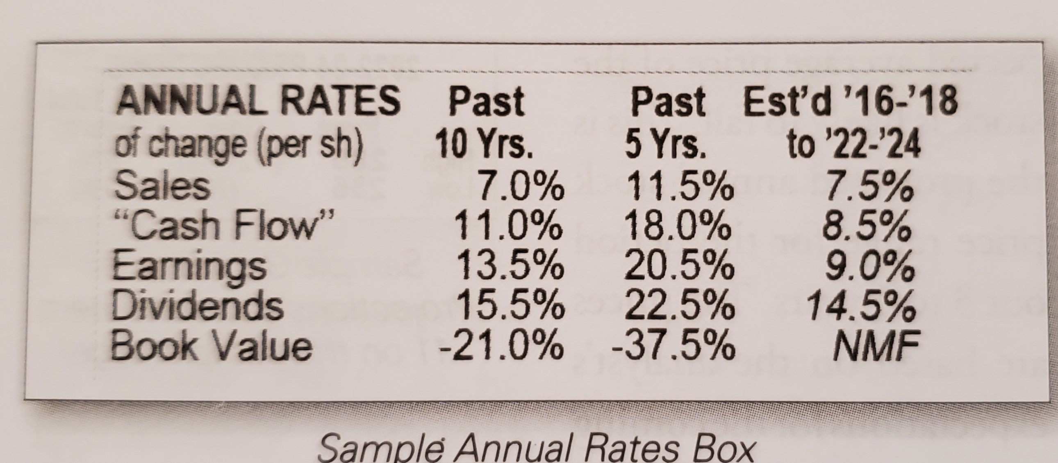
And the analyst gives his % expectation of growth for the future 3-5 years
Earnings are (ABOVE) (BELOW) 10%? ______++

Slide 11
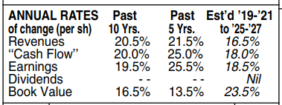
6. SALES & EARNINGS:
This company is a _____________ company. The projected EARNINGS are___________.
Sales or Revenue of a SMALL company (less than 1 billion)
should be projected to grow 12%-15% or even higher.
Sales of a MEDIUM company (1 billion to 10 billion) should grow 10% - 12% or even higher.
Sales of a LARGE established company (blue chip with revenue 10 billion and more) should grow 5% - 7% or higher.
WE TRACK THESE GROWTH PERCENTS EACH QUARTER AGAINST OUR PROJECTED SALES AND EARNINGS ON OUR SSG.

Slide 12
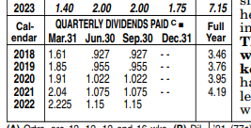
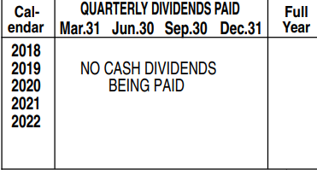
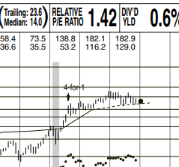
Does the company issue a dividend? __________
Reinvestment Plan? _______
When did the company last split? _________
What type of split? 2 for 1? ______,
3 for 2? ______, other? ________

Slide 13
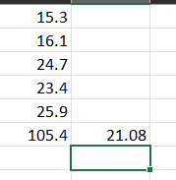
7. STOCK PRICE: _____________ The price (IS) (IS NOT) within the BUY range. (Get current price and P/E from Internet)
8. PRICE TO EARNINGS RATIO (P/E): This determines the cost of the stock relative to its PROJECTED EARNINGS. Track the P/E ratio for the last five years and restrict investments to companies that have a P/E ratio at or below the average for THE LAST 5 YEAR period.

Slide 14
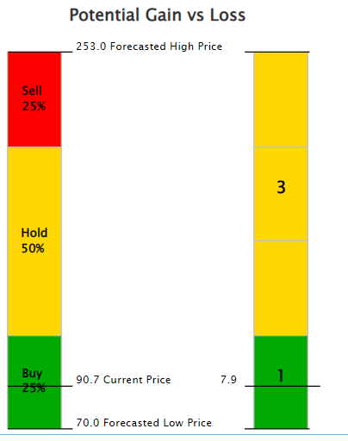
9. UPSIDE DOWNSIDE RATIO: A 3 to 1 potential upside is preferred.
This is a (GOOD) or (POOR) Buy at the current price. ____
Beware if your Upside Downside Ratio number is very high. You may need to revisit your projections and see if they are reasonable.

Slide 15
10. MANAGEMENT: Review Annual Report, 10K, 10Q and Final pages of SSG Narrative
Stock Selection Guide tests:
a. Test I – Does management as indicated by the past record have the ability to expand sales?
b. Test II – Does management appear to have the ability to maintain profit margins?
c. Test III – What % has the company earned on invested capital (equity)? From
_______% to _______%. See Section 2. Line 2 of the SSG. Earnings are (ABOVE) (BELOW) 10%?
Value Line
SSG

Slide 16
11. I would consider selling this stock (When in need of cash or to improve the portfolio by REPLACING this stock )
If company is acquired
The CEO or CFO leave, especially under adverse circumstances
Financials are deteriorating or questionable
4. Sales drop 3 quarters in a row
5. Earnings drop 3 quarters in a row
6. Debt continues to increase 2 or more quarters
7. Company is not competing well with peers
8. Profit margin is deteriorating
9. Product or service no longer relevant (becoming obsolete)
10. Limited upside potential (“4 strikes you are out”)

Slide 17
“4 Strikes, You’re Out” Stocks with limited upside threaten total portfolio returns
• Conduct these 4 tests of valuation:
Upside/Downside Ratio < 1:1.
Projected Relative Value < 80% OR > 150%.
Stock in SELL zone on SSG.
Projected Total Return unacceptably low: – < long-term bond or savings rates (~5%). – < your threshold.
• Mark these stocks “Available For Cash” & seek replacements.
(per Doug Gerlach)

Slide 19
12. Do you RECOMMEND that we BUY, WATCH, SELL, HOLD, REPLACE this stock?
This Photo by Unknown Author is licensed under CC BY-SA

