Slide 1
What’s New in Online Tools: Portfolio Reports and SSG Audit Function
By Gladys Henrikson, Oct 11, 2022
Adapted from Suzi Artzberger’s BI Online Presentation, “What’s New in Online Tools,” August, 2022; located under “Learning Center/Video Learning Library/Online Tools”

Slide 3
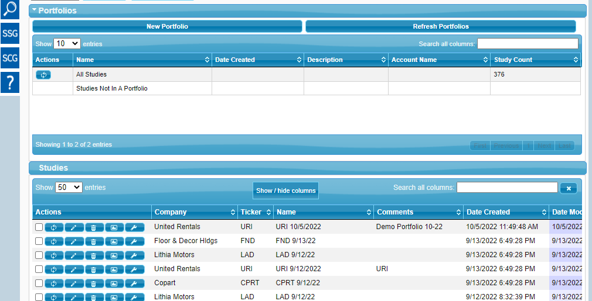
New Tool 1: “Reports” for Portfolios
Step 1: Go to Online SSG Tools, and click on “My Studies”
No Portfolios, yet
Studies

Slide 4
New Tool 1: “Reports” for Portfolios, cont. Step 2: Create a “Portfolio” for some of your Studies – (“Demo Portfolio”)

Slide 5
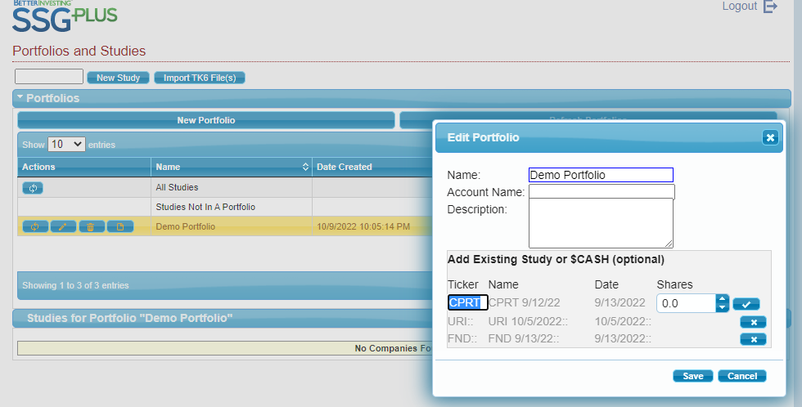
New Tool 1: “Reports” for Portfolios, cont. Step 3: “Edit” your portfolio by adding some tickers from your stock studies.

Slide 6
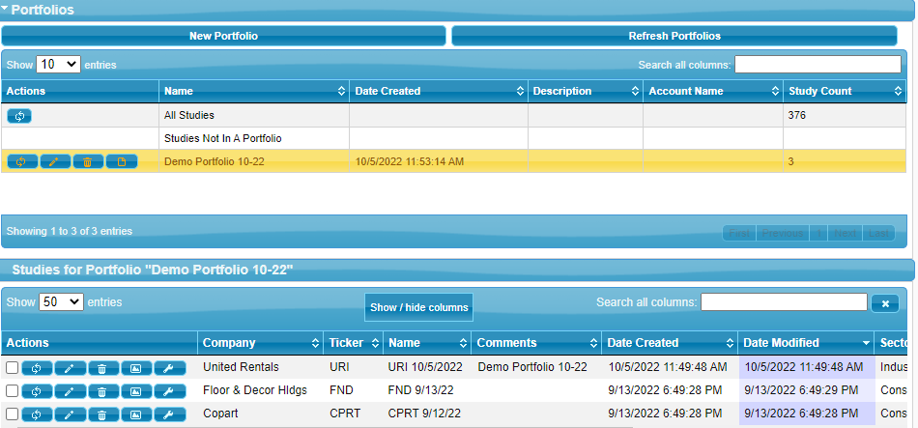
New Tool 1: “Reports” for Portfolios (Using my “Demo Portfolio”)
Step 4: Click “Reports” for Portfolio Studies (URI, FND, and CPRT)

Slide 7
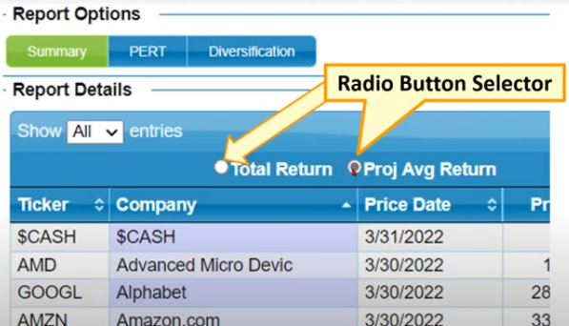
After Selecting “Reports” for Portfolio, Choose whether to display “Total” (default) or “Average” Returns

Slide 8
“Reports” Example Using “Demo Portfolio” and default “Total Return”

Slide 9
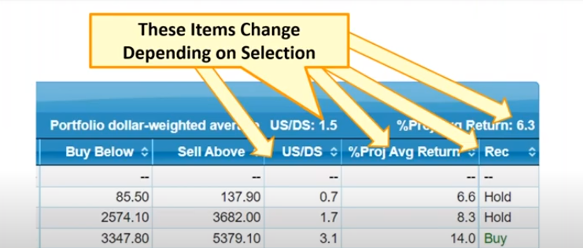
Changing Reports Option to “Average Returns” will also change the Buy and Sell Range, Stock Return, and Recommendations (Buy, Hold, Sell)

Slide 10
Note Changes in “Demo Portfolio” using Average Returns: Lower Ranges, returns, and recommendations reduced from “Buy” to “Hold”

Slide 11
New Tool # 2: Audit Tab Applies to Individual Stock Studies; We’ll use it to Improve our judgements
For Example: We’ll use the “Audit” function to check our judgements for one of the studies in our “Demo Portfolio”: URI

Slide 12
Locating the Audit Tab at the top of your SSG

Slide 13
What Audit will Reveal About an SSG

Slide 14
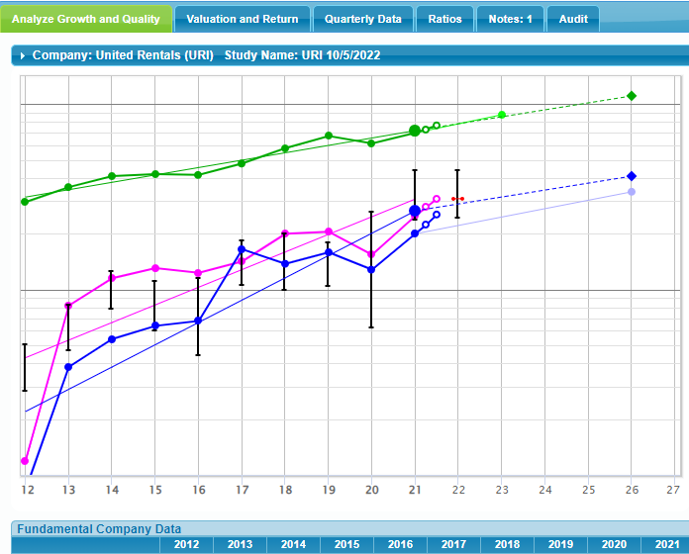
Ex: Demo Portfolio Stock URI (SSG) – note lines, esp 2020
After completing SSG Click on Audit Button

Slide 15
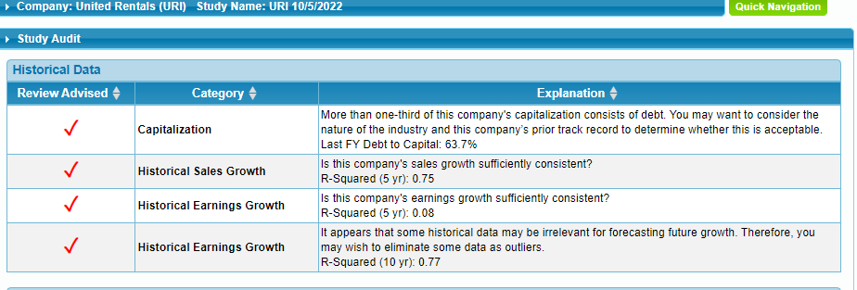
What Audit Questioned About URI SSG

Slide 16
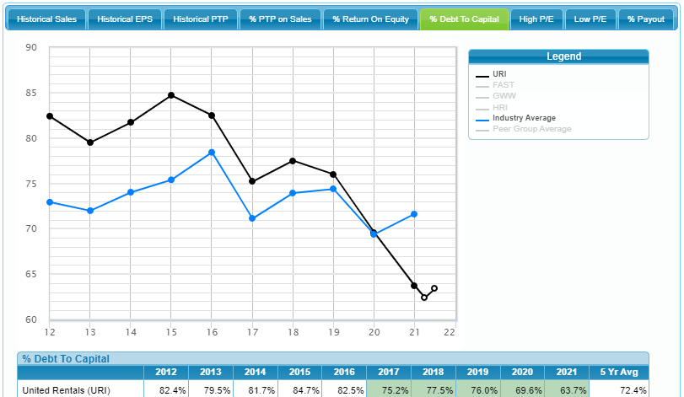
Addressing Audit Issue 1- Debt vis-à-vis Industry: last FY (Peers Screen)

Slide 17
Addressing the 3 “R-Squared” Issues for URI
R-squared values range from 0 to 1 and are commonly stated as percentages from 0% to 100%. An R-squared of 100% means that all movements of a security (or another dependent variable) are completely explained by movements in the index (or the independent variable(s) you are interested in).
R-Squared of “1” (a straight line) is best, R-Squared closer to “0” (crooked lines) is weak
URI R-Squares in Audit were:
Historical Sales Growth, strong = .75
Historical Earnings Growth 5 years, weak = .08
Historical Earnings Growth, 10 years, mitigating 2020, strong = .77

Slide 18
Conclusions re New Online Tools: Portfolio Reports and SSG Audit
The Portfolio Reports feature is most helpful for comparing returns on a portfolio or, similar to the Stock Comparison Guide, comparing several prospective stocks for further study.
The SSG Audit feature may help us fine tune both our judgements on a stock and determine whether an individual stock is worth further pursuit.

