Slide 2
Disclaimer
The information in this presentation is for educational purposes only and is not intended to be a recommendation to purchase or sell any of the stocks, mutual funds, or other securities that may be referenced. The securities of companies referenced or featured in the seminar materials are for illustrative purposes only and are not to be considered endorsed or recommended for purchase or sale by BetterInvesting TM National Association of Investors Corporation (“BI”). The views expressed are those of the instructors, commentators, guests and participants, as the case may be, and do not necessarily represent those of BetterInvesting TM. Investors should conduct their own review and analysis of any company of interest before making an investment decision.
Securities discussed may be held by the instructors in their own personal portfolios or in those of their clients. BI presenters and volunteers are held to a strict code of conduct that precludes benefiting financially from educational presentations or public activities via any BetterInvesting programs, events and/or educational sessions in which they participate. Any violation is strictly prohibited and should be reported to the CEO of BetterInvesting or the Director of Chapter Relations.
This presentation may contain images of websites and products or services not endorsed by BetterInvesting. The presenter is not endorsing or promoting the use of these websites, products or services.

Slide 4
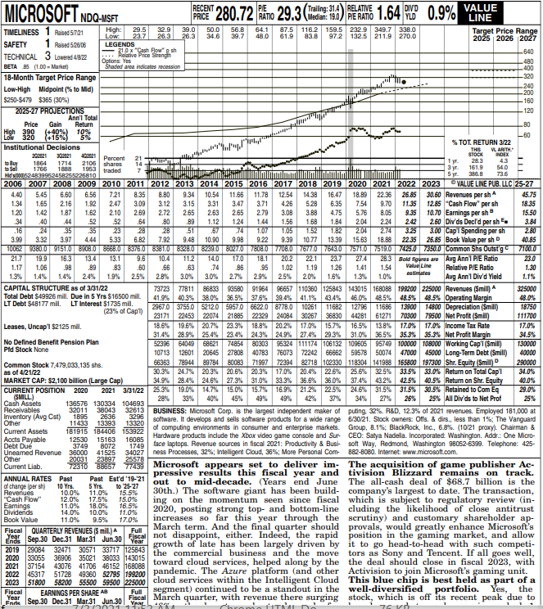
Why Value Line?
1.Company
Description
2. Rankings &
Ratings
3. Commentary
4. Long-term
Projections
5. “Value Line” &
Total Return Box

Slide 5
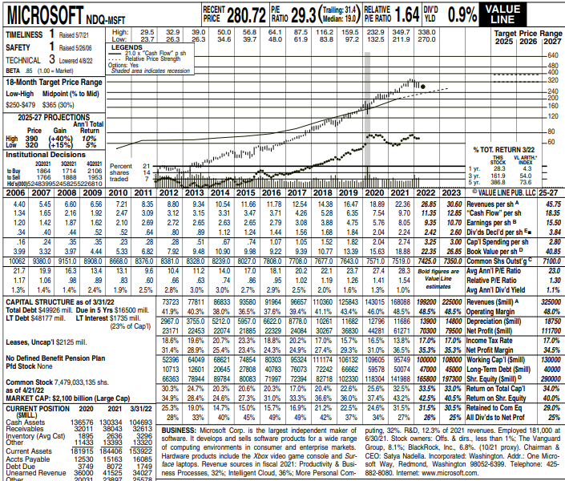
1.Company
Description
Start with the Business Box

Slide 6
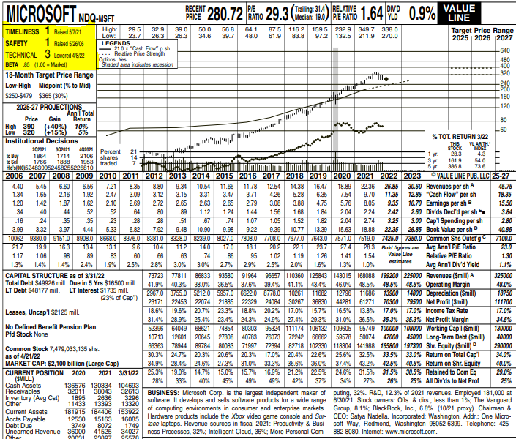
Check Value Line Ratings & Rankings
• Safety
• Financial Strength B++
or Better
• Earnings Predictability

Slide 7
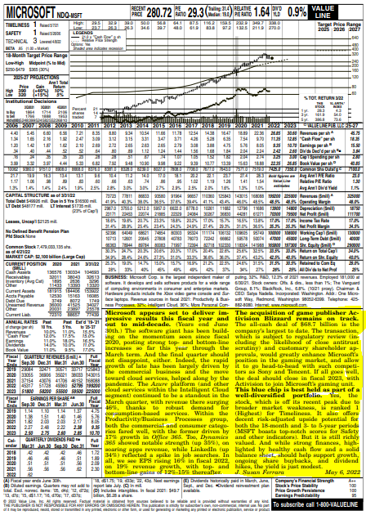

Slide 8
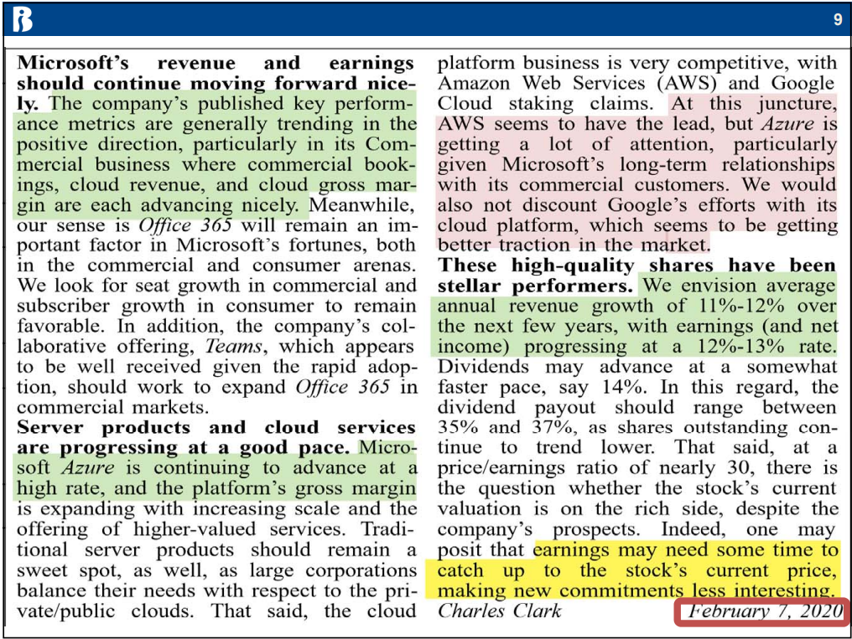

Slide 9
