Slide 1
Tax Loss Harvesting
December 14, 2021

Slide 2
Tax Loss Harvesting
Every time you sell an investment for more than you paid,
you create a
Capital Gain
And the government likes to tax your profit
depending on your tax bracket and how long you have held the investment

Slide 3
Tax Loss Harvesting
Terminlogy:
Realized and unrealized losses and gains.
A loss on paper is unrealized until it is sold. Once sold, it becomes realized.
A gain on paper is unrealized until it is sold. When sold, it becomes a realized gain.

Slide 4
Tax Loss Harvesting
Tax loss harvesting is also known as “tax loss selling”.
Usually this strategy is used near the end of the calendar year, but it may happen at any time in a tax year.

Slide 5
Tax Loss Harvesting
Tax-loss harvesting is the selling of securities at a loss to offset a capital gains tax liability. This strategy is typically employed to limit the recognition of short-term capital gains. Short-term capital gains are generally taxed at a higher federal income tax rate than long-term capital gains.

Slide 6
Tax Loss Harvesting

Slide 7
Tax Loss Harvesting
An investment loss can become a win.
By selling (realizing) the losing investment, you can “harvest” that loss and use it to:
Offset your capital gains
Reduce your capital income
Maybe even improve your portfolio.

Slide 8
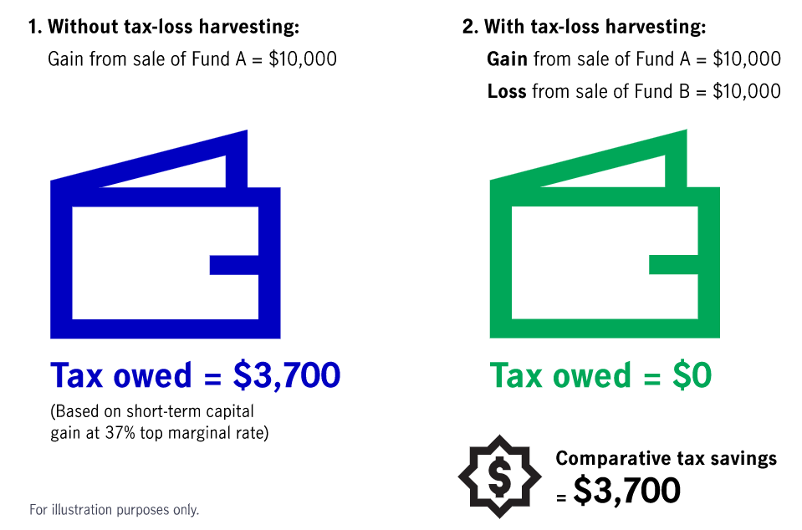
Tax Loss Harvesting

Slide 9
Tax Loss Harvesting
It is possible to eliminate all your capital gains tax liability if you have enough realized losses to offset your realized gains.
Have realized gains, but un-realized losses? Sell (realize) the losses which then offsets some or all of the taxable gain from the already realized gains.

Slide 10
Tax Loss Harvesting
Note: Losses can be used to limit tax exposure from noninvestment income, as well as to offset investment gains.
Under current law, a capital loss deduction allows an investor to claim up to $3,000 more in losses than in capital gains, meaning investors can reduce their taxable income dollar for dollar, up to that $3,000 limit. (The limit is $1,500 for a taxpayer who's married and files separately.)

Slide 11
Tax Loss Harvesting
Around October or November, fund asset managers typically provide notices to shareholders to aid in year-end tax planning.
These notices, as well as online disclosures, indicate which mutual funds are expected to pay gains by year end—based on market performance at the date the estimates are made, typically through the end of September—and provide estimates of the amounts of those expected gains as well as funds’ estimated income distributions from dividends, interest, and other net income.

Slide 12
Tax Loss Harvesting
Example with a stock:
Invest $20,000 in a stock at beginning of the year, but it goes down to $18,000
What to do?
Hold on, thinking it will go back up
Sell, taking $2000 loss and deduct it from your taxable income
3) Sell, take loss and deduction and buy something else with the cash

Slide 13
Tax Loss Harvesting
Or I could buy something like it. But be cautious!
The IRS wash sale rule says you can’t buy an investment that is substantially identical to the one you’ve sold within 30 days of sale, or you will lose the ability to claim the loss.
Note: ETFs are not currently considered substantially identical to mutual funds, says a Wisdom Tree article. But, doublecheck the latest IRS rulings.

Slide 14
Tax Loss Harvesting
How can tax loss harvesting improve a portfolio?
Example: Have realized losses of $3000, but haven’t sold any gains.
If one or more of my stocks is becoming overvalued, I could trim it by selling enough shares to equal my $3000 loss and thus cancel out the capital gain tax and bring an oversized holding into a more equal share in the portfolio.

Slide 15
Tax Loss Harvesting

Slide 16
Tax Loss Harvesting
The three stocks listed here are all short term purchases and they show all of MicNOVA’s unrealized losses:
VRTX ($14.94) AQN ($107) META ($168.58)
That is less than $300 in unrealized losses.

Slide 17
Tax Gain Harvesting
Problem: Micnova has $9,066 in realized gains, but only $300 in unrealized losses.
If we realized our unrealized $300 in losses, could offset $300 from $9066 in gains.
OR
MSFT ($342 a share, cost basis $25.53) 11.9% of portfolio: capital gain of $316
could sell one share??
OR
AAPL ($179 a share, cost basis $12.53) is 11.2% of portfolio: capital gain of $176
could sell 2 shares??
This could trim our largest positions and cut off $300 of capital gains from their sale. But we still have the rest of $9066 of capital gains. Worth it this year?

Slide 18
Questions?
More information in the December BetterInvesting Magazine, p. 12. “Year-End Tax Planning Tips”, by Alexandra Armstrong and Christopher Rivers.
Small Cap Informer, December 2021, Vol. 10, Issue 12 editor Doug Gerlach’s comments: “Tis the Season for Tax Loss Harvesting.”
IRS Publication 544, “Sales and Other Dispositions of Assets”

