Slide 1
Using Exchange Traded Funds (ETF) in a Portfolio
MicNOVA
November 17, 2020
Linda Hunt
Lindann7@comcast.net
Notes:
When I was asked by the Education Committee for MicNOVA to talk about Exchange Traded Funds as a possibility for a portfolio she especially mentioned an ETF that some of you had heard Kim Butcher talk about during a Mid-Michigan Roundtable, NERD. She was intrigued by this ETF because it is focused on the industry of gaming, especially video games, eSports, and online gambling This arena has soared in popularity as users worldwide stay at home due to the COVID-19 pandemic. Also, a recent email from Gladys indicated you might be interested in another ETF by Renaissance with the ticker IPO. I will talk about these as I briefly outline some basic principles I follow when investing in ETFs.

Slide 2
Notes:
This is our usual disclaimer stating that any ETFs or individual companies that I talk about are not for recommendation. Also any products or services are in the line of education and I am not suggesting that you buy them. This presentation is for education only. It is important to do our own research.

Slide 3
What I will cover…
Advantages of using ETFs
Provides diversification for a Portfolio
Funds in sectors with high volatility, risk
Funds focused on small companies not followed by analysts
Funds with international exposure
Makes investing easier
Potential Pitfalls to investigate
Not understanding prospectus of the fund & the Fund Family
Funds that close
Short history
Low assets under management
Low volume
Valuation
Notes:
In the amount of time for this presentation, I cannot begin to talk about the differences between using mutual funds and exchange-traded-fund. I will only mention that since their inception over 20 years ago, ETFs have grown exponentially, much of the money flowing out of mutual funds. There are several reasons for that; ETFs can be more easily traded, there tax advantages for ETFs, and expenses are usually less for ETFs to name a few. However, with the growth of this asset class which initially only followed large indexes, we have also seen some riskier offerings such as ones that are leveraged or managed resulting in higher expense ratios. It is good to be careful not to be drawn into this more speculative and costly arena.
This is an outline of what I will cover looking at some of the advantages of ETFs and then some of the pitfalls to watch out for.

Slide 4
Advantages of Using ETFs
Diversification
There are some sectors that have high volatility and/or risk making it difficult to invest in individual companies.
Biotechnology (XBI and IBB)
Gaming (NERD)
Initial Public Offerings (IPO)
Notes:
Volatile and riskier industries often can make us uncomfortable trying to pick one company to invest in. Yet, the companies in these industries may offer great potential for growth. Depending on the popularity of a particular industry, there may be a number of fund offerings by the various ETF providers. I have a slide later that lists some of these providers. What will be important is to investigate how the ETF is structured. I will be showing some features of Morningstar which can help with that analysis

Slide 5
Biotechnology Two ETFs of interest
Notes:
The biotechnology industry has received much attention lately because of the virus. Companies in this industry, especially smaller ones, are on the cutting edge of research, but may have no earnings yet. There also could be substantial debt. However, they’re often funded by larger companies and can be a potential buyout.

Slide 6
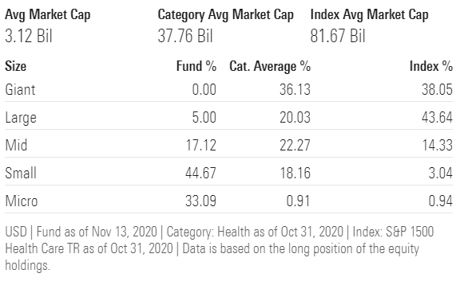
Exchange Traded Fund Biotech - XBI
Notes:
XBI is offered by State Street Global Advisors and contains primarily small companies as you can see in this Morningstar chart listing the categories. The majority of the companies are small and even micro. XBI holds 181 companies with the largest holding under 2%. Two of the five top holdings had a one-year return of just slightly less than 400%.

Slide 7
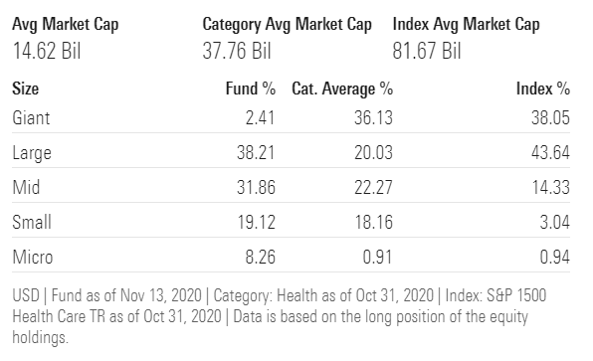
Exchange Traded Fund Biotech - IBB
Notes:
IBB is provided by Blackrock and contains the larger biotech companies. Unlike XBI their top holdings will probably be familiar to you: Amgen, Gilead and Modera which was in the news recently because of their vaccine announcement that is 95% effective. Their four top companies are over 27% of their 200 holdings—a larger percentage than for XBI. There is a reason for this which I’ll explain in the next slide. IBBs expense ratio of 0.46% a little higher than XBI which is 0.35%.

Slide 8
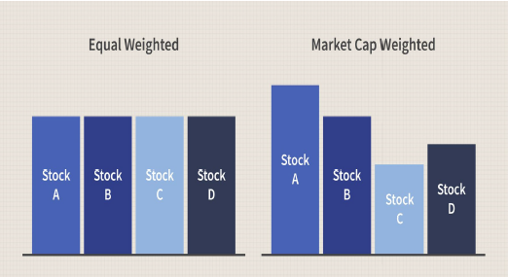
Biotechnology Industry XBI and IBB
Notes:
In addition to different holdings by these two ETFs—small companies vs. large ones– their indexes are constructed differently. XBI is an equal-weighted index which means each stock in the holdings has equal value regardless of the price of the stock. This is illustrated in the graph. One of the features of this type of construction is that there will probably be more stock turnover and higher trading costs in this fund.
IBB follows a cap-weighted index, sometimes referred to as a market-value-weighted index. Thus, stocks with a higher market cap are responsible for more of the fluctuations in the price of the ETF. Here you may not be getting the diversification that comes with an equal-weighted index.

Slide 9
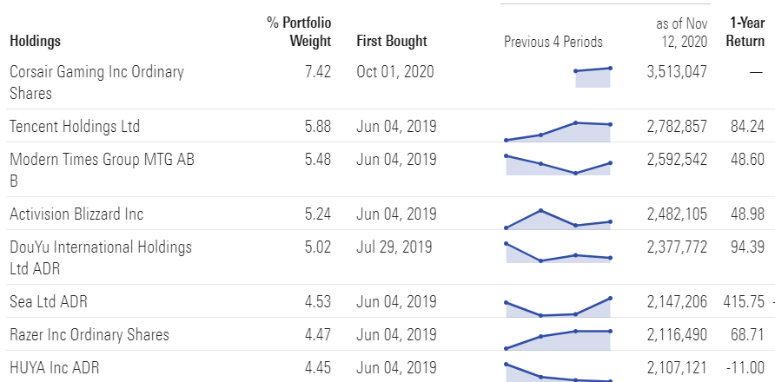
Gaming Industry--NERD
Notes:
The gaming ETF, NERD, has 32 companies and an expense ration that is reasonable, 0.25%. There are other ETFs that follow this industry, and the holdings vary depending on the focus. This industry is affected by many different types of companies from technology to communications. For NERD the largest holdings seen here in this chart have been bought since 2019. Morningstar provides all of the holdings for an ETF by clicking on portfolio and then “Show More Holdings.” As you can see from this chart the return on these top holdings have had healthy returns with the exception of HUYA, a Chinese company that operates a game live streaming platform. Morningstar makes it possible to dig further into the holdings of an ETF, and as you can see from this chart you can easily get a quick look at their return.

Slide 10
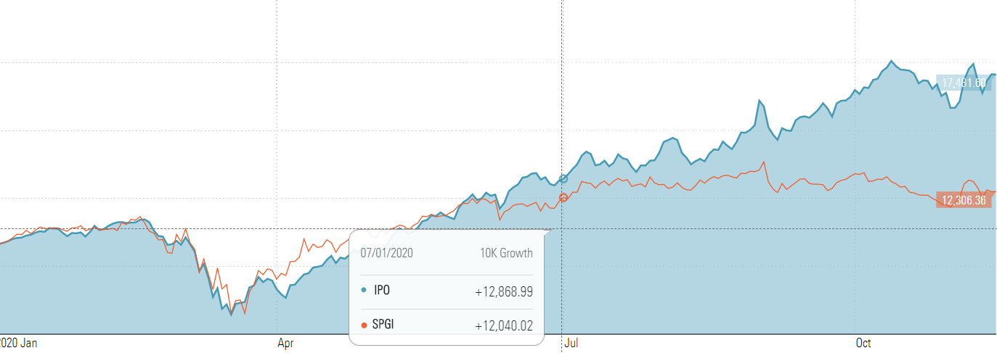
Initial Public Offerings - IPO
Notes:
Initial Public Offerings are not considered an industry but certainly this group of companies falls into the category of usually being off-limits for Better Investing folks since the companies do not have a history of filings with the Securities and Exchange. However, they may have been private companies for years. It is just harder to know how to make more reliable judgments on the Stock Selection Guide. This chart offers another feature in Morningstar that lets you compare the performance of the IPO ETF and, in this case, another ETF that follows the S&P 500 with global companies added. Hopefully you can see the orange line which represents a large number of companies held in the S&P 500 along with a global exposure of companies. While this isn’t a perfect comparison, it does give a graphic picture of how IPO has done since the beginning of 2020. This chart is interactive in Morningstar so you can choose other comparisons.
Their portfolio consists of companies that have recently completed an IPO and are traded on a US exchange. Uber is their largest holding at 10.6% of the portfolio. Zoom is next at 8.3%. The fund has 48 holdings, and they have a turnover ratio of 92%. Lots of selling and buying. Their expense ratio is 0.60%. I keep mentioning the expense ratio of the ETFs I’m discussing because the expenses of a fund take profits from you.

Slide 11
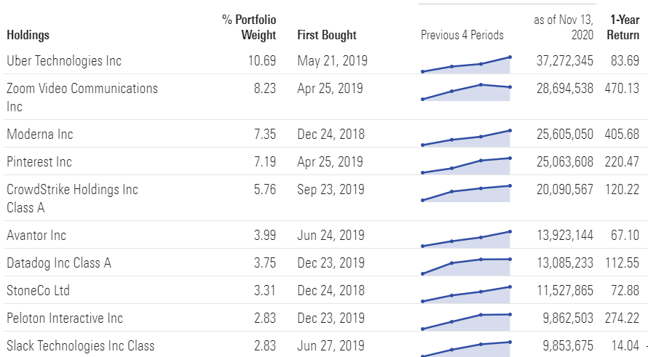
Notes:
Their portfolio consists of companies that have recently completed an IPO and are traded on a US exchange. Uber is their largest holding at 10.6% of the portfolio. Zoom is next at 8.3%. The fund has 48 holdings, and they have a turnover ratio of 92%. Lots of selling and buying. Their expense ratio is 0.60%. I keep mentioning the expense ratio of the ETFs I’m discussing because the expenses of a fund take profits from you.

Slide 12
Advantages of Using ETFs
Diversification
Small companies usually have the greatest growth potential; however, it can be difficult to find unbiased information from analysts. Fund families like Vanguard have a variety of ETFs for both small and mid-cap companies.
Having exposure to foreign companies is usually only available if they are listed as ADRs. However, there are ETFs for Emerging Markets as well as ETFs for specific countries or areas of the world.
Notes:
Another advantage of using ETFs in your portfolio is for diversification in areas that have companies that are difficult to analyze or even buy like foreign stocks. Both small companies and companies in emerging markets have begun to do very well overall. They tend to have a negative correlation to large caps.
Small companies usually have the greatest potential for growth, but they often don’t have analysts following them. There is a wide variety of small cap ETFs to pick from. I have listed two here, offered by Vanguard which tends to have very low expense ratios; however, providers have been racing to compete with lower expense ratios. VB is a blend growth and value while VBR is focused on value companies. VB holds 1,406 companies and VBR has 896 companies. Their expense ratios are 0.05% and 0.07% respectively. Assets under management for VB is $32.6 billion and for VBR $15.5 billion, about half as much. When an ETF focuses on a narrower index, then the assets under management tend to be smaller.
Diversification into areas such as emerging markets is especially helped with owning funds since many foreign holdings are not available on US exchanges. Vanguard’s ETF, VWO has over four thousand companies. Chinese stocks make up almost 40% of the holdings with the two largest companies being Alibaba at 8% and Tencent at 6%. The index is market weighted so the larger companies hold more weight. The expense ratio is 0.10% which is low considering the extra cost of buy foreign companies. Again, there are other options for ETFs when looking outside the US. VWO is followed by an analyst. Blackrock, Schwab and Wisdom Tree also have ETFs that focus on emerging markets.

Slide 13
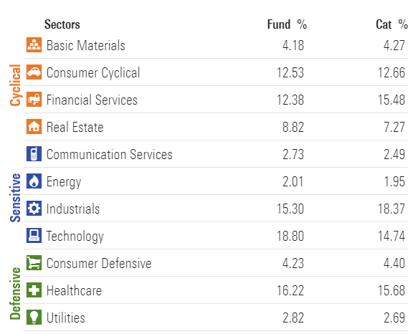
Small Cap ETF - VB

Slide 14
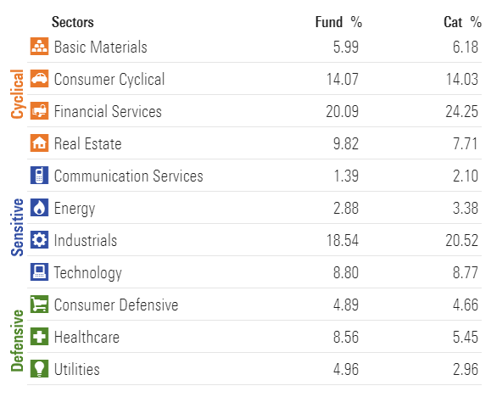
Small Cap ETF - VBR

Slide 15
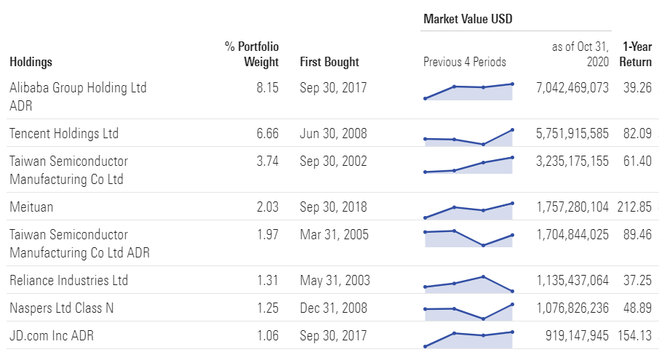
Advantages of Using ETFs Foreign Companies - VWO
Notes:
Diversification into areas such as emerging markets is especially helped with owning funds since many foreign holdings are not available on US exchanges. Vanguard’s ETF, VWO has over four thousand companies. Chinese stocks make up almost 40% of the holdings with the two largest companies being Alibaba at 8% and Tencent at 6%. The index is market weighted so the larger companies hold more weight. The expense ratio is 0.10% which is low considering the extra cost of buy foreign companies. Again, there are other options for ETFs when looking outside the US. VWO is followed by an analyst. Blackrock, Schwab and Wisdom Tree also have ETFs that focus on emerging markets.

Slide 16
Advantages of Using ETFs
Makes investing easier…
Notes:
I have heard many say, especially if they are still working that they just don’t have the time to do the research needed to buy individual stocks. Indeed, keep track of individual companies can be time-consuming. Personally, I enjoy it and I also have the bulk of my portfolio in what I call core holdings that don’t take quite as much watching.
However, it is possible to have a well-diversified portfolio with only 3-5 ETFs. Morningstar often makes suggestions along that line. Then your portfolio follows whatever the market is doing. Actively managed funds have tended to lag the overall market; but that is primarily due to the cost for the manager. You are paying for his/her time. By doing your own research for individual companies you are paying yourself.

Slide 17
Pitfalls to Avoid
Reading about the fund and the company that is offering it is very important.
How is the fund set up? Does it follow a well-known index?
How long has the company been in existence?
When was the fund established?
Major fund providers with a history.
Vanguard
BlackRock (iShares)
State Street Global Advisors
Fidelity
T. Rowe Price
Pro Shares
Notes:
There is a lot of information available online about fund providers as well as the construction of the index that an ETF mimics. As I have suggested, Morningstar can help with your analysis, especially if there is an analyst following the ETF.
I’ve listed some of the major fund providers with a history. A relatively new provider has a lot of competition breaking into the field because assets under management are important and it take some time to attract investors. It is important to know your provider and ETF you want to purchase are on firm ground.

Slide 18
Pitfalls to Avoid
Of primary importance is making sure the ETF fund won’t close. The company usually announces its closure but by the time that notice is posted, other investors have probably already exited.
Funds have a short history often don’t attract the number of investors needed to keep it going.
Of great importance is the Assets Under Management (AUM). Less than $50 M means lower liquidity than larger ETFs. This can result in higher trading costs which can negate some of your investment gains or increase your losses.
Low volume for an ETF usually means a wider spread between the Bid and Ask prices. Usually, in this case it is best to not put a market price in but rather a limit order.
Notes:
According to Morningstar, the number of ETFs liquidated annually has doubled between 2015 and 2019. This is often due to lack of interest by investors. The ETF may be too narrowly focused, too complex, or it may have a poor rate of return on investment. When an ETF has dwindling assets under management and can’t attract enough investors the provider may decide it is no longer profitable for them. Generally, ETFs tend to have low profit margins, so a company won’t want to keep it open. If a fund has only been in existence for a relatively short time, there could be more risk that is won’t attract enough investors and it will close. It needs to build up its Assets Under Management in order to stay viable. The spread between the Bid and Ask prices gives some indication of whether the volume is sufficient. Looking at the ETFs I mentioned earlier for example, IPO has a spread of 2.76%, NERD has a spread of 12.32% while XBI which has been around much longer has a spread of 0.35% and IBB’s spread indicates it has high volume with a spread of 0.01%.

Slide 19
Valuation
Ticker | 52-Week Lows & Highs | Current Price | Assets Under Management
XBI | $62.94 - $126.75 | $124.89 | $6.6 Billion
IBB | $92.15 – 146.53 | $141.08 | $9.8 Billion
NERD | $11.91 - $27.36 | $26.53 | $48.3 Million
IPO | $20.37 - $57.70 | $55.92 | $348.4 Million
VB | $95.51 - $178.81 | $178.00 | $32.b Billion
VBR | $73.32 - $139.42 | $132.08 | $15.5 Billion
VWO | $29.96 – $48.43 | $47.55 | $65.8 Billion
Notes:
And finally, you want to be sure you are not over-paying for an ETF, just as we look for reasonable prices for companies. You can see if the current price is near the top of the 52-week range. As we all probably realize, the market is quite frothy now with new highs being reached. All of the ETFs I’ve talked about are near or at their 52-week highs. The prices I quoted for this table are from yesterday.
Paying attention to the larger picture is also a good idea. For example, tech stocks have been doing well while it seemed there was little light at the end of the tunnel for our lock-down would. With the news that vaccines are close to approval, tech had receded some. NERD has probably had much of its growth from investors thinking working from home and even gaming would boost keep their stocks at highs. They may continue. I have done quite a bit of reading about the addition many young people have for gaming—to the extent they lose focus on anything else in their lives.
Emerging markets are doing better because China seems to have a better handle on controlling the virus. Their GDP has been going up.

Slide 20
Notes:
So, Exchange Traded Funds can offer a basket of stocks in industries or areas where it is difficult to pursue individual companies. They usually are not as volatile because they hold so many companies. I recommend Morningstar to help with your research on ETF. Usually the library gives you online access and also provides books ont eht subject of ETFs. Thanks for your attention.

