Slide 1
SSG Plus Ratios
Another Tool in the toolbox

Slide 2
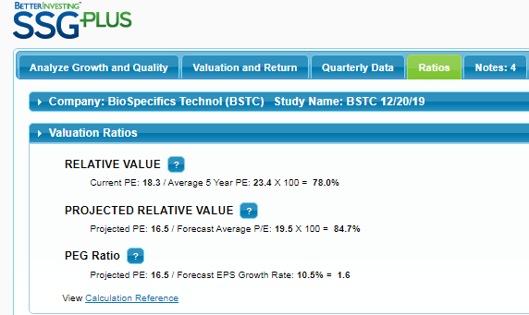

Slide 3
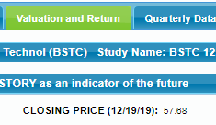
Projected P/E = Current Stock Price
Estimated EPS over next 12 months

Slide 4
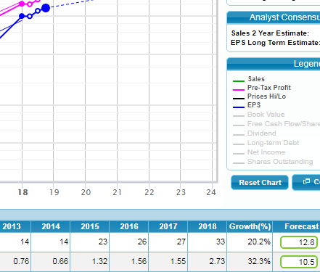
Estimated EPS over the next 12 months
3rd quarter EPS = $3.16 times one year of Forecast annual EPS

Slide 5
$57.68
$3.16 + (10.5% one year growth or .286)
$57.68
$3.5
=
16.5

Slide 6
Differing opinions on what constitutes a good PEG ratio
Undervalued PEG can fall between under 1 to under 2
Overvalued PEG is can fall under 2 or over
Warning: Your ratios are very dependent on your JUDGEMENTS!

Slide 8
Companies selling for lower ratios than usual can be attractive buys for value investors

Slide 10
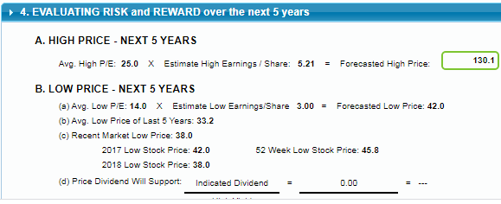
Forecast Average P/E is Average of Average High P/E and Average Low P/E Judgements
Avg High of 25 plus Avg Low of 14 divided by 2 equals 19.5

