Slide 1
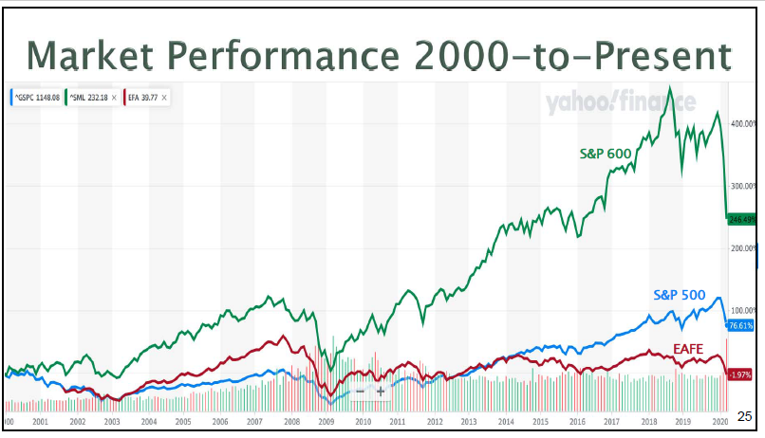
From Doug Gerlach – Investing in Troubled Times

Slide 5
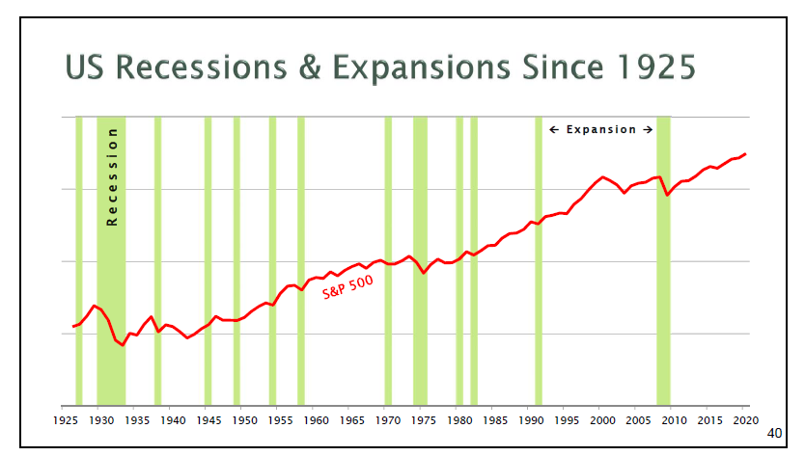

Slide 7
From Doug Gerlach – Investing in Troubled Times

Slide 8
Portfolio Recommendations for Super Sectors- Kathleen Richards, Better Investing
Defensive – 29%
E.g. Consumer Staples, Health Care
Cyclical – 36%
E.g. Consumer Cyclical, Financials, Basic Materials
Sensitive – 35%
E.g. Industrials, Technology

Slide 9
From Doug Gerlach – Investing in Troubled Times

