Slide 1
Middleby (MIDD) Stock Exercise- Re-evaluation from Watch List
1. ACID Tests: Does MIDD still meet them? (Y/N)
Sales – growing (target for Med Co = 7-12%)? _________________
Earnings per Share – growing? _________________________
Pre-tax Profits/ Margins – better than last year? ___________________even with sales or growing?_______________
2. Beyond the ACID Tests: Exploring the ORE Vein:
Return on Equity (>15%)?_________________
Debt to Capital levels (under 33%? Declining or even?)____________________----
P/E Ratio. How does current P/E compare to Average P/E (higher/lower/same)?_____________
Trailing Twelve Months’ –TTM- Quarterly Sales & Earnings per Share – compared to last full year: (higher/lower/same)?_____________
Industry Sales Comparison. How does this stock’s sales compare to industry (higher, even, lower)?
_______________________________________
f. What are analysts’ consensus recommendations?______________________

Slide 2
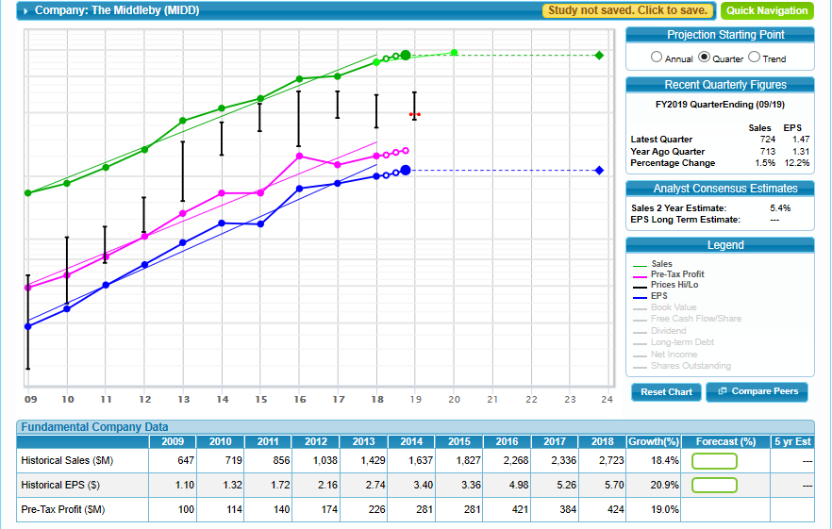
2.a-b Beyond the Acid Tests on MIDD from Front of SSG
Sales
EPS
c. Profit Margin

Slide 3
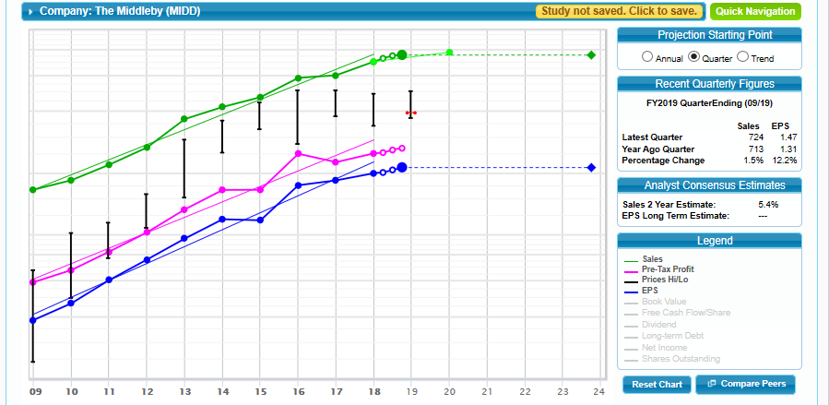
2.a,b Beyond the Acid Tests on MIDD: Debt & ROE
ROE
Debt

Slide 4
2.c. Beyond the Acid Tests on MIDD: P/E Ratios, Current vs Average (from back of SSG)

Slide 5
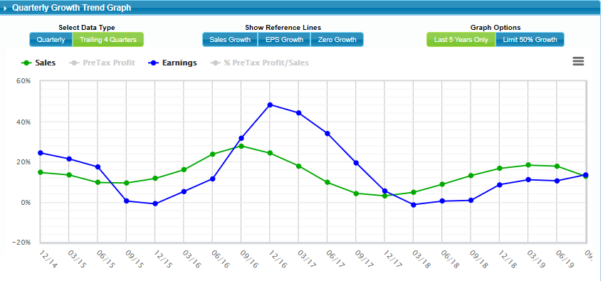
2.d. Beyond the Acid Tests on MIDD: Quarterly Sales & EPS (TTM-from back of SSG)

Slide 6
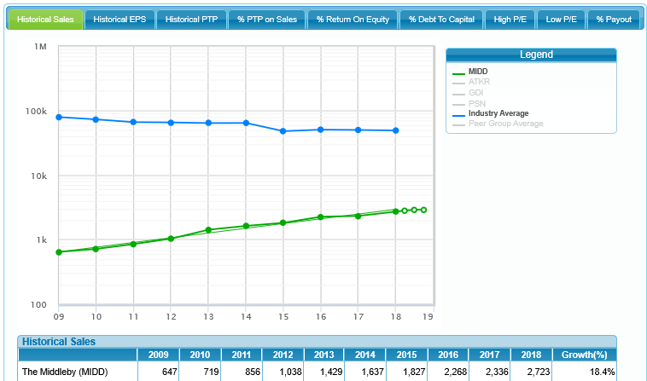
2.e. Beyond the Acid Tests on MIDD: Sales-Industry Comparison (from back of SSG)

Slide 7
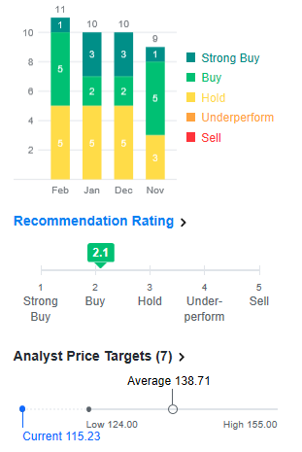
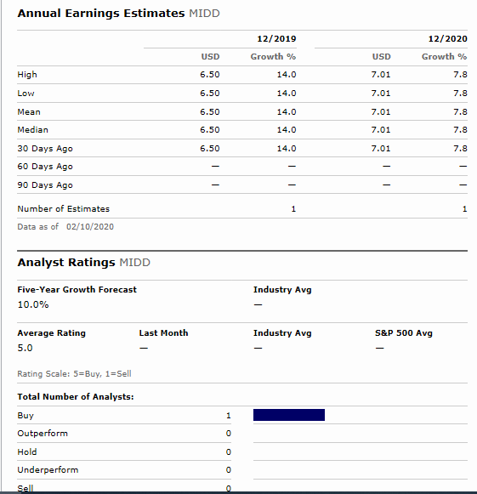
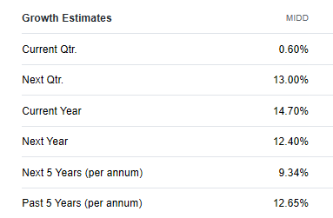
2.f. Beyond the Acid Tests on MIDD: Research- Analysts’ Consensus (from Research Tab on SSG)
Morningstar
Yahoo Finance

