Slide 1
Estimating Preferred Procedure
Sales Growth
Expenses
Taxes
Shares Outstanding
EPS

Slide 3
Agenda
Review making EPS growth projections
(the un-preferred way)
Introduction to the Income Statement
The Preferred Procedure
The calculations
Using the Preferred Procedure in the SSG Plus BetterInvesting online tool Guidelines for judgements

Slide 11
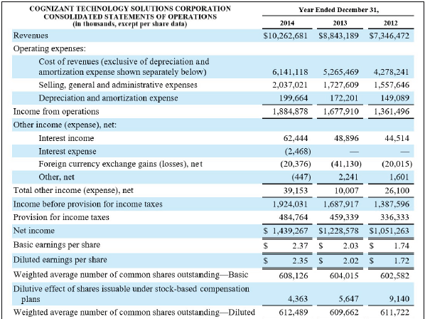

Slide 12
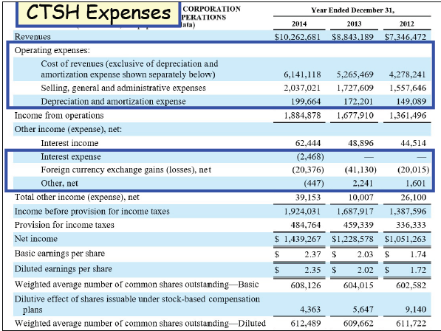

Slide 13
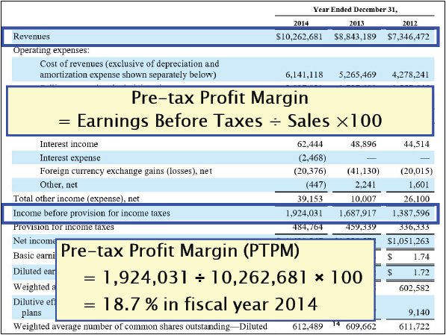

Slide 19
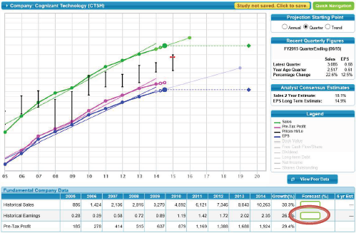
Let the Computer do the Work

Slide 20
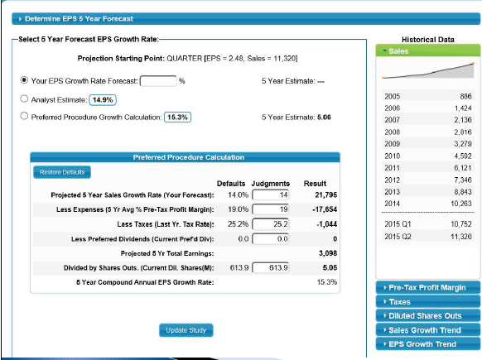

Slide 26
Why use the Preferred Procedure?
Sales growth often more regular and predictable than earnings growth.
Tax rate change due to 2017 tax law (short-term).
Most companies do not have preferred stock.
Focus on sales growth, % PTP, and number of outstanding shares available.

Slide 27
Why use the Preferred Procedure?
Forces us to think about how a company currently makes money and will grow.
Understand the Business Model
Increases confidence in earnings projection.
Earnings growth based on applying logic to what you know about the business.
Reduces reliance on analysts.

Slide 31
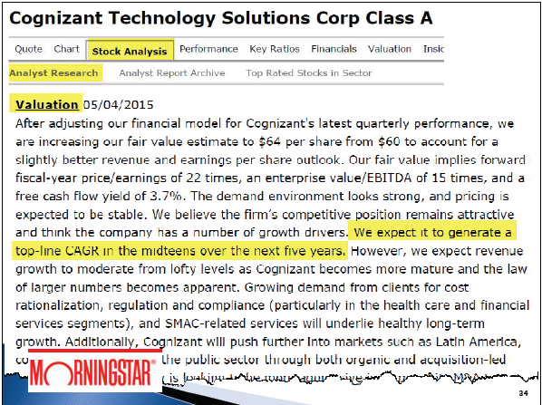

Slide 32
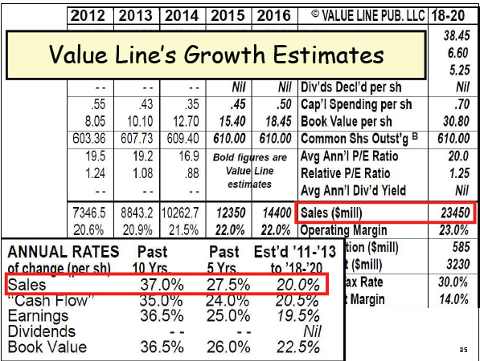

Slide 35
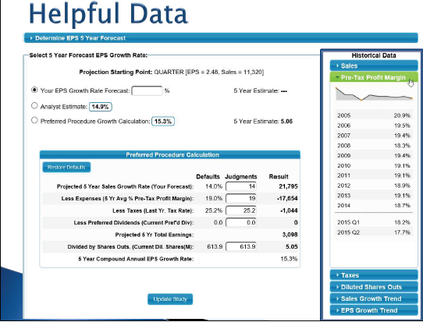

Slide 38
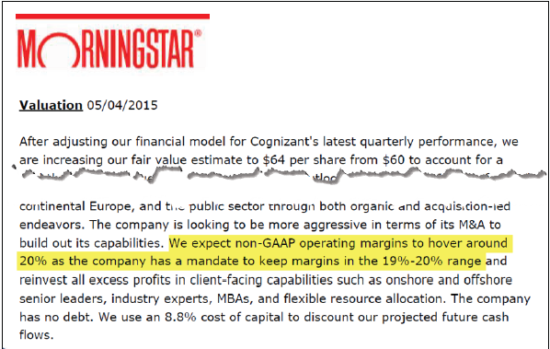

Slide 39
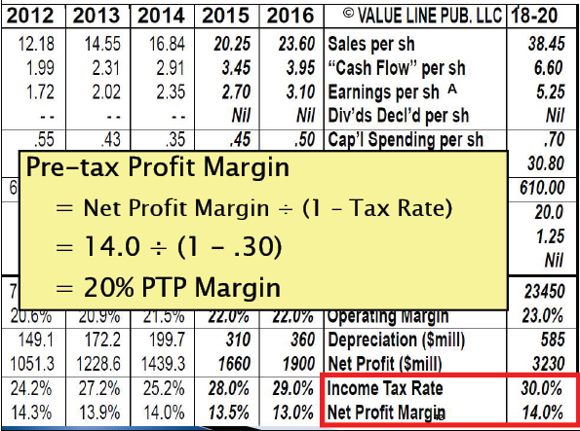

Slide 45
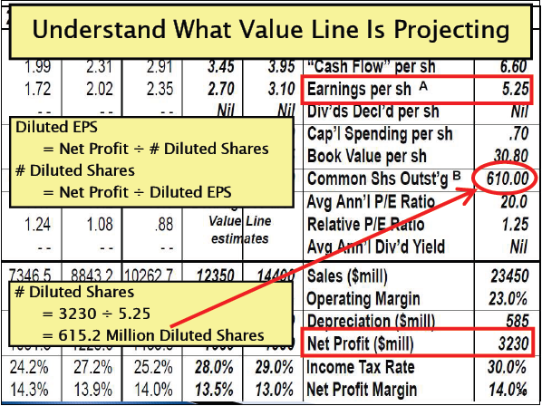

Slide 48
