Slide 1
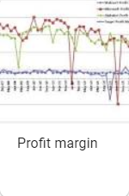
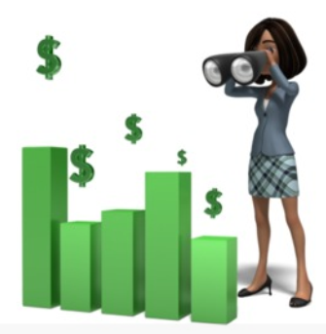
Financial Ratios
Linda Hunt (Lindann7@comcast.net)

Slide 2
What is a financial ratio? From Investopedia (Investopedia.com)
There are many standard ratios used to try to evaluate the overall financial condition of a corporation or other organization.
Financial ratios are used to compare the strengths and weaknesses of a company.
If shares in a company are traded in a financial market, the market price of the shares is used in certain financial ratios.

Slide 3
Outline
Sources of data—there are others
Morningstar
Investopedia
Return on Equity—important on the SSG for evaluating management
Net Profit Margin
Asset Turnover Ratio
Financial Leverage

Slide 4
Disclaimer
All stock references are meant to be used for educational purposes. No recommendation for purchase or sale is intended or implied.

Slide 5
Ecolab
Ecolab serves a wide range of industries from food production, restaurants, hotels and hospitals to paper mills, power generation, manufacturing plants, spanning more than 40 industries across more than 170 countries.

Slide 6
Ecolab SSG

Slide 7
Sustainability Statement
We focus every day on finding new solutions to help deliver clean water, safe food, abundant energy and healthy environments while saving water and energy and reducing waste. Our expertise helps our customers reduce their reliance on finite natural resources and achieve the best results at the lowest total cost. Within our own facilities, we work on reducing our water consumption, carbon emissions and waste stream, now and in the future.

Slide 8
Global Warming Efforts

Slide 9
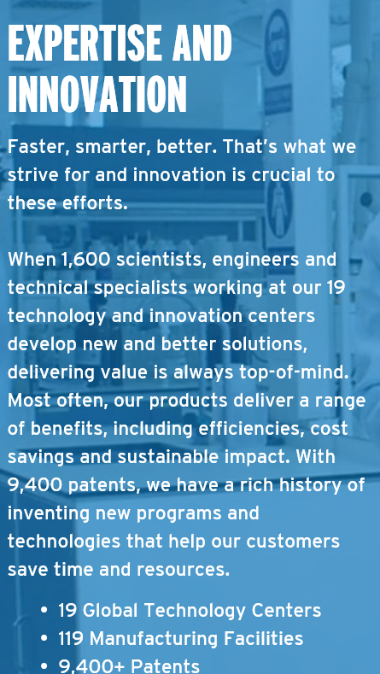

Slide 10
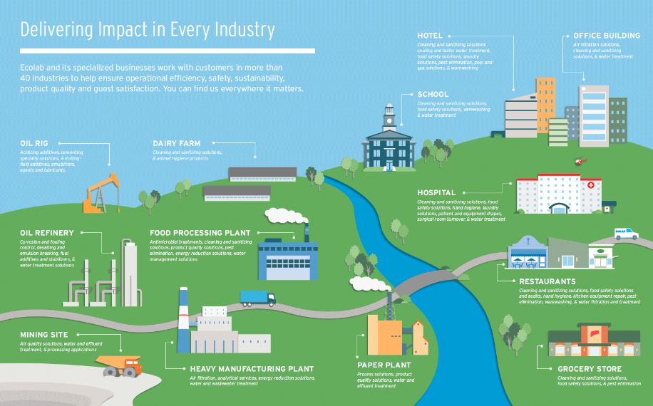

Slide 11
Stock Selection Guide Graph

Slide 12
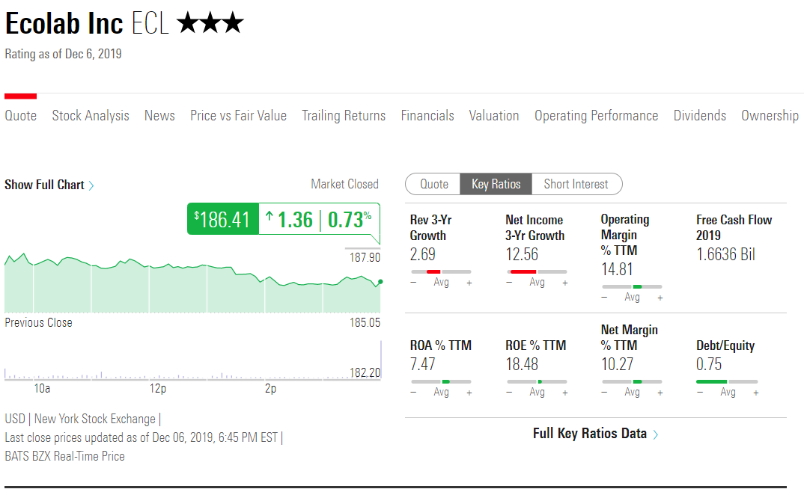

Slide 13
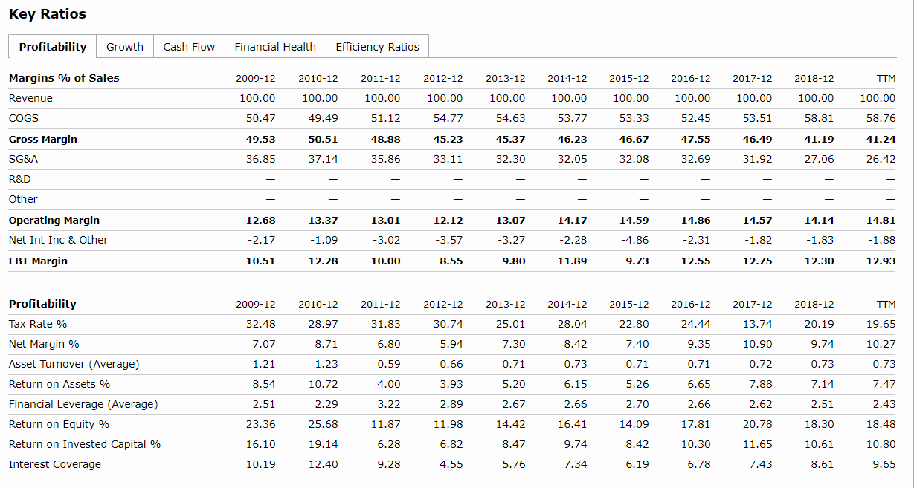

Slide 15
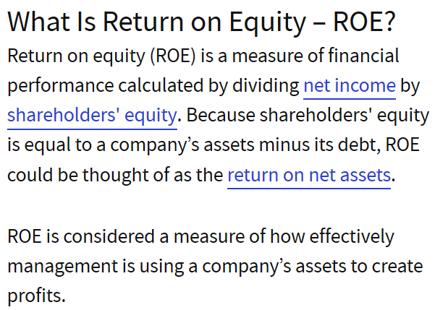

Slide 16
How Important is ROE
“The primary test of management’s economic performance is the achievement of a high earnings rate on equity capital and NOT the achievement of consistent gains in earnings per share.”
Warren Buffet, Berkshire Hathaway, 1979 Annual Report

Slide 17
What Does ROE Tell Us According to Investopedia
ROE does have some variation for different industries.
ROE can be used to compare peers.
The long-term average of ROE for stocks in the S&P 500 is 14% and can be considered an acceptable ratio.
A ROE less than 10% is poor.
Better Investing pros will say they want at least 15%, and preferably 20%.

Slide 18
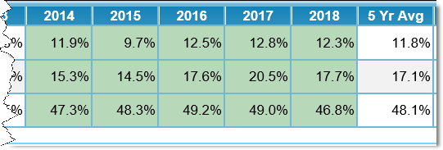
Evaluating Management Section on the SSG for Ecolab

Slide 19
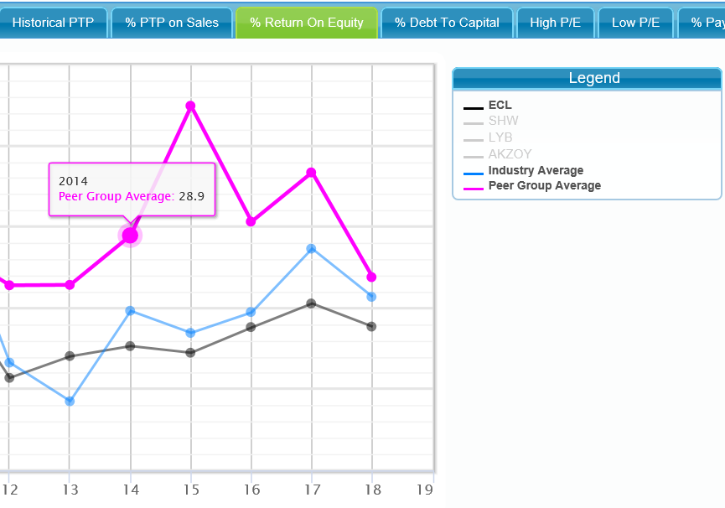

Slide 20
The Three Components in ROE
Net Profit Margin = Net Income/ Sales X 100
Asset Turnover Ratio = Sales/ Assets
Financial Leverage = Assets/ Equity

Slide 22
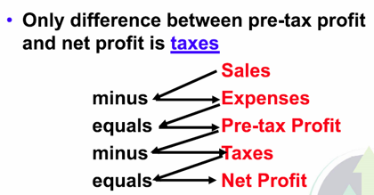
Net Profit Margin
Taxes are seldom the problem if net profit margin declines
Usually a decline is due to a problem with sales and/or expenses—not taxes

Slide 23
Asset Turnover Ratio
Measures the efficiency of sales produced based on the company’s assets.
For example, an Asset Turnover Ratio of 4.76 means that for every $1 worth of assets, the company generated $4.76 worth of revenue or sales.
The higher the ratio, the better.

Slide 24
Industry Dependent

Slide 25
Improving Asset Turnover
New assets that management can invest in to grow future sales and earnings are:
New stores or factories
New products
New markets
Acquisitions

Slide 27
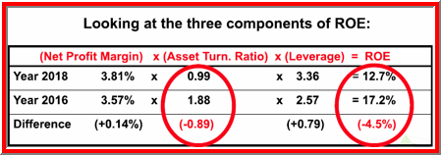
CVS Analysis of ROE

Slide 28
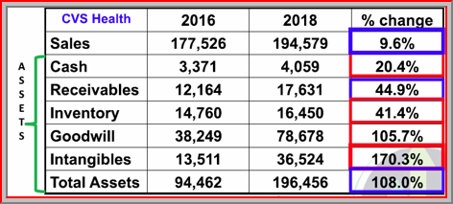
CVS Analysis of ROE

Slide 29
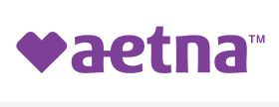
What caused this jump?
CVS acquired 100% of the outstanding shares of Aetna.
Aetna shareholders received $145 in cash and 0.8378 CVS Health shares for each Aetna share.
The transaction valued Aetna at approximately $212 per share or approximately $70 billion plus debt.
Total value was $78 billion.
CVS took on new debt.

Slide 30
Aetna’s Goodwill and Intangible Assets
Goodwill:
Health Care Benefits $44.5B
Pharmacy Services 1.5B
Retail 0.7B
Total goodwill $46.7B
Intangible Assets: $23.7B

Slide 31
Financial Leverage (Debt)
A company can obtain money for growth in three ways:
Retain earnings (use profits for reinvestment)
Sell additional shares of stock (dilution)
Borrow money (debt)

Slide 32
How debt works with ROE
Jason buys a house for $100,000
Mortgage is for $80,000 (debt)
Down payment is $20,000 (equity)
One year later…
House is worth $110,000
Return is $10,000 on equity of $20,000
ROE is 50%
Karen buys a house for $100,000
Mortgage is for $50,000 (debt)
Down payment is $50,000 (equity)
One year later…
House is worth $110,000
Return is $10,000 on equity of $50,000
ROE is 20%

Slide 33
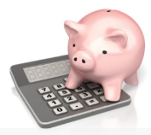
Financial Leverage (Debt)
The financial leverage ratio tells how well a company is using borrowed funds.

Slide 34
Considerations About Debt
The risk in borrowing money is interest must be paid and the principal repaid.
If a company borrows money, ROE should increase due to financial leverage, assuming net profit margin and asset turnover ratio remain constant.
The financial leverage ratio may decline when a company pays off its long-term debt. This one-time decline in ROE can be a good thing.
Beware of ROE for companies with large debt.

Slide 35
Apple (AAPL)

Slide 36
What has Apple been doing with the additional debt?
Repurchasing shares at a cost less than the current market share price.
Increasing dividends.
Financing the debt with low interest rates.

Slide 37
Summary
Evaluating management is important and Return on Equity is an important measurement to use.
Judgment often must be used along with extensive reading about the company to determine if capital is being used wisely.
There may not be an absolute answer, only a best answer. The value of an investment club is that many heads are used to look at situations differently.

