Slide 1
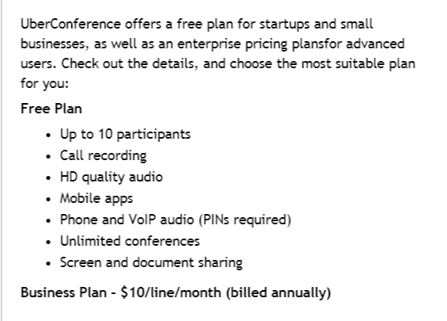
UBER Conference
Works best with Google Chrome
Tutorials on
You Tube

Slide 2
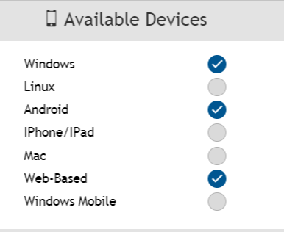
UBER Conference

Slide 3
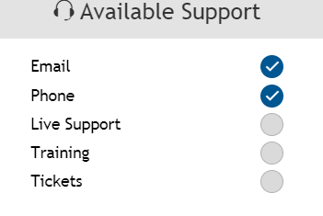
UBER Conference

Slide 4
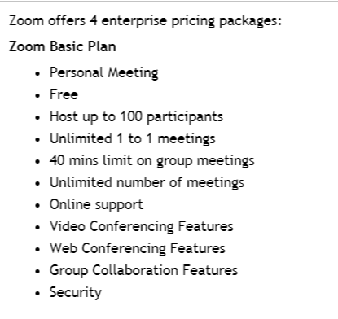
ZOOM

Slide 5
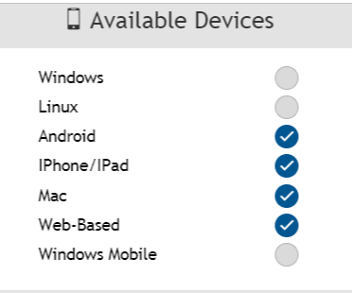
ZOOM

Slide 6
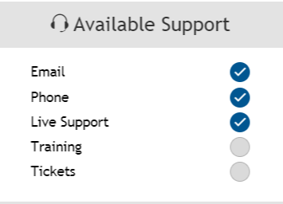
ZOOM

