Slide 1
Introduction to Technical Analysis
-- Wilbert Nixon, McNoVA
April 11, 2018

Slide 2
“Gravity does not require our belief.”

Slide 3
What we will cover:
What are Technical and Fundamental Analyses and how can the two forecasting tools be used to our advantage?
The Trend is our friend
Support & Resistance
Trendlines
Moving Averages
Our Stocks and our new tools

Slide 4
What is Technical Analysis?
Technical Analysis is the study of market action, primarily through the use of charts, for the purpose of forecasting future price trends.

Slide 5
What is Fundamental Analysis?
Fundamental Analysis is the study of economic, industry and company data as well as conditions in an effort to determine the value of a company’s stock. Fundamental analysis typically focuses on key statistics in a company’s financial statements to determine if the stock price is correctly valued.

Slide 6
Fundamental vs. Technical Analysis?
Both Fundamental and Technical Analyses are forecasting tools that ultimately purport to predict stock price
Fundamental Analysis offers a reasoned “estimation” of what the company value should be
Technical Analysis yields a depiction of what the past and current prices, and price patterns are

Slide 7
Fundamental vs. Technical Analysis? Part 2
Technical Analysis isn’t antithetical to fundamental analysis, as some critics think
The two are compatible and can be used together
Although many “Fundamental” traders claim not to use technical analysis, most technical traders use both forms of analysis

Slide 8
Fundamental vs. Technical Analysis? Part 3
Many analysts choose to trade or invest in only the highest-quality securities on a fundamental basis, but time purchases and sales according to technical criteria

Slide 9
Fundamental vs. Technical Analysis? Part 4
We use Fundamental Analysis to identify companies whose value (and therefore stock price) may double in 5 years. We can use Technical Analysis to confirm this.

Slide 10
The Trend is our friend
Most of us can look at most charts and see that in some time frame, securities prices tend to move in trends, and trends often persist for long periods of time
A trend is a discernible directional bias in the price – upwards, downwards or sideways
Trends tend to persist, until they don’t

Slide 11
Support and Resistance (Support)
Support is a price level that is difficult for a stock to move below because there are so many investors and traders willing to buy at that level.
It may be a horizontal or diagonal price level.

Slide 12
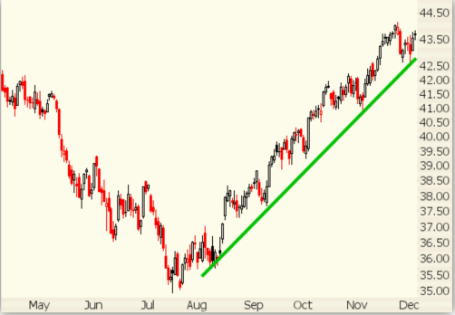
Support

Slide 13
Support and Resistance (Resistance)
Resistance is the opposite of support. It is a price level that is difficult for a stock to penetrate on the upside. It may be either a horizontal or diagonal price level.
Resistance is created when the bears gain enough momentum to overwhelm the bulls and stop or reverse upward movement.

Slide 14
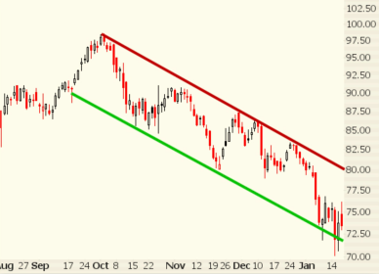
Resistance

Slide 15
Trendlines
Often we can see a trend with the unassisted eye, but to impose order on our visual impression, we can “connect the dots,” by actually drawing a line along the price bars
A trendline is a straight line that starts at the beginning of the trend and stops at the end of the trend, whether up, down or sideways

Slide 16
Channels

Slide 17
Moving Averages (Using Dynamic Lines)
Moving averages are the workhorses of technical analysis
A moving average is an arithmetic method of smoothing price numbers so that we can see and measure a trend
A straight line is a good visual organizing device, but a dynamic line – the moving average – more accurately describes what’s really going on

Slide 18
The Simple Moving Average
We all know what an average is – you measure ten of something, add up the measurements, and divide by ten
You make it a moving average by adding today’s data and dropping the oldest day’s data to keep the day-count constant at ten
(you can assume closing prices unless specified otherwise)

Slide 19
Our Stocks and our new tools
So what can we do with our new tools?
… and can our new tools be used with our stocks?
Answer: Plenty and Yes

Slide 20
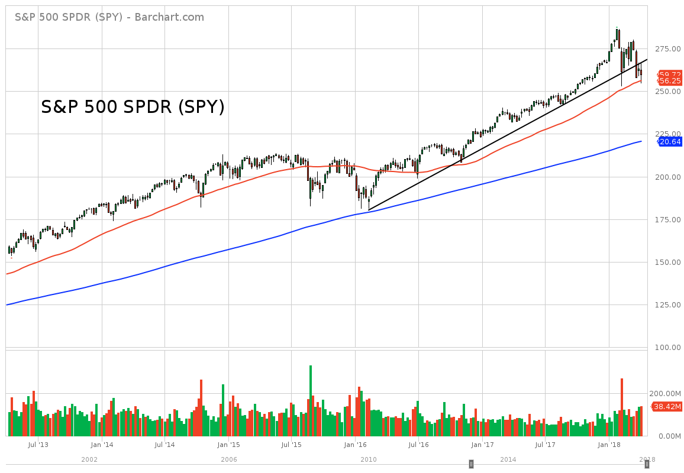
Notes:
SPY up ~ 65% in 5 years, up ~ 80% recently

Slide 21
Notes:
QQQ up ~ 125% in 5 years, up ~ 145% recently

Slide 22
Support and Resistance (Trading Range)

Slide 23
Notes:
ABBV up ~ 110% in 5 years, up nearly 190% recently

Slide 24
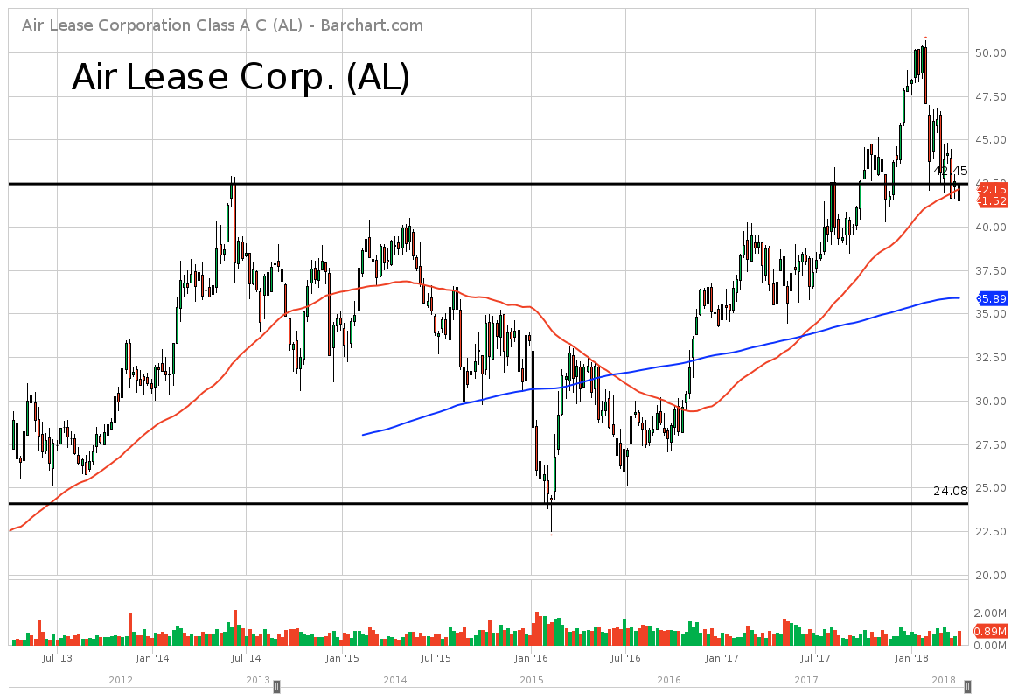
Notes:
AL up ~ 45% in 5 years, up over 70% recently

Slide 25
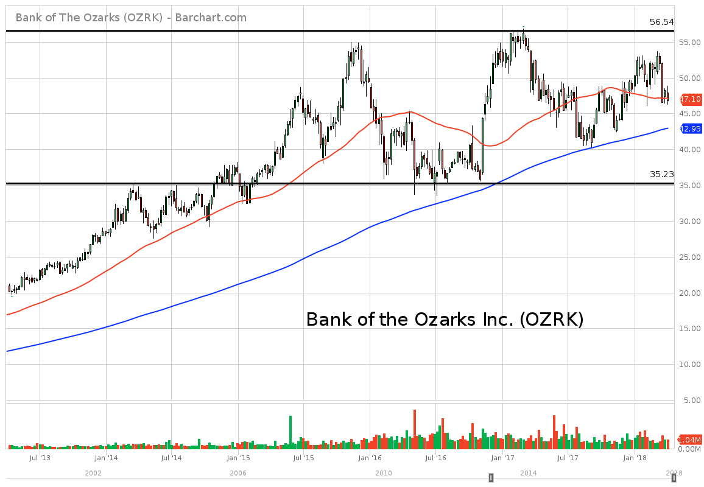
Notes:
OZRK up ~ 130% in 5 years, up nearly 180% recently (2017)

Slide 26
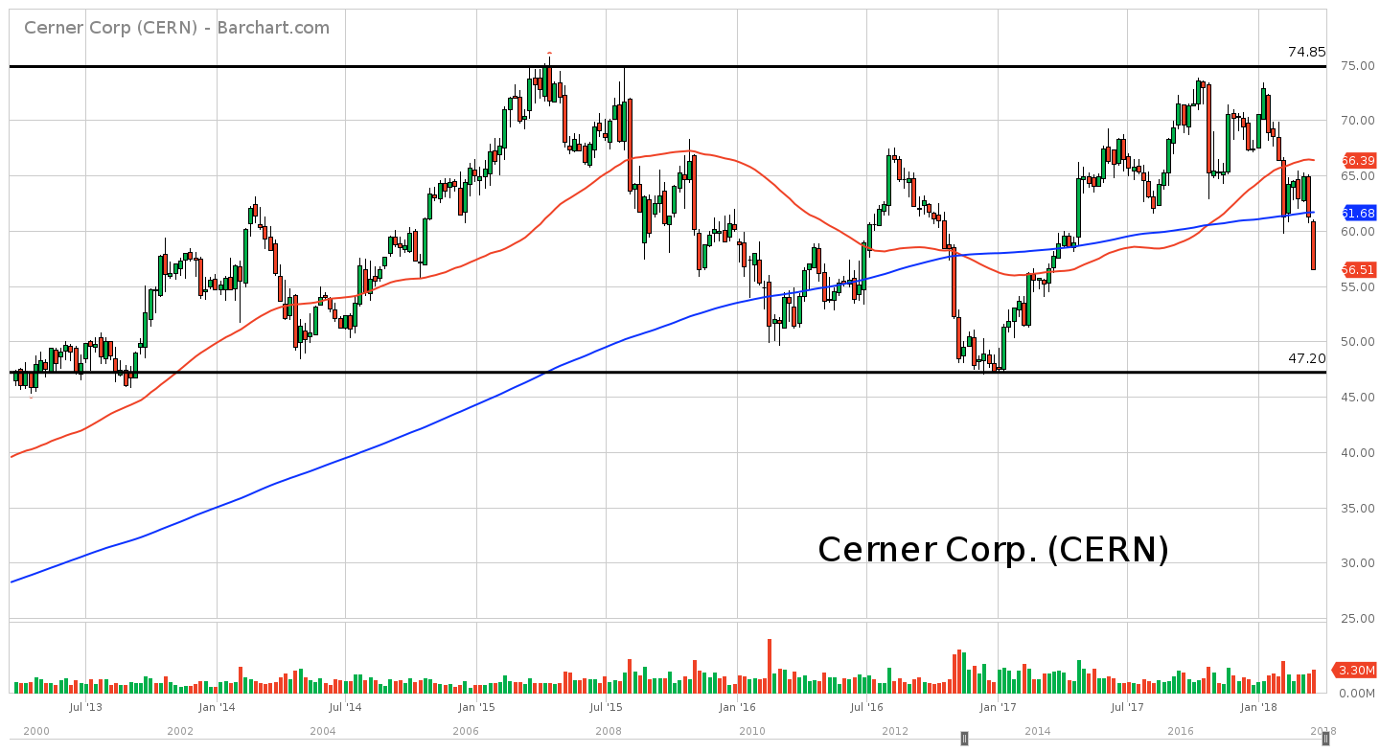
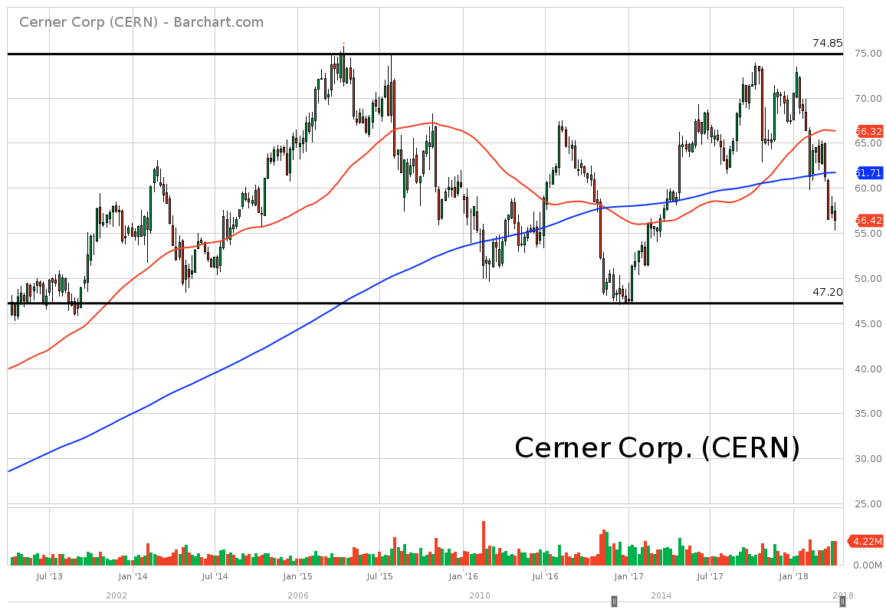
Cerner Corp (CERN)
26
24
Notes:
CERN up ~ 20% in 5 years, up over 50% recently

Slide 27
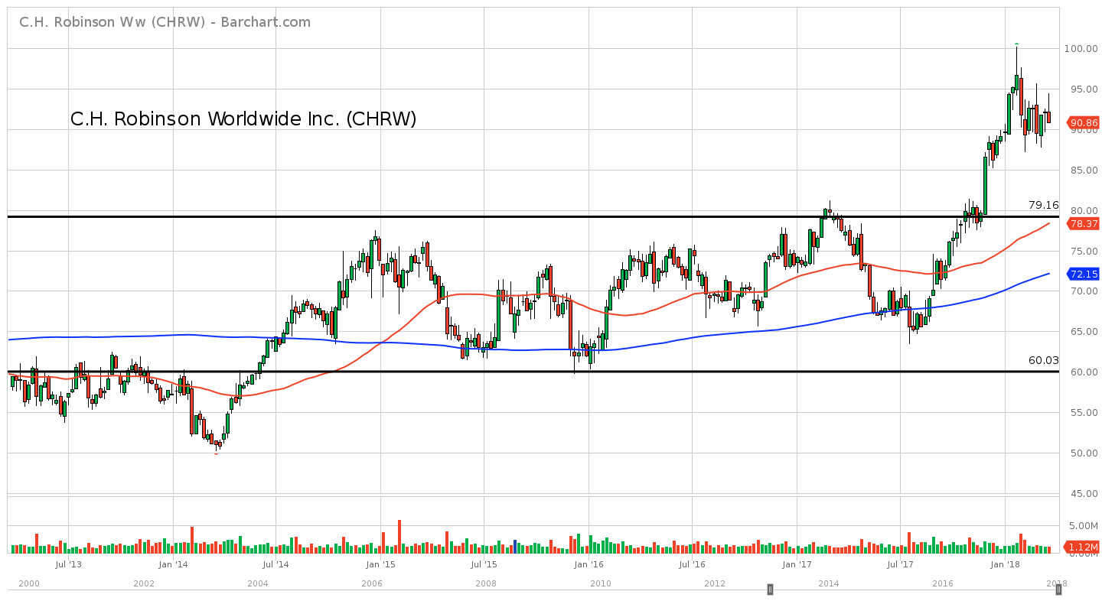
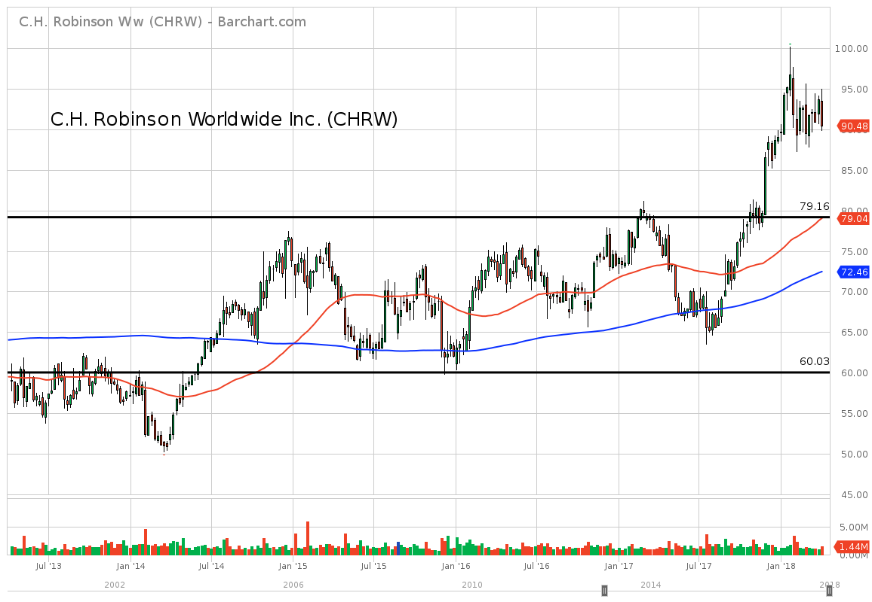
C.H. Robinson Worldwide Inc (CHRW)
25
27
Notes:
CHRW up ~ 55% in 5 years, up over 60% recently

Slide 28
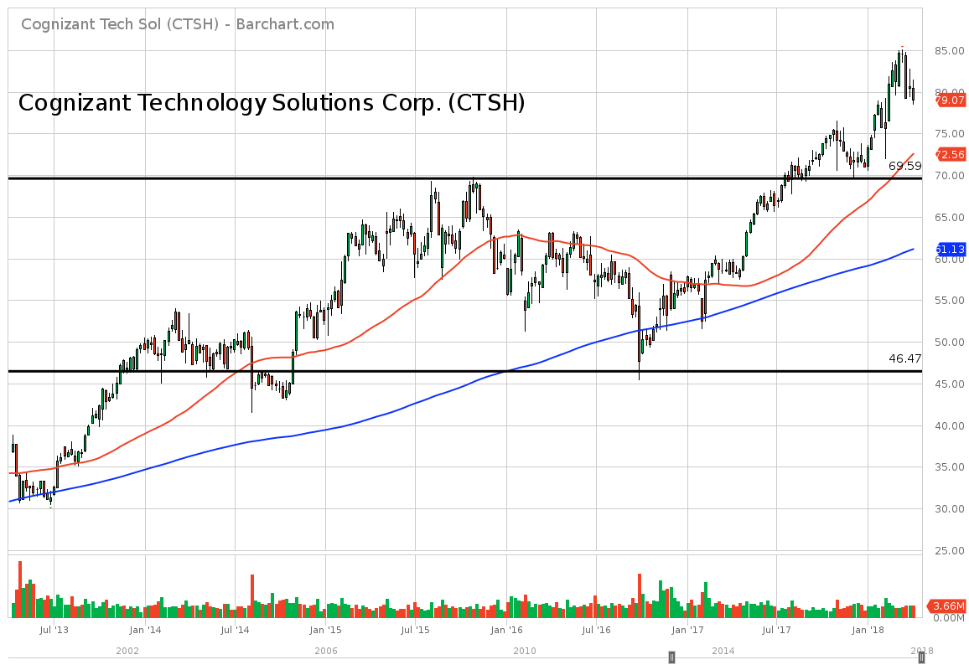
Notes:
CTSH up ~ 110% in 5 years, up over 120% recently

Slide 29
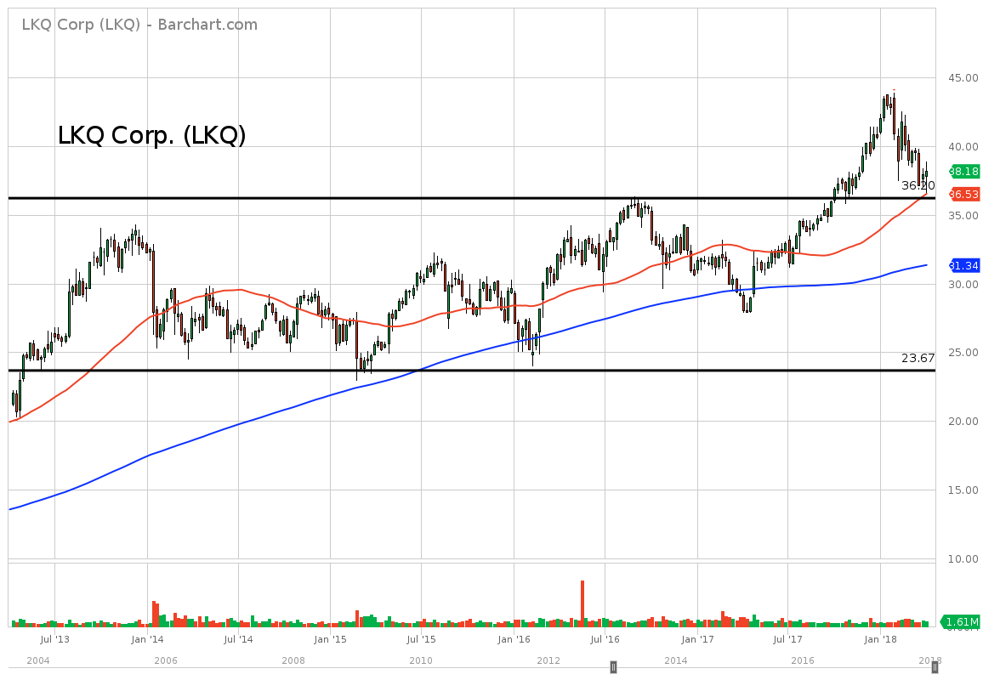
Notes:
LKQ up ~ 75% in 5 years, up over 95% recently

Slide 30
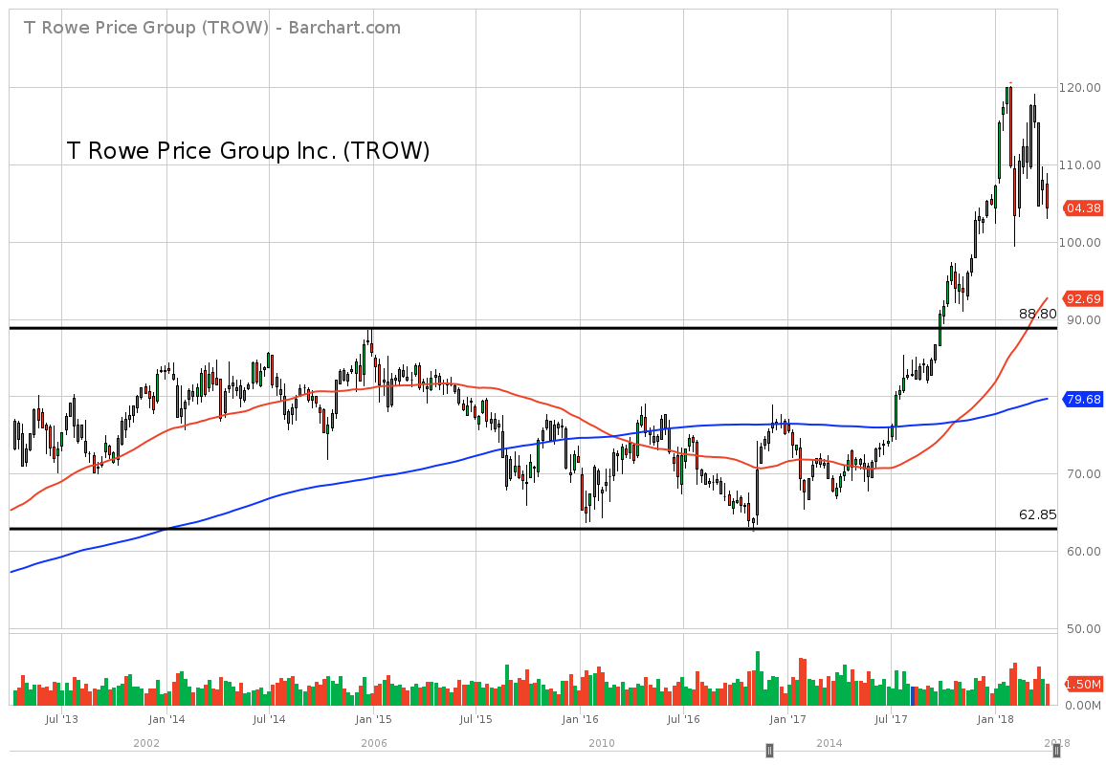
Notes:
TROW up ~ 35% in 5 years, up ~ 55% recently

Slide 31
Down Trend

Slide 32
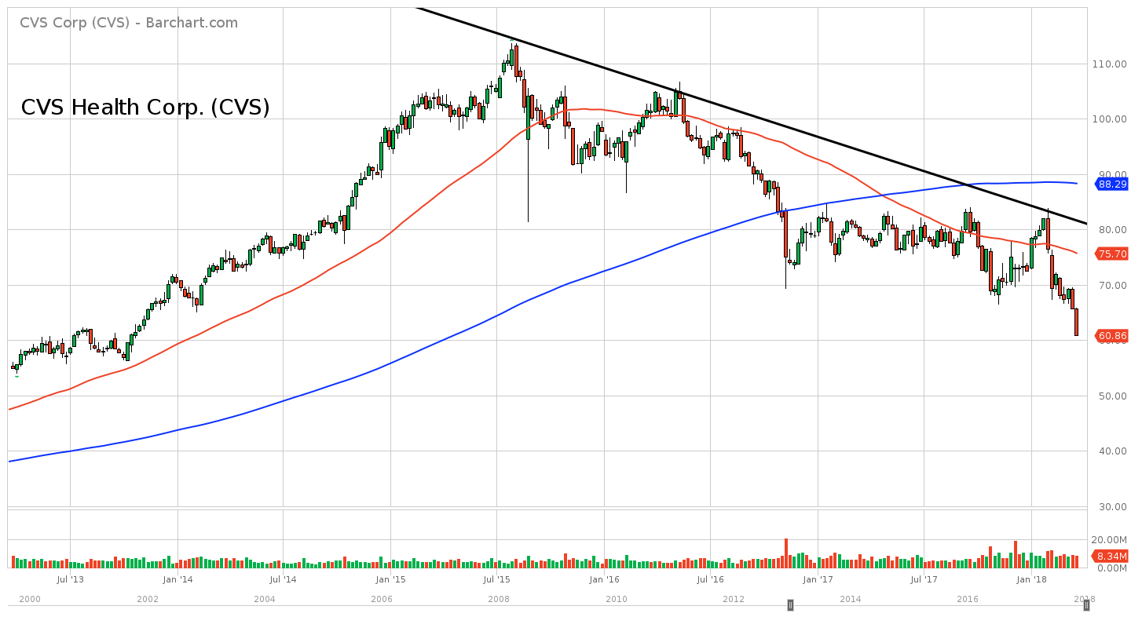
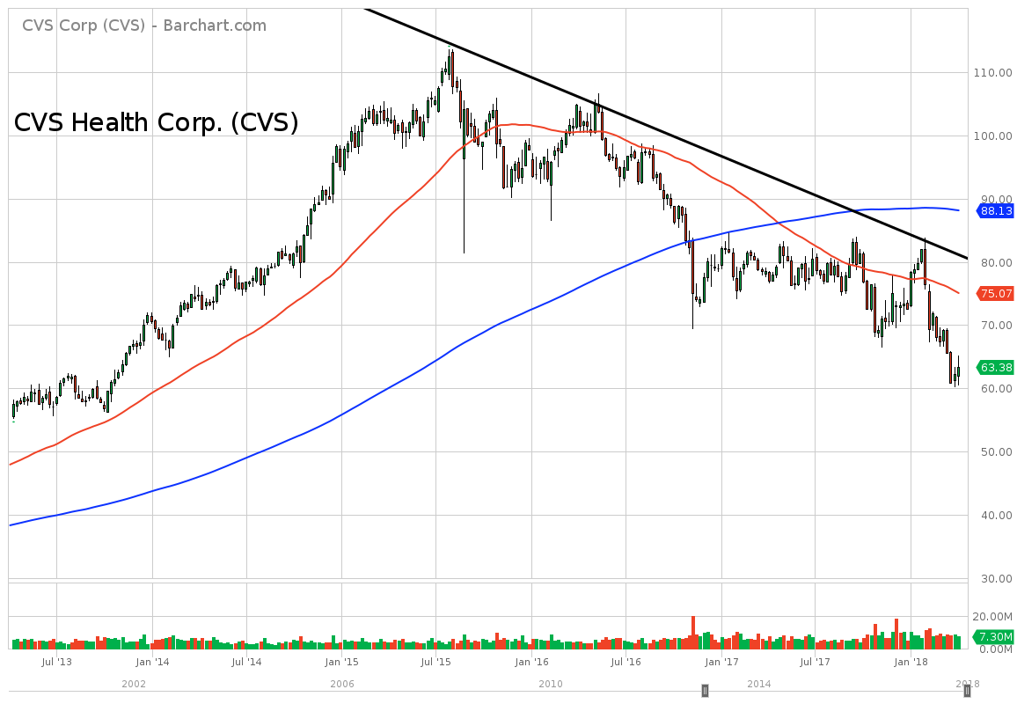
CVS Health Corp (CVS)
30
32
Notes:
CVS up ~ 10% in 5 years; up only 5% recently; up ~ 95% April 2013 –August 2015

Slide 33
Up Trend

Slide 34
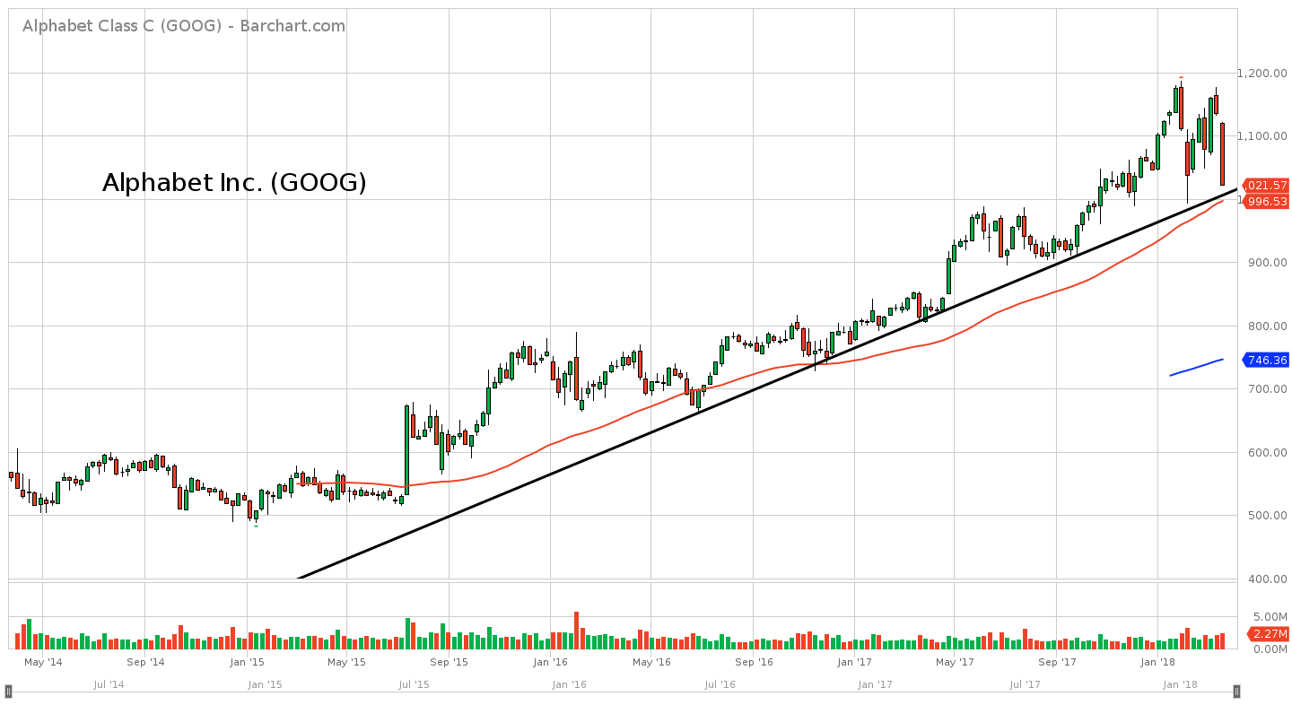
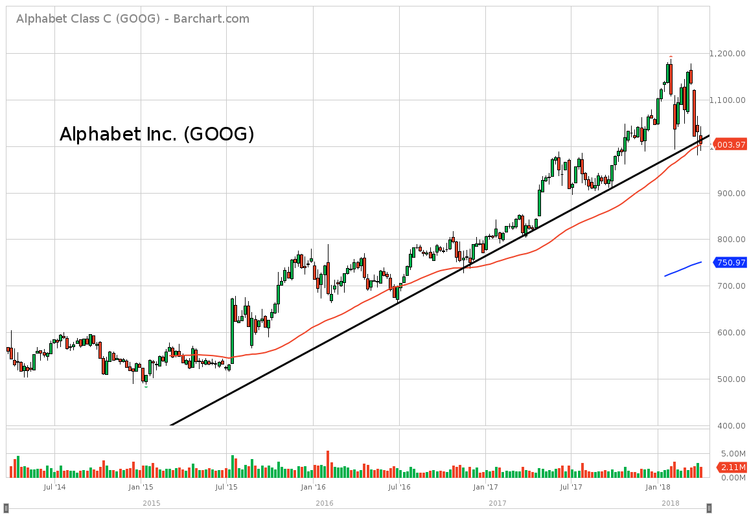
Alphabet Inc (GOOG)
32
34
Notes:
GOOG up ~ 80% in 4 years, up ~ 110% recently

Slide 35
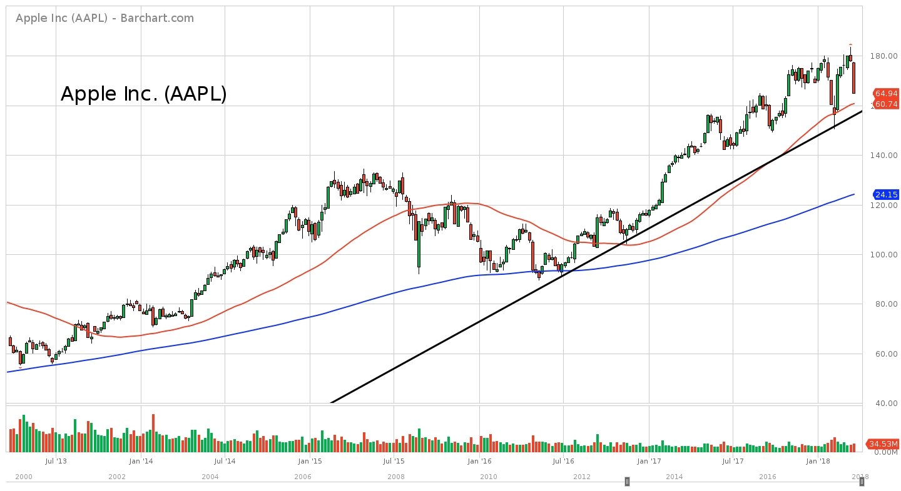
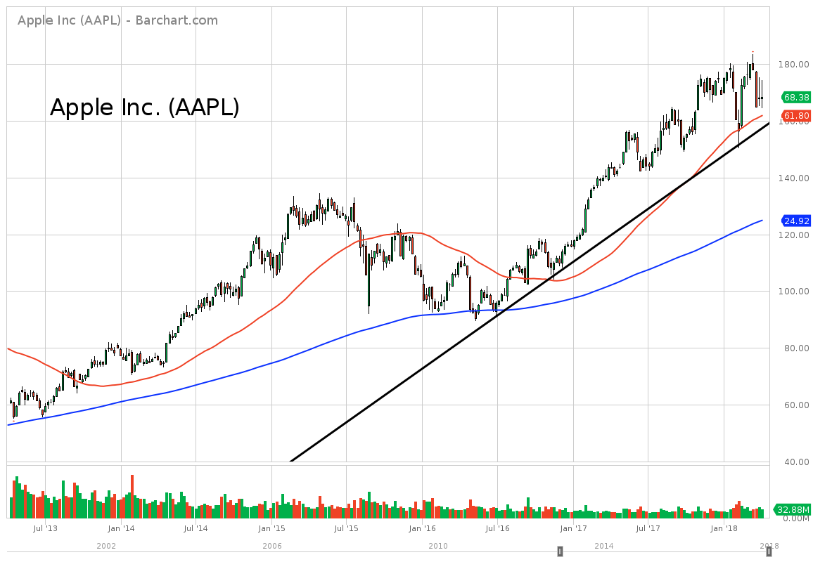
Apple Inc (AAPL)
33
35
Notes:
AAPL up ~ 170% in 5 years, up ~ 190% recently

Slide 36
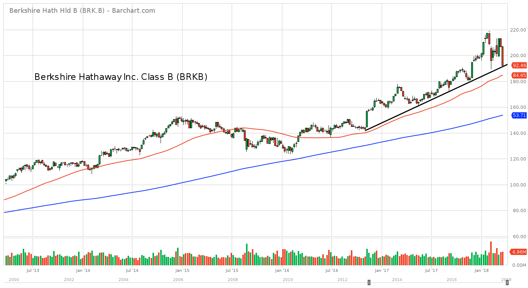
Berkshire Hathaway Inc Class B (BRK.B)
36
Notes:
BRK.B up ~ 85% in 5 years, up over 100% recently

Slide 37
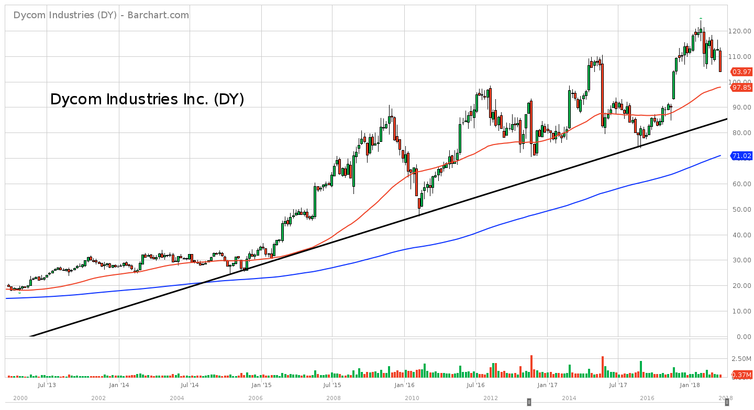
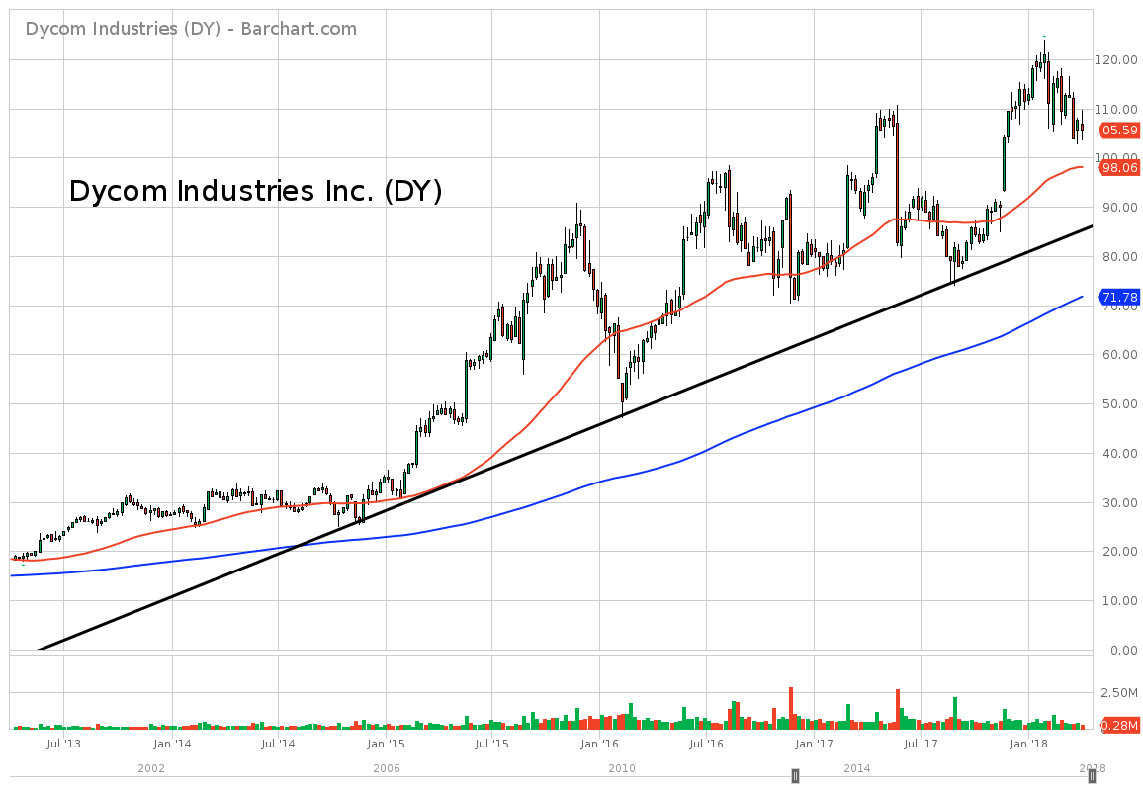
Dycom Industries Inc (DY)
35
37
Notes:
DY up ~ 450% in 5 years, up over 525% recently

Slide 38
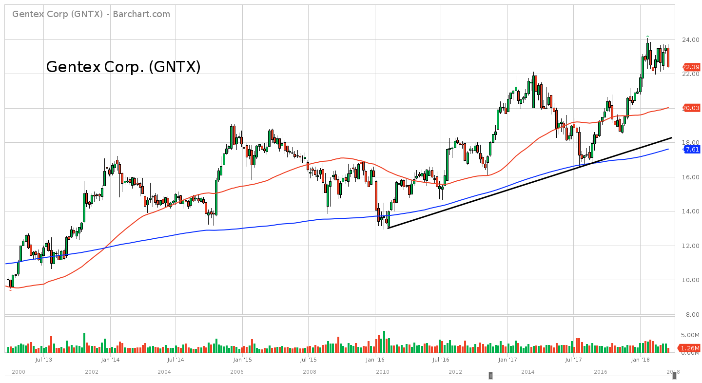
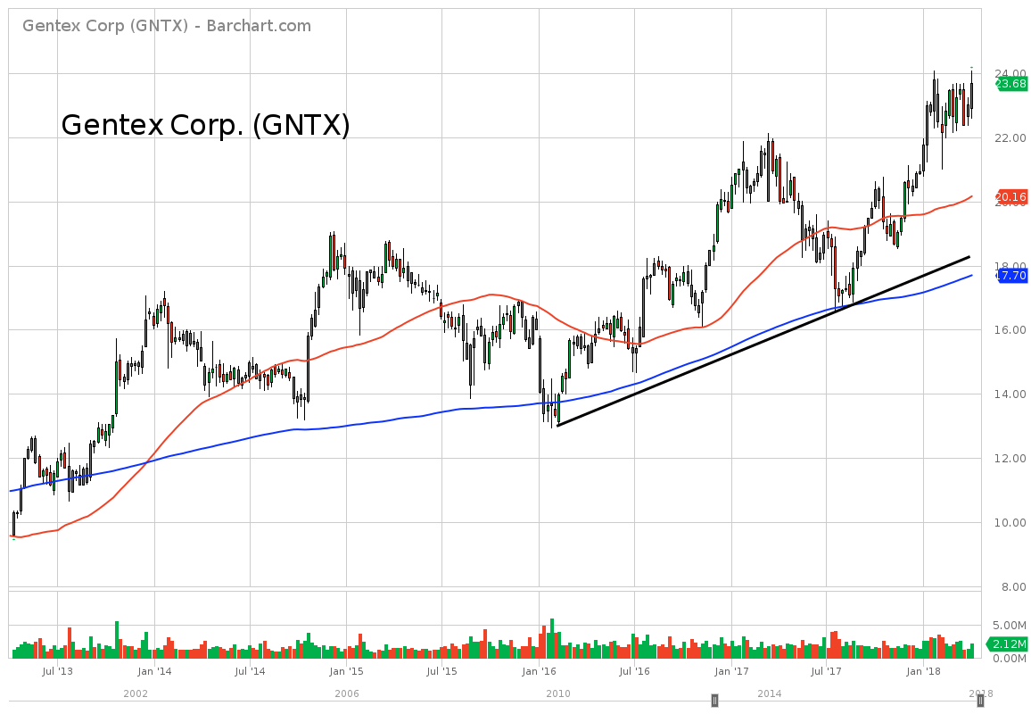
Gentex Corp (GNTX)
36
38
Notes:
GNTX up ~ 130% in 5 years

Slide 39
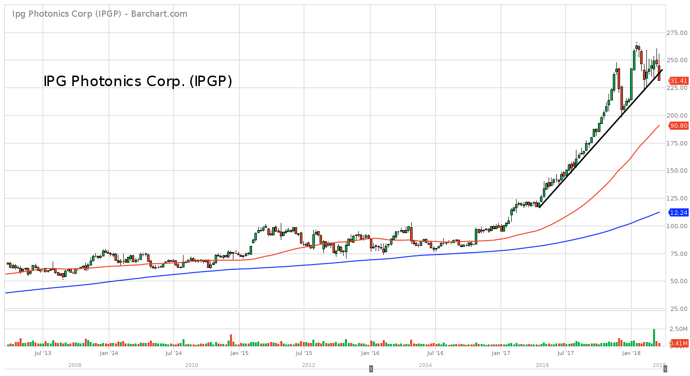
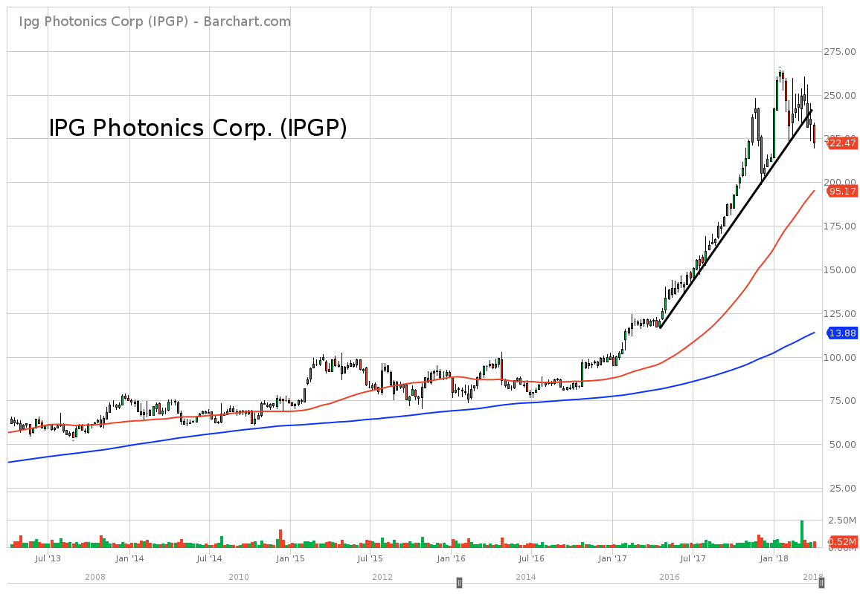
IPG Photonics (IPGP)
37
39
Notes:
IPGP up ~ 240% in 5 years, up over 300% recently

Slide 40
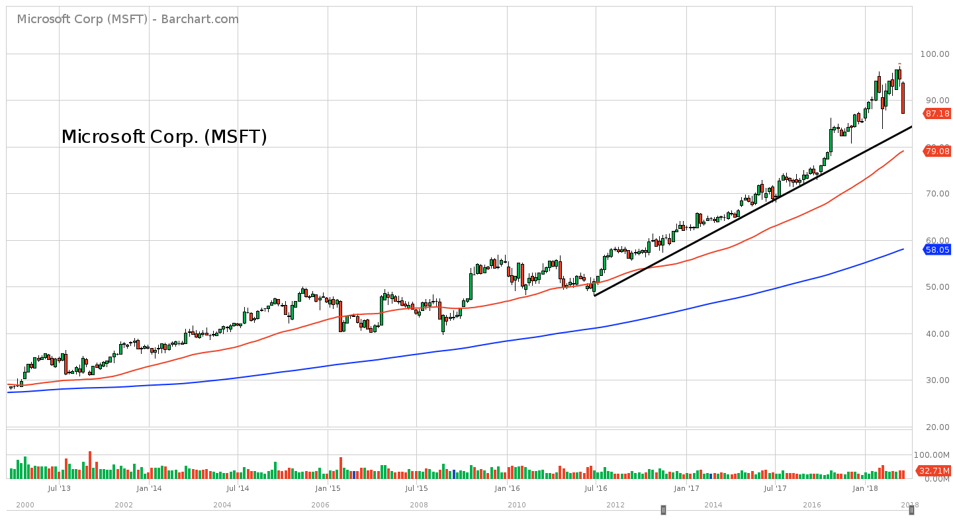
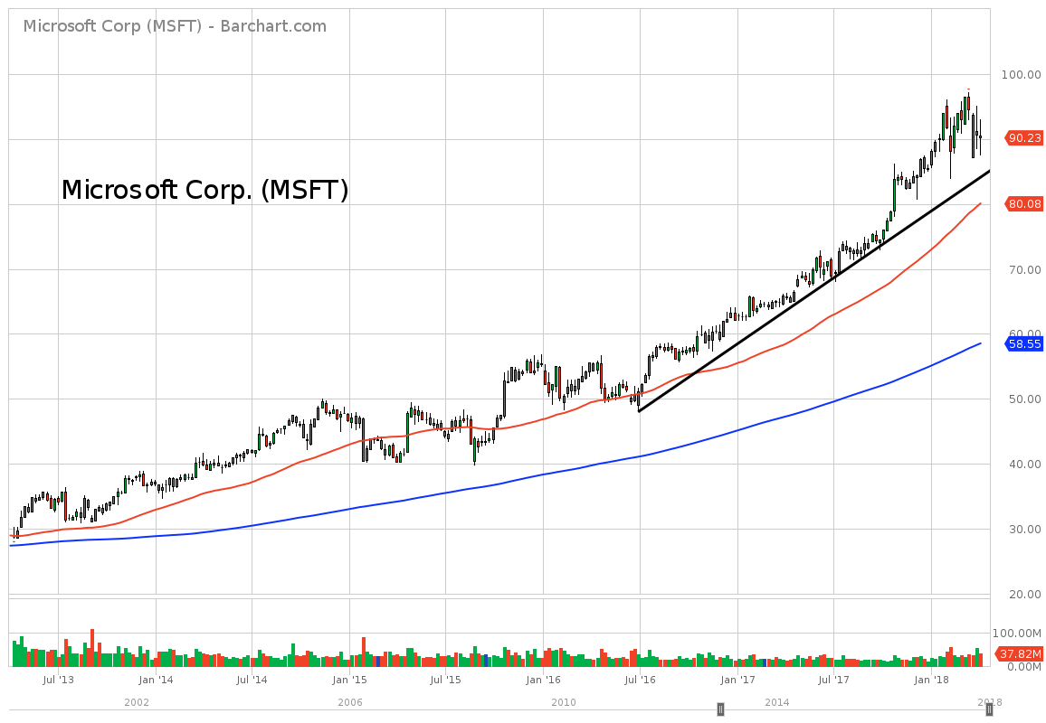
Microsoft Corp (MSFT)
38
40
Notes:
MSFT up ~ 210% in 5 years, up over 230% recently

Slide 41
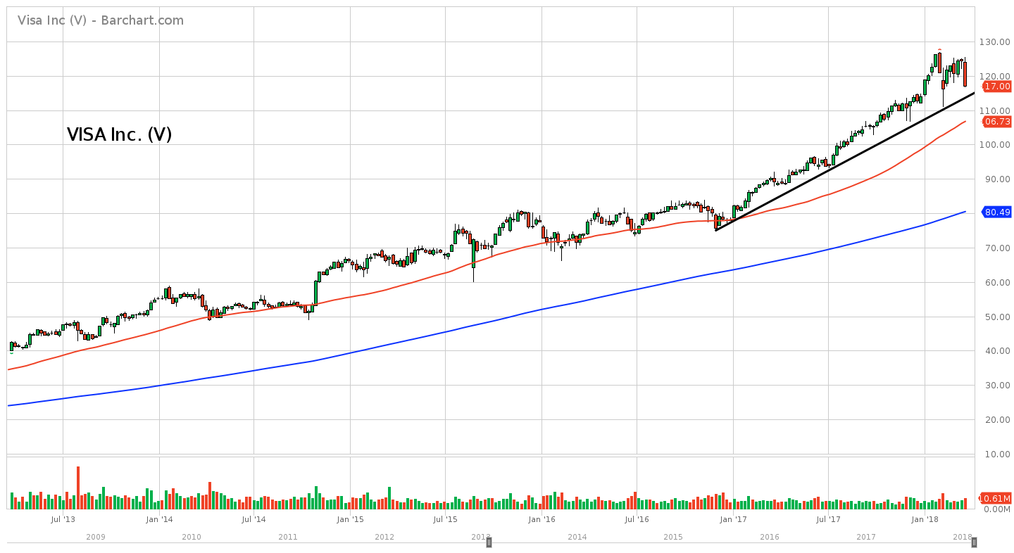
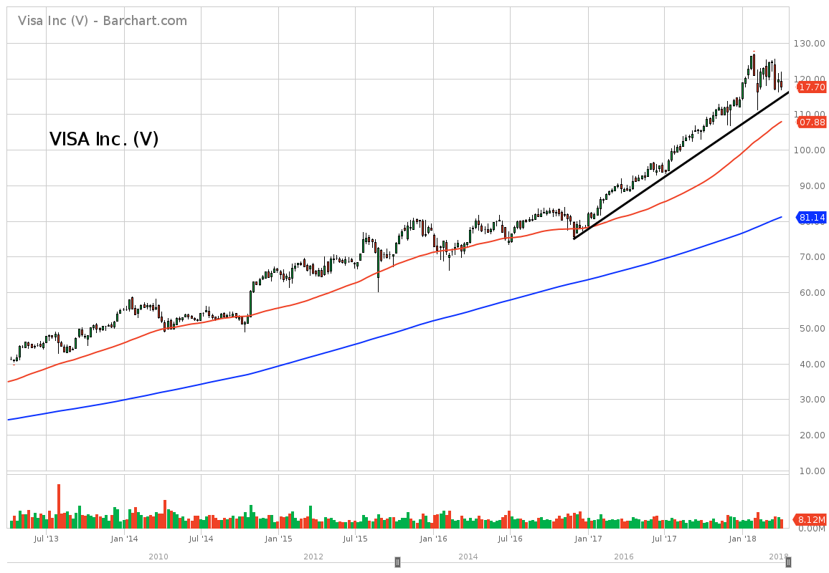
Visa Inc (V)
39
41
Notes:
V up ~ 185% in 5 years, up over 200% recently

Slide 42
Where do we go from here?

Slide 45
Thank You! Questions?

