Slide 1
From February 2018 Ticker Talk Education Presentation
Notes:
Dec 22, 2017 new tax laws signed into effect – 2018 Corporate tax reduced from a top rate of 35% to a top rate of 21%
Repatriation tax – Income earned and held overseas was tax deferred is now subject to a one time repatriation tax charge.
Rates will vary by sector. Greatest benefit to companies with the highest 2017 rate.

Slide 2
Notes:
Estimate of $2.6 trillion in corporate profits sitting in foreign banks.
One time tax of 15.1% on cash holdings and 8% on non-cash holdings with option to pay in 8 annual payments.

Slide 3
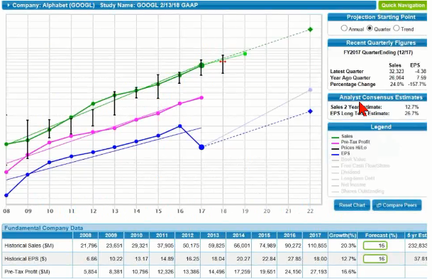

Slide 7
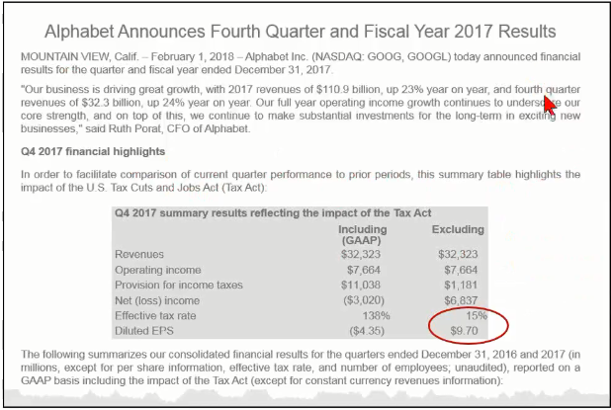

Slide 8
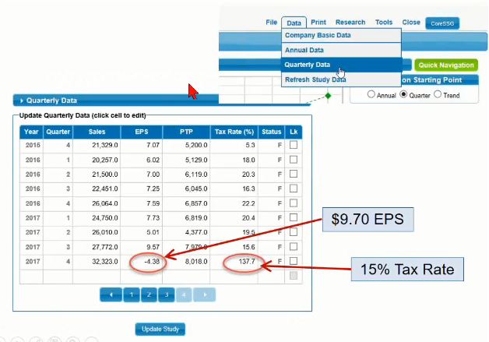

Slide 10
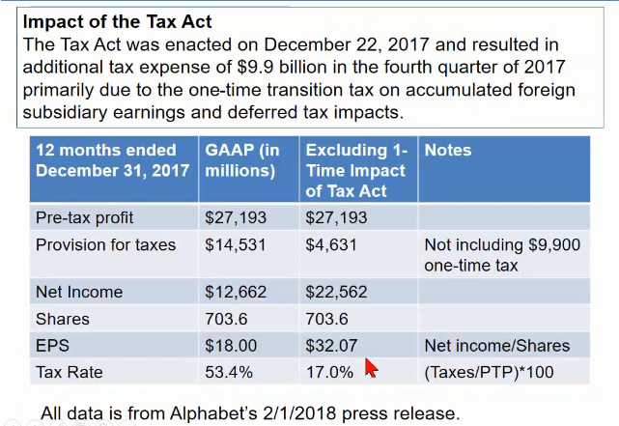

Slide 11
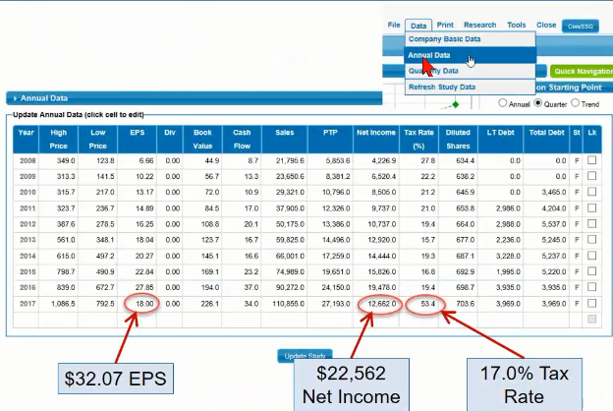

Slide 12
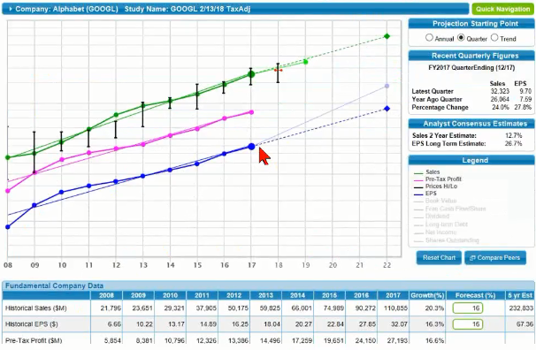

Slide 14
Notes:
Already expensed…move from one account to another…like an escrow account

Slide 16
