Slide 1
MICNOVA Education Presentation – September 2016
How we can profit from using selection and opinion from value line Investment survey

Slide 2
Agenda
Economic and stock market commentary
Four Model Portfolios
Portfolio 1 – Stocks with above average price appreciation potential
Portfolio 2 – Stocks for income and price appreciation potential
Portfolio 3 – Stocks with long term price growth potential
Portfolio 4 – Stocks with above average dividend Yields
Model Portfolios – Recent Developments
Model Portfolios - Company Snapshots (09/09/2016 issue Page 3397)
Income stocks with healthy total return potential (09/09/2016 issue Page 3397)
Growth stocks with Low Risk
Stocks for dividend growth with low risk
Stock Market Averages

Slide 3
Industry price performance for last six weeks ending 09/20/2016
The seven Best and worst performing industry.
10. Major Insider Transactions.
Purchases
Sales

Slide 4
ECONOMIC AND STOCK MARKET COMMENTARY
The federal reserve has remained on the side lines with the interest rates.
They are more likely to do something by the end of this year or the beginning of next year.
The markets have been at times volatile in view of the federal reserve and the pending election.
It also talks about the GDP growth rate for the second half may be subdued to 2%.
From the S&P 500 companies 80 of them issued negative guidance, while 35 have so far issued positive guidance.
Stock market will remain volatile while equities still remain attractive – still caution should be exercised.

Slide 5
To illustrate how an investment strategy can meet different goals, Value Line analysts select and maintain four model portfolios, each with a distinctive investment objective.
All four portfolios hold 20 stocks.
These portfolios, which are closely monitored and regularly updated, are featured each week in Selection & Opinion.
The weekly updates include commentary on any changes to the portfolios, along with general discussions on recent performance and particular holdings of interest.

Slide 6
To be considered for Portfolio 1, modeled for the more aggressive investor wanting to emphasize year-ahead price performance, a stock must have a Timeliness rank of 1 or 2 and Financial Strength rating of at least B+ at the time of purchase.
Stock whose Timeliness rank falls to 3 or lower is automatically dropped.
Here are some other characteristics of Portfolio 1: ● The companies generally have above-average records for earnings growth. ● Few of these stocks pay a dividend and most pay no dividends at all. ● Stocks in the portfolio can have Betas considerably higher than 1, which indicates that they will likely increase the risk/reward profile of the portfolio.

Slide 7
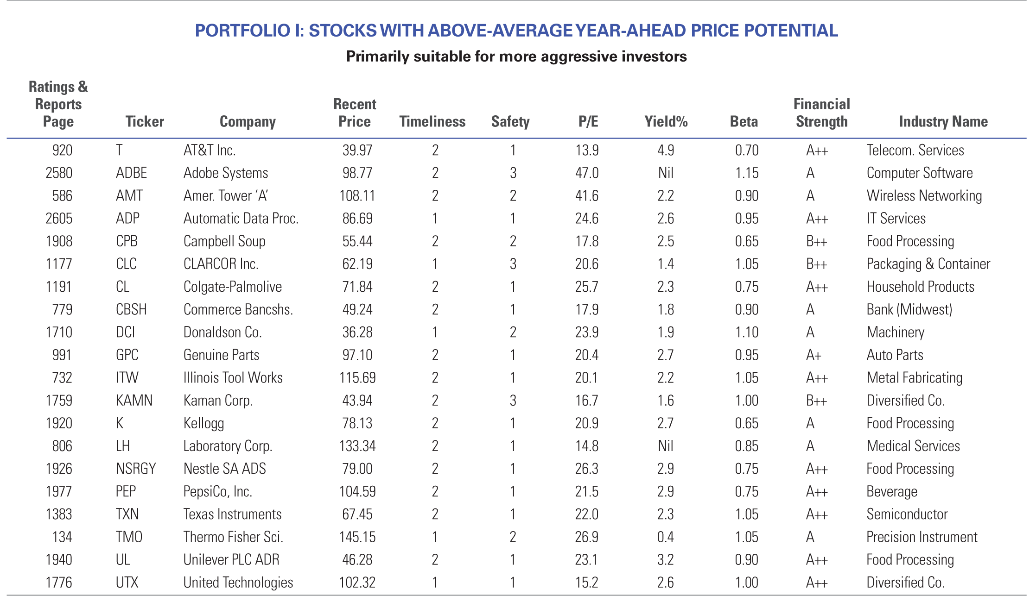
Notes:
To be considered for Portfolio 1, modeled for the more aggressive investor wanting to emphasize year-ahead price performance, a stock must have a Timeliness rank of 1 or 2 and Financial Strength rating of at least B+ at the time of purchase.
stock whose Timeliness rank falls to 3 or lower is automatically dropped.
Here are some other characteristics of Portfolio 1: ● The companies generally have above-average records for earnings growth. ● Few of these stocks pay a dividend and most pay no dividends at all. ● Stocks in the portfolio can have Betas considerably higher than 1, which indicates that they will likely increase the risk/reward profile of the portfolio.

Slide 8
Portfolio 2, for the moderate investor, includes stocks that will provide above-average income and whose prices have the potential to increase. Typically, more conservative investors will be most comfortable with this portfolio.
To be included in the portfolio, a stock must pay a large enough dividend so that its yield ranks in the top half of all stocks tracked in The Value Line Investment Survey.
Although unranked stocks may be held, they must have a Timeliness rank of at least 3 and a Safety rank of 3 or higher at the time of selection. If the Timeliness or Safety rank drops below 3, the stock is automatically dropped from the portfolio.
Here are some distinguishing features of Portfolio 2: ● The portfolio includes some value stocks, which are stocks with generally lower P/E ratios than the other stocks Value Line tracks in The Value Line Investment Survey, ● With few exceptions, the Betas of the stocks in Portfolio 2 are below—sometimes well below—those in Portfolio 1, which indicates that the risk associated with this group is usually less than portfolio 1.

Slide 9
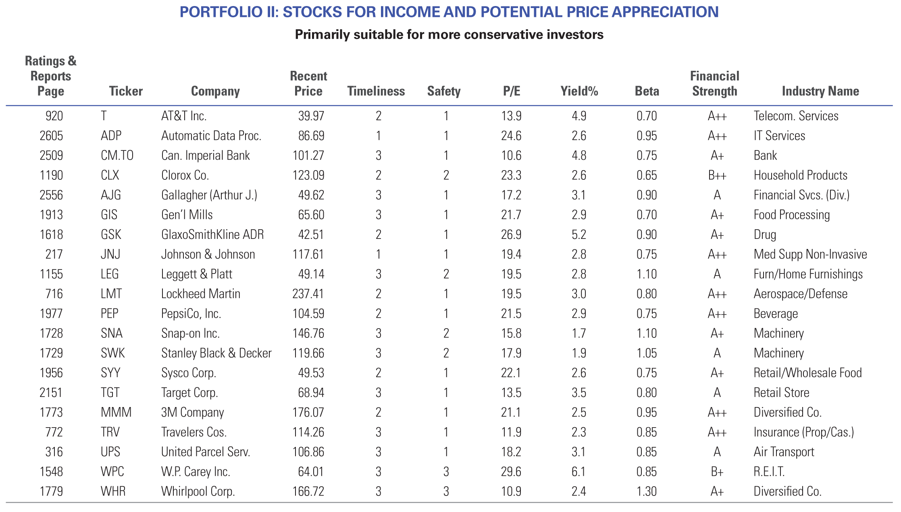

Slide 10
Portfolio 3 emphasizes stocks with worthwhile appreciation potential. It is most appropriate for investors focused on long-term capital gains.
Among the factors considered for selection are a stock's Timeliness and Safety rank and its 3–5-year appreciation potential.
In addition, you can observe that: ● This portfolio is more varied than the others in almost every area. The range of prices is the greatest as is the variation in P/E’s. There is also a mix of stocks paying dividends and others paying no dividends.
● The portfolio at times includes stocks with no Timeliness rank because of recent restructurings or pending acquisitions.

Slide 11
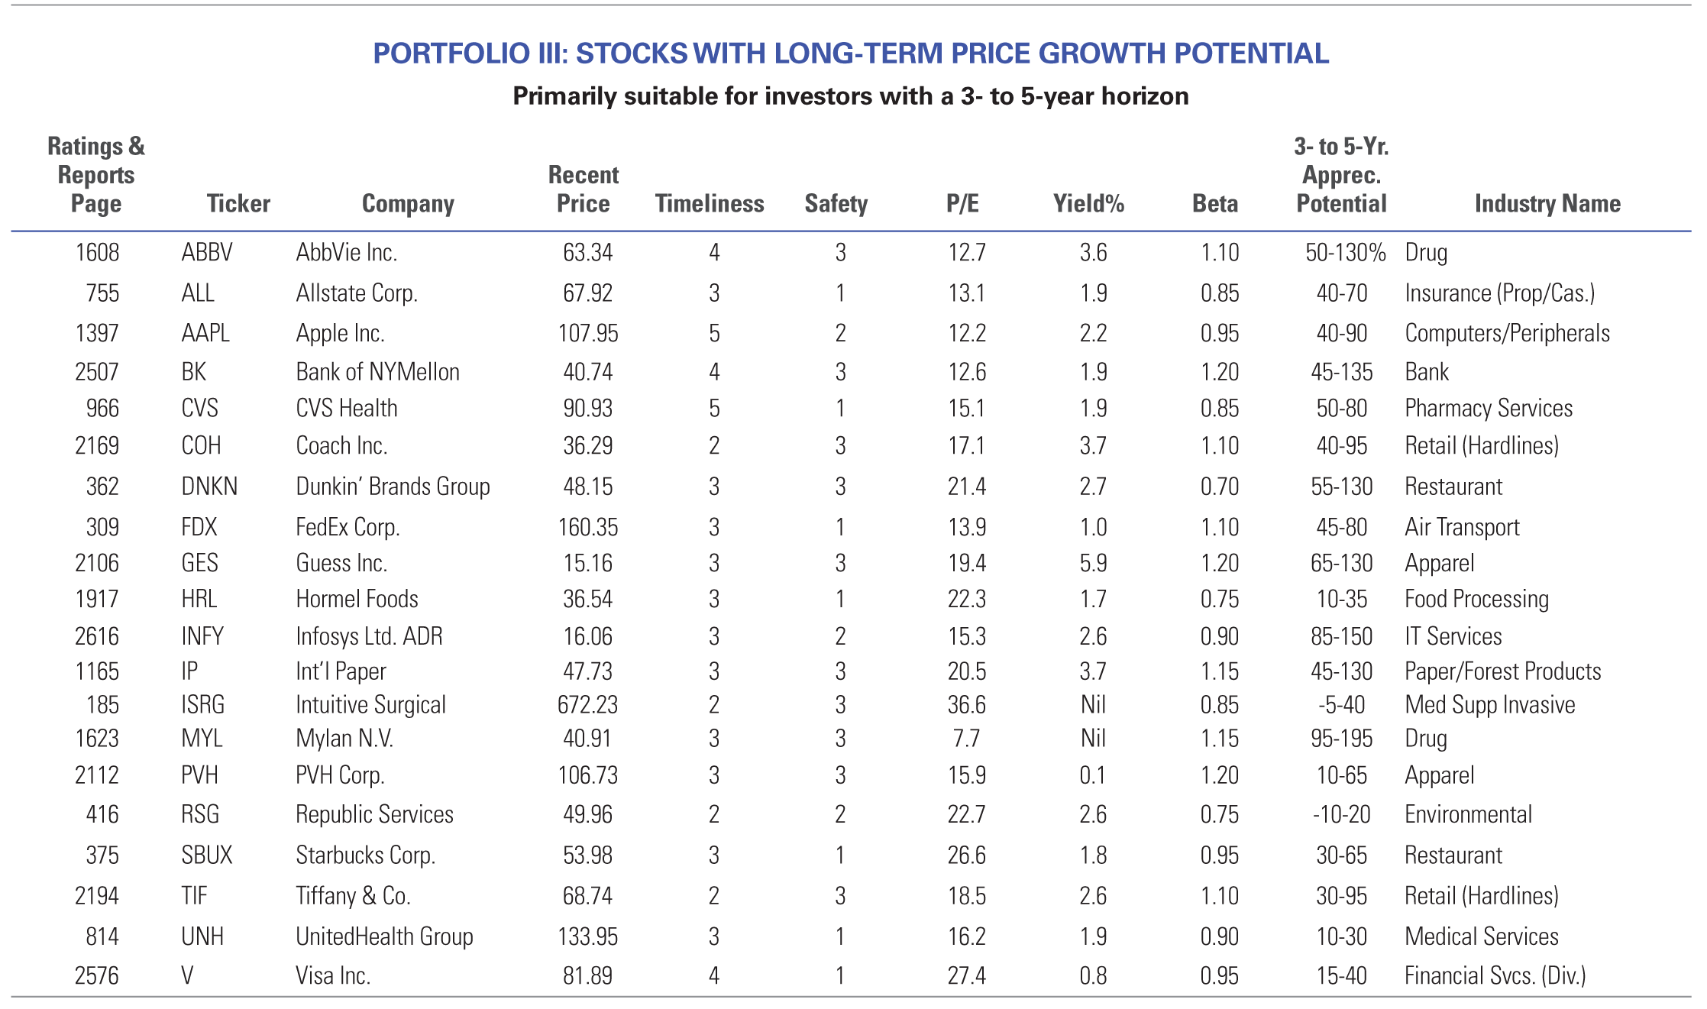

Slide 12
Portfolio 4 focuses on stocks with above-average dividend yields. Investors with an interest in current income are likely to find interest here.
Stocks selected for the portfolio must have a yield of at least 1% above the median of all dividend-paying stocks tracked in The Value Line Investment Survey, a Timeliness rank of at least 3, and a Financial Strength rating of least B+ at the time of purchase.
Although the analyst managing Portfolio 4 may sell a holding at any time, replacing it with a new stock with better prospects, any stock whose Timeliness rank falls below 4 is automatically replaced.
In general, Portfolio 4 will tend to exhibit the following features:
● Despite the focus on dividend yield and current income, stocks are typically selected from a broad range of industries, providing a meaningful degree of diversification.
● The portfolio's risk profile will likely be less than the broader market, given the usual concentration of low-Beta stocks.

Slide 14
Model Portfolios – Recent Developments.
Portfolio 1 –
ITW and LH are replaced by Owens Minor and Northwest Bank shares.
Adobe systems traded higher because of its good third quarter earnings.
Portfolio 2 –
Higher prices drove CLX, General Mills, PEP and Sysco well above their 10 year averages and their Dividend yields are well below the historic levels.
Met life replaced Legget and Platt company which should benefit from higher interest rates.
Portfolio 3 – No changes. Apple is trading higher for IPhone 7.
Fed Ex acquisition of TNT a European company smooth transition, cost cutting, solid growth in commerce resulted in traded higher.
Portfolio 4 – No changes for this week.
Talks about the utility companies and health care stocks. Merck is doing well and position in Pfizer has been sluggish.

Slide 15
Model Portfolios – Company snapshots.
To Bring interested subscribers up to date with the companies Value line puts out the snapshots of the less known companies like Colgate- Palmolive, Dunkin brands group, Eaton Corp. etc. You can get information about the companies from 09/09/2016 issue page 3397.

Slide 16
Growth Stocks with Low Risk
This list is designed for investors seeking stocks with a combination of worthwhile long-term appreciation potential and low risk.
we required that all stocks selected have a Safety rank of at least 2 (Above Average).
Financial Strength rating of at least B++.
A score of 85 or more on the Price Stability Index.
Timeliness rank of at least 3 (Average).
Those wanting to hold low-risk stocks with good prospects may consider most of the choices listed below.

Slide 17
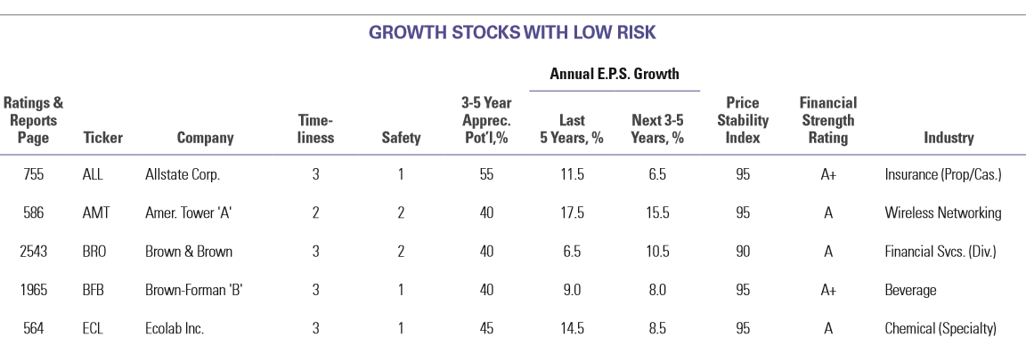

Slide 18
Stocks for Dividend Growth with Low Risk
Low-risk stocks that have good records for dividend growth.
Providing investors with dividends that are likely to increase at above-average rates.
Safety ranks of at least 2 (Above Average), and Financial Strength Ratings of B++ or better (B+ is Average).
Companies whose shares earn high marks for these metrics generally will fare better in volatile markets than the typical stock under our review.
we limited the selection to issues ranked 3 (Average), or better, for relative price performance over the next six to 12 months.

Slide 19
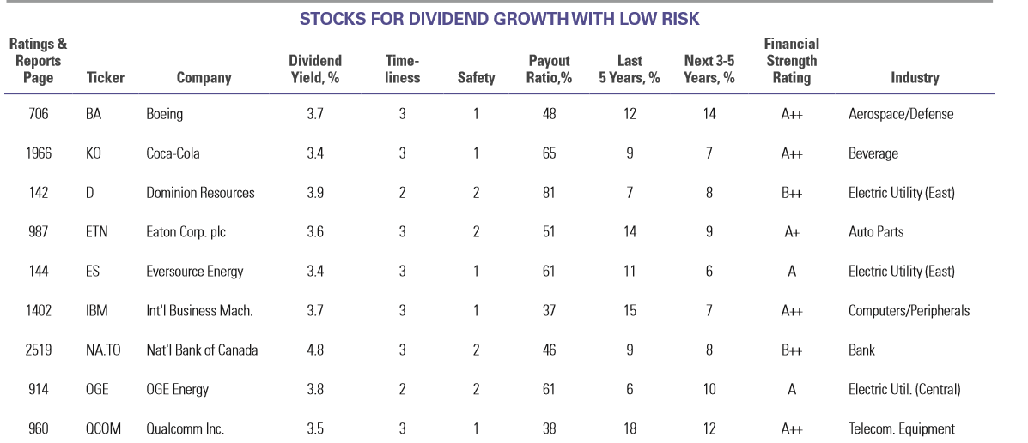

Slide 20
Closing Stock Market Averages

Slide 21
Best and Worst Industry Price Performance - last six weeks 9/20/16

Slide 22
Major Insider Transactions

Slide 23
Changes in Financial Strength Ratings of Stocks.
Company Name From To Reports Page
AMAT A A++ 1385
Essandant Inc. B++ B+ 1417
NXP Semiconductors C++ C+ 1405

